Slide 1
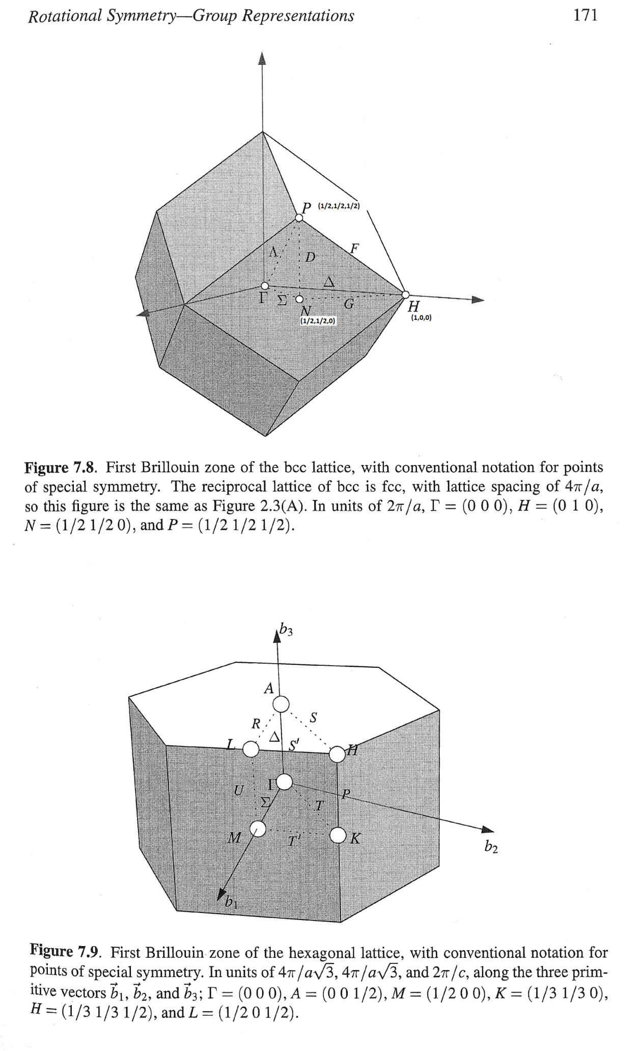
Identifying NP cut. Script at Fe\Article2020\fit_NP_Ei800_allCuts2.m

Slide 2
Background1 (cut_at_edges): edges of np cut at [-0.5,2.5,-0.5]; [0.5,2.5,-0.5]

Slide 3
Partial cuts:

Slide 4
sym_cut with Background1 (cut_at_edges):
Corrected magnetic form factor
Fitting parameters: 0.468004 0.015127

Slide 5
Background2 (average_cut):

Slide 6
Partial cuts:

Slide 7
sym_cut with Background2 (average_cut):
Fitting parameters: [0.437546 0.014128]

Slide 8
Background3 (remote_cut): Overcompensation. Ideas for high energy background removal.
Fitting parameters: [0.437546 0.014128]; Overcompensation

Slide 9
Summary: All backgrounds are good enough. What about high energy range?

