Slide 1
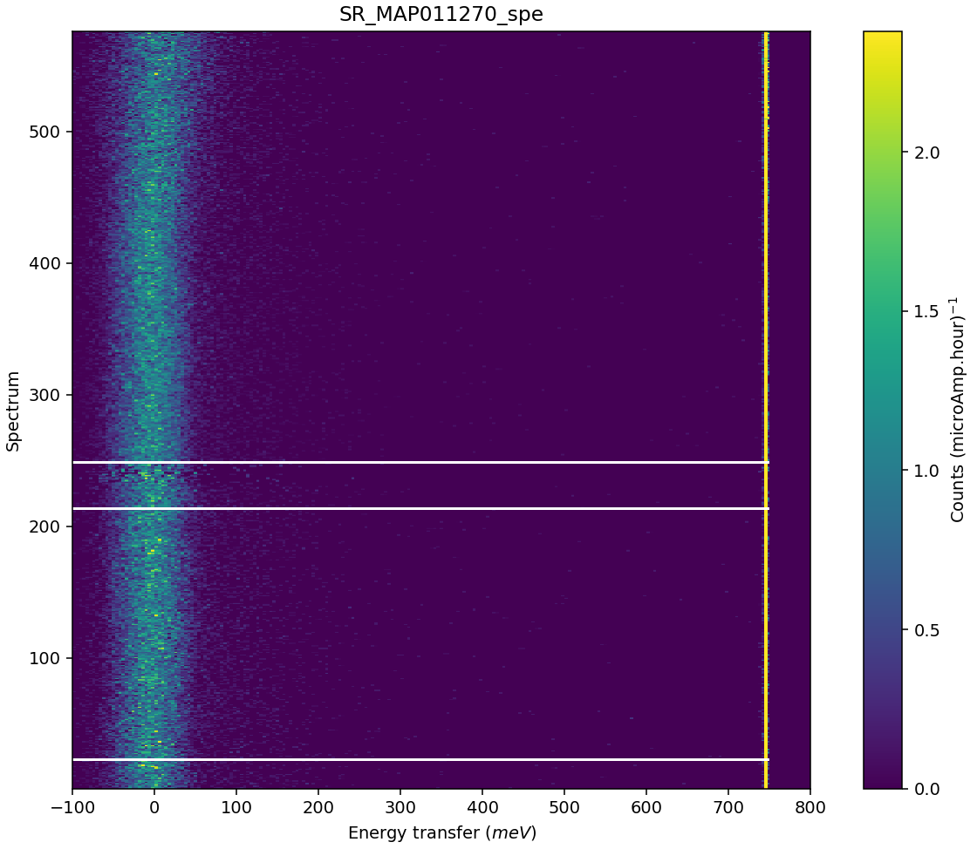
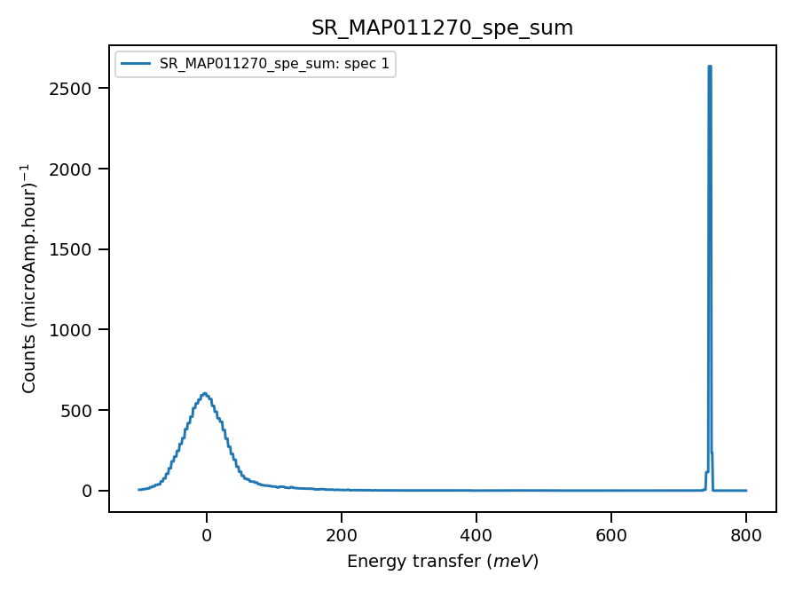
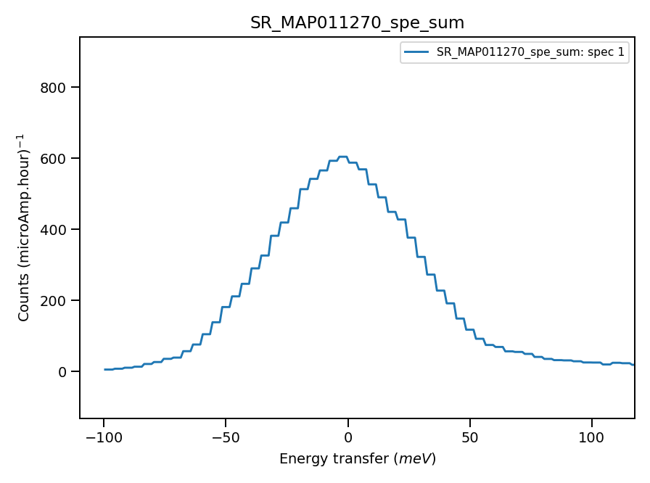
Validate correct incident energy for mono-vanadium run N11270
Chopper peak around 800meV
Some misalignment?
Binning range 735meV
Correct Ei = 793, so that Ei = 0.01 where

Slide 2
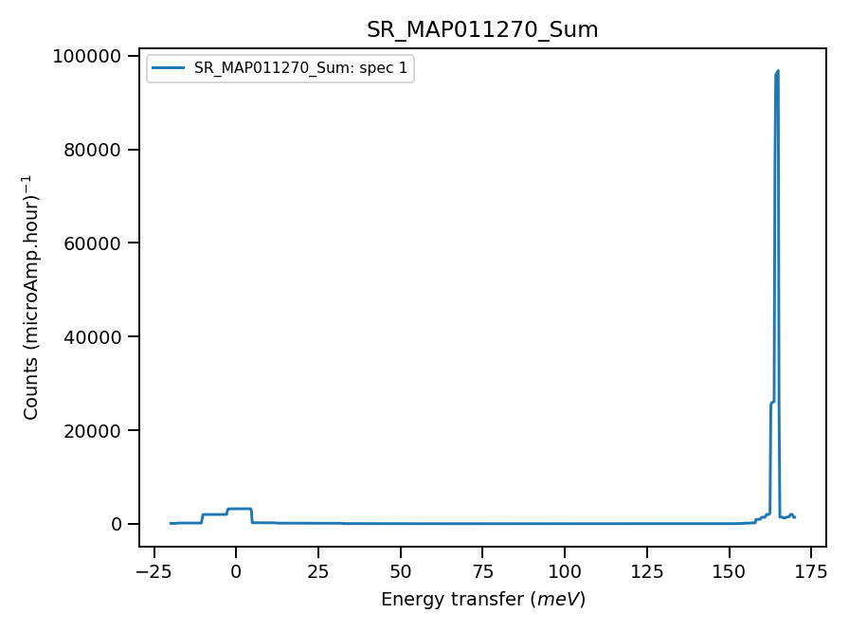
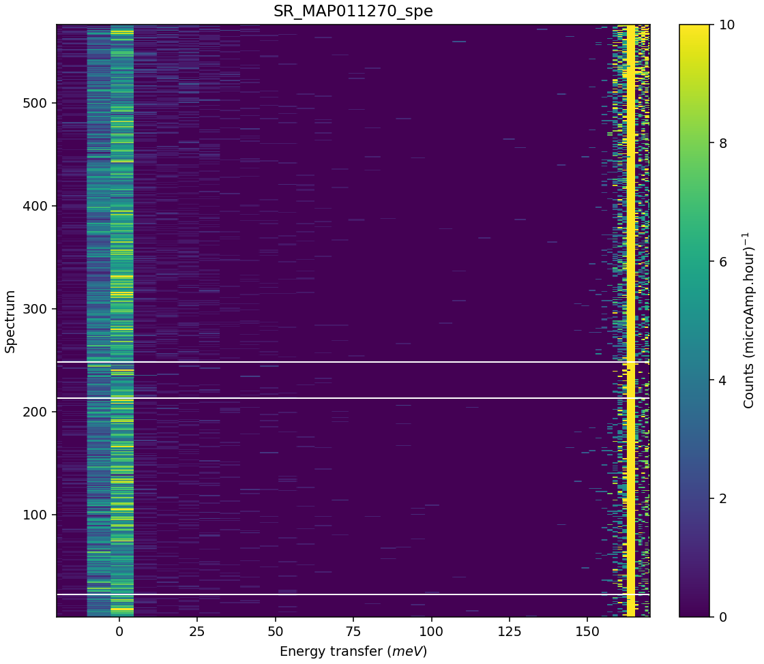
Chopper peak around 200meV. Histogram mode, poor energy accuracy
Binning range 156 meV

