Slide 1
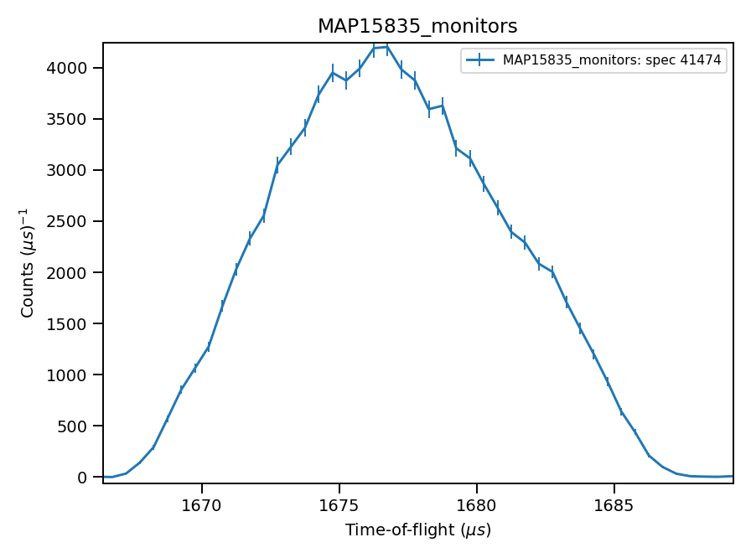
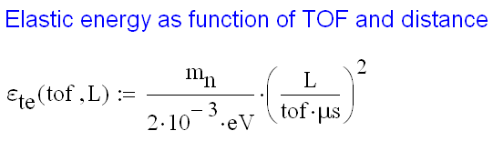

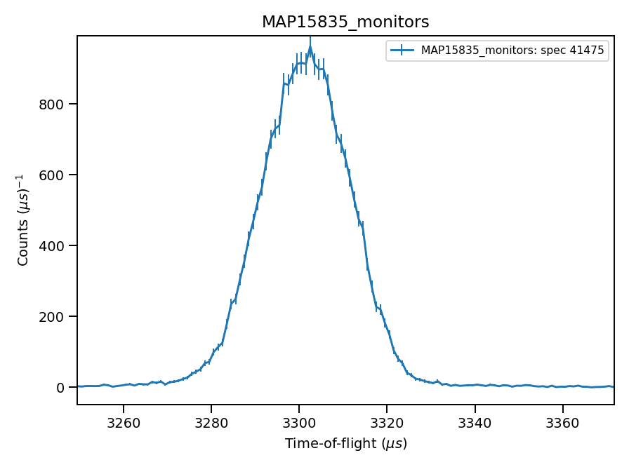
Monitors signal, run N15835
1676.5
1677 using integration
3302
3301 using integration

Slide 2
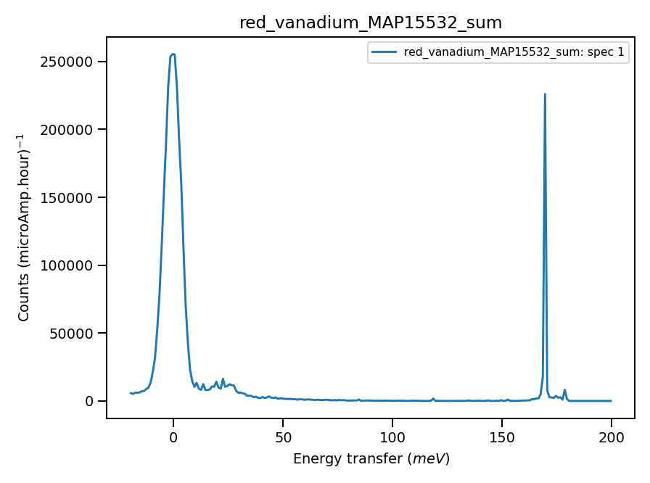
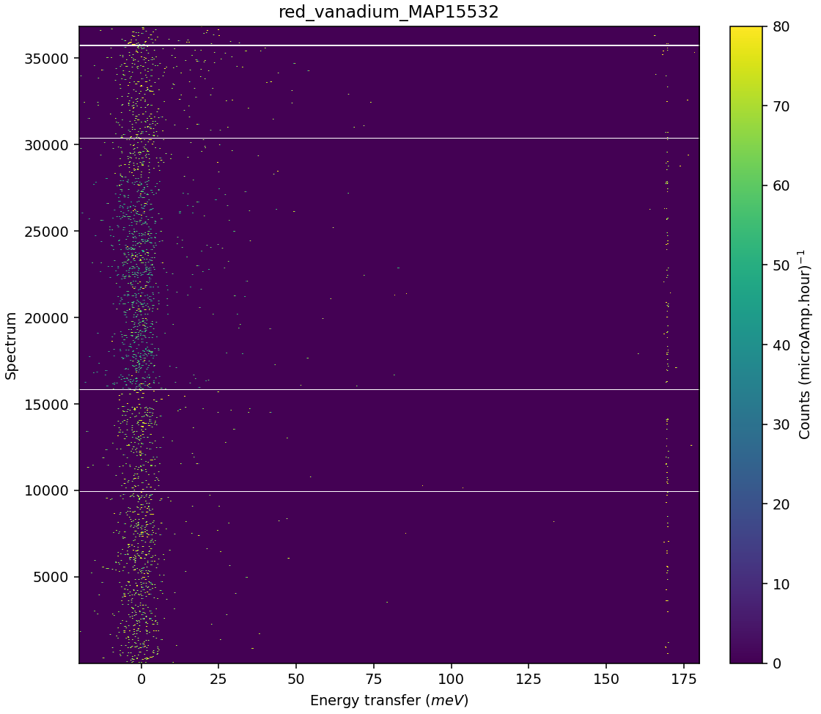
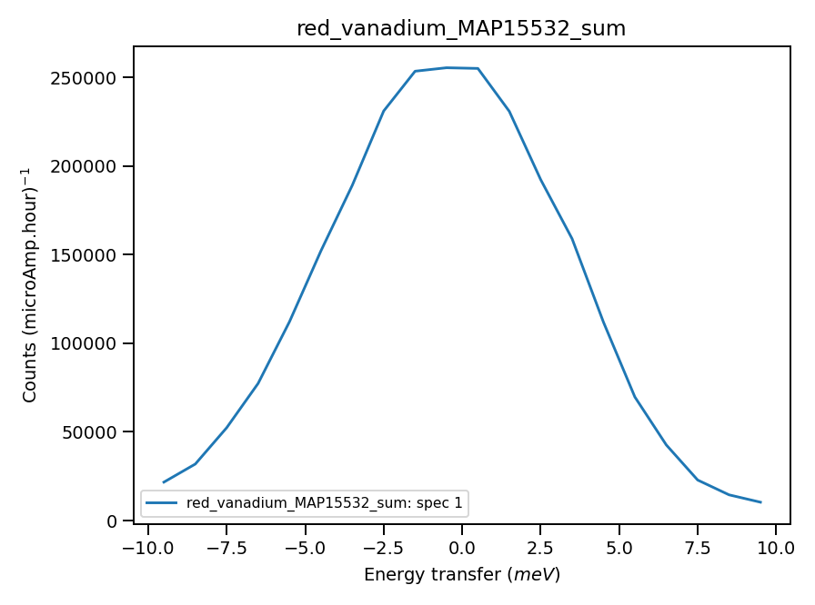
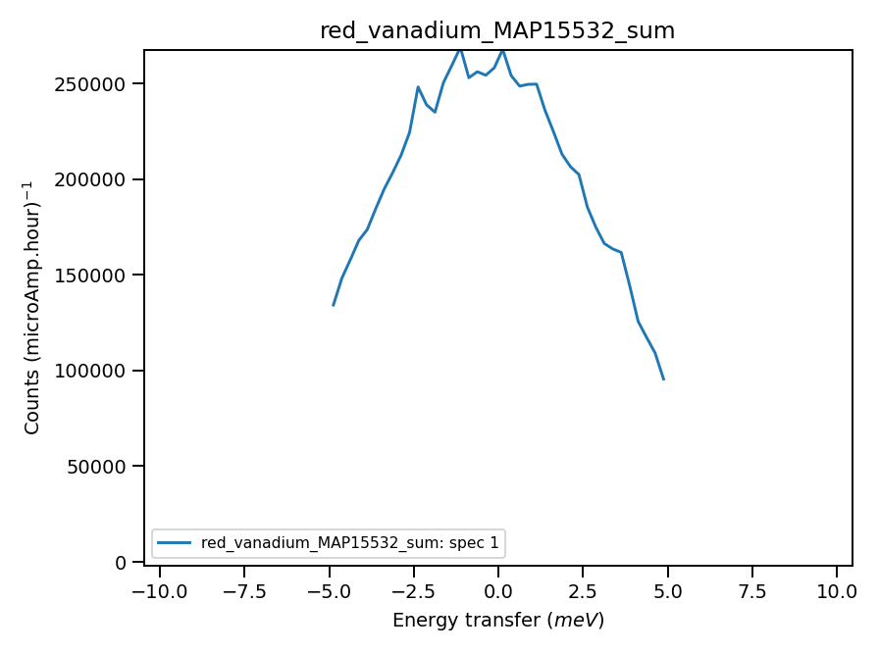

Validate correct incident energy for mono-vanadium run N15532
Chopper peak around 201meV
Binning range 162 meV
166meV if Ei=201
Correct Ei = 201, so that ΔEi = -0.55 where:
$$ΔE_{i}={\int_{−10}^{10}{f\left(e\right)⋅e⋅de}}/{\int_{−10}^{10}{f\left(e\right)⋅de}}$$
Integration from -5 to 5 gives ΔΕi=-0.2meV (overlapping
Solid line)

Slide 3
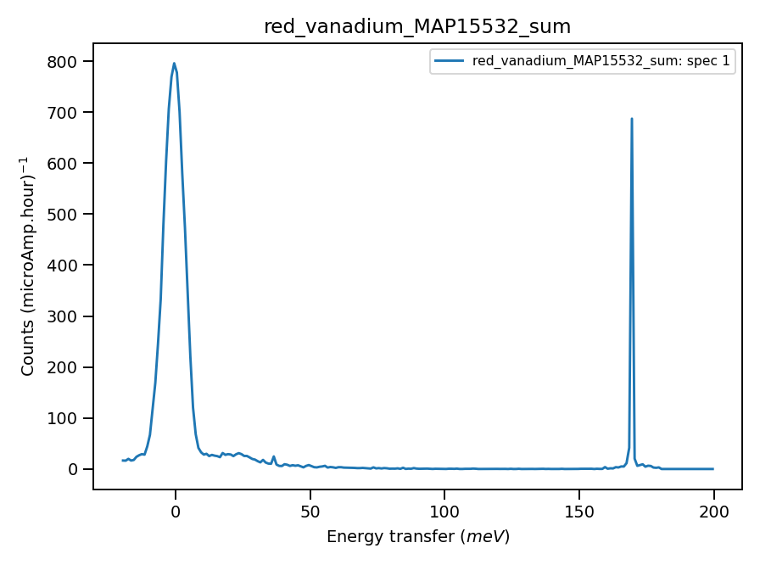
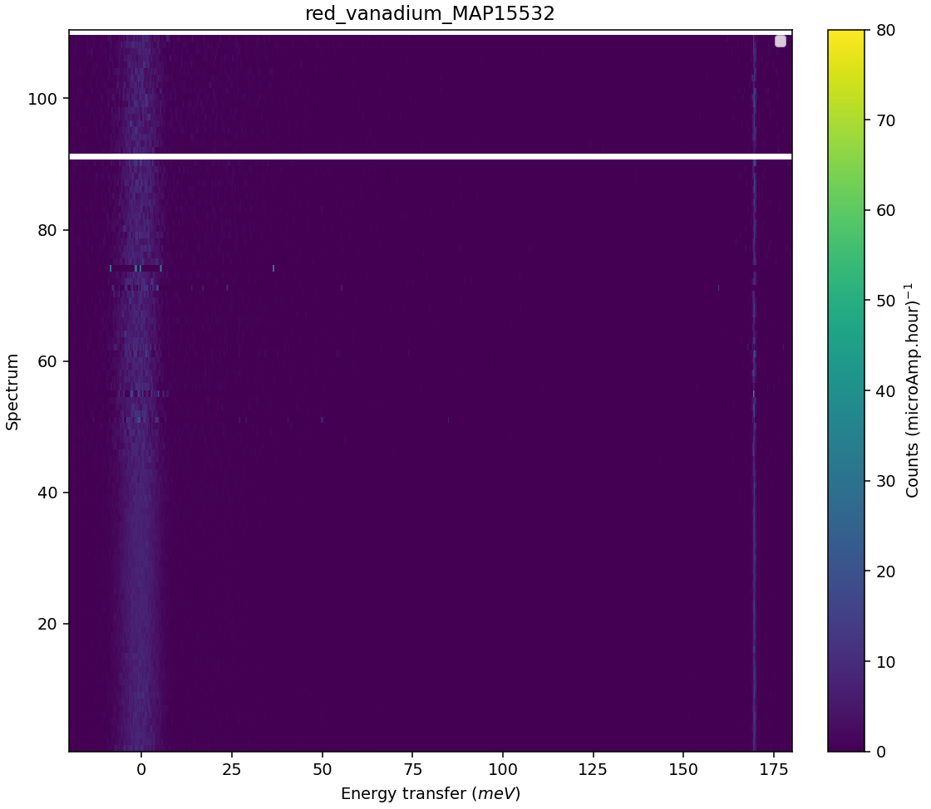
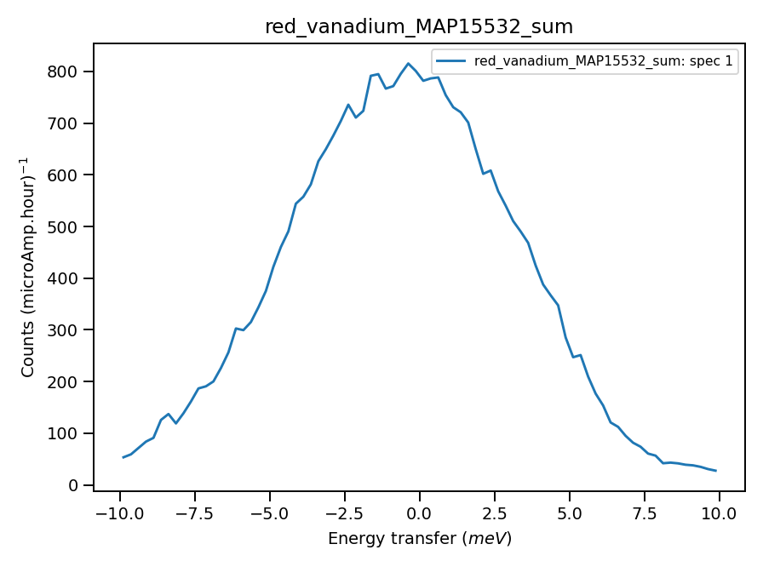
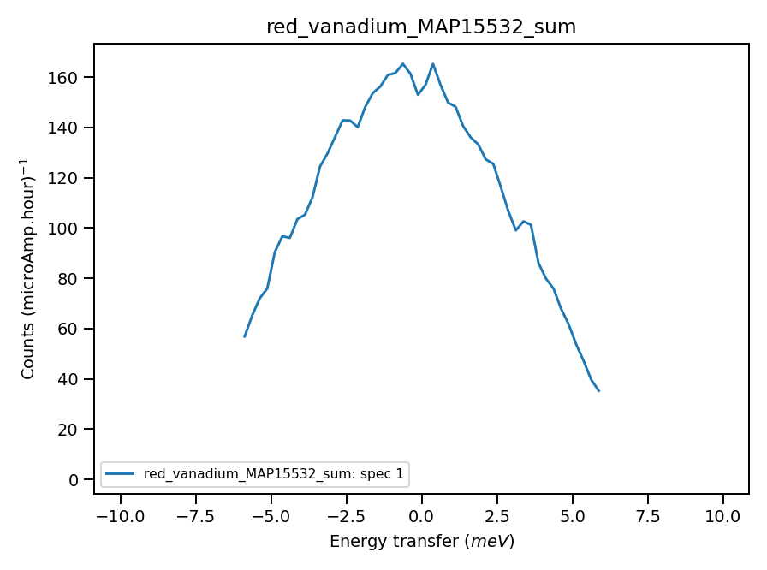
Validate correct incident energy for mono-vanadium run N15532, use rings
Ei = 201, ΔEi = -0.6 integration +-10meV;
ΔEi = -0.2 integration +-6meV, 20 low angle spectra (overlapping picture)

Slide 4
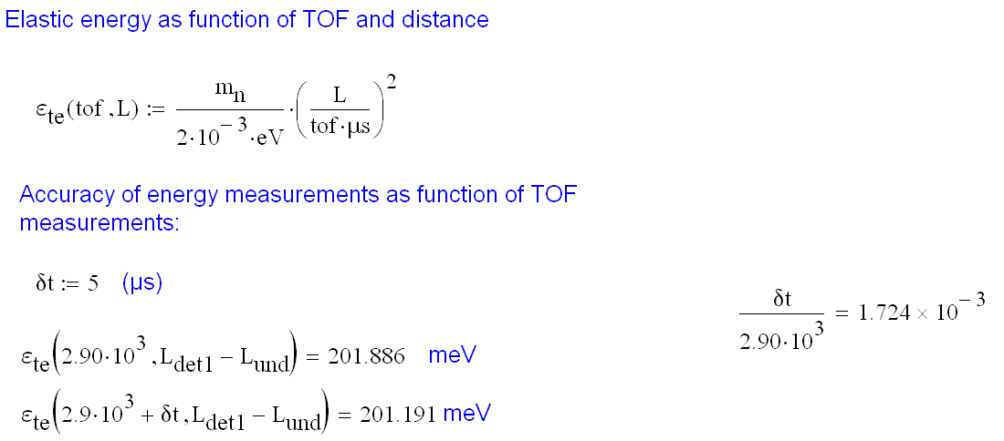
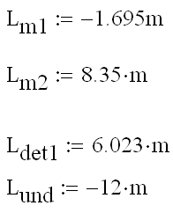
Error in TOF to error in Ei:

Slide 5
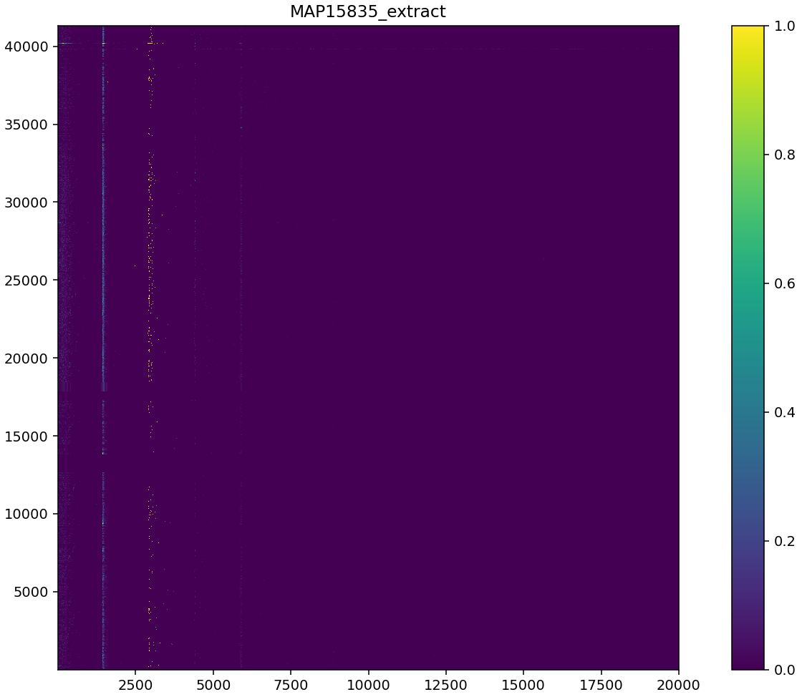
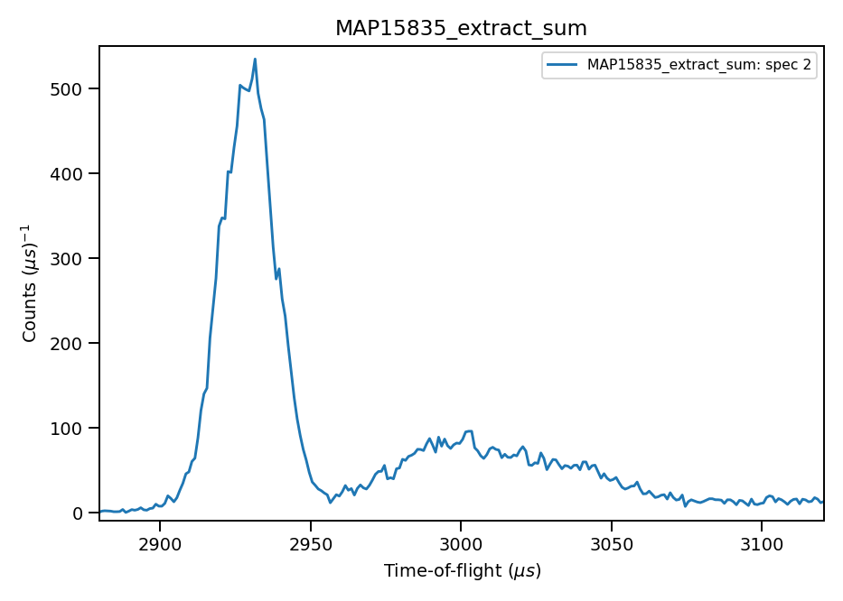
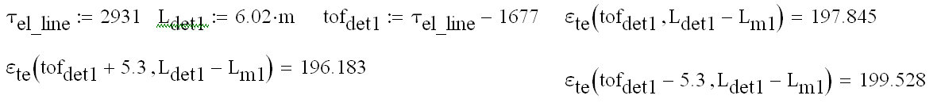
Ei from Fe elastic line position in TOF:
Selection of spectra at 6.02+-0.002m
2931
2931.(5-8) – integration (symmetric or hw)

Slide 6

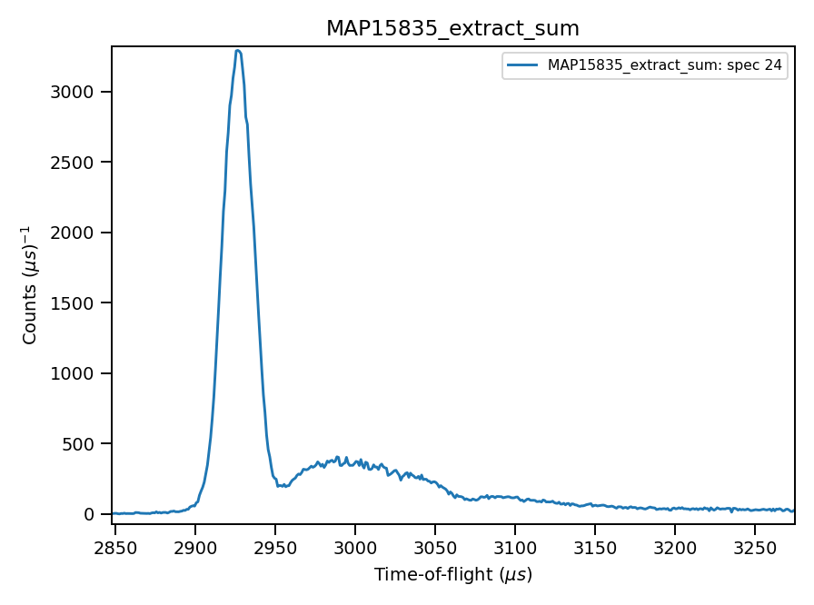
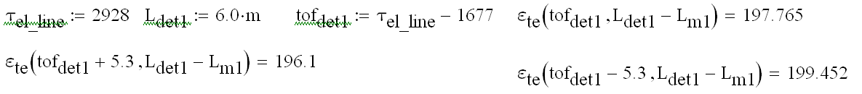
Ei from Fe elastic line position in TOF:
Selection of spectra at 6.0+-0.002m
2927
2928; 2929 – integration (symmetric or hw)
Calibration is necessary – either align elastic line or

