Slide 1
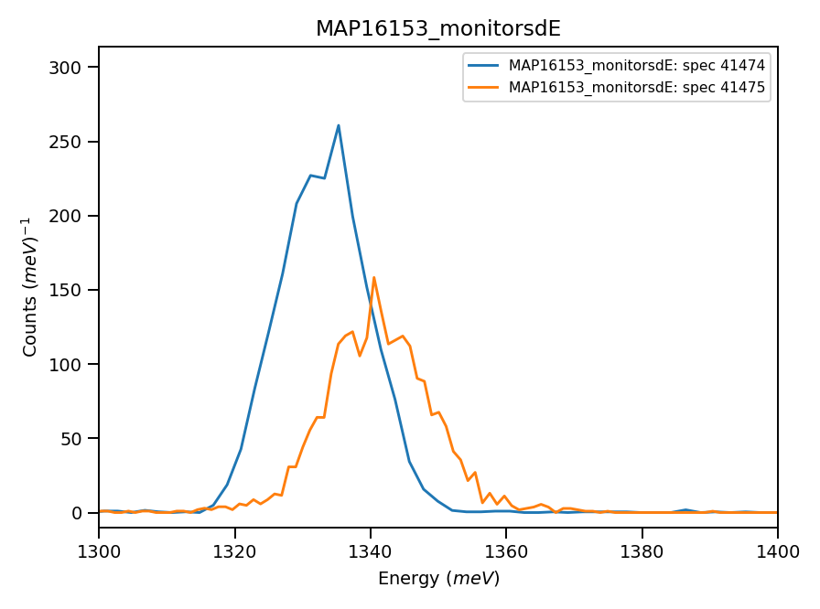
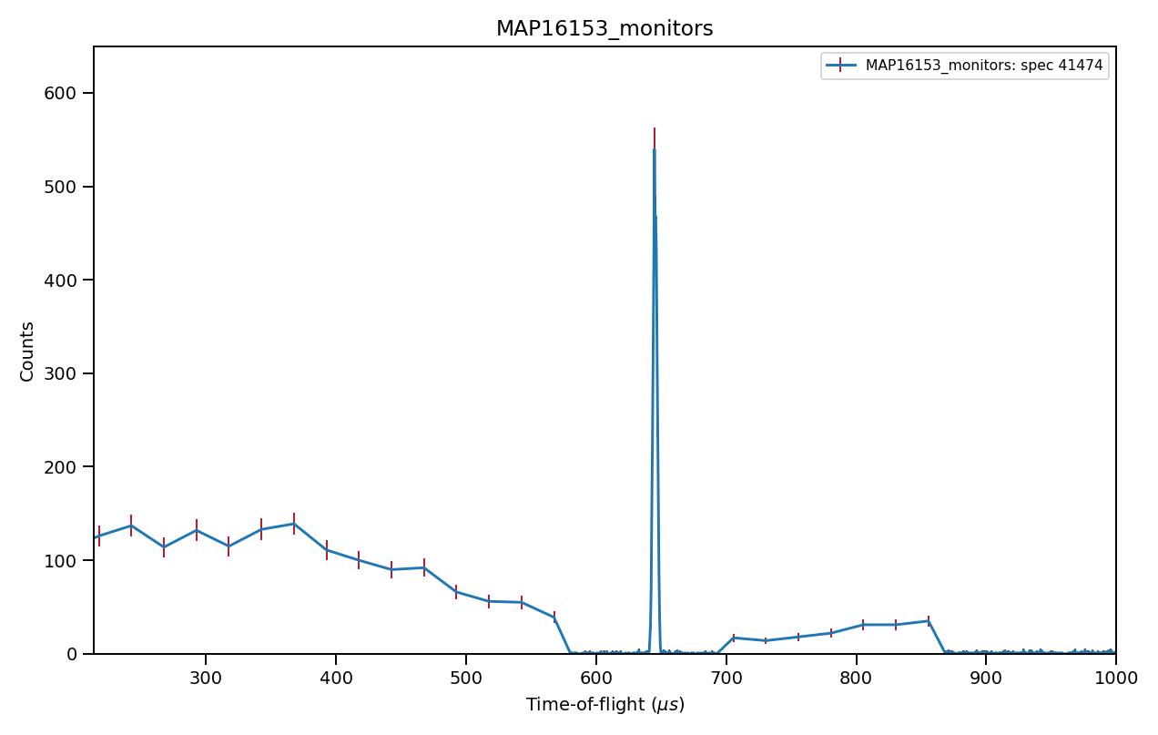
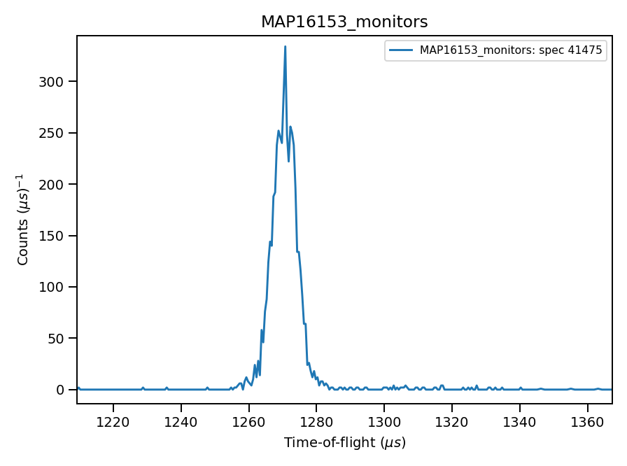

Monitors signal, vanadium run N16153
645μs
1270 μs
*** Using calculated value : 14.71
of absolute units correction factor (TGP)

Slide 2
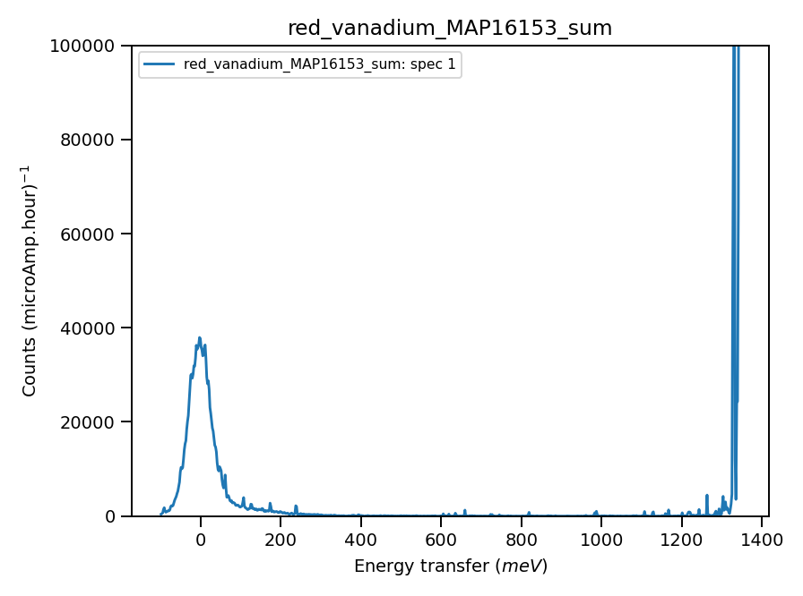
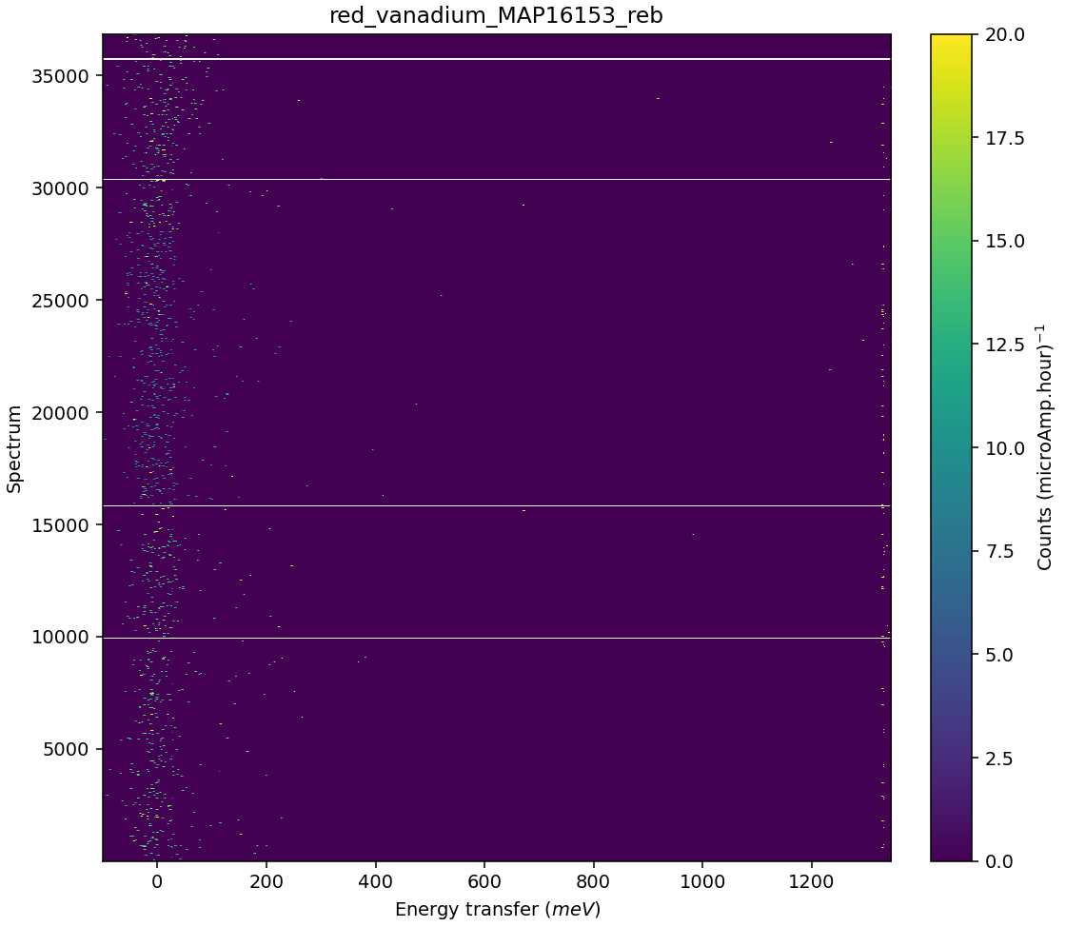
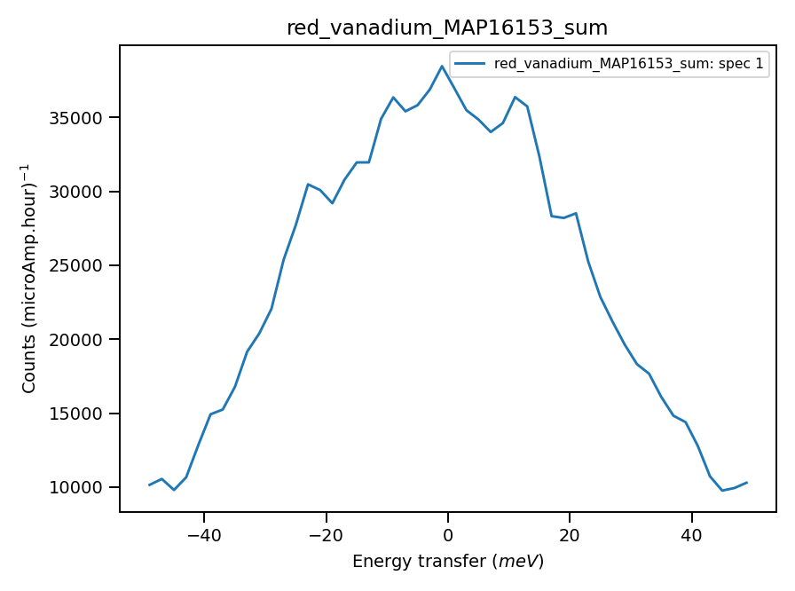
Validate correct incident energy for mono-vanadium run N16153
Chopper peak around 1350 meV
Binning range 1250 meV
Correct Ei = 1348, so that ΔEi = -0.56 where:

