Slide 1
High Energy Magnetic Excitations in the Itinerant Electron Ferromagnet Iron Measured throughout the
Brillouin Zone
A. Buts, H.A. Mook, M. Lueders and T.G. Perring
Iron is:
A classical example of itinerant electron ferromagnet
A textbook example of medium correlated electronic system
The benchmark example of various computational magnetism codes
The system we know all about and can model with high level of accuracy?

Slide 2
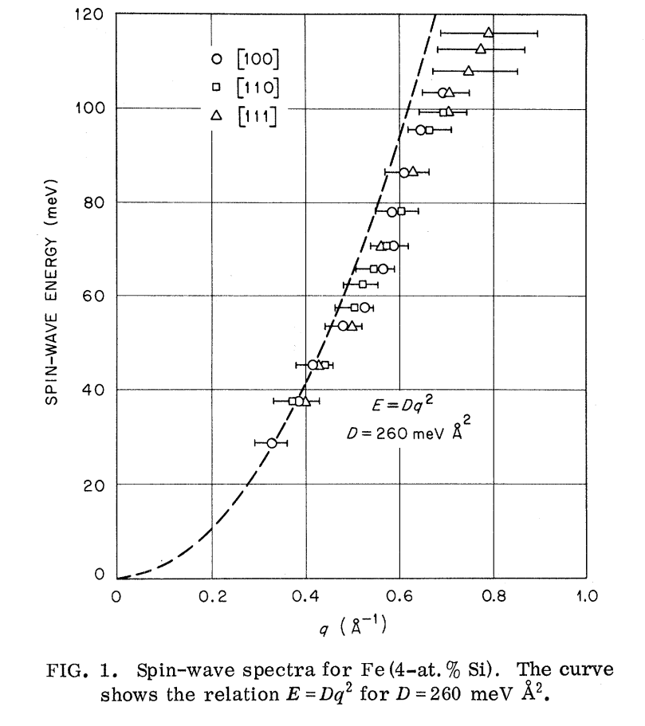
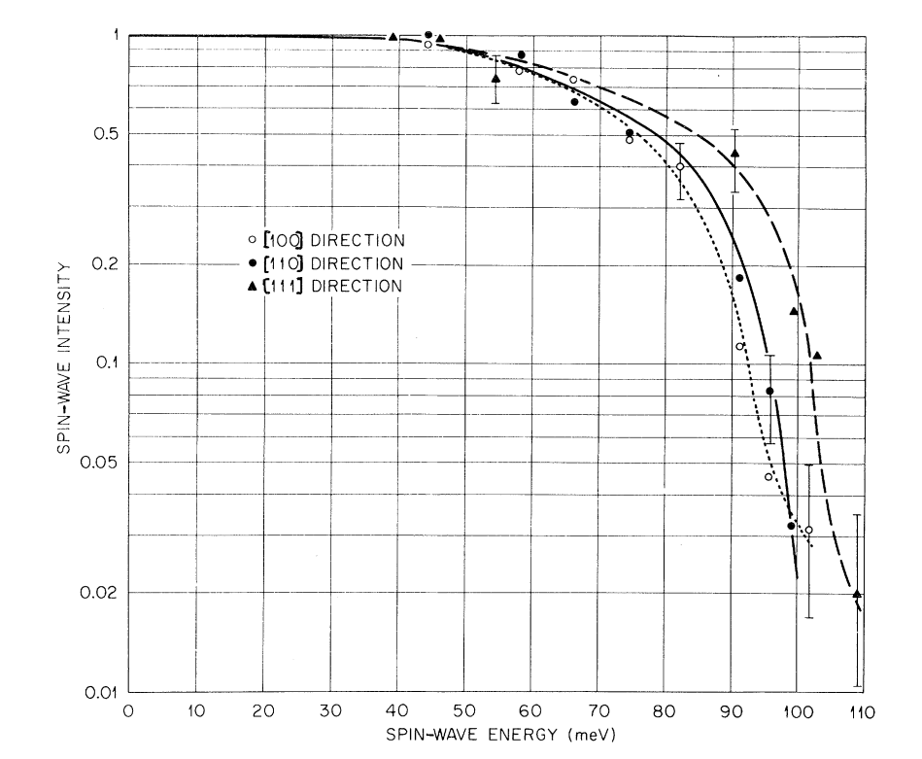
Experiments: Spin wave dispersion and interaction with Stoner continuum (1973)
Triple-Axis: H. A. Mook R;. M. Nicklow; PRB 7(1) 1973 (Fe54+4at%Si)
Spin wave intensity as function of energy for Fe (4at%Si)

Slide 3
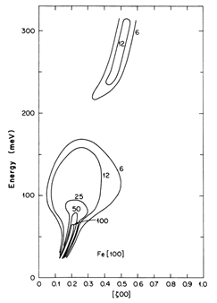
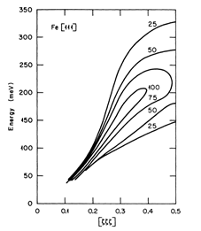
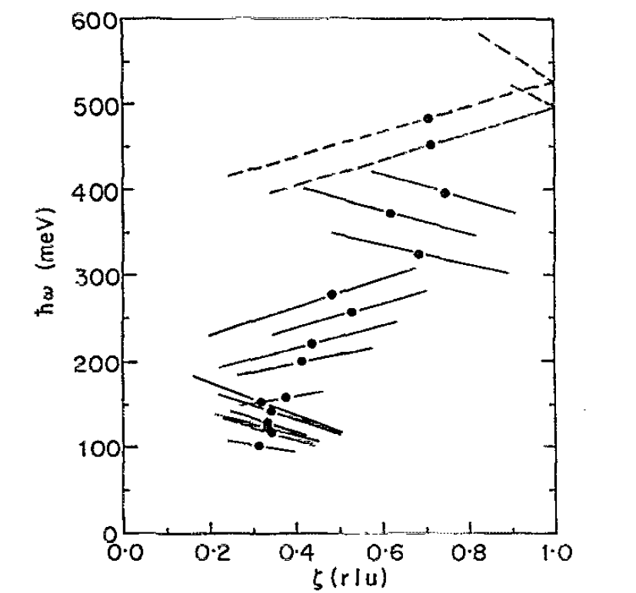
Experiments: Spin wave dispersion and interaction with Stoner continuum
(Triple axis : 1988, TOF: 1991)
Triple axis:
D. McKenzie Paul, P. W. Mitchell; H. A. Mook; U. Steigenberger PRB 38 (1 ) 1988 (Fe54+10at%Si)
TOF instrument:
T. G. Perring, A. T. Boothroyd, D. McK.
Paul A. D. TaylorR. OsbornR. J. Newport;
J. A. Blackman H. A. Mook; JAP 69 (8) 1991
[100]
[111]
[100]

Slide 4
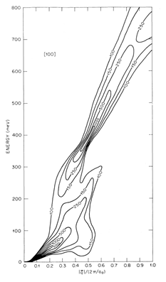
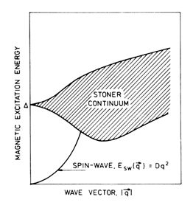
Theory: Classical zone theory wave functions random phase approximation (1985), 2007 – tight binding model.
J. A Blackman T. Morgan J. F Cooke PRL 55(25) 1985
Masayuki Naito; Dai S. Hirashima : J.Phys. Soc. Jpn 76(4) 2007
Predicted energy gap in [100] direction,
caused by interaction with Stoner continuum

Slide 5
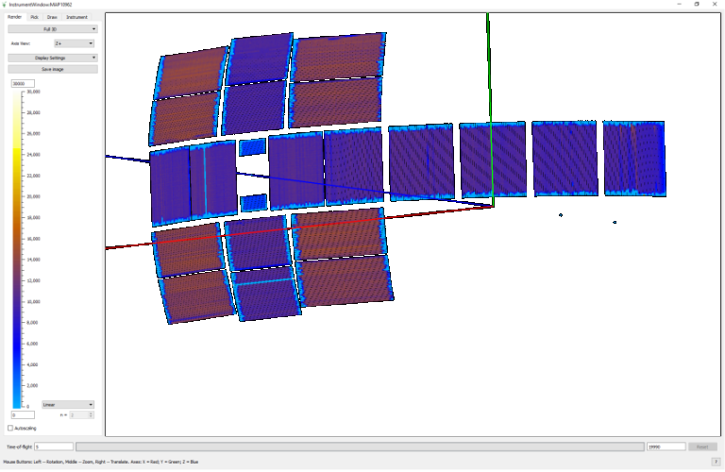
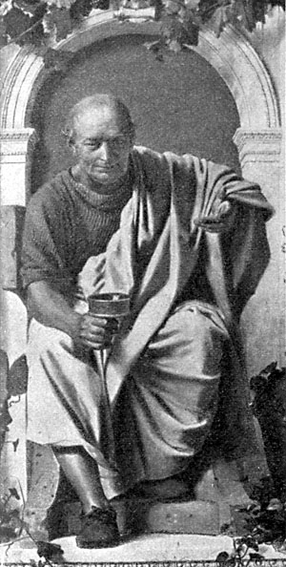
High energy magnons excitation measurements using MAPS spectrometer and processed using Horace
http://www.isis.stfc.ac.uk/instruments/maps
166g crystal of BCC Fe⁵⁴ + 10at%Si
Performed neutron scattering
experiments for Ei =0.2, 0.4, 0.8 and
1.4eV incident energies
The resolution is 4% of Ei at
FWHM
Crystal rotated in +/-90º energy range
with 1º step to cover large reciprocal
space area to do complete 4D S(Q,w)
Data for each incident energy are combined in large Horace datasets
and analysed using Horace
MAPS: 38*10³ PSD detectors
http://horace.isis.rl.ac.uk
Horace: Software for the analysis of data from single crystal spectroscopy experiments at time-of-flight neutron instruments

Slide 6
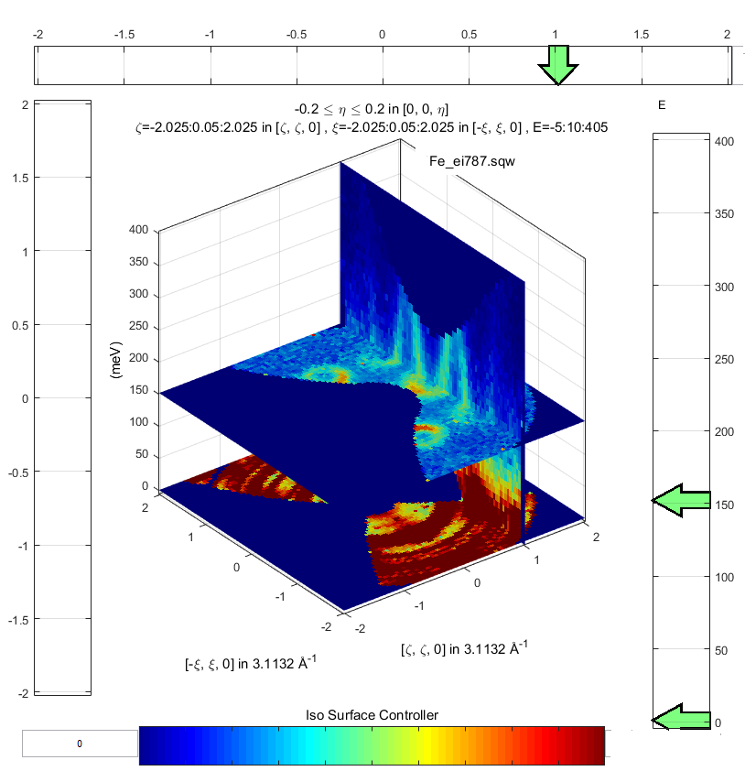
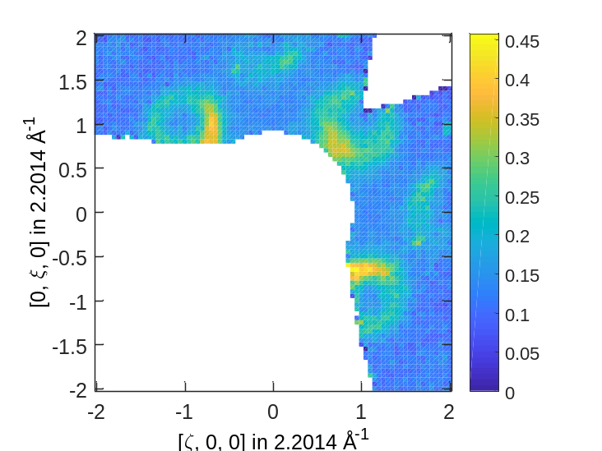
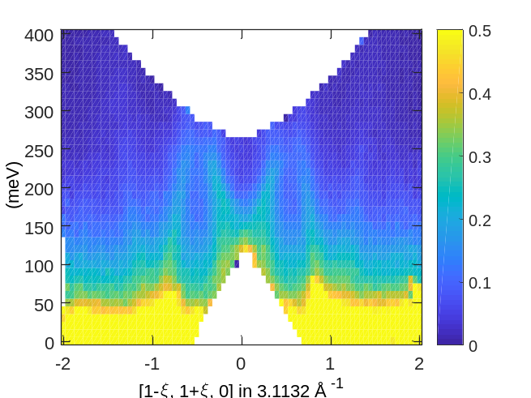
Example: Subsection of reciprocal space showing strong spin waves

Slide 7
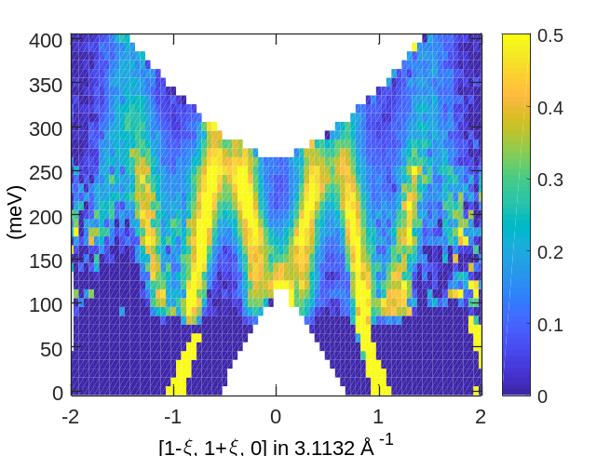
Example: Subsection of reciprocal space showing strong spin waves

Slide 8
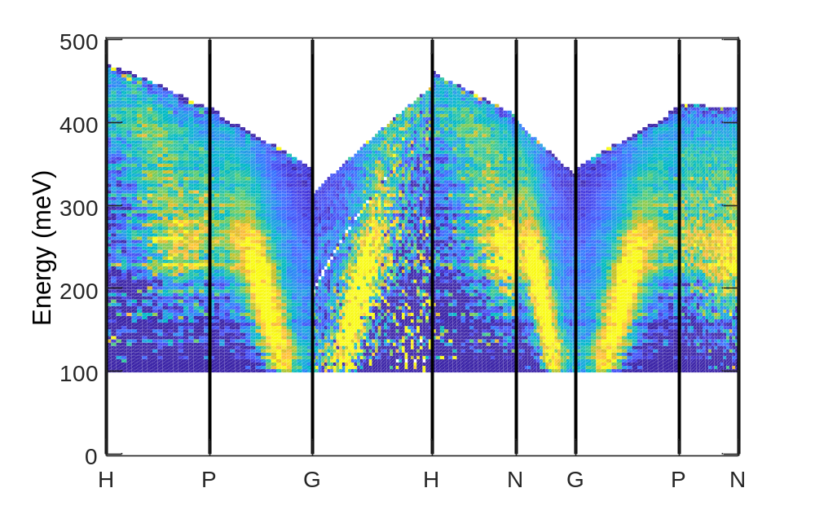
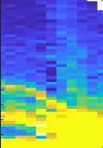
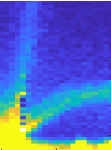
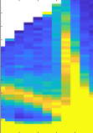
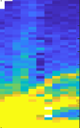
Result: Full high energy range mapping

Slide 9
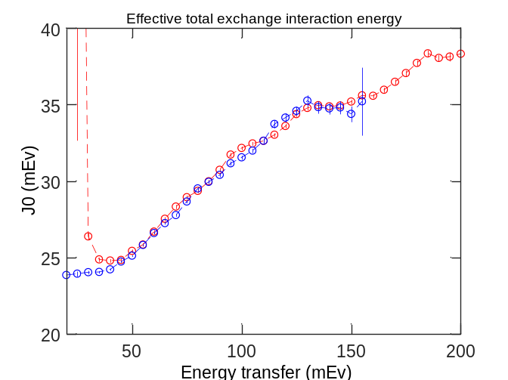
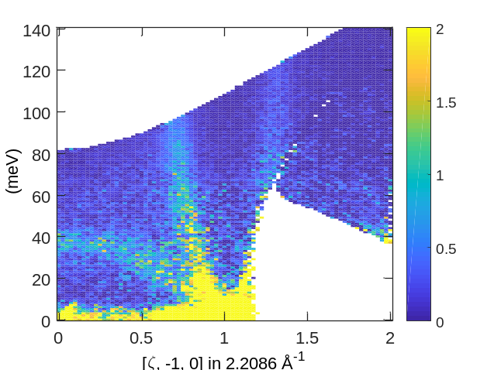
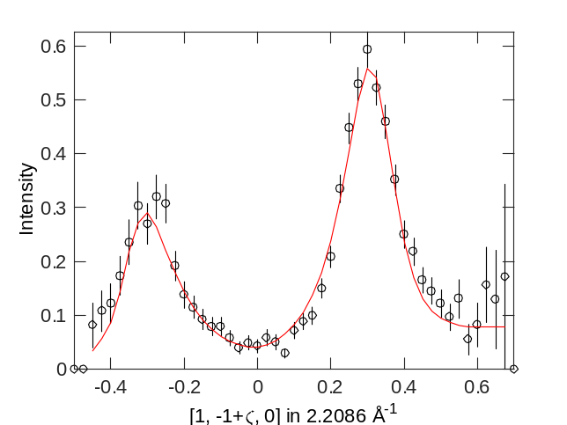
Analysing results. Is resolution hiding changes in intensity?
-- Ei 400 mEv
-- Ei 200 mEv
γ
Do least squares fitting the data to model of:
Heisenbergh Ferromagnet dispersion
Broadened by damped simple harmonic oscillator (damping parameter γ)
Having intensity scale I
Convoluted with MAPS resolution function

Slide 10
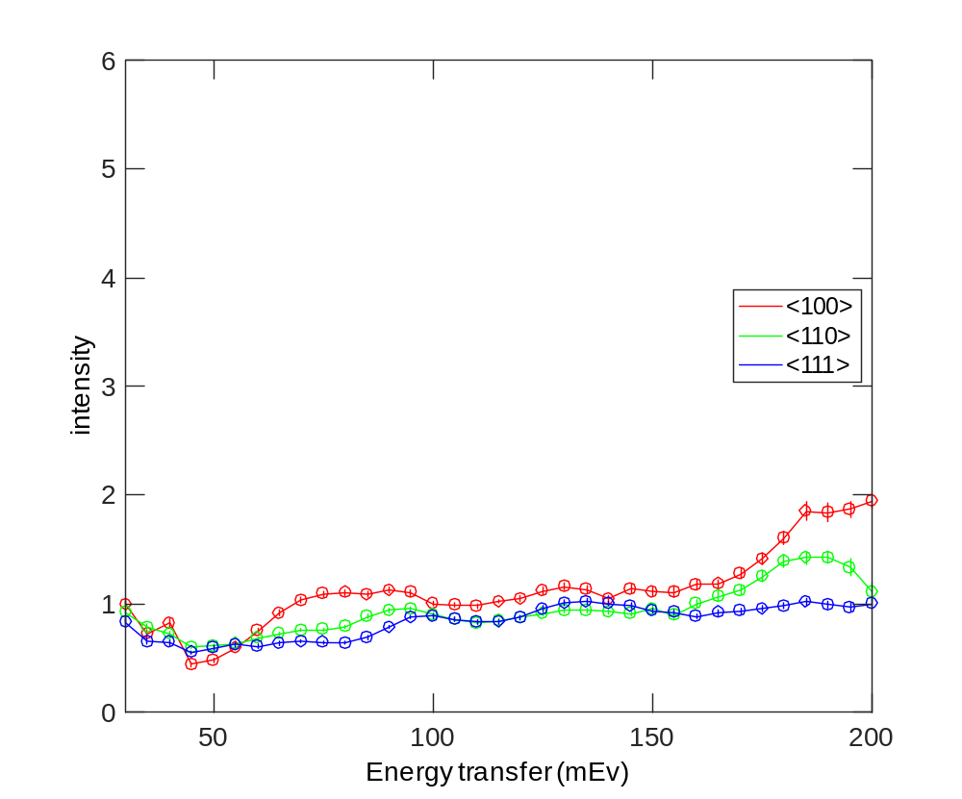
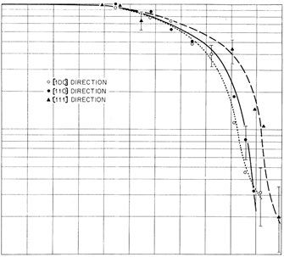
Result of fitting:
Intensity scale (I) for 3 high symmetry directions

Slide 11




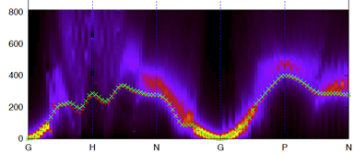
TD-DFT modelling
TD DFT Calculations of Dr Martin Lueders

Slide 12
Conclusions:
Performed measurements of magnetic excitations in iron over the whole
Brillion zone and advanced data processing reveal magnons dispersion
along the major part of Brilouin zone.
The results contradict the previous measurements and calculations:
namely:
No spin wave intensity decay at ~90 mEv due interaction with Stoner continuum.
Well defined spin waves along 100 direction at all accessible energies
The results are in better agreement with the results of modern TD-DFT calculations
though some details of the predicted dispersion are still different from the one,
observed experimentally.
Further improvement to TD-DFT codes and advanced data analysis is necessary.

Slide 13
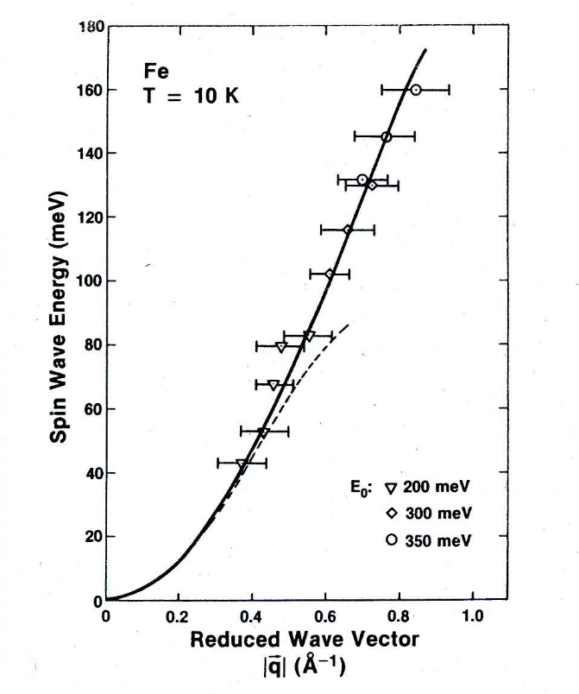
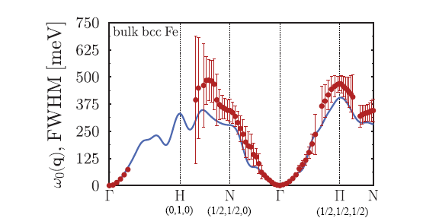
Preliminary evidence of different picture:
1) Inconclusive TOF measurements (1988)
2) linear response time dependent density functional theory (2011)
Experiment: C.-K. Loong; J. M. Carpenter; J. W. Lynn; R. A. Robinson; H. A. Mook; JAP 55(6) 1988
TD DFT sumulations: P.Buczek; A.Ernst; L. M.Sandratskii PRB 84(17) 2011
110

Slide 14
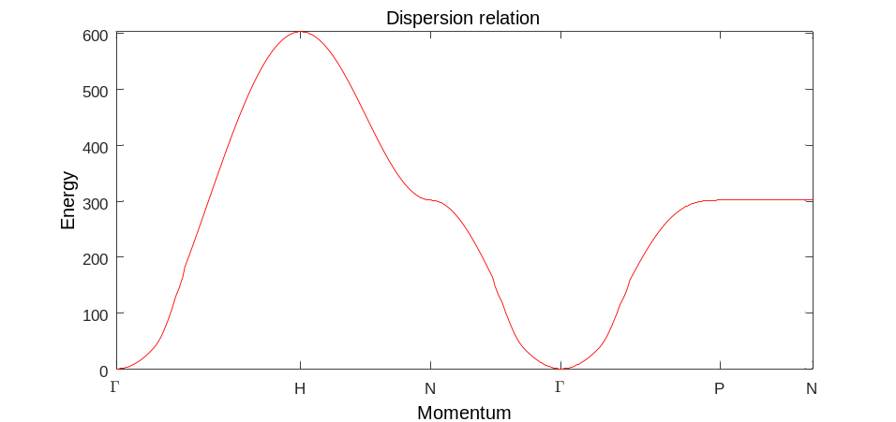



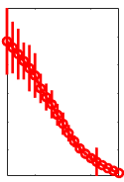
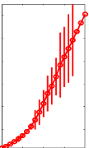
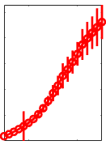
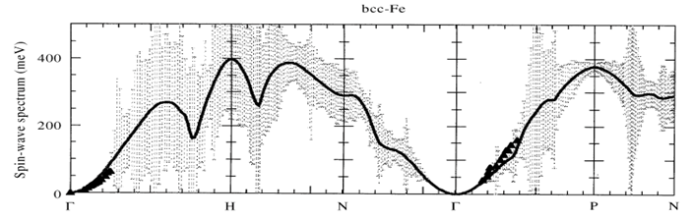
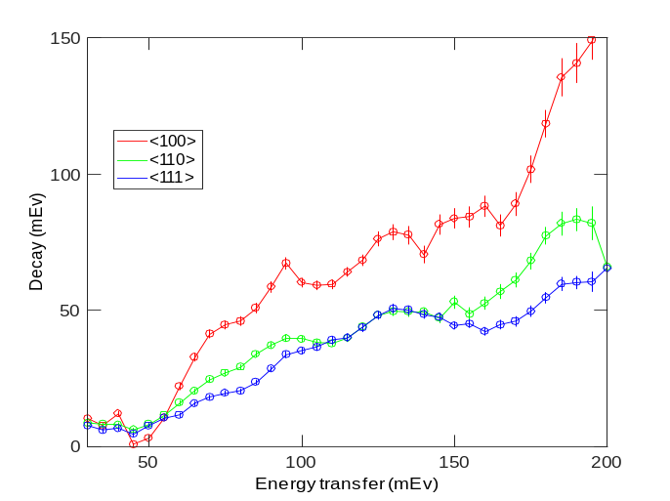
Results and comparison with modelling:
Intensity scale (I) for 3 high symmetry directions
TD DFT for BCC-Fe; Antropov at all, JM&MM 200(1999)
SW Decay γ for 3 high symmetry directions
TD DFT Calculations of Dr Martin Lueders

