Slide 1
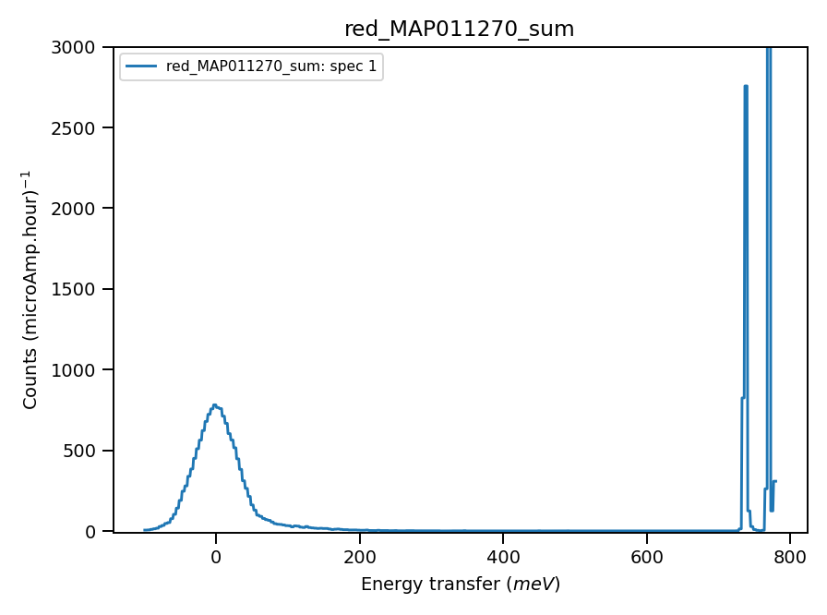
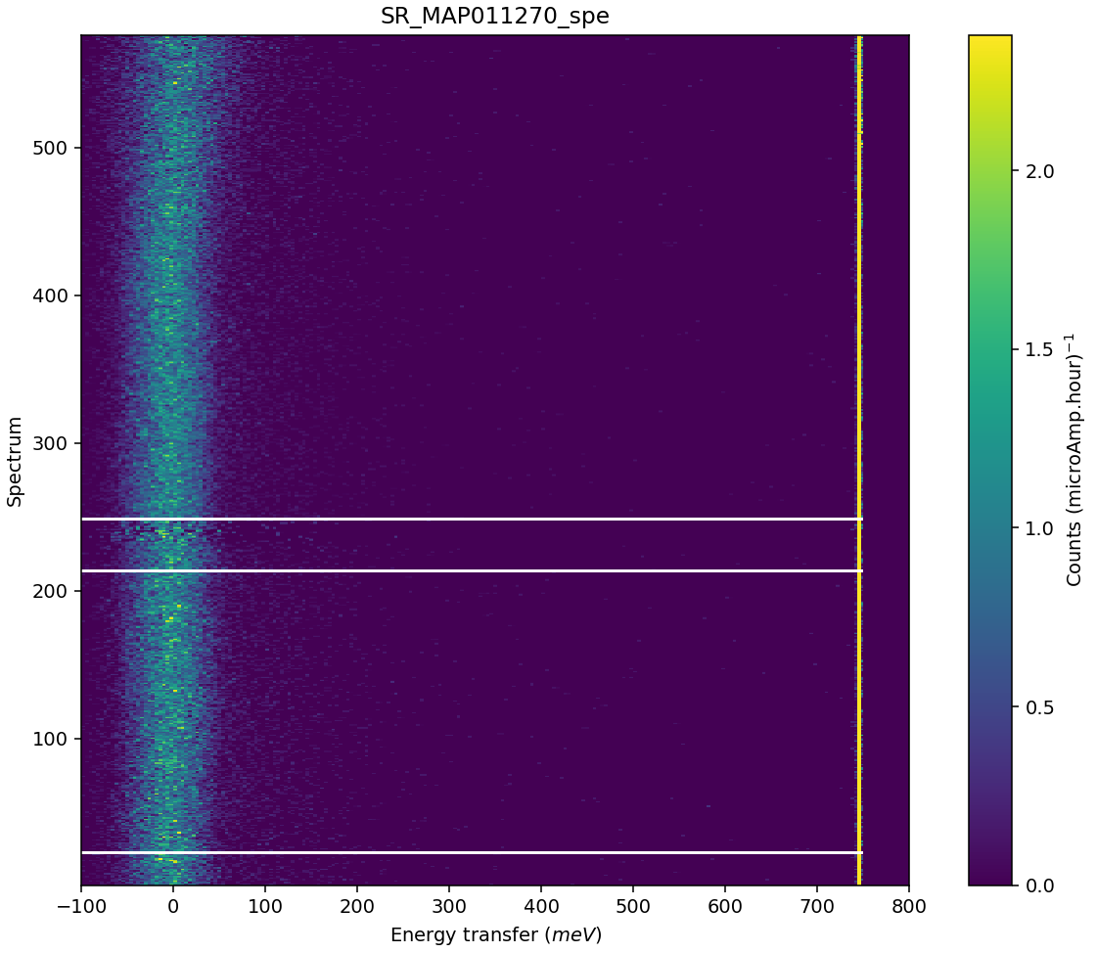
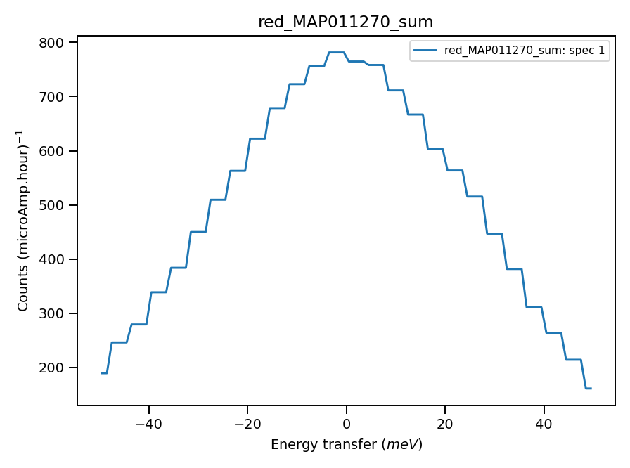
Validate correct incident energy for mono-vanadium run N11270
Chopper peak around 800meV
Some misalignment?
Binning range 720meV
Using calculated value : 42.9 of absolute units correction factor (TGP)
Correct Ei = 785, so that Ei = -0.35 where

Slide 2
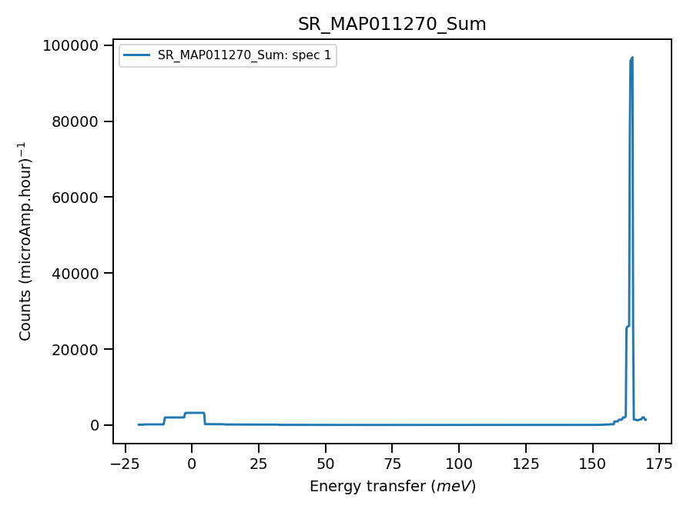
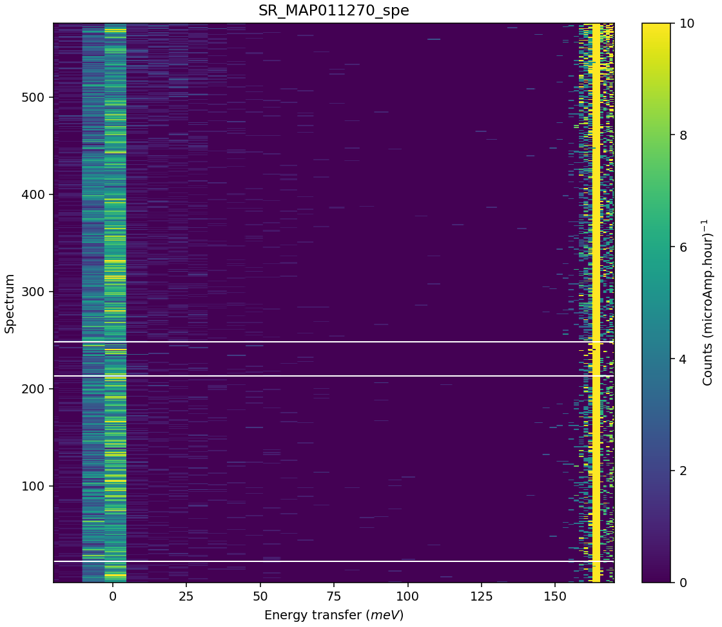
Chopper peak around 200meV. Histogram mode, poor energy accuracy
Binning range 156 meV
*** Using calculated value : 4.563024378055734 of absolute units correction factor (TGP)

