Slide 1
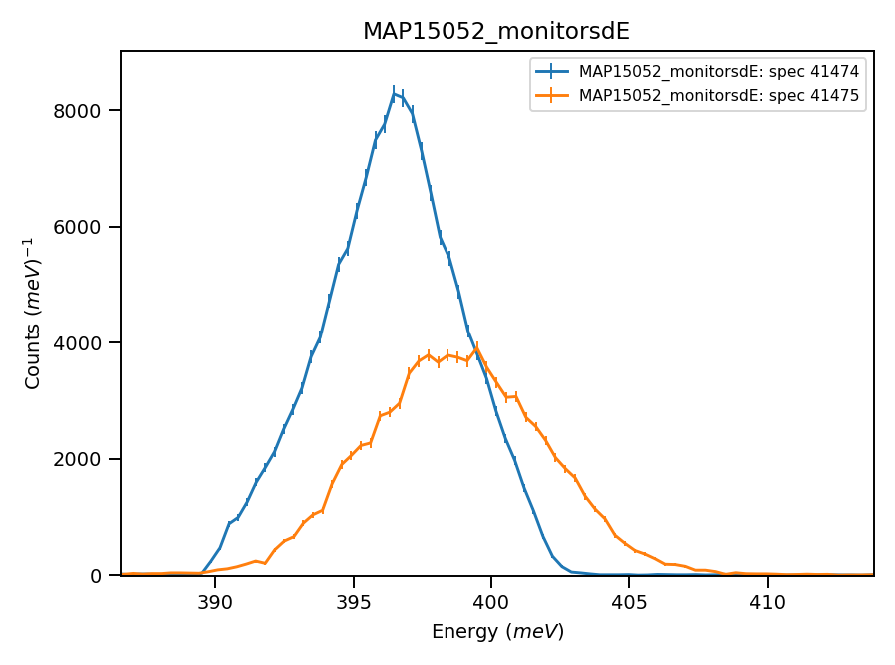
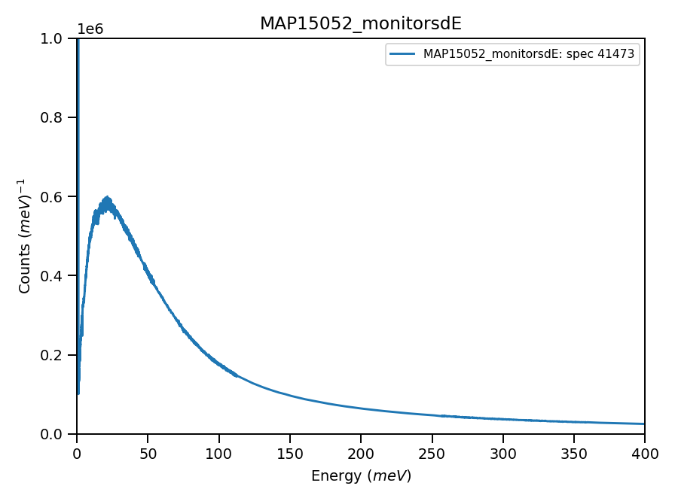
Monitors:
Wrong IDF ?

Slide 2
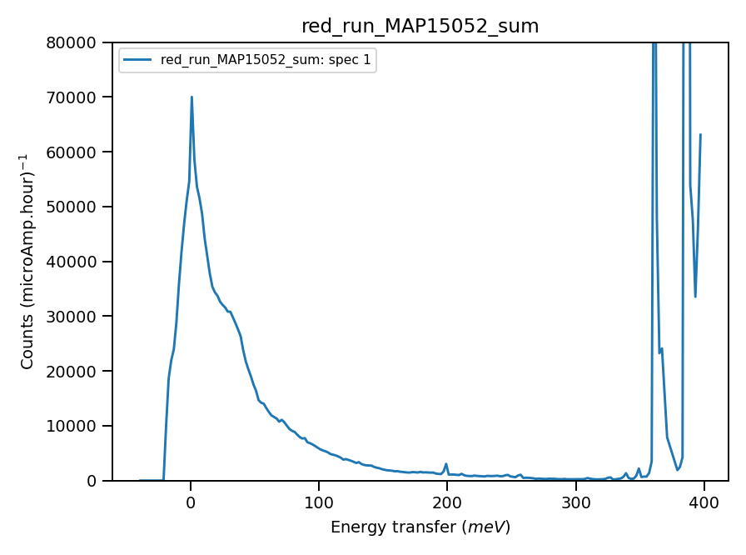
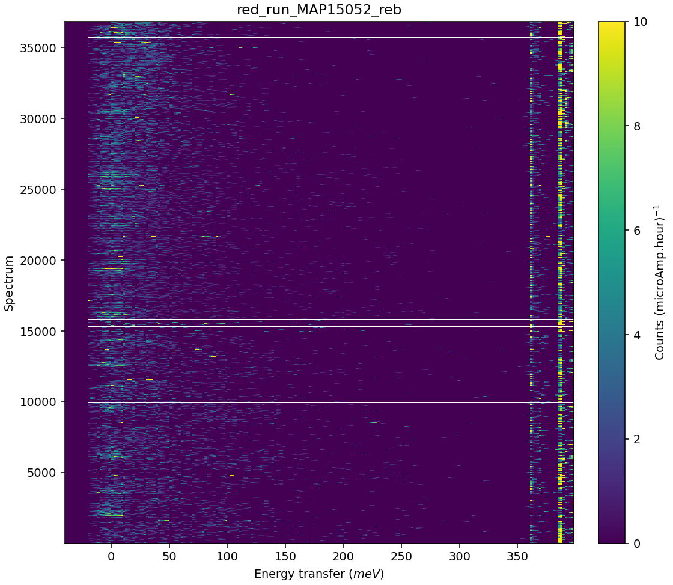
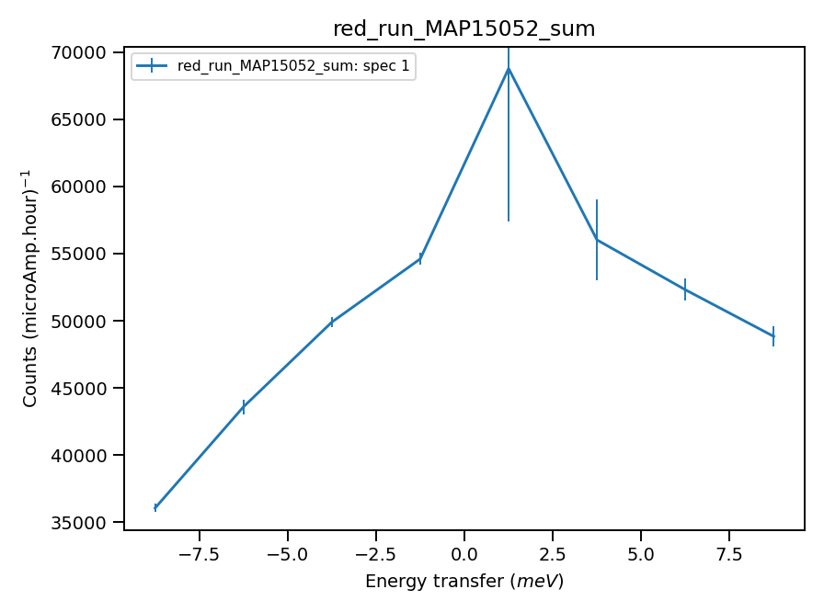

Validate correct incident energy for run N15052
Chopper peak around 400. meV. Calibration necessary.
Binning range 344 meV
Using calculated value : 30.17of absolute units correction factor (TGP)
Use vanadium Ei=401, as elastic line distorted here
$$ΔE_{i}={\int_{−10}^{10}{f\left(e\right)⋅e⋅de}}/{\int_{−10}^{10}{f\left(e\right)⋅de}}$$
Correct Ei = 401.meV, so that ΔEi = 0.49 where:

