Slide 1
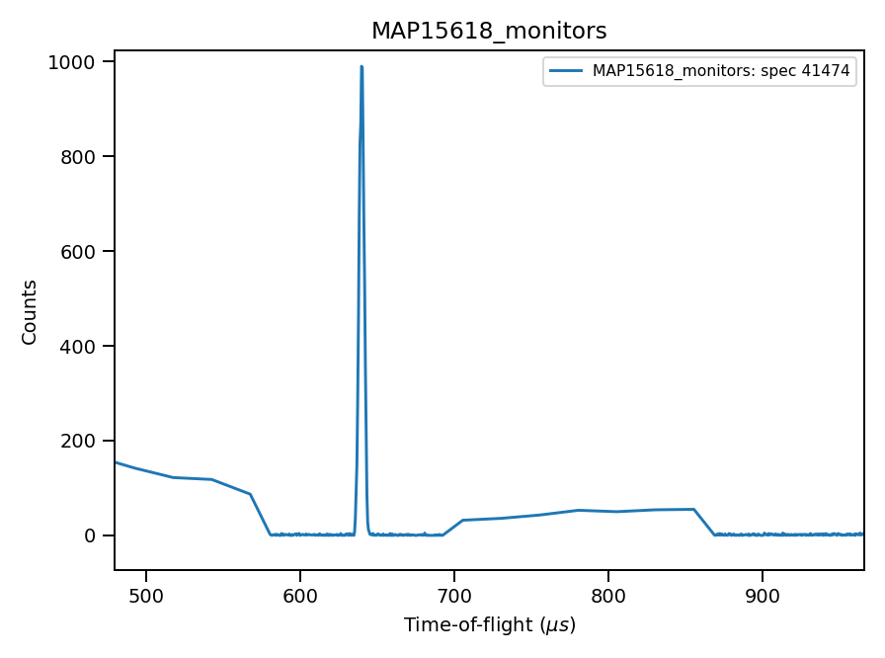
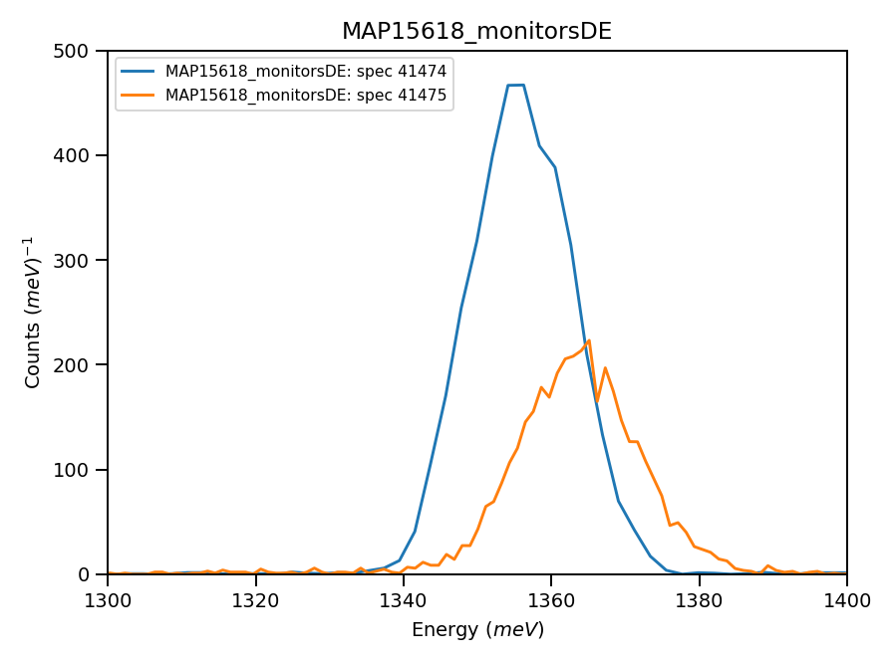
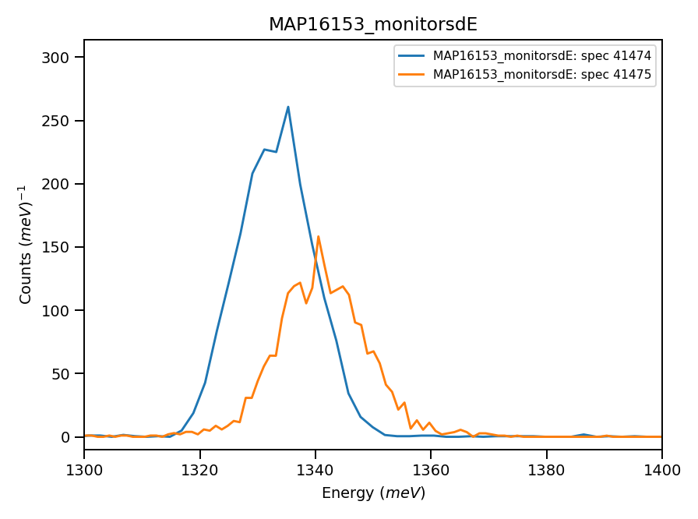
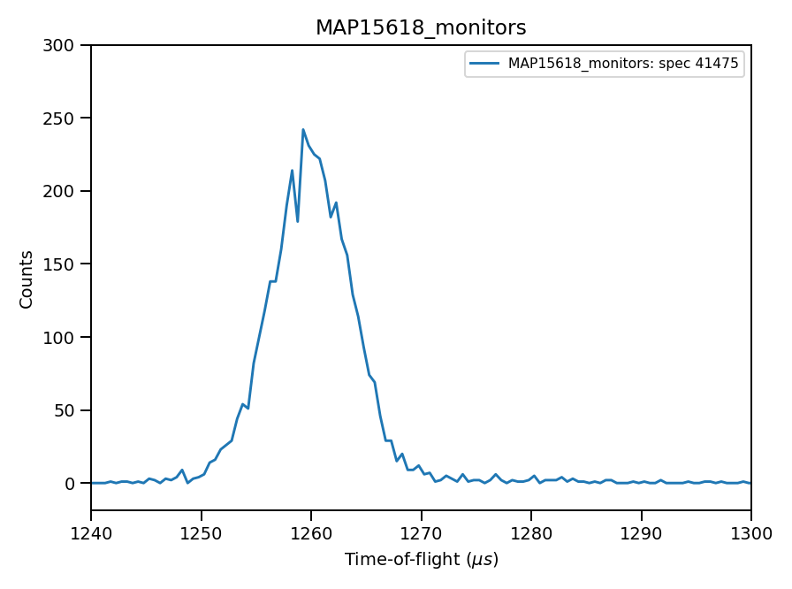


Monitors signal, run N15618
639μs
1259 μs
1261 μs from integration
*** Using calculated value : 11.31
of absolute units correction factor (TGP)

Slide 2
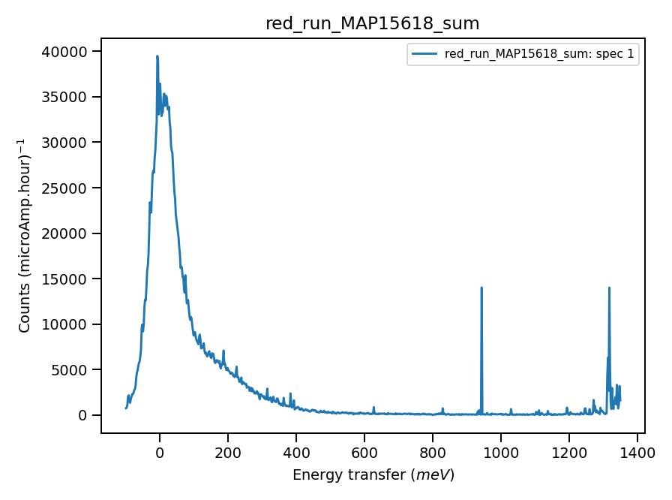
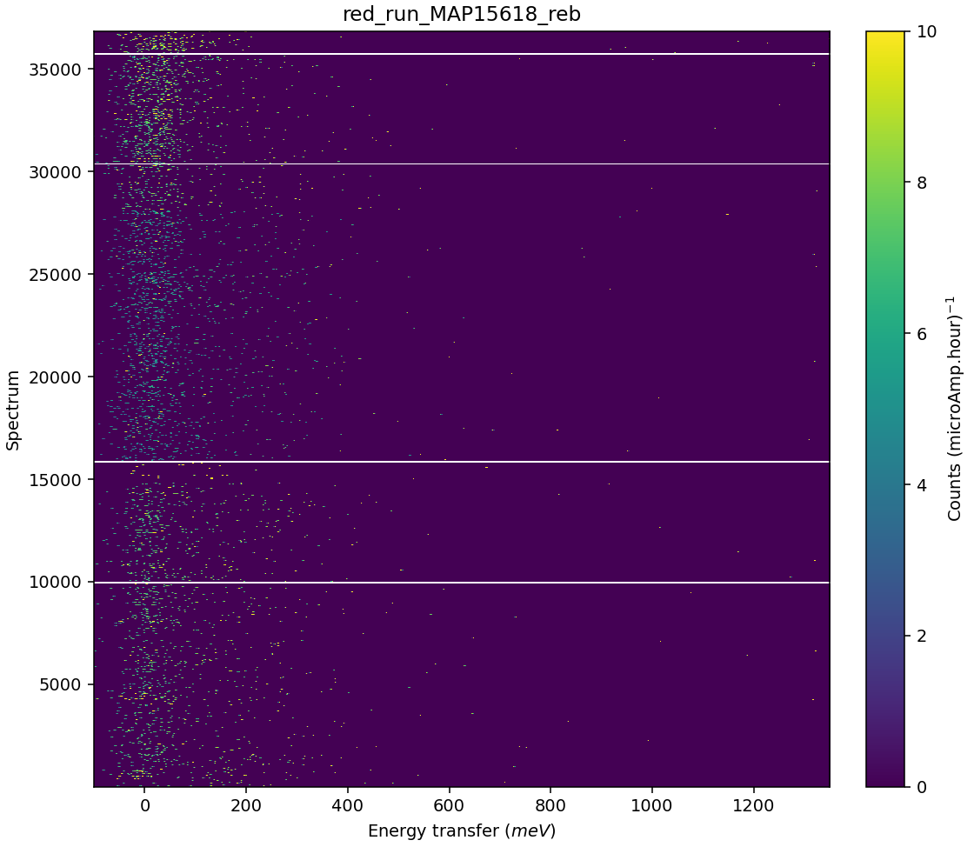
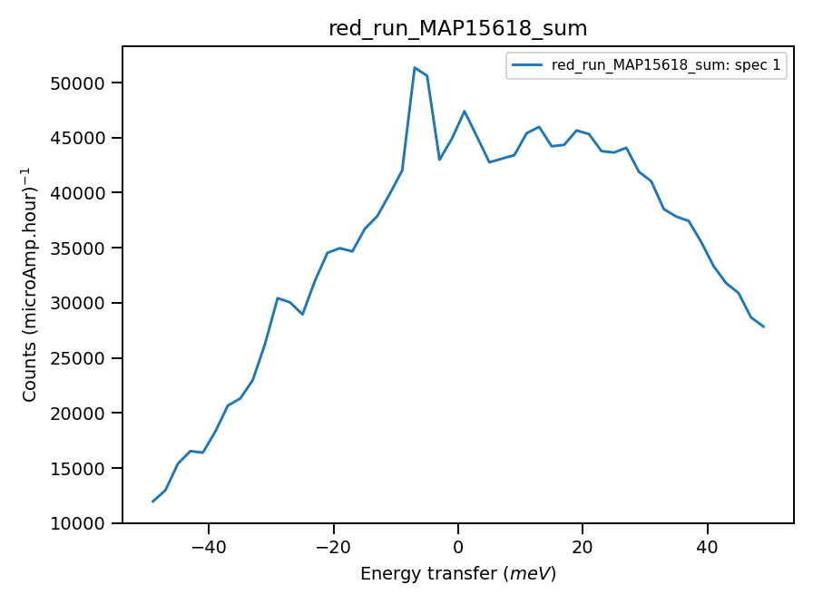
Validate correct incident energy for mono-vanadium run N15618
Chopper peak around 1372 meV
Binning range 1300 meV
Correct Ei = 1372, so that ΔEi = 4.8 where:
Phonons!

Slide 3
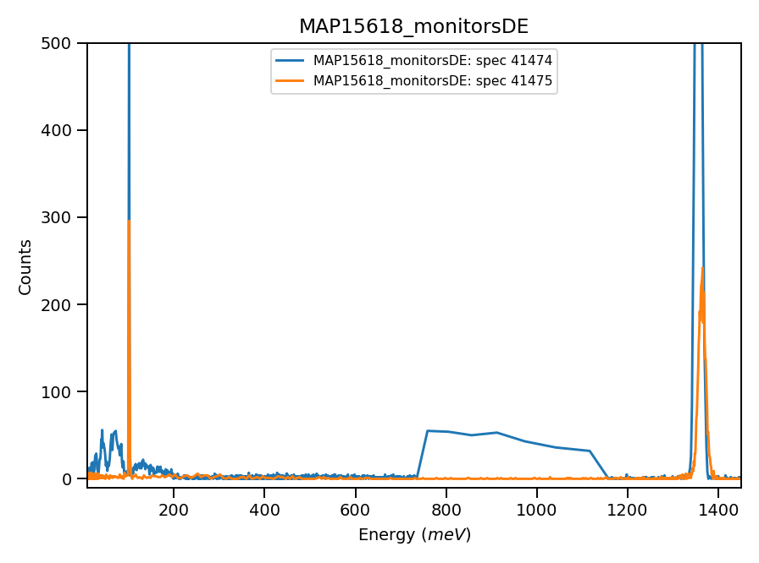
Constraining binning range to Ei-100?
100meV

