Slide 1
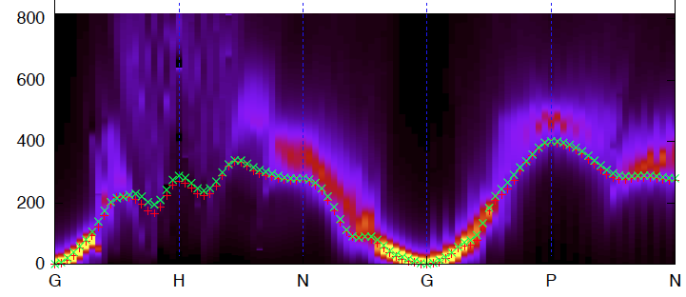
Dynamical susceptibility of iron
Motivation:
Interest in own right: classic example of itinerant electron ferromagnet
Test-bed for state of the art calculations of dynamical susceptibility
Experiment and theory:
Full mapping of the four-dimensional S(Q,ω)
Time-dependent DFT (Martin Lueders)
Results so far: (work in progress)
Good agreement at low energies along GN and GP to 200meV
BUT well defined magnons along GH, in contrast to calculations
Is TD-DFT alone? What do other computational techniques give?

