Slide 1
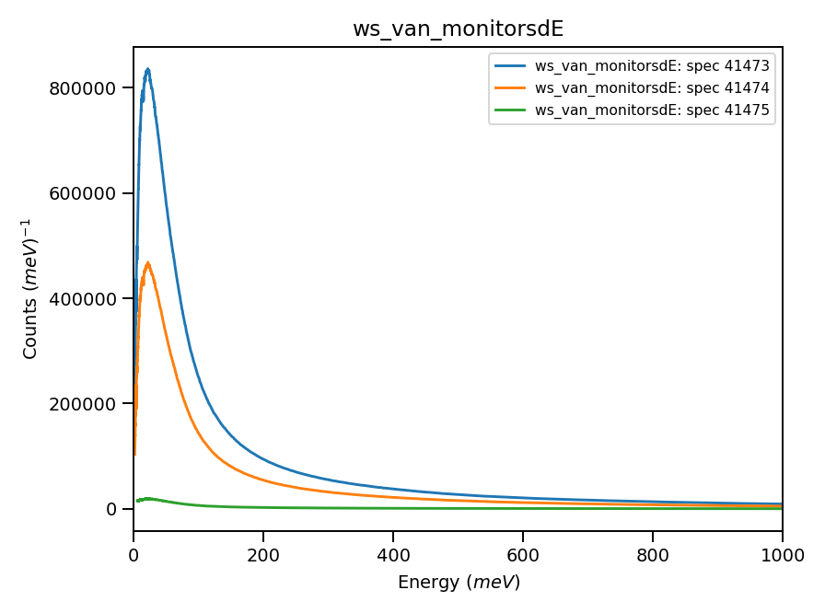
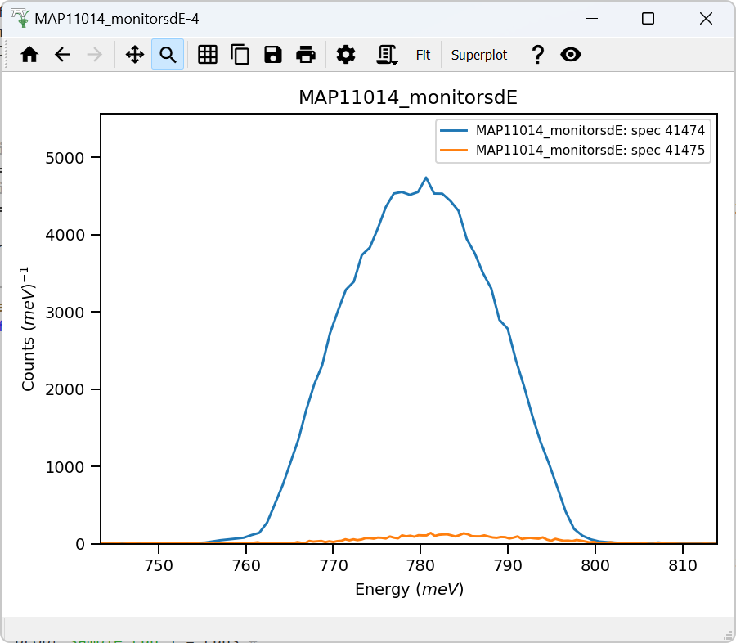
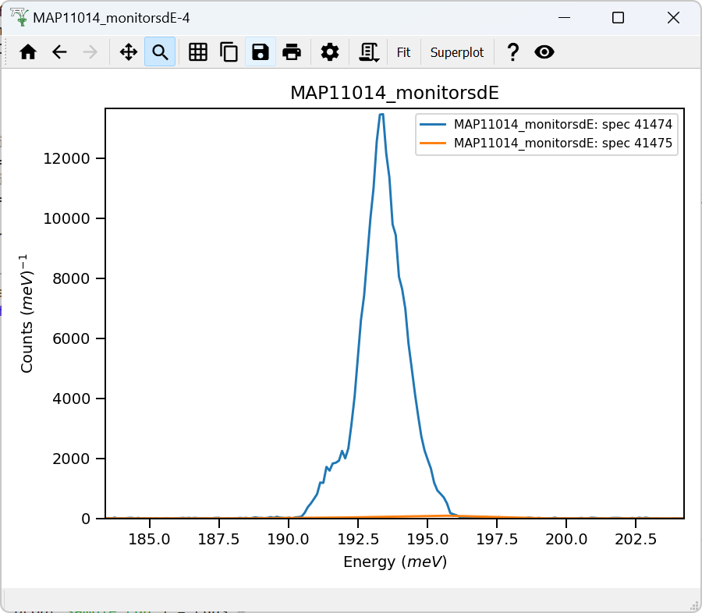
Detector’s vanadium
Monitors-1,2
dE = 800
Monitors-1,2
dE = 200
22mEv
Using -cached- value : 42.9 of absolute units correction factor (TGP)

Slide 2
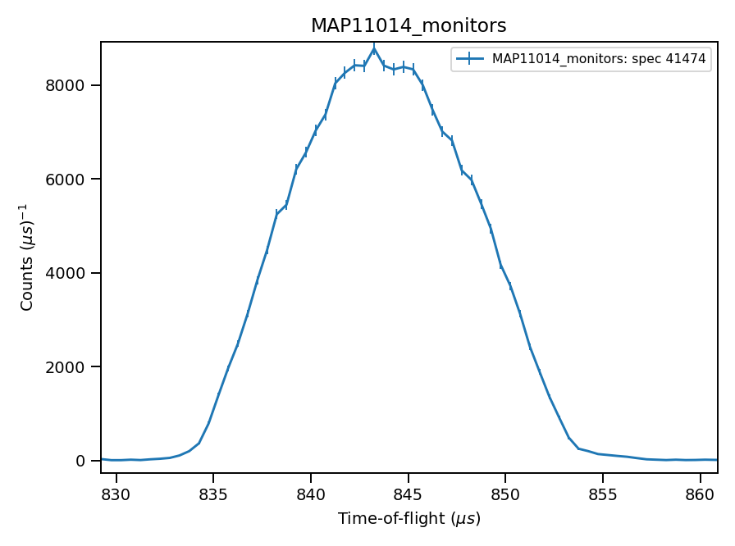
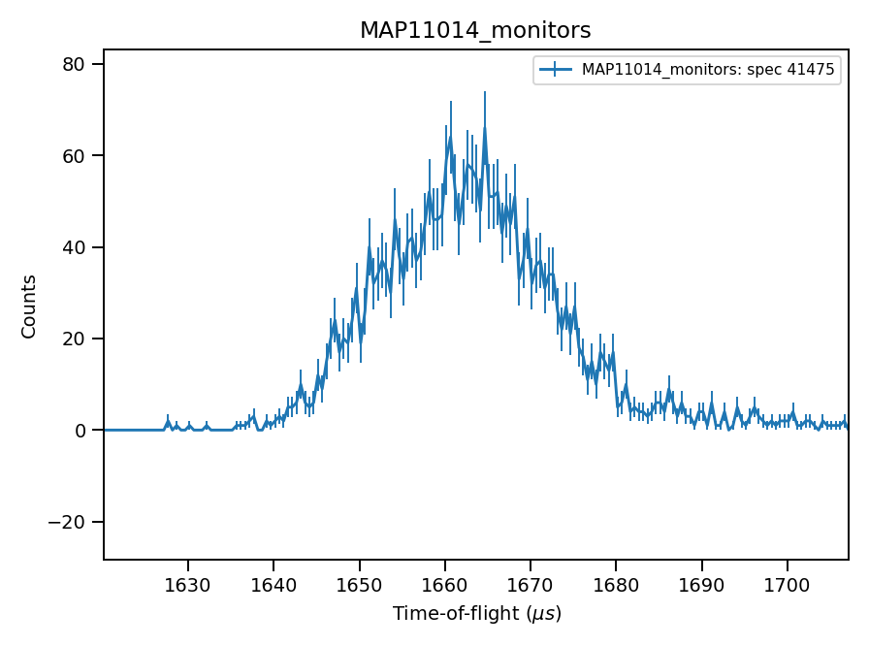

EI from TOF on monitors
843μs
844μs -- integration
1662μs
1662μs -- integration

Slide 3
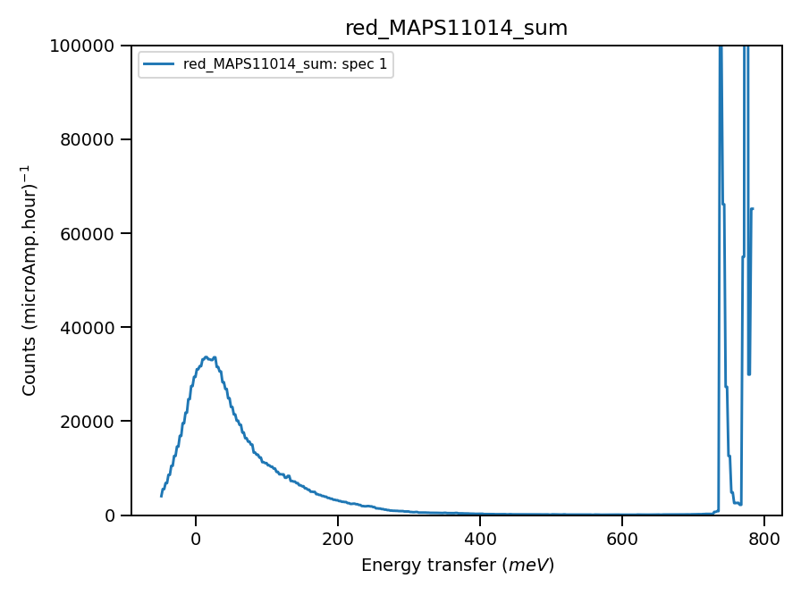
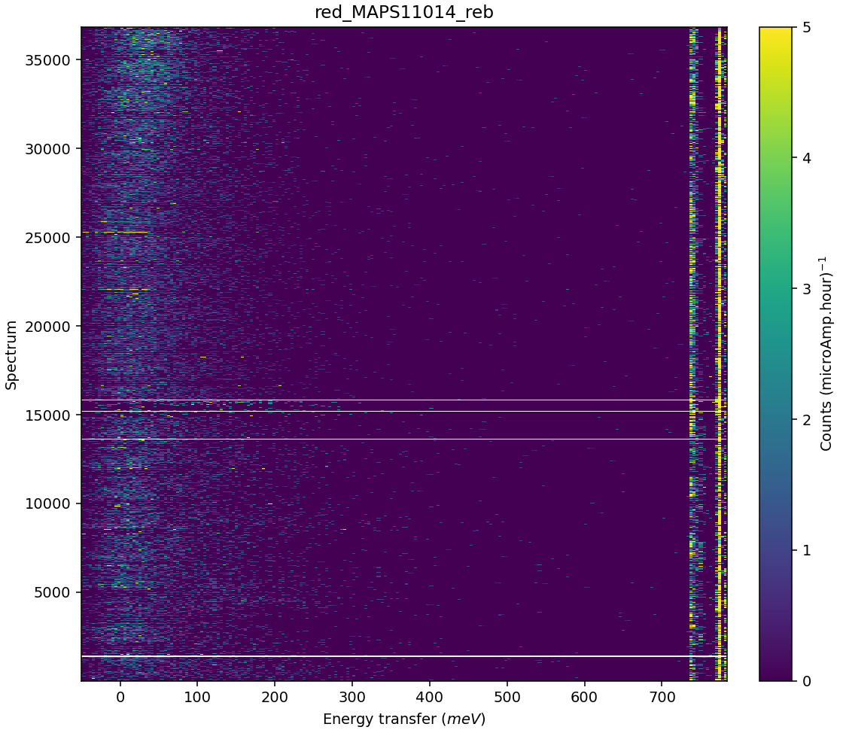
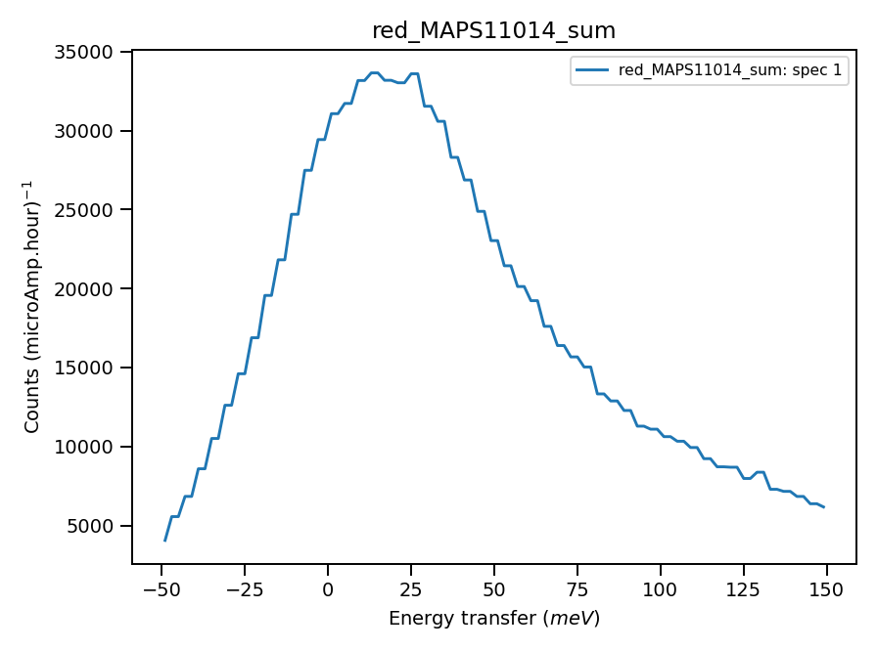
Validate correct incident energy using Vanadium run N11014
Chopper peak around 800meV..
Binning range up to 726
When Ei = 788, ΔEi =36.7

Slide 4
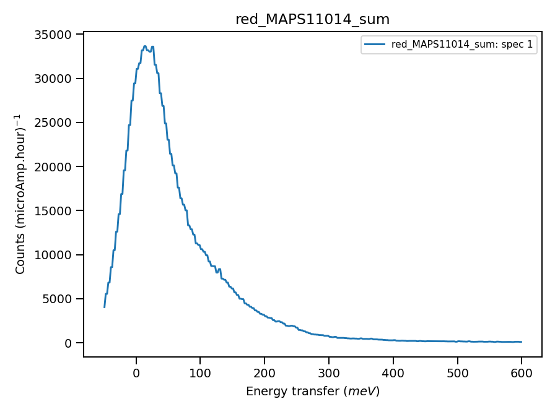
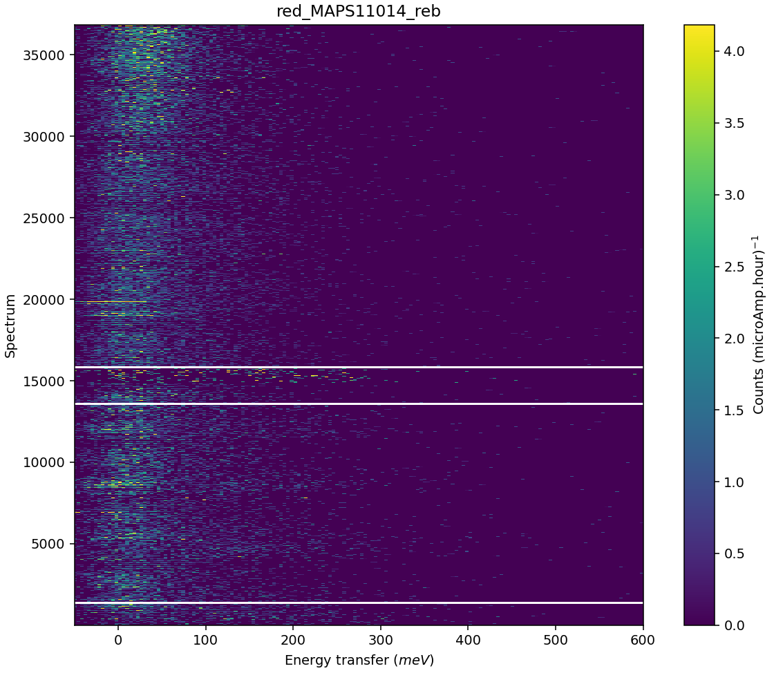
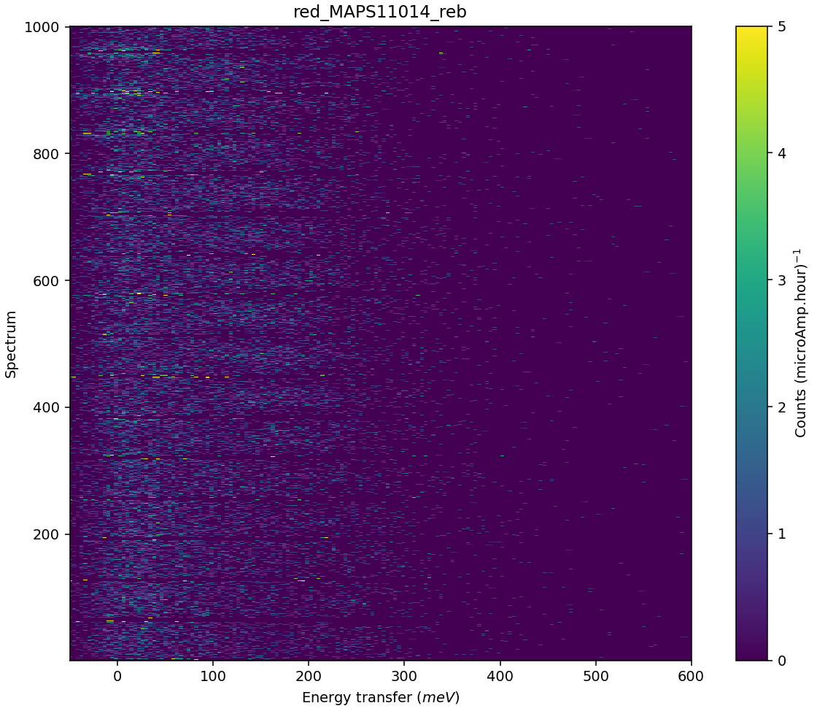
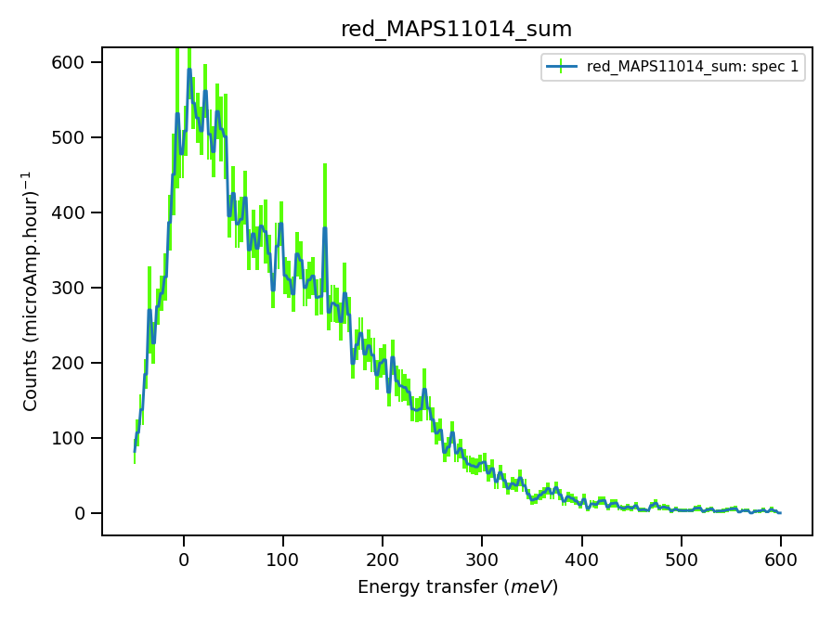
Validation for elastic line location at small angles (Ei=788meV) is inconclusive, though may be cautiously explained:

Slide 5
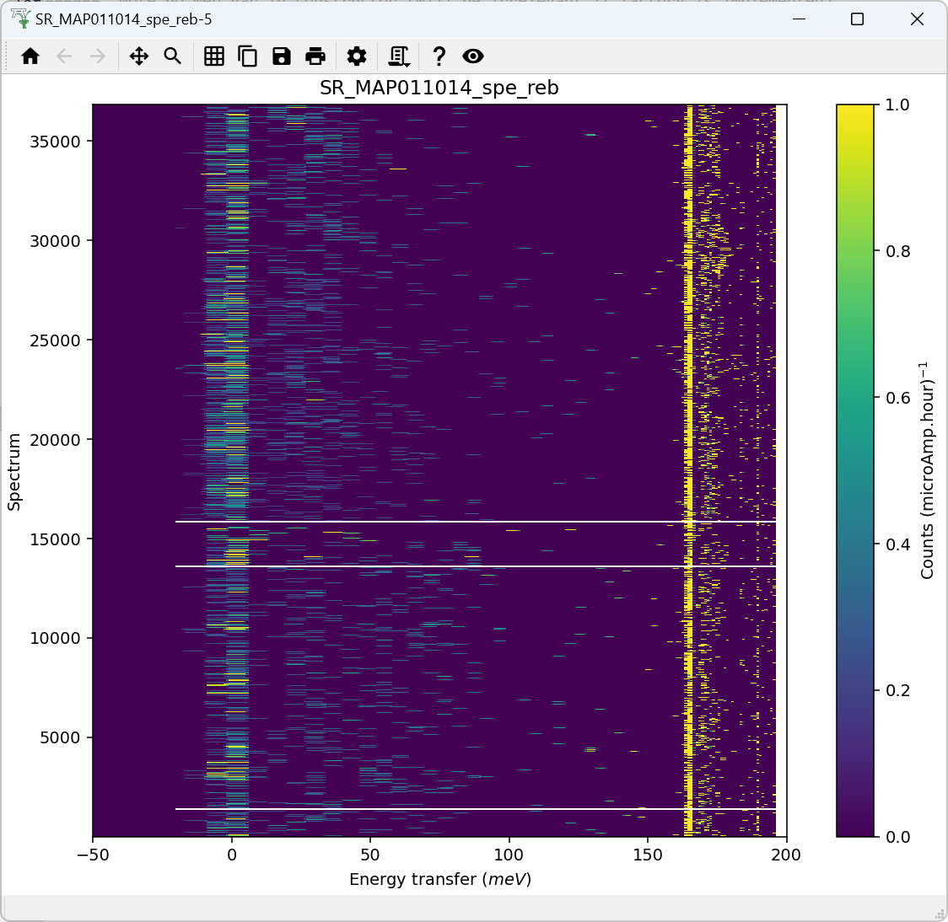
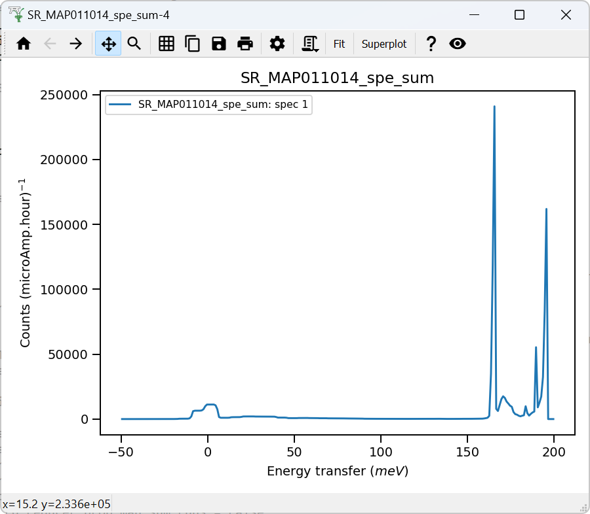
Chopper peak around 195meV. Calibration (Tube delays) necessary. Histogram mode, poor energy accuracy
Binning range 158 meV
*** Using calculated value : 4.563024378055734 of absolute units correction factor (TGP)
When Ei = 195, ΔEi = -0.26

