Slide 1
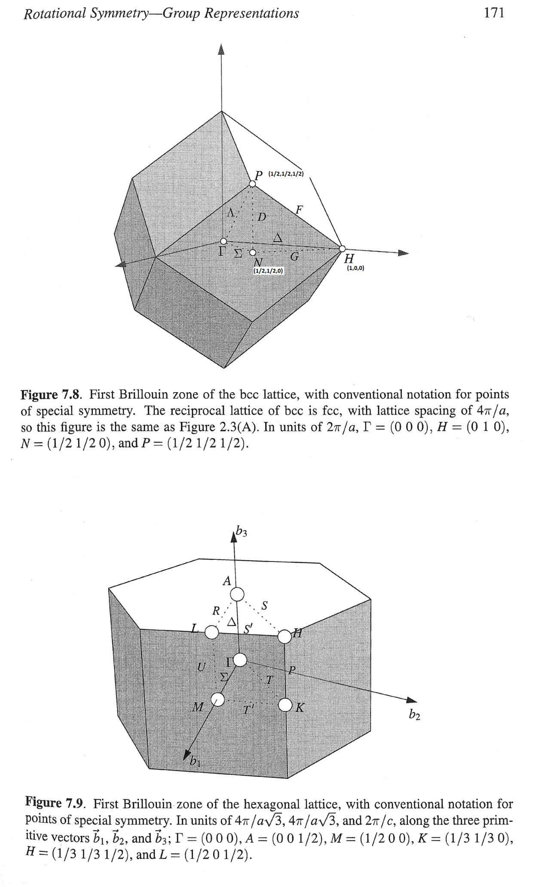
Identifying NP cut. Script at Fe\Article2020\fit_NP_Ei800_allCuts2.m
Locations of the cuts used in analysis:
(in the image plain and orthogonal to it)

Slide 2
Conclusion:
The cuts have exponential background region
Similar type of cuts (symmetrical wrt. the beam direction and at the same Q distance from the [0,0,0])
have similar exponential background parameters
The background parameters identified for group of similar cuts are independent on the way of obtaining them
The background parameters obtained for one group of similar cuts are not consistent with the parameters,
obtained for another group
Fitting & numerical comparison with Kun’s calculations does not work. The apparent reason for this is that
the theoretical decay, predicted by magnetic form factor is much smaller then the one, observed in experiment

Slide 3
Background1 (cut_at_edges): edges of np cut at [-0.5,2.5,-0.5]; [0.5,2.5,-0.5]

Slide 4
Partial cuts:

Slide 5
sym_cut with Background1 (cut_at_edges):
Corrected magnetic form factor
Fitting parameters: 0.468004 0.015127

Slide 6
Background2 (average_cut):

Slide 7
Partial cuts:

Slide 8
sym_cut with Background2 (average_cut):
Fitting parameters: [0.437546 0.014128]

Slide 9
Background3 (remote_cut): Overcompensation. We can not use this background.
Need ideas for high energy transfer background removal.
Fitting parameters: [0.437546 0.014128]; Overcompensation. Some homogeneous magnetic scattering at high Q

Slide 10
Summary: All backgrounds are good enough. What about high energy range?

Slide 11
Fitting with DFT model (Quantum expresso calculations)
Amplitude of the model goes to 0 (10⁻⁵ as, it seems, the intensity at the edges in experiment falls much faster then
predicted according to magnetic form factor.

