Slide 1
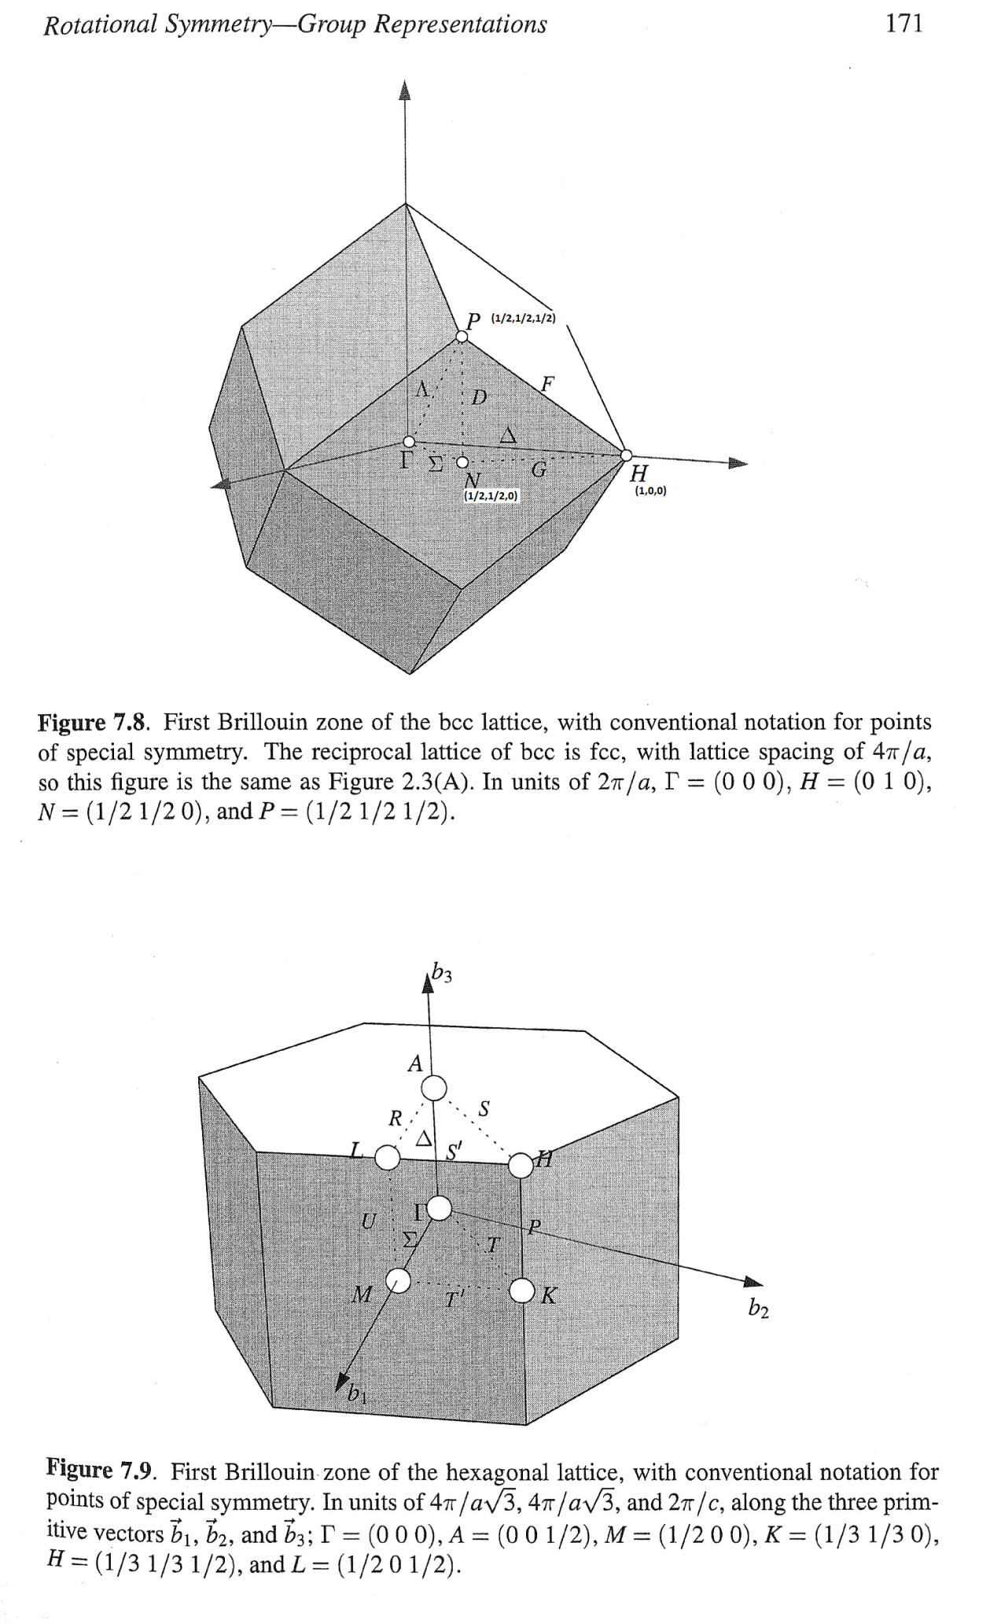
Identifying NP cut. Script at Fe\Article2020\fit_NP_Ei800_allCuts_fin.m
Locations of the cuts used in analysis:
(in the image plain and orthogonal to it)

