Slide 1
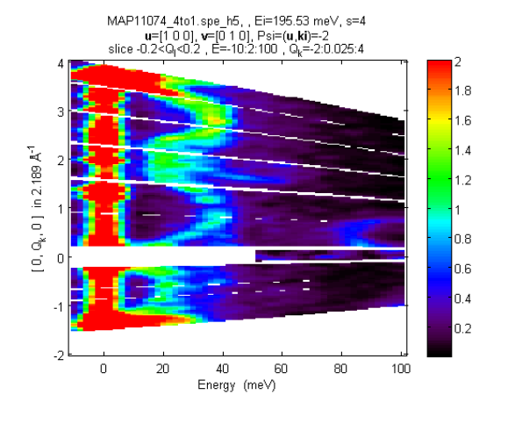
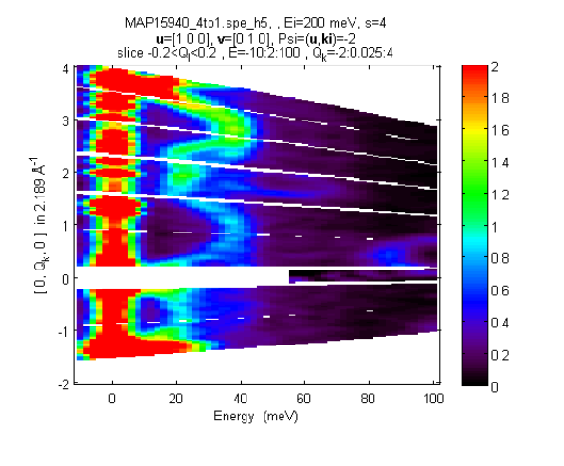
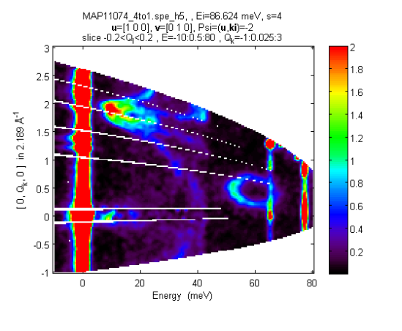
Two experiments, the same psi (-30), first – chopper
reversed, second – chopper direct
“Free” data
“intended” data
“Free” data for 86meV:

