Slide 1
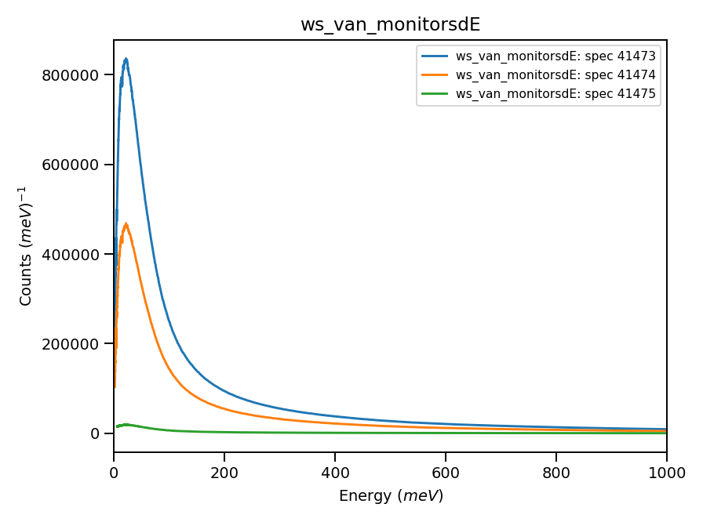
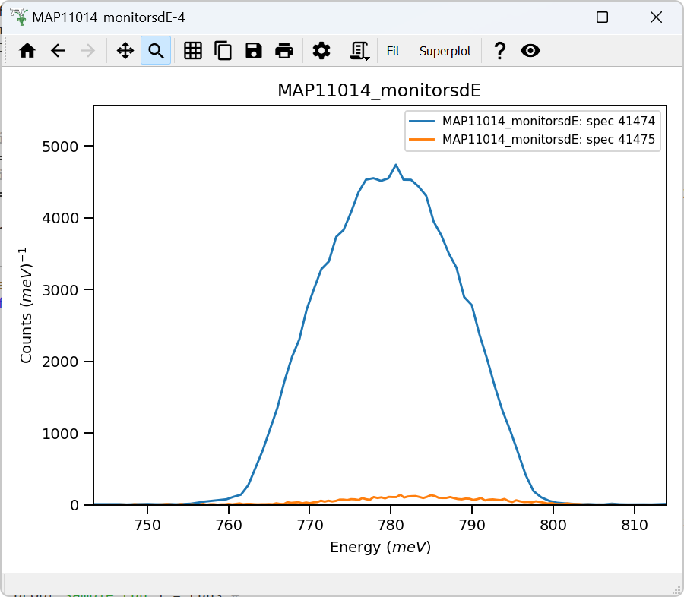
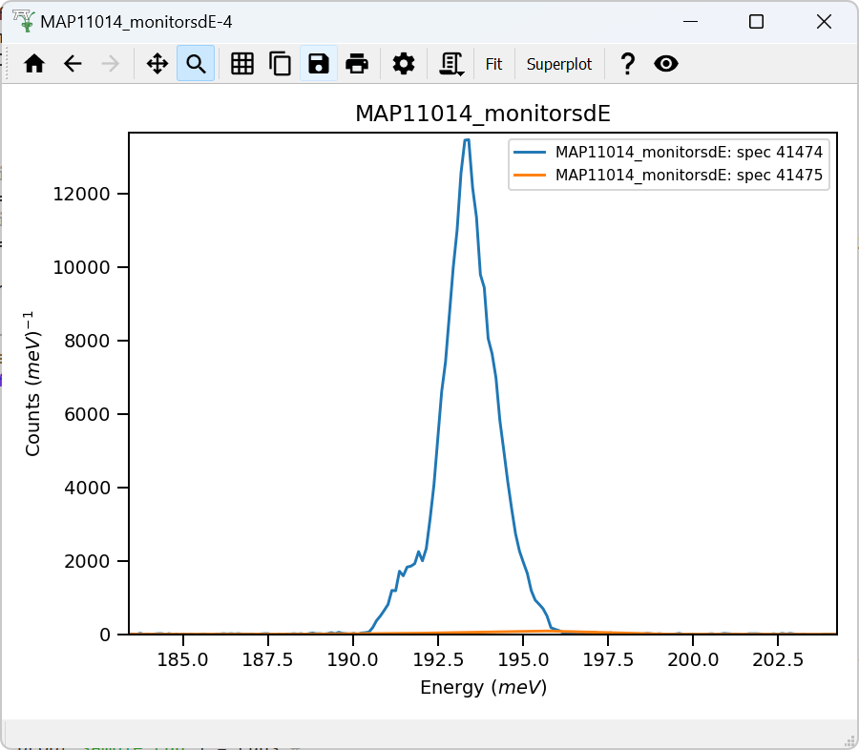
Detector’s vanadium
Monitors-1,2
dE = 800
Monitors-1,2
dE = 200
22mEv

Slide 2
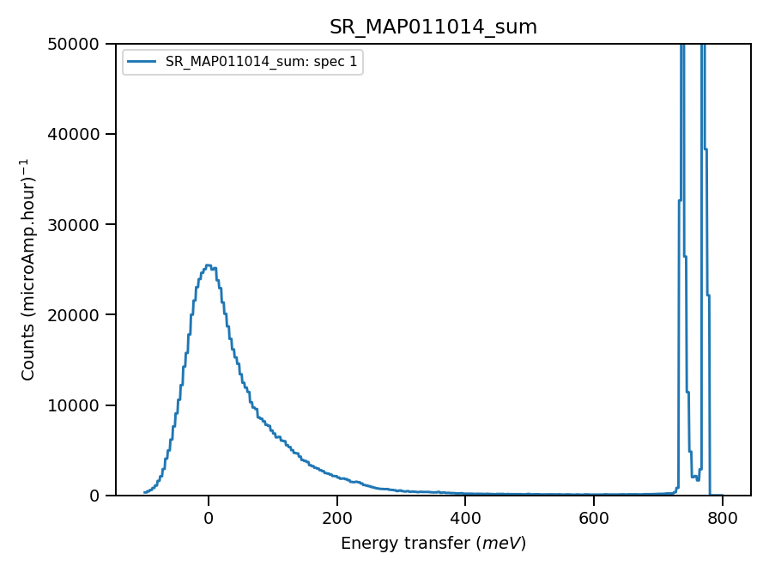
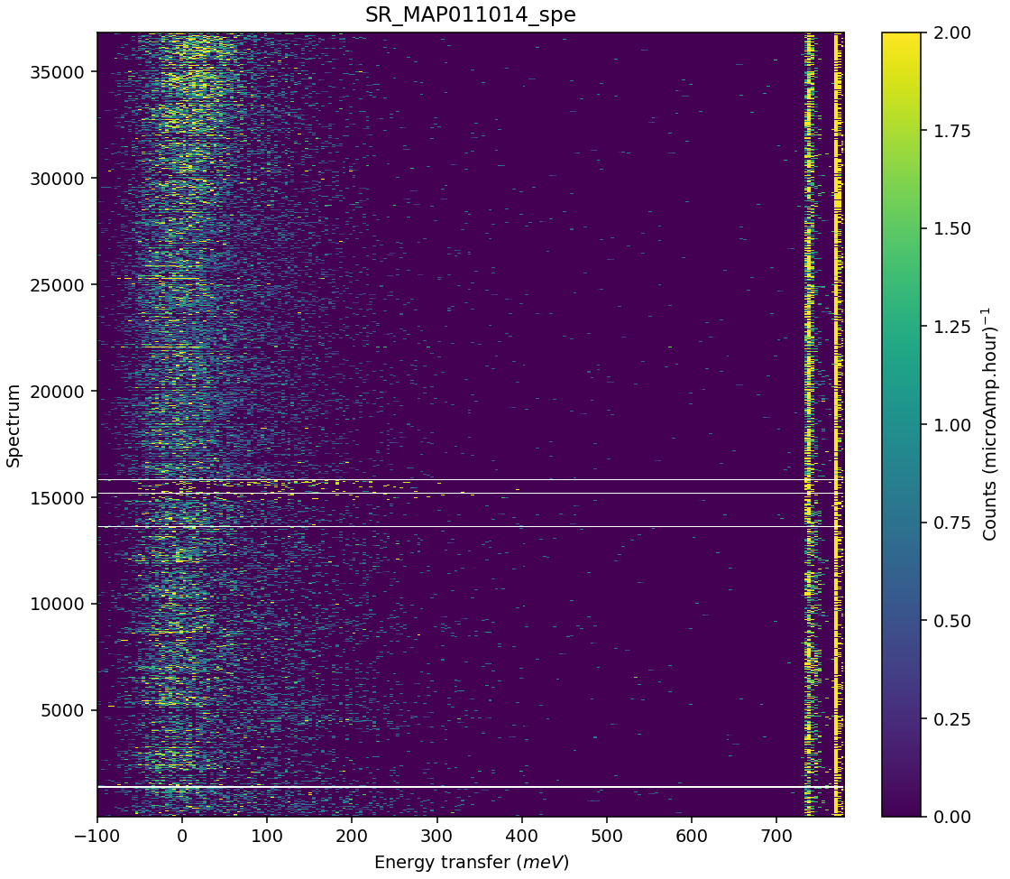
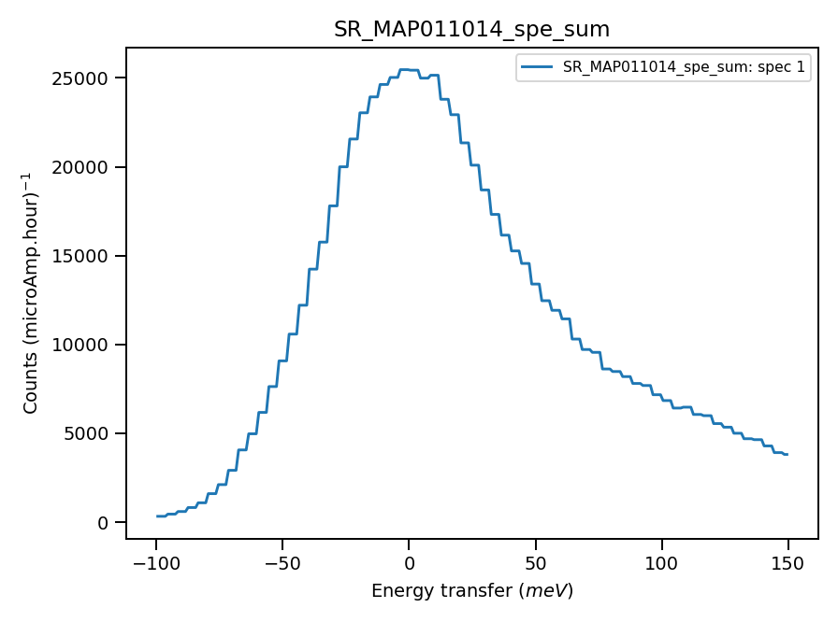
Validate correct incident energy for sample run N11014
Chopper peak around 800meV
Binning range 720meV
When Ei = 785, ΔEi = 1.16

Slide 3
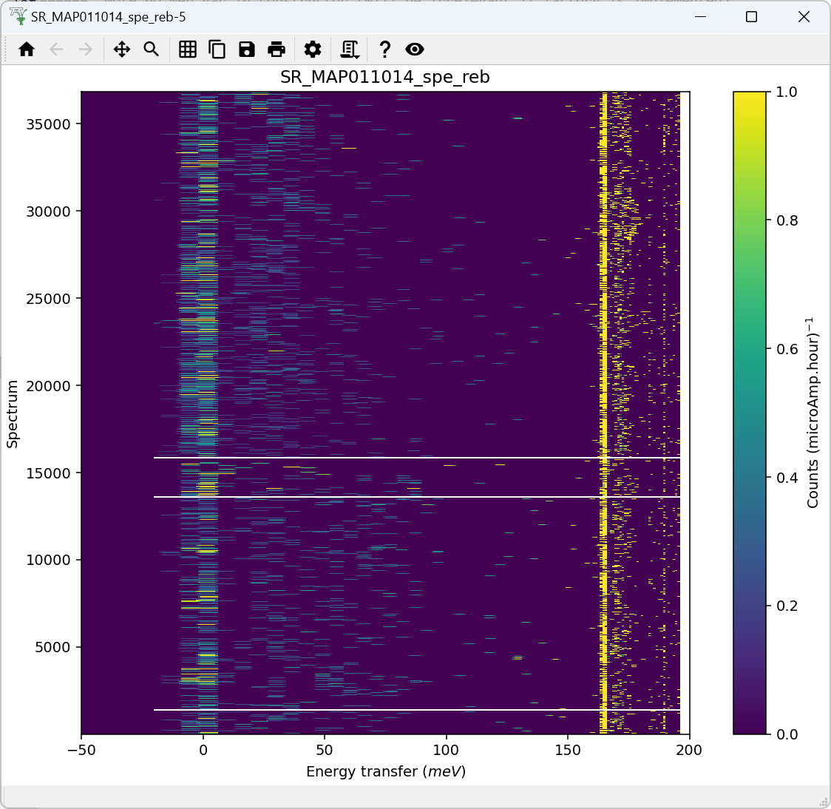
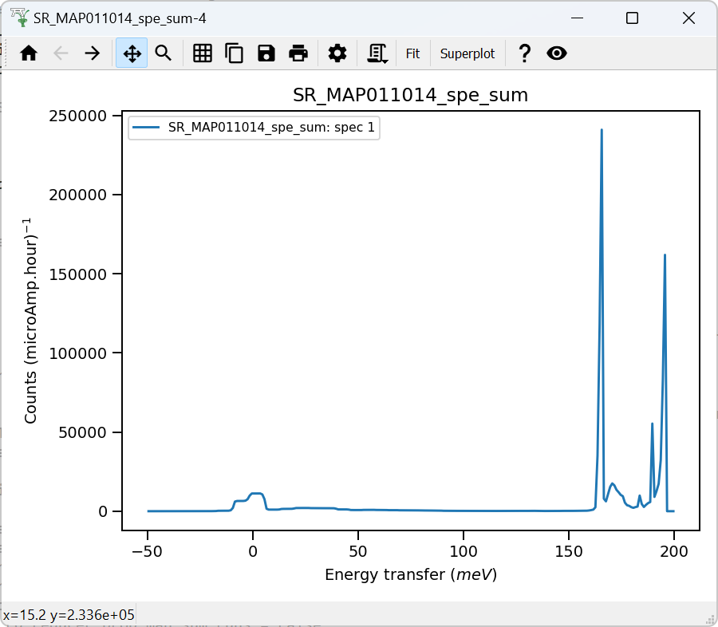
Chopper peak around 200meV. Histogram mode, poor energy accuracy
Binning range 162 meV
When Ei = 196, ΔEi = -0.13

