Slide 1
SQW object design including generic projection
Purposes:
Separate sqw object and operations over sqw object () into smaller testable parts.
Provide possibility for simple addition of other types of cuts(projections), e.g. spherical, cylindrical, symmetry; q-dE, skewed, etc.

Slide 2
SQW object operations:
GenSQW: convert from instrument to
crystal Cartesian (Pixel coordinate system)
and build appropriate image
(Crystal Cartesian?)
CutSQW convert from Pixels to oriented hkl
+ symmetry transformation
+ more transformations requested
Instrument (Runs information)
? (Mantid have this)
We have run_explorer
SQW object
Data (Image)
GenSQW
CutSQW
Pixels (Crystal Cartesian)
aProjection – generic way to describe operations necessary to convert
from one coordinate system of interest to another.
Data – 4D-Image in hkl (DnD object) and we want more types of images

Slide 3
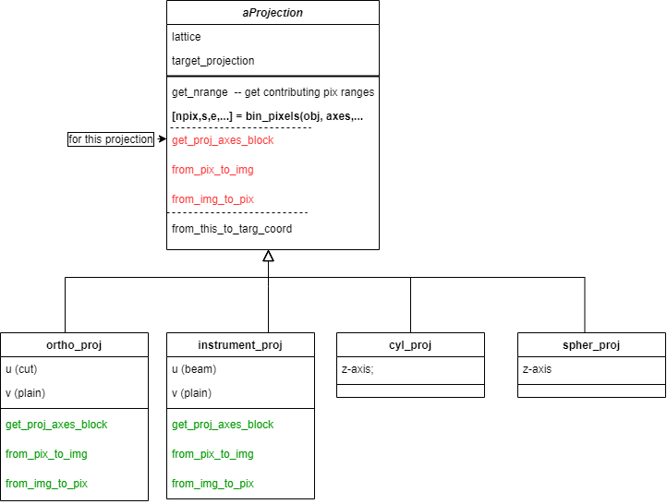
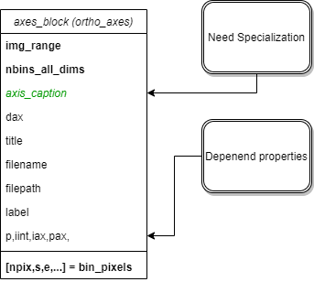
New support for operations (CutSQW, GenSQW and image description)
Abstract
Not Here yet

Slide 4
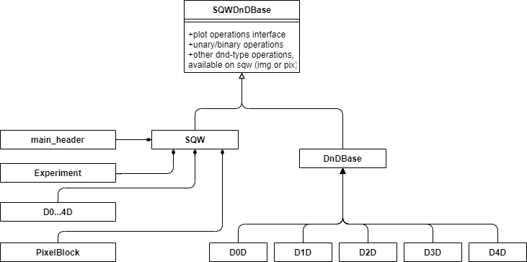
Main Horace’ objects interfaces:

Slide 5
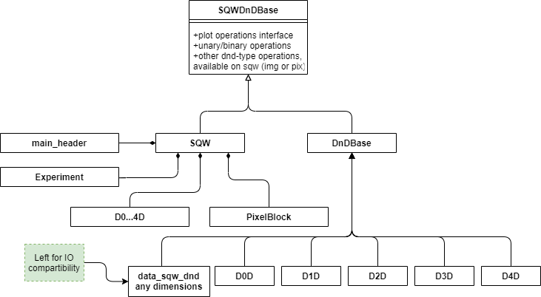
Main Horace’ objects interfaces:

Slide 6
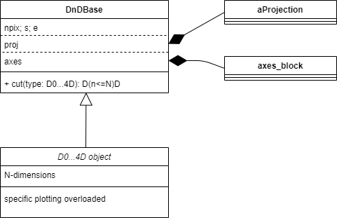
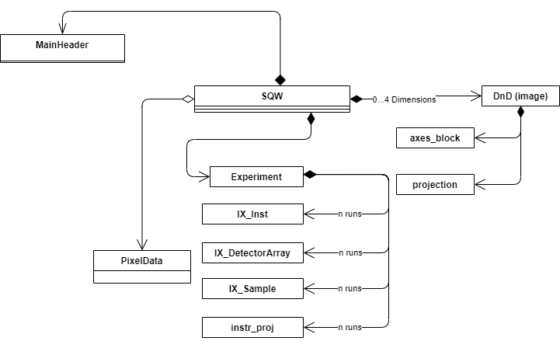
SQW and DND objects. Composition:
IX_experiment to go

Slide 7
New design main features:
DnD object is serializable and valid on assignment (a lot of time to fix existing tests)
Standard form of object constructor (properties names with their values or properties values itself located from the beginning in the order, defined in savebleProperties method)
Separation between image methods and pixel methods (mind method location e.g. mask_pixels)
EG: head:
EG: mask_pixels -> sqw only:
Prohibit file based constructors (you mast read object – file IO is always much slower)?
head (on dnd)
(head dnd)
head (on sqw)
(head dnd + pix part)
head (on file)
(file accessor + head)

Slide 8
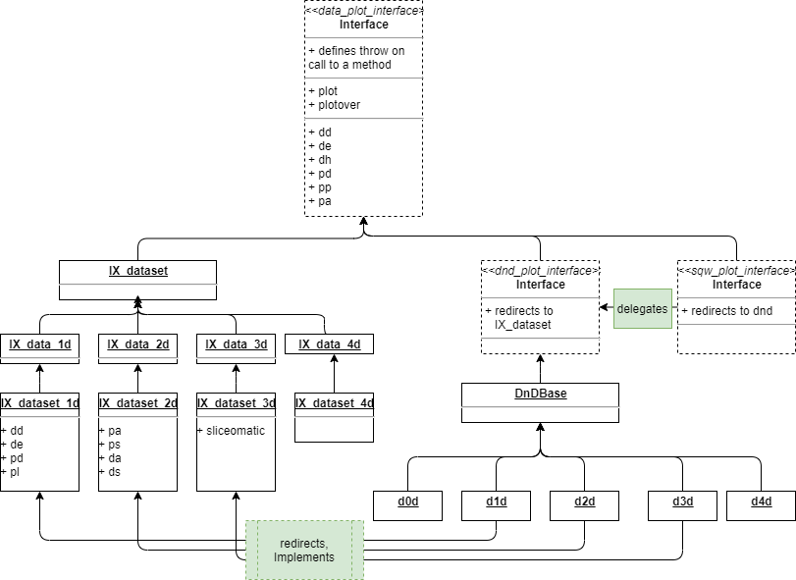
Plot interface:

Slide 9
SQW object Cut Algorithm. Principles

Slide 10
SQW object Cut Algorithm Implementation:
[targ_proj,targ_binning] = process_and_validate_cut_inputs(source_sqw,binning_inputs)
targ_ax_block = targ_proj.get_proj_axes_block(targ_binning);
%
[pix_starts, block_sizes] = source_proj.get_nrange(npix,source_axes,targ_axes,targ_proj);
ch_cube = cur_axes_block.get_axes_scales();
trans_chcube = source_proj.from_this_to_targ_coord(ch_cube)
bin_nodes = targ_axes_block.get_bin_nodes(trans_chcube) % needs halo
nodes_here = targ_proj.from_this_to_targ_coord(bin_nodes);
nbin_in_bin = cur_axes_block.bin_pixels(nodes_here)
contrib_ind = find(nbin_in_bin>0)
Find pixel indexes from cell indexes using pix in cell density
candidate_pix = source_pix.get_pix_in_ranges(pix_starts, block_sizes);
[npix,s,e,pix_ok,unique_runid] = targ_proj.bin_pixels(targ_axes,candidate_pix)
pix_in_targ_coord_system = targ_proj.from_pix_to_img(candidate_pix)
[npix,s,e,pix_oke_runid] = targ_axes_block.bin_pixels(pix_in_targ_coord_system)

Slide 11
DND object Cut Algorithm: Forthcoming
Convert to density;
Interpolate density in the centres of new grid;
convert to signal/error/npix on new grid, rebalance npix to be even;
Sum (integrate) over collapsed dimensions, if this is necessary;

Slide 12
Validation of serializable objects
PROBLEM:
Different complex constructors, difficult to comprehend and modify
Clue to solution:
Serializable objects have empty constructor and public interface,
allowing fully define the object state
Complication: Interdependent properties.
Suggested solution: separate specific and interdependent validators.
Constructors sets up all necessary public properties and then run common
validator. If common validator fails, throw.
Profit: generic constructor in the form:
obj(positional_arg1,positional_arg2…., keyN,valueN,keyN,valueN)
Positional arguments in the order they appear in the list of saveableFields; keys are the property names
Disadvantage: An incomplete object defined through its public interface may be invalid

Slide 13
0 – finish and commit generic cut framework (virtual projections) 1) Rewrite DND 3) Modify SQW to presented plan 2) Fix cut_dnd (PR in progress) Save objects as nexus as Nexus, all except pixels → release possible 4) write pixels as nexus? → release possible 5) Add other projections → release possible
We are here.

