Slide 1
SQW object design including generic projection
Purposes:
Separate sqw object and operations over sqw object () into smaller testable parts.
Provide possibility for simple addition of other types of cuts(projections), e.g. spherical, cylindrical, symmetry; q-dE, skewed, etc.

Slide 2
SQW object operations:
GenSQW: convert from instrument to
crystal Cartesian (Pixel coordinate system)
and build appropriate image
(Crystal Cartesian?)
CutSQW convert from Pixels to oriented hkl
+ symmetry transformation
+ more transformations requested
Instrument (Runs information)
? (Mantid have this)
We have run_explorer
SQW object
Data (Image)
GenSQW
CutSQW
Pixels (Crystal Cartesian)
aProjection – generic way to describe operations necessary to convert
from one coordinate system of interest to another.
Data – 4D-Image in hkl (DnD object) and we want more types of images

Slide 3
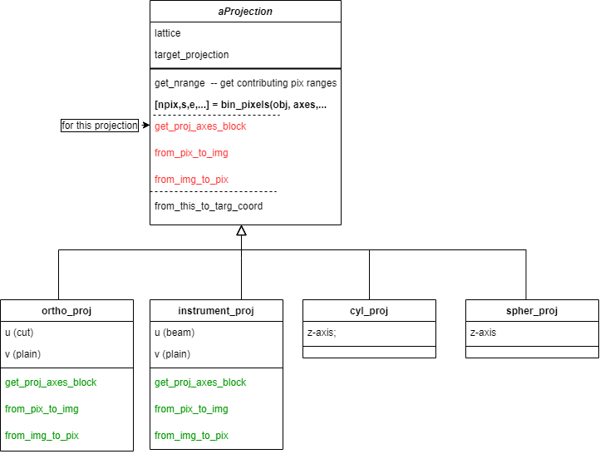
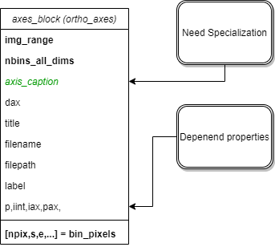
New support for operations (CutSQW, GenSQW and image description)
Abstract
Not Here yet

Slide 4
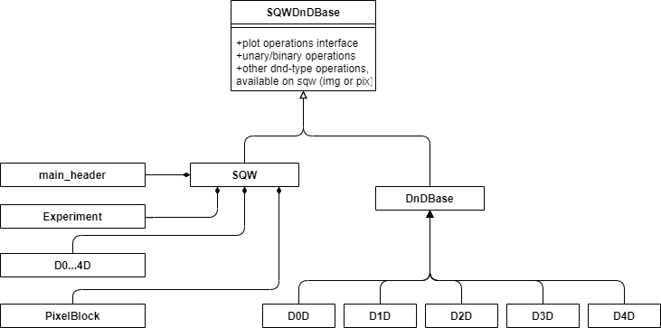
Main Horace’ objects interfaces:

Slide 5
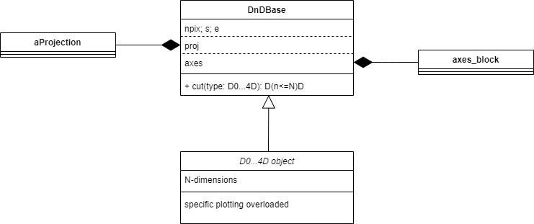
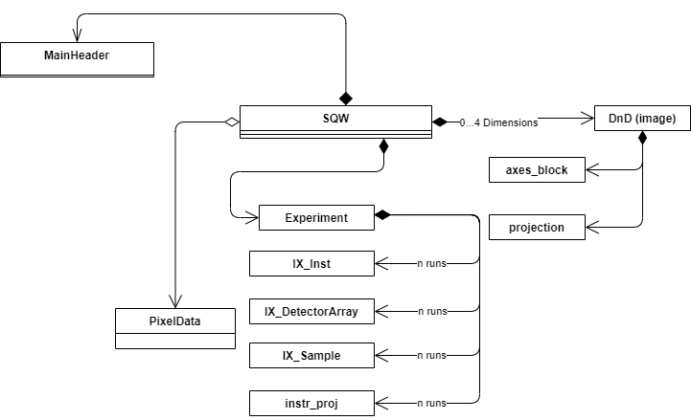
SQW and DND objects:
IX_experiment have gone

Slide 6
SQW object Cut Algorithm. Principles

Slide 7
SQW object Cut Algorithm Implementation:
[targ_proj,targ_binning] = process_and_validate_cut_inputs(source_sqw,binning_inputs)
targ_ax_block = targ_proj.get_proj_axes_block(targ_binning);
%
[pix_starts, block_sizes] = source_proj.get_nrange(npix,source_axes,targ_axes,targ_proj);
ch_cube = cur_axes_block.get_axes_scales();
trans_chcube = source_proj.from_this_to_targ_coord(ch_cube)
bin_nodes = targ_axes_block.get_bin_nodes(trans_chcube) % needs halo
nodes_here = targ_proj.from_this_to_targ_coord(bin_nodes);
nbin_in_bin = cur_axes_block.bin_pixels(nodes_here)
contrib_ind = find(nbin_in_bin>0)
Find pixel indexes from cell indexes using pix in cell density
candidate_pix = source_pix.get_pix_in_ranges(pix_starts, block_sizes);
[npix,s,e,pix_ok,unique_runid] = targ_proj.bin_pixels(targ_axes,candidate_pix)
pix_in_targ_coord_system = targ_proj.from_pix_to_img(candidate_pix)
[npix,s,e,pix_oke_runid] = targ_axes_block.bin_pixels(pix_in_targ_coord_system)

Slide 8
DND object Cut Algorithm: Forthcoming
Convert to density;
Interpolate density in the centres of new grid;
convert to signal/error/npix on new grid, rebalance npix to be even;
Sum (integrate) over collapsed dimensions, if this is necessary;

Slide 9
Validation of serializable objects
PROBLEM:
Different complex constructors, difficult to comprehend and modify
Clue to solution:
Serializable objects have empty constructor and public interface,
allowing fully define the object state
Complication: Interdependent properties.
Suggested solution: separate specific and interdependent validators.
Constructors sets up all necessary public properties and then run common
validator. If common validator fails, throw.
Profit: generic constructor in the form:
obj(positional_arg1,positional_arg2…., keyN,valueN,keyN,valueN)
Positional arguments in the order they appear in the list of saveableFields; keys are the property names
Disadvantage: An incomplete object defined through its public interface may be invalid

Slide 10
0 – finish and commit generic cut framework (virtual projections) 1) Rewrite DND and save it as Nexus 2) Fix cut_dnd 3) Modify SQW to presented plan and save it as Nexus, all except pixels → release possible 4) write pixels as nexus? → release possible 5) Add other projections → release possible

