Slide 1
Matlab Horace redesign Completed (mainly):
The purpose of the planned redesign was:
Rebuild Horace according to modern OOP design
Increase code modularity. Separate large objects into sequence of the smaller one, interacting through well-defined interfaces.
Design these interfaces to satisfy user/developer requests namely:
Unified support for parallel operations over file based and memory based sqw and dnd objects.
Generic projection, allowing to make cuts in any (e.g. spherical or cylindrical, or q-E mixed) coordinate systems.
Split the further improvement among number of developers
4. Decrease code duplication.

Slide 2
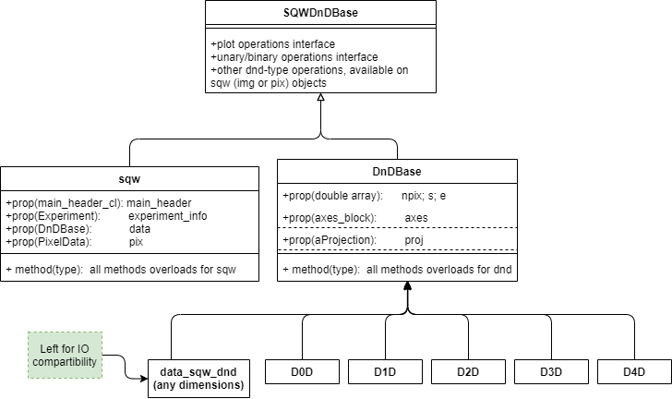
Main Horace’ objects interfaces:

Slide 3
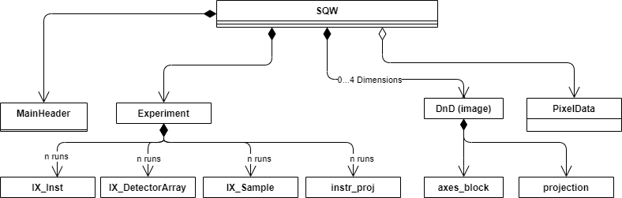
SQW object construction:

Slide 4
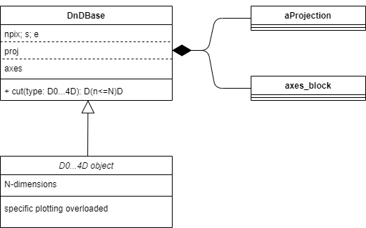
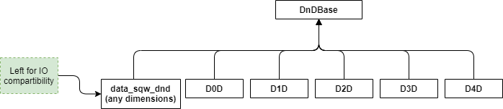
DnD object construction
axes_block:
Axes and scales for image object
proj:
Transformation between pixels and image coordinate system
Nice dnd constructor (factory):
dnd(axes_block_instance,proj,[s,e,npix])
(d0d, d1d … have similar form)

Slide 5
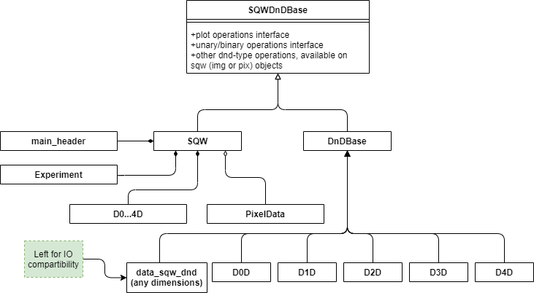
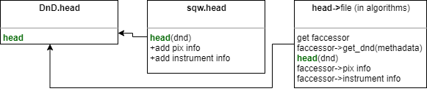
Code design: (on the example of head function)
head(abstract)

Slide 6
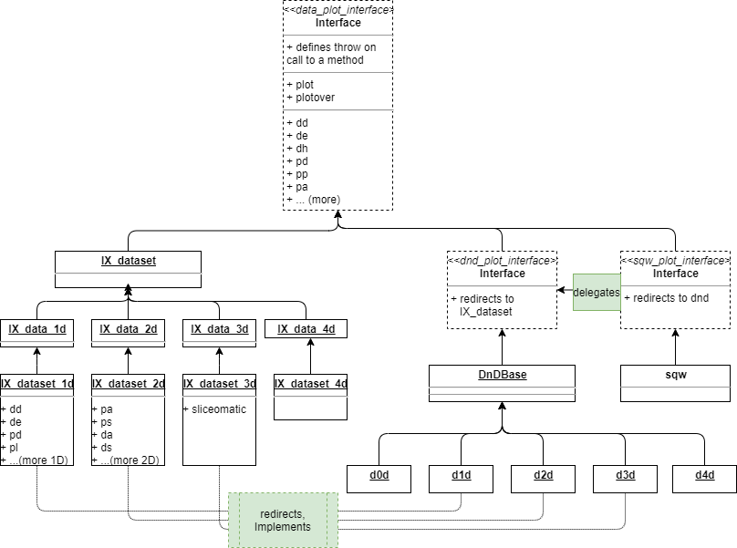
Plot interface:

Slide 7
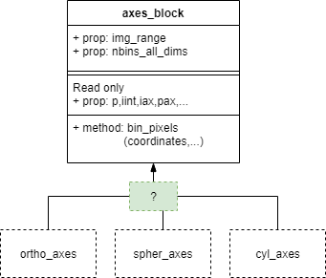
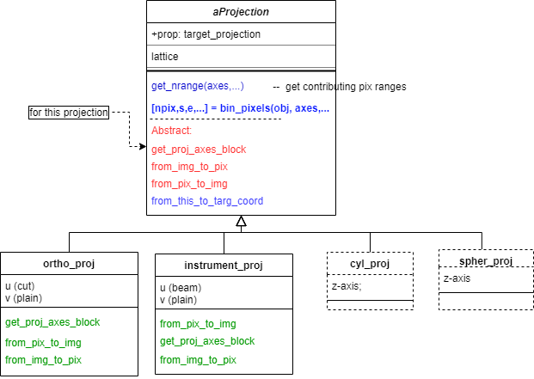
projection, axes_block and methods used in cuts
DnD object
axes_block constructor:
Binning constructor and two properties constructor
Nice dnd constructor (factory):
dnd(axes_block_instance,proj,[s,e,npix])
Generic and optimized versions

Slide 8
SQW object Cut Algorithm. Principles
targ_axess_block
targ_projection
source_axes_block
source_proj.get_nrange
source_pix._get_pix_in_range
targ_proj.bin_pixels(targ_axes…)

Slide 9
SQW object Cut Algorithm Implementation:
[targ_proj,targ_binning] = process_and_validate_cut_inputs(source_sqw,binning_inputs)
targ_ax_block = targ_proj.get_proj_axes_block(targ_binning);
%
[pix_starts, block_sizes] = source_proj.get_nrange(npix,source_axes,targ_axes,targ_proj);
ch_cube = cur_axes_block.get_axes_scales();
trans_chcube = source_proj.from_this_to_targ_coord(ch_cube)
bin_nodes = targ_axes_block.get_bin_nodes(trans_chcube) % needs halo
nodes_here = targ_proj.from_this_to_targ_coord(bin_nodes);
nbin_in_bin = cur_axes_block.bin_pixels(nodes_here)
contrib_ind = find(nbin_in_bin>0)
Find pixel indexes from cell indexes using pix in cell density
candidate_pix = source_pix.get_pix_in_ranges(pix_starts, block_sizes);
[npix,s,e,pix_ok,unique_runid] = targ_proj.bin_pixels(targ_axes,candidate_pix)
pix_in_targ_coord_system = targ_proj.from_pix_to_img(candidate_pix)
[npix,s,e,pix_oke_runid] = targ_axes_block.bin_pixels(pix_in_targ_coord_system)

Slide 10
Project progress:
0 – finish and commit generic cut framework (virtual projections) 1) Rewrite DND 3) Modify SQW to presented plan 2) Fix cut_dnd (PR in progress) Bugs
2a) Save objects as nexus as Nexus, all except pixels → release possible 4) write pixels as nexus? → release possible 5) Add other projections → release possible
We are here.

