Slide 1
Superresolution, can we achieve it in ISIS?
Digital signal processing to increase resolution and efficiency of inelastic instruments – direction, opposite to PACE approaching data analysis
Super-resolution energy spectra from neutron direct-geometry spectrometers.
Rev. Sci. Instrum. 90, 105109 (2019);
ORNL:
Fahima Islam; Jiao Y. Y. Lin; Richard Archibald; Douglas L. Abernathy; Iyad Al-Qasir; Anne A. Campbell; Matthew B. Stone; and Garrett E. Granroth

Slide 2
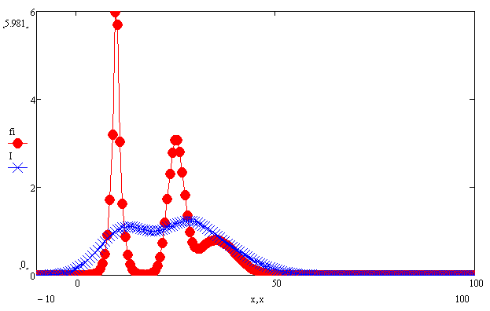
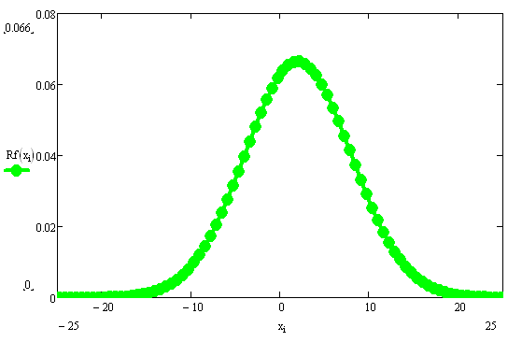
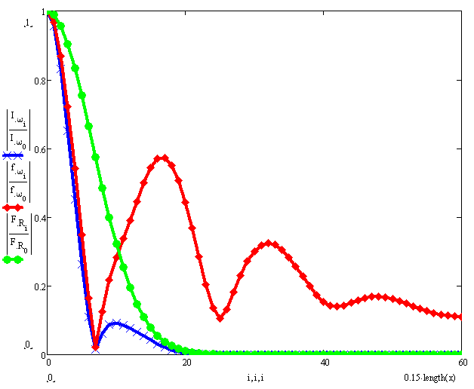
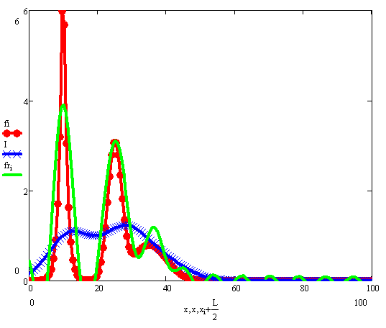
DSP: Invert resolution function equation directly:
Signal to recover S(x)
Resolution function R
Registered signal I(ε)
Spectral intensities for:
Recovered signal
Resolution function
Registered signal I(ε)
Signal to recover
Cut-off frequency

Slide 3
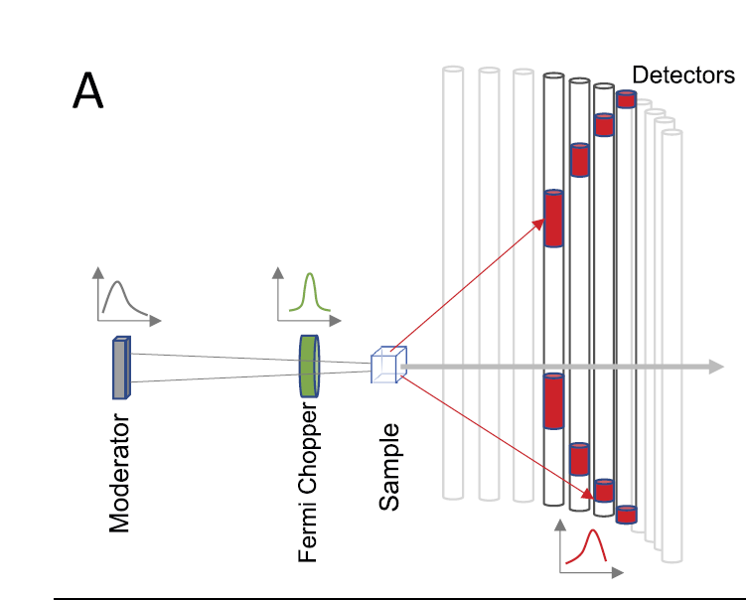
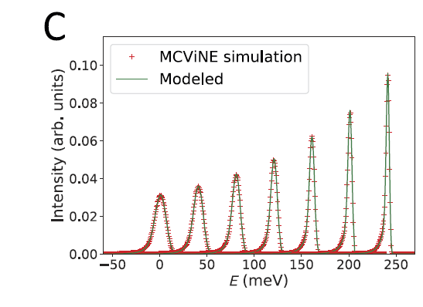
Estimate resolution using Image processing methodology
Energy-transfer-dependent resolution at Ei = 300 meV for the ARCS instrument at SNS.
Ikeda-Carpenter model

Slide 4
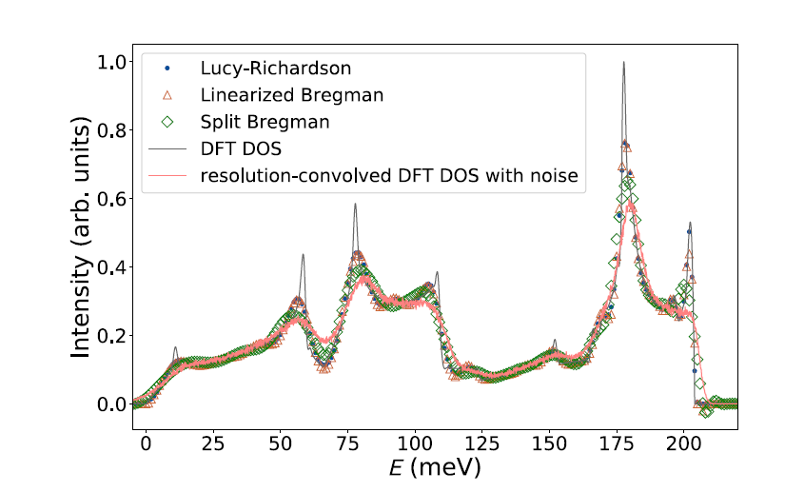
Phonon DOS reconstruction: Resolution Deconvolution of inelastic signal using regularization :
Deconvolution

Slide 5
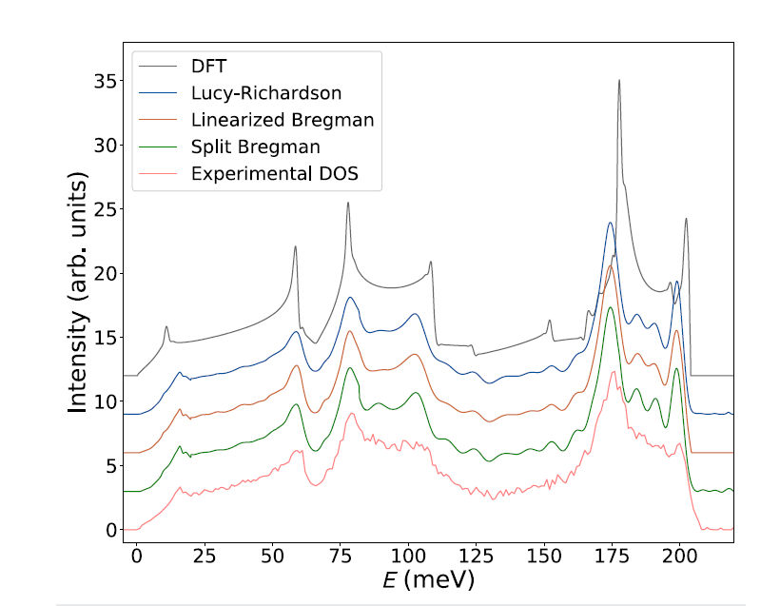
Deconvolution in real experiment:
Conclusions:
Achieved
Up to 15 times improvement in energy
resolution at selected energy transfers
Average 5-fold improvement of the
resolution
Extension into 3D problem is possible.
Necessary:
Measurement sampling frequency higher than that
of the nominal resolution;
The point spread function having a sharp feature.
3) sub-bin shifts for multiple measurements of the same
Data?

Slide 6
Missing problems/conclusions:
Influence of signal to noise ratio on the resolution.
Spectral intensities for:
Recovered signal
Cut-off frequency
Optimal shape of the point spread function.
Better usage of the existing moderator signal.

Slide 7
Alternative approach:

Slide 8
Solution of the overdefined propagation equation with noise
using Fourier transformation:
Model Signal+noise on Detector
Recovered distribution
Simulated MERLIN detector, 150mEv:
Regulatisation &Noise filtration need further
Development
(Appropriate mathematical apparatus
Is, seems, ready)
Time
Velocity transfer

Slide 9
CONCLUSION:
Achieving superresolution is possible
Resolution deconvolution will be mainstream calculations in a future
The The question of resources to

