Slide 1
Growth and Evolution of Open-Tamil
Syed Abuthahir M, T. Arulalan, Sathia Narayanan, Surendhar Ravichandran,
A. Arunram, T. Shrinivasan and Muthiah Annamalai
ezhillang@gmail.com

Slide 2
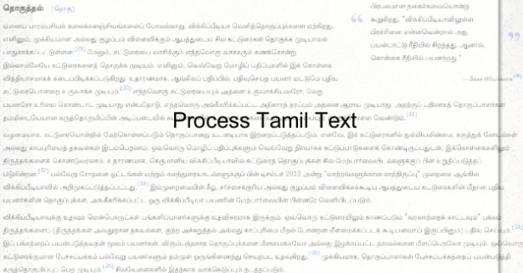
Process Tamil Text

Slide 3
Installing
Python Package - https://pypi.org/project/Open-Tamil/
Git-Hub Collaboration - https://github.com/Ezhil-Language-Foundation/open-tamil
Install Using Command – sudo pip install open-tamil==0.7

Slide 4
Introduction
Help create high-level applications in tamil
Fully open-source
Many contributations from 12 developers
Library for tamil text processing
Encoding Conversions

Slide 5
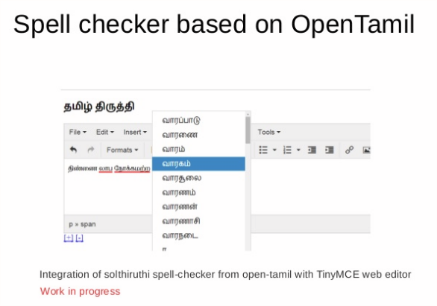
Spell Checker For Tamil

Slide 6
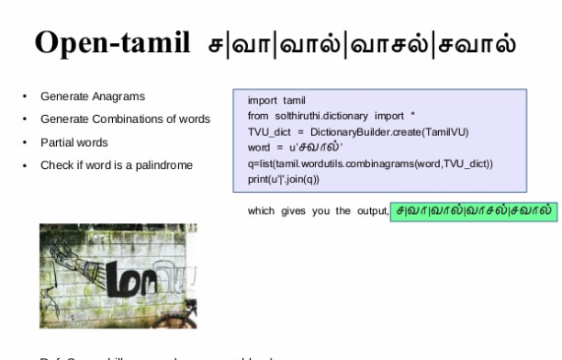
Anagram

Slide 7
What's New?
Our new contributors enabled Sandhi checker
And new Web interface based on Django for open-tamil hosted at http://tamilpesu.us

Slide 8
Tamilpesu.us
Published some of important functions within open-tamil on web-interface views
The web-interface also allow a simple json API as well for the following actions
Word search application - சொல் தேடல்
Tamil numeral generator - தமிழ் எண்கள்
Tamil sandhi checker - தமிழ் சந்திப்பிழை திருத்தி
Transliterator for Tamil - ஒலிபெயர்ப்பி
Tamil word spelling checker - தமிழ் எழுத்துப் பிழை திருத்தி
Unicode encoding converter -ஒறுங்குறி (யுனிகோட்) மாற்றி
Tamil anagram checker -தமிழ் அனாகிராம். etc..

Slide 9
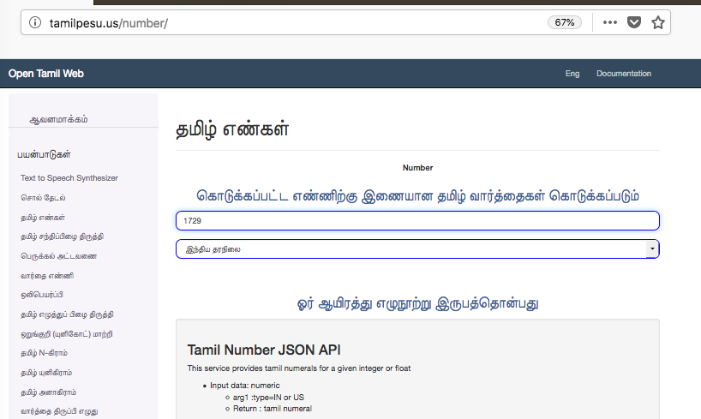
Web interface For tamil numeral generator

Slide 10
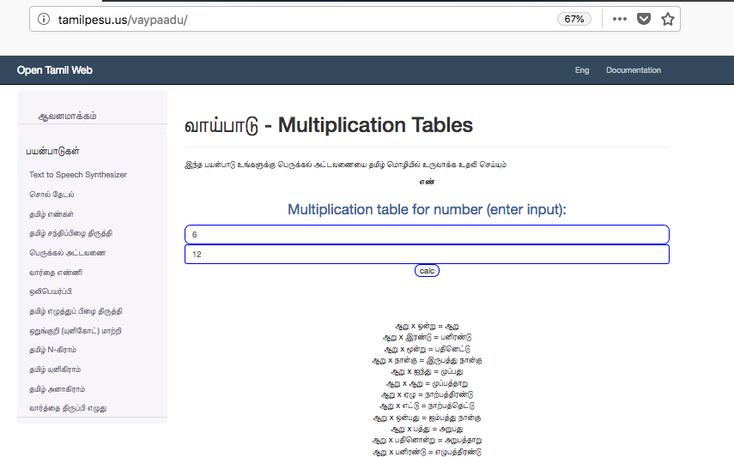
Multiplication Table Generator

Slide 11
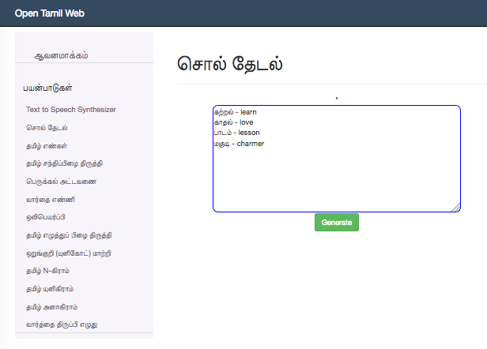
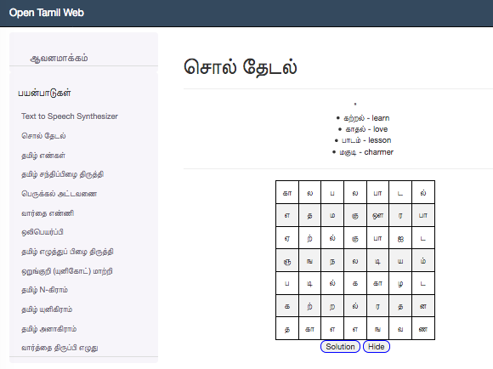
Word Search

Slide 12
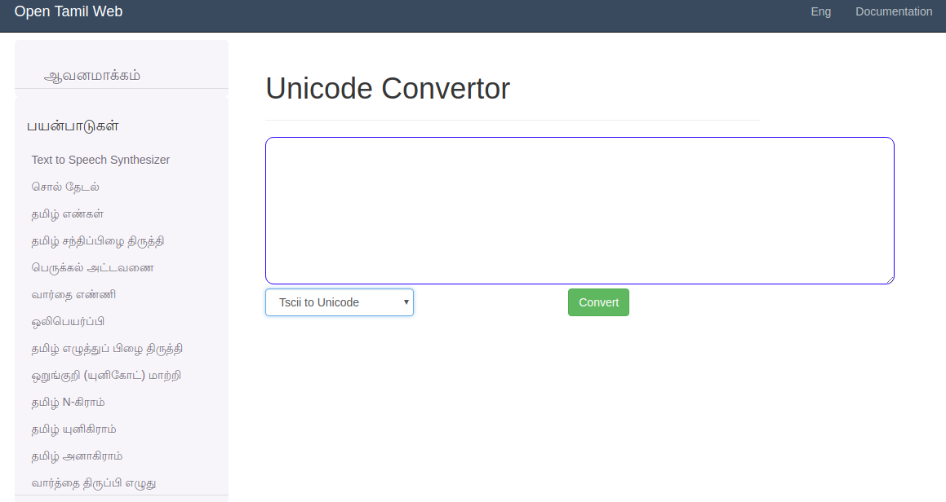
Online Encoding convertor

Slide 13
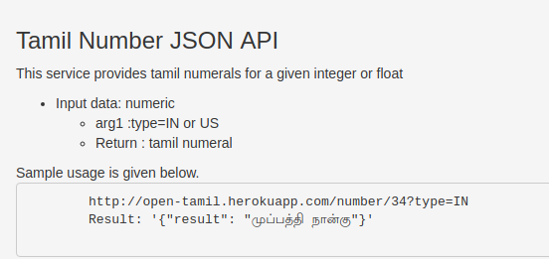
Json Api service

Slide 14
Commad Line Utilities
Few user commands are provided in latest release of Open-Tamil project for using library functions as command line tools
1. tamilphonetic
2. tamilwordfilter
3. tamilurlfilter
4. tamiltscii2utf8
5. tamilwordgrid
6. tamilwordcount

Slide 15
Quality
Open-Tamil project is developed on Github
Approximately 22k LOC on this revision.2018 [Git HEAD=ca6a8e19... ] version = 0.70 of open-tamil
We have resolved several bugs and have 84 closed tickets and 57 open tickets at this time.

Slide 16
Machine Learning Applications
We expect open-tamil project to grow in additional relevance with surge in Machine Learning (ML) applications and requirement for generating features from large data sets [to train the ML models]
In this paper we show classification of Tamil words between words that are natively Tamil or just a direct English transliterations into Tamil, using the features generated based on open-tamil library. We found a 95% accuracy and 95% recall in testing dataset for models using open-tamil and SciKit learn on Python environment

Slide 17
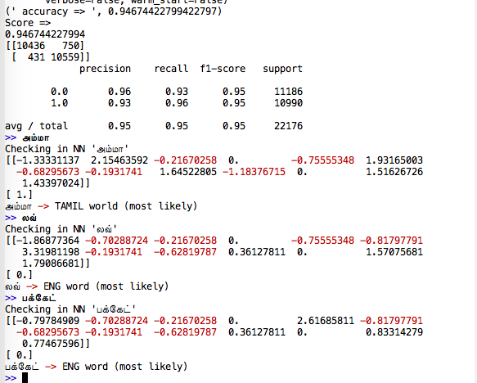
Classifier output and feature vector

Slide 18
Demo

Slide 19
