Slide 1
ECO346 Assignment 1 — Variant 5: KP urban
Registration number
FA24-BEDS-105
Variant
5 = Khyber Pakhtunkhwa, urban (prov_code 1, urban_rural 2)
Data
PSLM 2019-20 person and household files; Population estimates weighted by hhweight
Deliverables
Two figures in R, a makeover, and the band table reproduced in Python

Slide 2
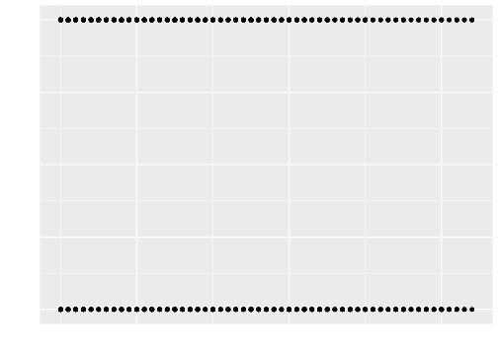
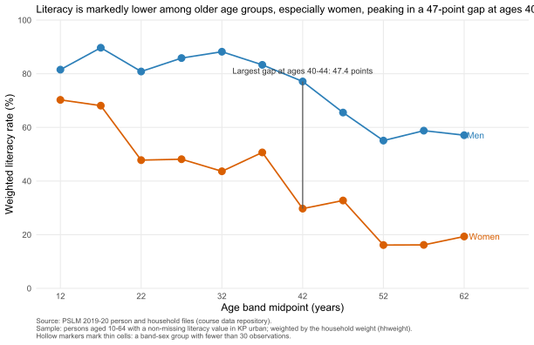
The makeover: default (left) vs redesign (right)
Default: raw literate-vs-age points, heavily overplotted. Redesign: weighted literacy by age band, two series, direct end labels, no legend, thin cells hollow, widest gap directly annotated.

Slide 3
Key finding: large gender gap in literacy across older cohorts
Women: 68.1% at ages 15-19 vs 16.2% at ages 55-59
Men: 89.7% at ages 15-19 vs 58.8% at ages 55-59
Largest gap at ages 40-44: 47.4 percentage points
Men 77.1% vs women 29.7%
Interpretation
Cross-sectional data show generational inequalities; cannot establish causes or aging effects

Slide 4
Education spending: skewed even in logs
Weighted median Rs 9,500; weighted 90th percentile Rs 39,000
Ratio of 90th to 10th percentile: 12.38
Weighting shifts median from Rs 10,100 (sample) to Rs 9,500 (population)
Lower-spending students have higher average survey weights (268.7 vs 228.4)
Sample
1,060 students analysed of 1,061 (1 excluded outside Rs 100-Rs 1,000,000)

