Slide 1
Foundation of Formal Methods
COMP-387
Instructor: Ms. Quratulain Bajwa

Slide 2
Agenda
Binary Logic Operations
Finite State Machine & It's Types

Slide 3
Basic Binary Logic Operations
These operations work on binary values (0 and 1).
Main operations:
AND
OR
NOT
NAND
NOR
XOR
XNOR

Slide 4
AND Operation
Output is 1 only when all inputs are 1.
Expression: A · B
A | B | A AND B
0 | 0 | 0
0 | 1 | 0
1 | 0 | 0
1 | 1 | 1

Slide 5
OR Operation
Output is 1 if at least one input is 1.
Expression: A + B
A | B | A OR B
0 | 0 | 0
0 | 1 | 1
1 | 0 | 1
1 | 1 | 1

Slide 6
NOT Operation
Reverses the input.
Expression: A'
A | NOT A
0 | 1
1 | 0

Slide 7
NAND Operation
NAND = NOT(AND)
Output is 0 only when both inputs are 1.
Expression: (A · B)'
A | B | NAND
0 | 0 | 1
0 | 1 | 1
1 | 0 | 1
1 | 1 | 0

Slide 8
NOR Operation
NOR = NOT(OR)
Output is 1 only when both inputs are 0.
Expression: (A + B)'
A | B | NOR
0 | 0 | 1
0 | 1 | 0
1 | 0 | 0
1 | 1 | 0

Slide 9
XOR (Exclusive OR)
Output is 1 when inputs are different.
Expression: A ⊕ B
A | B | XOR
0 | 0 | 0
0 | 1 | 1
1 | 0 | 1
1 | 1 | 0

Slide 10
XNOR Operation
XNOR = NOT(XOR)
Output is 1 when inputs are same.
Expression: (A ⊕ B)'
A | B | XNOR
0 | 0 | 1
0 | 1 | 0
1 | 0 | 0
1 | 1 | 1

Slide 11
Universal Gates
Gate | Why Important
NAND | Can build all logic circuits
NOR | Can build all logic circuits

Slide 12
Connection with FSM
FSM Implementation Steps:
State encoding (binary)
Create transition table
Derive Boolean equations
Implement using AND, OR, NOT (or NAND/NOR)
So, logic gates are used to implement:
Next state logic
Output logic

Slide 13
Summary
Basic Operations:
AND
OR
NOT
Derived Operations:
NAND
NOR
XOR
XNOR
These are the foundation of:
Digital Circuits
FSM Hardware Implementation
Sequential Systems

Slide 14
Introduction to FSM
A Finite State Machine (FSM) is a mathematical model of a system with:
Finite number of states
Defined transitions between states
Events/inputs that trigger transitions
Purpose:
Model system behavior
Represent sequences of actions
Verify correctness of designs
Applications:
Traffic lights
Elevators
Communication protocols
Software workflows

Slide 15
Types of Finite State Machines (FSM)
Finite State Machine consists of:
FSM & FA with output:
Moore Machine
Mealy Machine
FSM & FA without output:
Non-Deterministic Finite (NFA / NFSM)
Deterministic Finite (DFA / DFSM)
Epsilon NFA (ε-NFA)

Slide 16
Components of FSM
An FSM consists of 5 main components:
Formal notation: M = (Q, Σ, δ, q₀, F)
Component | Description
States (Q) | Set of all possible states
Input Alphabet (Σ) | Set of possible inputs/events
Transition Function (δ) | Rules that define how states change
Initial State (q₀) | The starting state of the system
Final/Accepting States (F) | Optional; goal or termination states

Slide 17
States
A state represents a specific condition of a system at a given time.
Key Points:
Only one state active at a time
Can be start, intermediate, or final
Example: ATM Machine States
Idle
Card Inserted
Processing
Transaction Complete

Slide 18
Events / Inputs
Events or inputs trigger transitions between states.
Examples:
Timer expires
Button pressed
Coin inserted
Data received
Representation:
Usually symbolic (A, B, Timer, etc.)

Slide 19
Transitions
A transition is the movement from one state to another based on an input.
Notation:
Current State + Input → Next State
Example (ATM):
Idle + Insert Card → Card Inserted
Card Inserted + Enter PIN → Processing

Slide 20
Initial and Final States
Initial State (q₀):
Where the FSM starts
Example: Idle for ATM
Final / Accepting States (F):
Where FSM stops or completes
Example: Transaction Complete for ATM

Slide 21
Representation of FSM
1. State Diagram
Circles → States
Arrows → Transitions
Double circle → Final state
2. Transition Table
3. Formal 5-tuple Notation
M = (Q, Σ, δ, q₀, F)
Present State | Input | Next State

Slide 22
Traffic Light FSM Problem: Model a traffic light with 3 states.
States (Q):
Red
Green
Yellow
Input (Σ):
Timer = 1
Transition Table:
Present State | Input | Next State
Red | 1 | Green
Green | 1 | Yellow
Yellow | 1 | Red

Slide 23
Deterministic FSM (DFSM / DFA)
A DFSM has exactly one next state for each input in every state.
Characteristics:
Predictable
No ambiguity
Simplest Model
Limited Memory
Used in software & hardware implementation
Formal Rule: δ(q, a) → only one next state

Slide 24
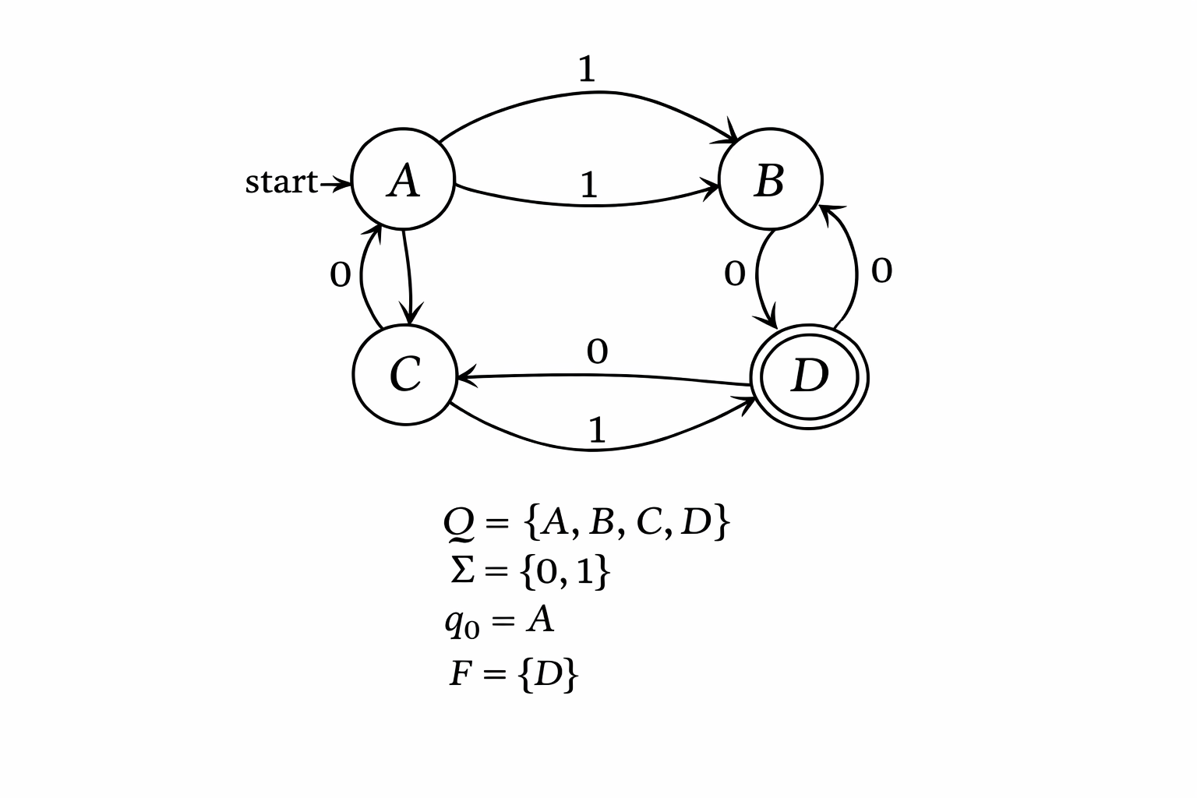
Deterministic FSM (DFA)

Slide 25
Example 1: ATM Machine Authentication System
Scenario:
ATM will only allow Cash:
Card Inserted
PIN is Correct
States
q0 → Idle (no card)
q1 → Card inserted
q2 → PIN entered
q3 → Access granted (Final state)
q4 → Blocked

Slide 26
Example 1: ATM Machine Authentication System
Alphabet (Inputs)
Σ = { insert_card, enter_correct_pin, enter_wrong_pin, cancel }
Logic
q0 → insert_card → q1
q1 → enter_correct_pin → q3
q1 → enter_wrong_pin → q4
q1 → cancel → q0

Slide 27
Example 2: Online Login System (3 Wrong Attempts → Account Locked)
Problem Scenario Design a system where:
A user tries to log in.
If the password is correct, the user logs in successfully.
If the password is wrong 3 times, the account gets locked.
States (Q)
q0 → Start state (0 wrong attempts)
q1 → 1 wrong attempt
q2 → 2 wrong attempts
q3 → Account Locked
q4 → Login Successful
So, Q={q0,q1,q2,q3,q4}

Slide 28
Example 2: Online Login System (3 Wrong Attempts → Account Locked)
Alphabet (Σ)
Σ={correct,wrong}
Start State: q0
Final States (F): F={q3,q4}
q3 = Locked
q4 = Successfully logged in

Slide 29
Example 2: Online Login System (3 Wrong Attempts → Account Locked)
Transition Function (δ)
Current State | Input = correct | Input = wrong
q0 | q4 | q1
q1 | q4 | q2
q2 | q4 | q3
q3 | q3 | q3
q4 | q4 | q4

Slide 30
Example 2: Online Login System (3 Wrong Attempts → Account Locked)
Mathematical Representation of δ
δ(q0,wrong)=q1
δ(q1,wrong)=q2
δ(q2,wrong)=q3
δ(q0,correct)=q4
δ(q1,correct)=q4
δ(q2,correct)=q4
Locked and success states remain in themselves:
δ(q3,correct)=q3
δ(q3,wrong)=q3
δ(q4,correct)=q4
δ(q4,wrong)=q4

Slide 31
Non-Deterministic FSM (NFSM / NFA)
An NFSM may have multiple next states for the same input or ε-transitions (no input).
Characteristics:
Flexible
Used in theoretical modeling
Can model multiple possibilities
Example – Simple NFSM:
State S1 with input a may go to S2 or S3
State S2 with input b goes to S3
ε-transition from S3 → S1
Every NFSM can be converted into DFSM

Slide 32
Example: System That Detects “Error” Pattern Anywhere in Input
Problem Scenario
Design a system that:
Reads a sequence of inputs (letters).
Accepts if the word "error" appears anywhere in the input.
The system can start checking for "error" at any position.
This is useful in:
Log file monitoring
Intrusion detection systems
Runtime verification (Formal Methods application)

Slide 33
Why This Is NFA?
Because:
The system does not know where the word “error” starts.
It can “guess” at any point that the pattern might start.
That guessing behavior makes it non-deterministic.

Slide 34
Example: System That Detects “Error” Pattern Anywhere in Input
States (Q)
q0 → Start state (waiting)
q1 → Saw 'e'
q2 → Saw 'er'
q3 → Saw 'err'
q4 → Saw 'erro'
q5 → Saw 'error' (Final state)
Q={q0,q1,q2,q3,q4,q5}

Slide 35
Example: System That Detects “Error” Pattern Anywhere in Input
Alphabet (Σ)
Σ={e,r,o,other}
Start State: q0 =q0
Final State: F={q5}

Slide 36
Example: System That Detects “Error” Pattern Anywhere in Input
Current State | e | r | o | other
q0 | {q0, q1} | {q0} | {q0} | {q0}
q1 | ∅ | {q2} | ∅ | ∅
q2 | ∅ | {q3} | ∅ | ∅
q3 | ∅ | ∅ | {q4} | ∅
q4 | ∅ | {q5} | ∅ | ∅
q5 | {q5} | {q5} | {q5} | {q5}

Slide 37
Why This Is NFA?
Because:
A state can have multiple next states for the same input.
Example:
δ(q0,e)={q0,q1}
DFA would not allow this.

Slide 38
How It Works
If input is: xxerrorxx
The machine:
Stays in q0 for x
When it sees 'e', it both:
stays in q0
moves to q1
Eventually one path reaches q5
So, string is accepted
NFA accepts if at least one path reaches final state.

Slide 39
Formal Methods Application
This NFA models:
Runtime monitoring
Pattern detection
Property verification
Property being verified:
“The word ‘error’ occurs in the system log.”

Slide 40
Summary of FSM Types
Type | Key Feature | Output | Use Case
FA (without output) | Accept/reject | No | Language recognition
FA (with output) | Produces output | Yes | Sequence detector
Moore | Output depends on state | Yes | Control systems
Mealy | Output depends on state + input | Yes | Real-time systems
DFA | Deterministic transitions | Optional | Implementation
NFA | Multiple transitions per input | Optional | Theoretical models
ε-NFA | NFA with ε-transitions | Optional | Regex processing

Slide 41
Thank You! quratul.ain@paf-iast.edu.pk

