Slide 1

Bayesian Modeling and Probabilistic Programming
Custom models with INFERENCE UNCERTAINTY
Notes:
Again, think of this as learning about a new tool
Skip the gory details and try to understand at a conceptual level what this is trying to do, and HOW DO WE MAKE IT WORK?

Slide 2
Layout of lecture
What is Bayesian Modeling?
Why do Bayesian Modeling?
What is probabilistic programming?
How do we do Bayesian modeling using probabilistic programming?
PyMC3
Interactive…building 3 different “models”
Jupyter notebooks
Locally or on google colab
Real-world use cases

Slide 3
What is Bayesian Modeling?
Slightly different “meaning” from models that just use Bayes Rule
Instead of finding “Best Model”, you find the “Distribution of Models”

Slide 4
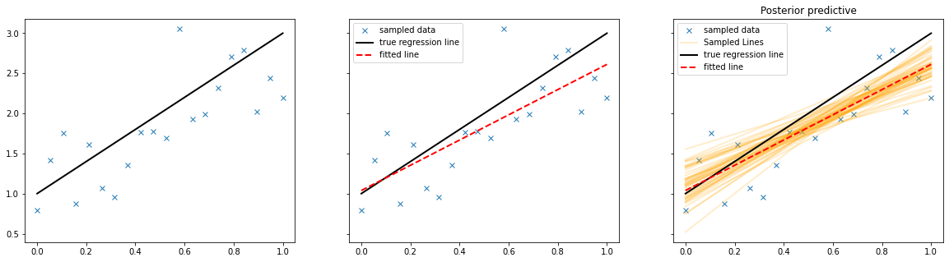
Linear Regression
Fitted line : Least Squares Regression
Sampled lines : Bayesian Regression

Slide 5
What is Bayesian Modeling?
Slightly different from models that use Bayes Rule
Instead of finding “Best Model”, you find the “Distribution of Models”
Instead of finding the “Best Parameters”, you find the “Distribution of Parameters”

Slide 6
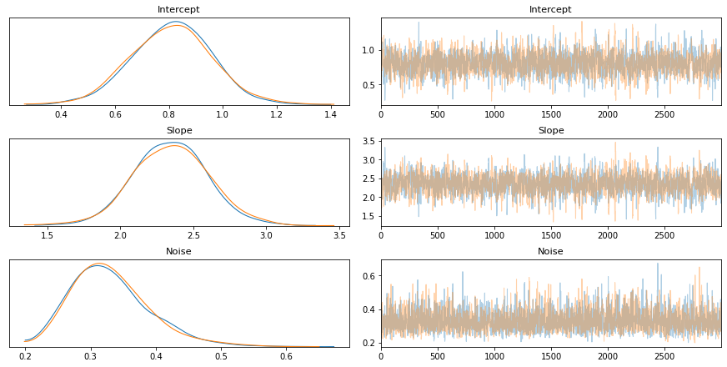
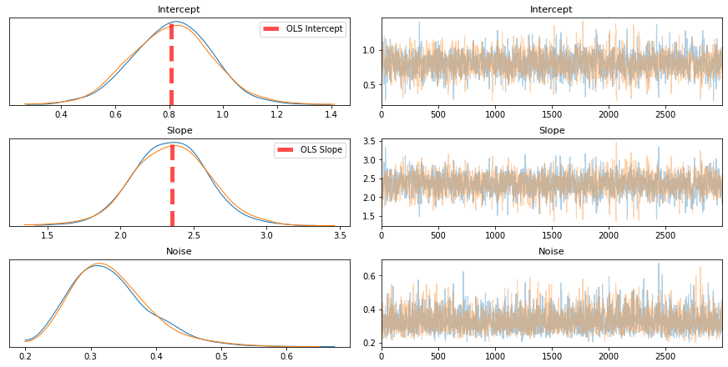
Ordinary Least Squares vs Bayesian:
Variables : Intercept, Slope …
Deviation of data from fitted line
Notes:
OLS model doesn’t explicitly model the noise
You can get an estimate of the noise after fitting the line, but it’s not included in the model

Slide 7
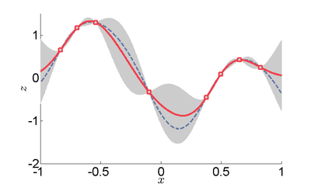
Why should I care?
1) An understanding of error in model predictions
Gaussian Process Fit
Error bounds
Spline fit

Slide 8
Why should I care?
2) Model flexibility
More related to probabilistic programming than Bayesian Modeling at large
We will apply same model structure to different kinds of data by changing the distributions we use,
but without solving any equations.
Allows us to create powerful models without any “mathematical” formulation/re-formulation

Slide 9
What is probabilistic programming?
Framework to:
Define a model in terms of statistical distributions
Perform inference/model fitting over these distributions
Can do Bayesian Modeling using math
Can do it with code using probabilistic programming
MUUUCH easier
Trade-off : Can be much slower
Because of general purpose inference algorithms
Example:
OLS used for linear models
We’ll use the same algorithm to fit all our models today
Pymc3
Notes:
Hopefully will make more sense once we start with out model building

Slide 10
How do we use probabilistic programming

Slide 11
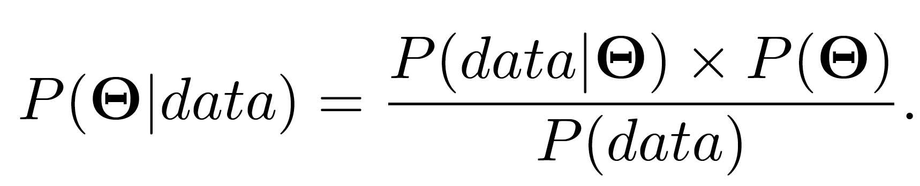
Constructing the Models
Likelihood:
Probability of data given “some” parameters
How to evaluate goodness of fit of our model.
What distribution to fit to the data?
Can’t evaluate data with the wrong distribution
Prior:
Our “institutional knowledge” (or lack of) regarding the data.
Model specification : What variables are you interested in?
Posterior:
Probability of PARAMETERS GIVEN THE DATA.
Output from inference.
Evidence for the data:
Probability for seeing current data
E.g. if your patient has a cold, what is the probability of a person having a cold given that 10% of all people have colds
Some normalizing constant
Notes:
Blackbox inference…don’t really care

Slide 12
What do we need to deal with for modeling
Likelihood:
What distribution to fit to the data
Prior:
What variables are you interested in
Notes:
Intersted in the parameters of the distribution…not the raw data usually

Slide 13
“Hello World!” of Probabilistic Programming
First, cover an example of a probabilistic “model”
Then cover how do we perform inference / fit the model.

Slide 14
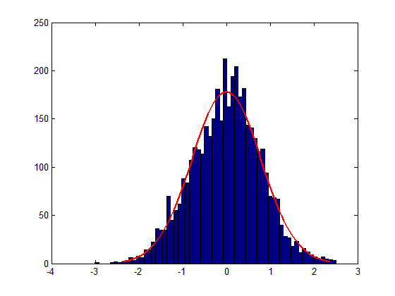
“Hello World!” of Probabilistic Programming
Fitting a Gaussian
Likelihood:
What distribution to fit to the data
Gaussian
Distribution
Parameters of a Gaussian
(Variables of interest)
Prior:
What variables are you interested in
Mean
Continuous
Any real number
Gaussian?
Standard Deviation
Continuous
Strictly Positive
Half-Gaussian?
Notes:
Have to define appropriate distributions over priors
Went backwards…started with the data and constructed the variables
Usually it is easier to the think about the other way around → Thinking about how you would generate the data
This is actually how the models are defined

Slide 15
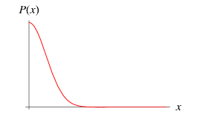
“Hello World!” of Probabilistic Programming
/ Generating Gaussian Data
Fitting a Gaussian
Mean
Standard Deviation
Gaussian
Don’t have to worry about exact values
Constrained by the data
Range of possible values NEEDS to be correct
Half-Gaussian
0
Gaussian Distribution
Notes:
First step…it can generate SOME GAUSSIAN
Improvement…start out closer to YOUR DATA

Slide 16
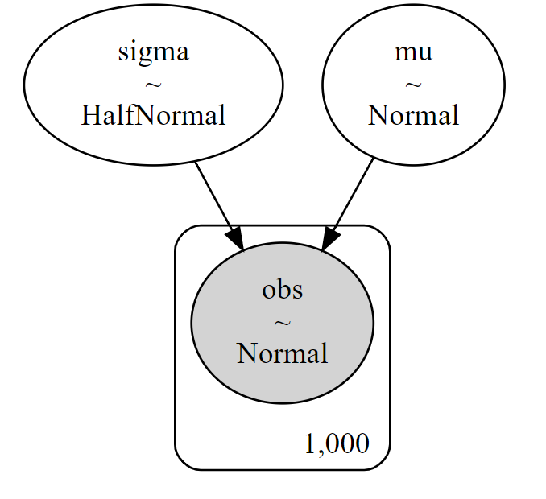
“Hello World!” of Probabilistic Programming
Fitting a Gaussian / Generating Gaussian Data

Slide 17
“Hello World!” of Probabilistic Programming
Fitting a Gaussian / Generating Gaussian Data
10 -15 min exercise

Slide 18
Inference in Probabilistic Programming
How do we “fit the distribution”?
For most “useful” models, we can’t.
The models get too complicated for exact fits.
Why this is the case is out of scope for discussion, but we can discuss informally.
Therefore, we approximate the distributions.
Types of approximations:
Sampling (Markov Chain Monte Carlo)
Approximate Fit (Variational Inference)

Slide 19
Markov Chain Monte Carlo
The Stata Blog, Introduction to Bayesian statistics, part 2: MCMC and the Metropolis–Hastings algorithm

Slide 20
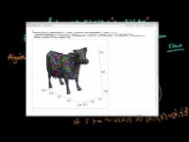
Markov Chain Monte Carlo

Slide 21
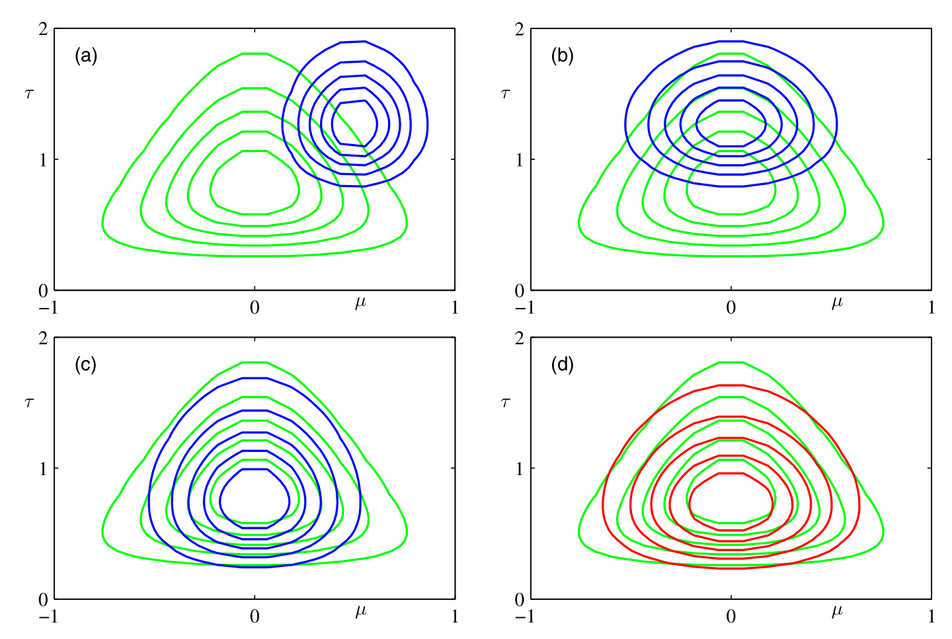
Variational Inference
Bishop 2006, Chap. 10, Approximate Inference

Slide 22
Back to models!!

Slide 23
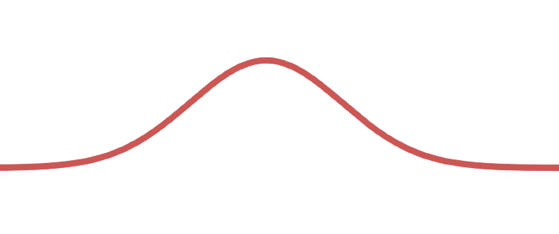
Linear Model
How would you generate this data in terms of distributions?
Equation of line:
Y = m*x + b
Known quantities
Input : x
Output : y
Unknowns : m, b → Real, Continuous numbers
Priors over “m” and “b”
What distribution for the actual data (Likelihood)
Centered on y = mx + b
Gaussian distributed with some sigma
Likelihood : Gaussian with mu = mx+b, and some variance
y
→ Gaussian
(why? → why not? Real and Continuous)
X
Notes:
If your model breaks, try a different distribution
As long as the support of your distribution, and the chain of values in and out of distributions works…things will work…even if not optimally
Once I have m and b, I can find the regression line…from there, I have to model the noisy data with a gaussian

Slide 24
Linear Model
Generate this data
Equation of line:
Y = m*x + b
Gaussian Priors on “m” and “b”
Likelihood : Gaussian with mu = mx+b, and some variance
Also need prior over variance
Actually don’t “NEED” it, but it helps our model
Strictly positive → Half Gaussian
y
X

Slide 25
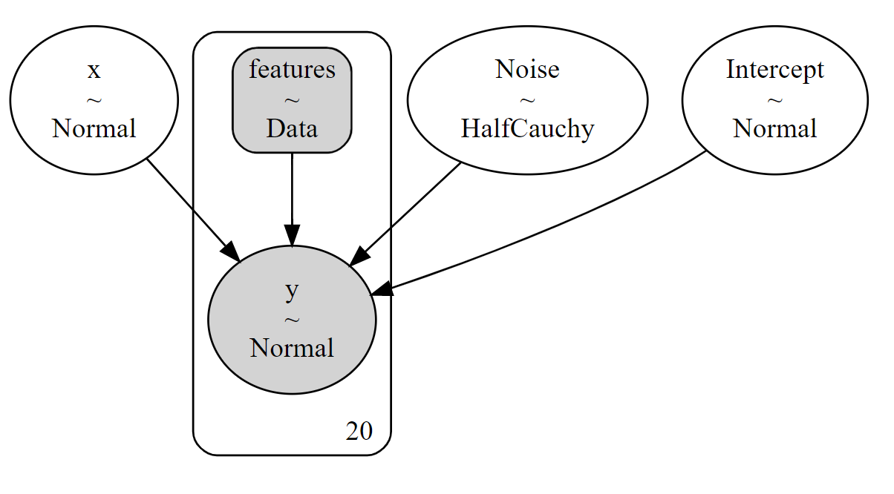
Linear Model
The known “x” values
Slope
10 -15 min exercise
Normal

Slide 26
What else can we do?

Slide 27
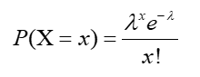
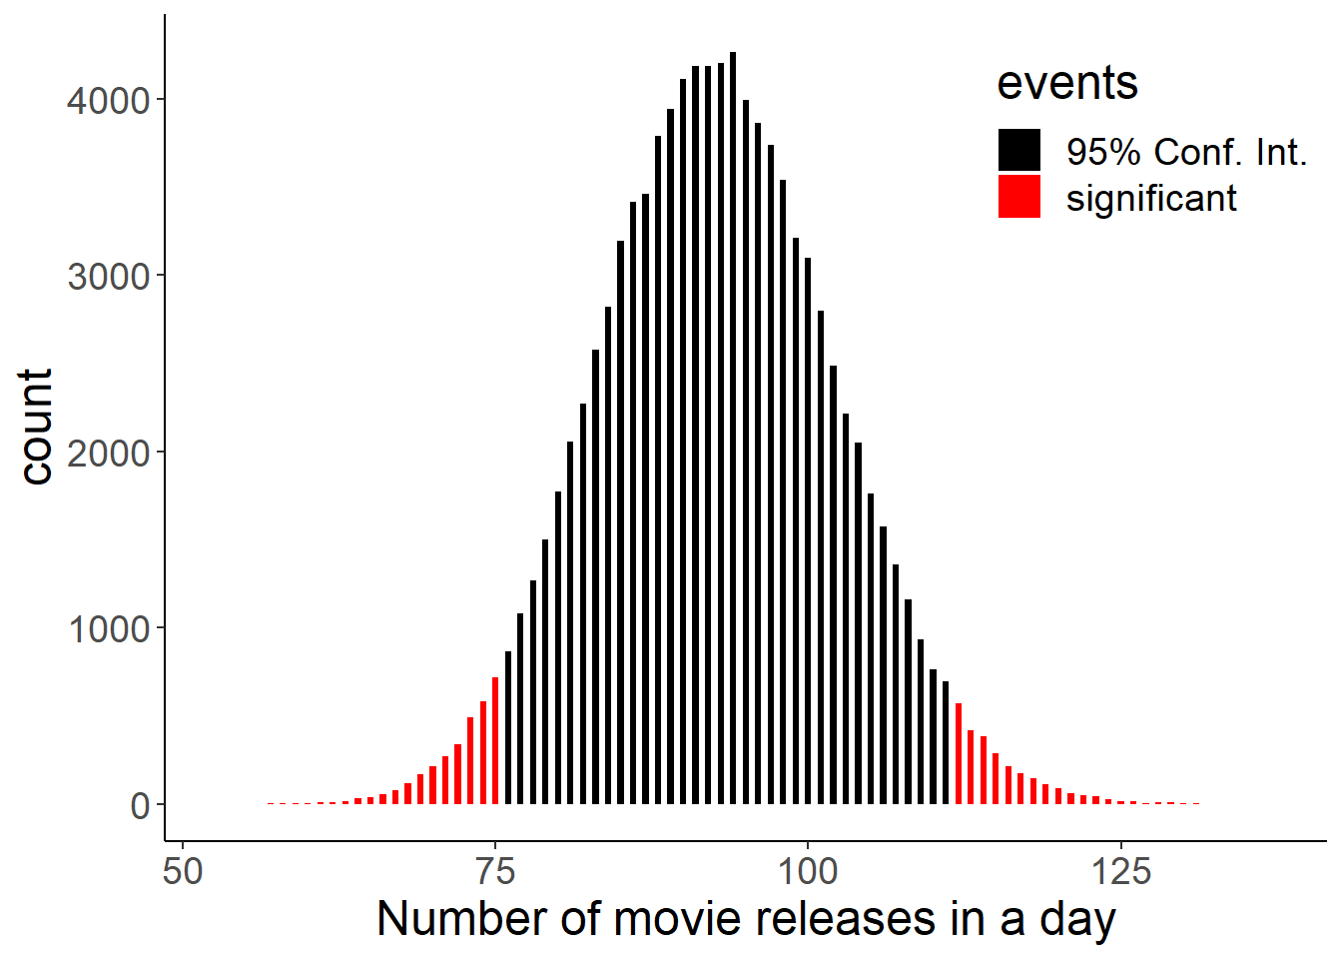
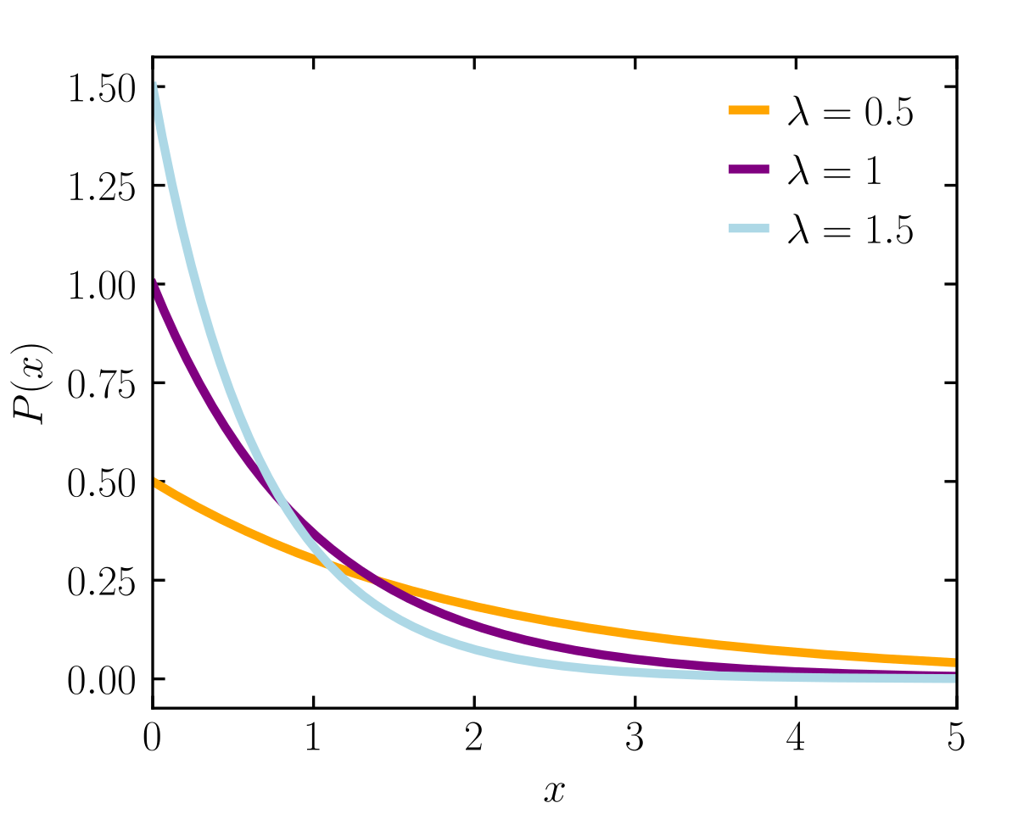
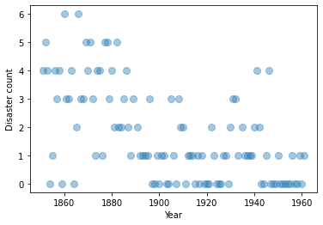
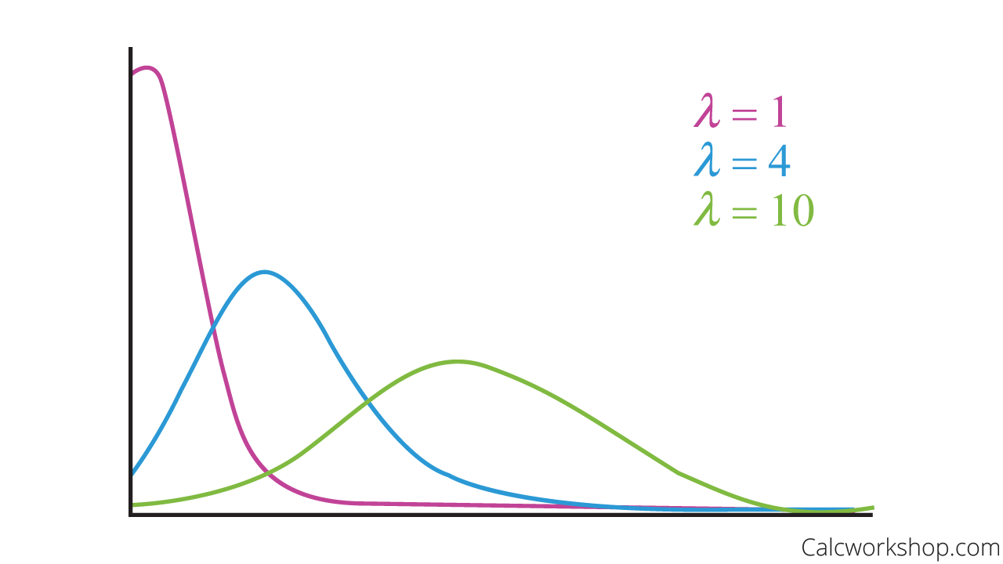
Bayesian Changepoint Model
Generating data with 2 different parts
Position of changepoint
Discrete time in this case
Discrete uniform prior
Rates (average values)
before and after changepoint
Rate can only be positive
Half-Normal? Exponential commonly used
Likelihood (distribution for the actual data)
Discrete, count data
Binomial? Poisson? Negative Binomial?
Poisson is simplest
Binomial
Poisson
Notes:
In theory, we could add a prior over the exponential lambda parameter too…hyperprior
But we don’t need to

Slide 28
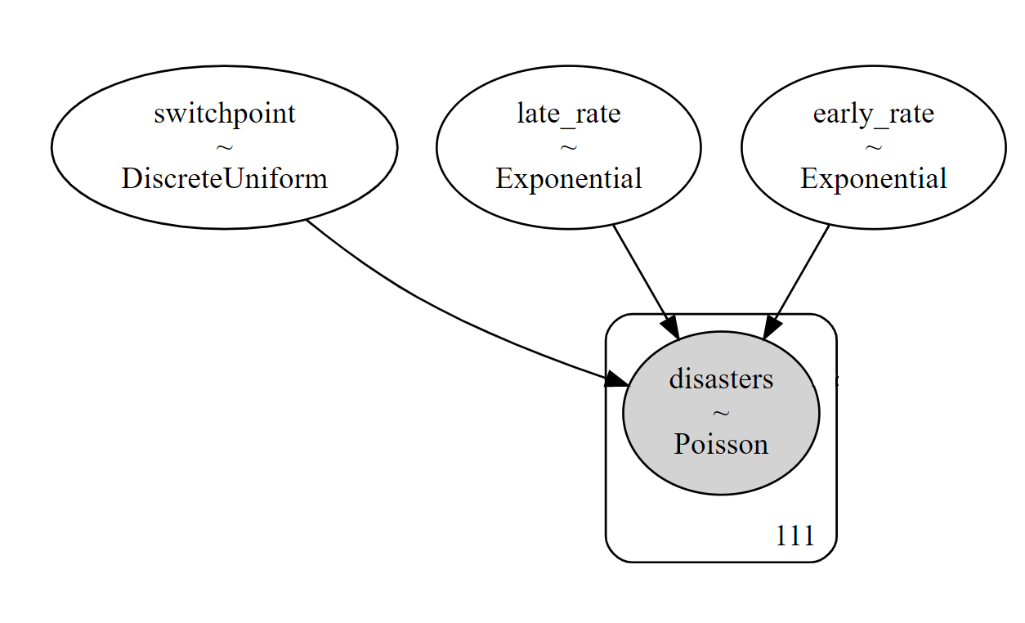
Bayesian Changepoint Model
10 -15 min exercise
Controlling λ at each timepoint
Switch statement :
Before switchpoint, use early rate
After switchpoint, use late rate
Notes:
Timeseries…need to account for monotony of time. Can’t treat as spatial random variable
Use switch statement

Slide 29
Real-World Use Cases
Why should I write my own code for linear regression when I can just use a package?
Same applies to other common models, e.g. time-series forecasting

Slide 30
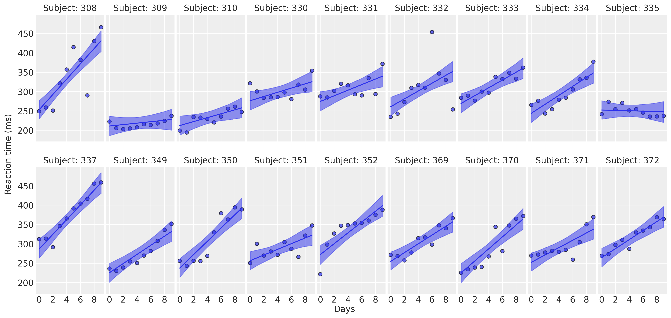

Real-World Use Cases Linear Regression
We don’t have to write our own code for linear regression to use probabilistic models
https://bambinos.github.io/bambi/main/notebooks/sleepstudy.html

Slide 31

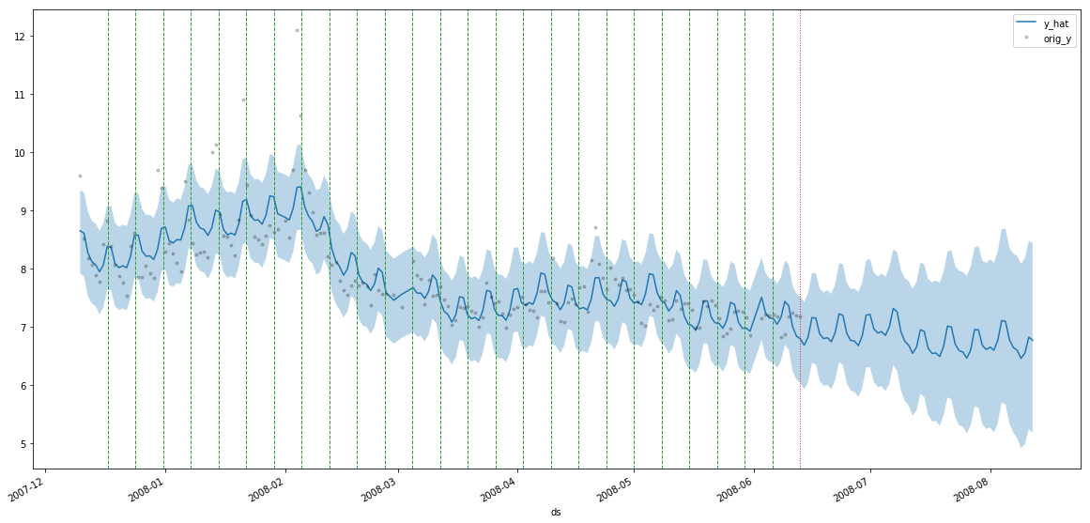
Real-World Use Cases Time Series Prediction
m = PMProphet(df, growth=True, intercept=True, n_changepoints=25, changepoints_prior_scale=.01, name='model')
m.add_seasonality(seasonality=30, fourier_order=3)
m.add_seasonality(seasonality=7, fourier_order=3)
m.fit(method=Sampler.NUTS)

Slide 32
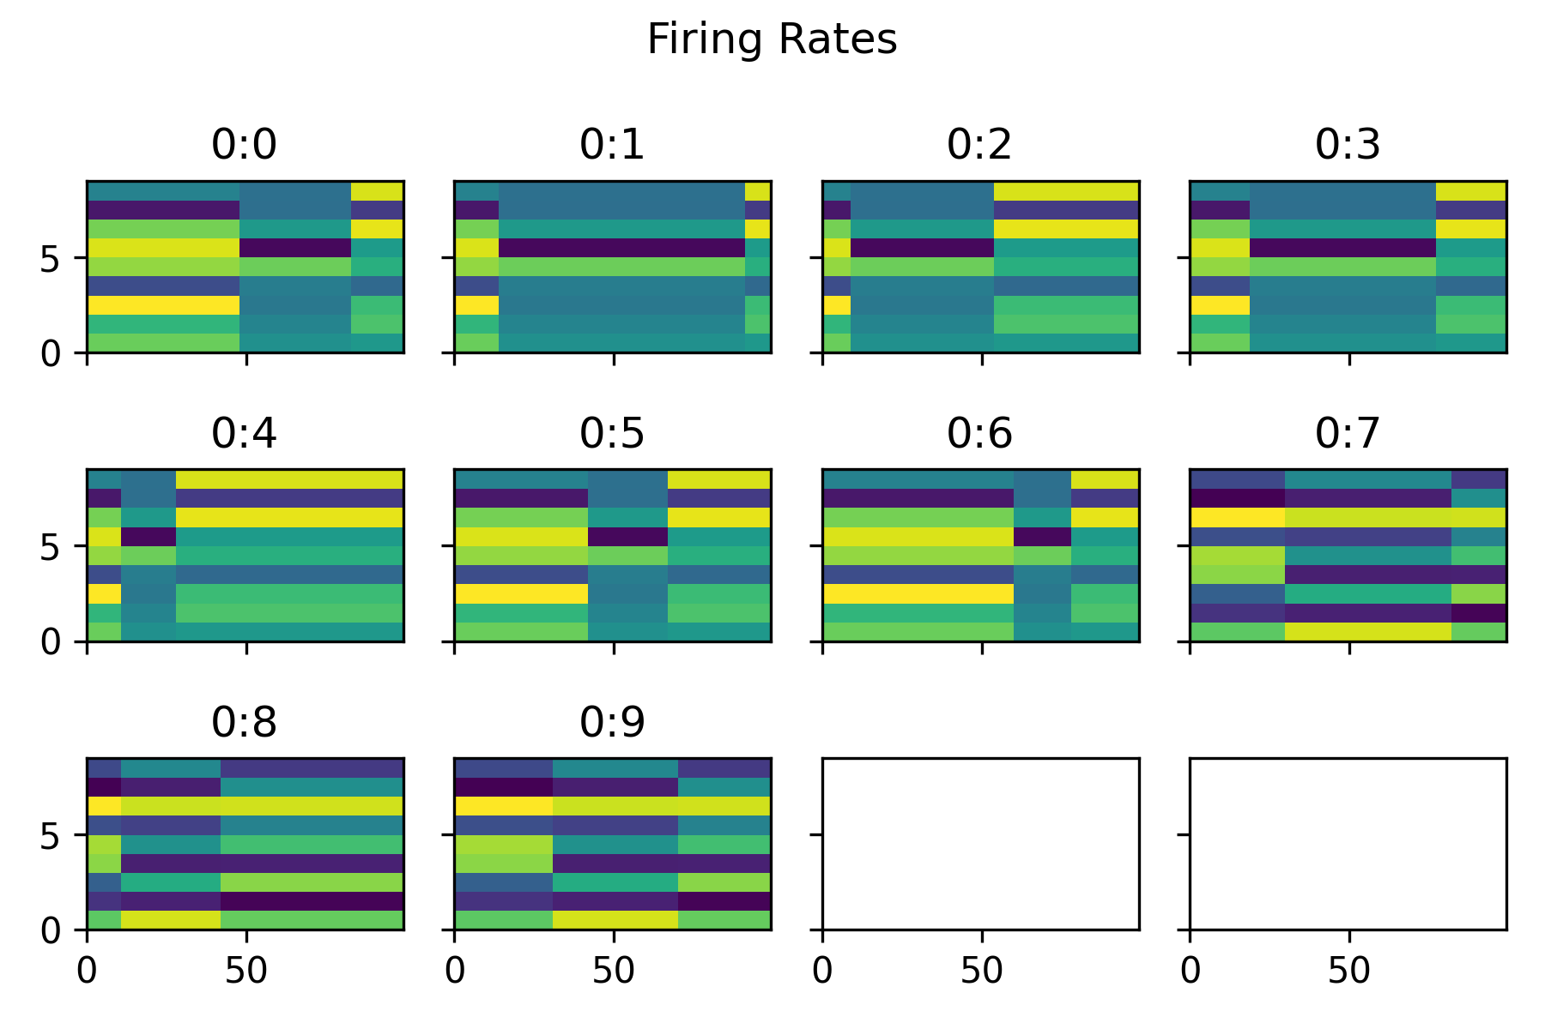
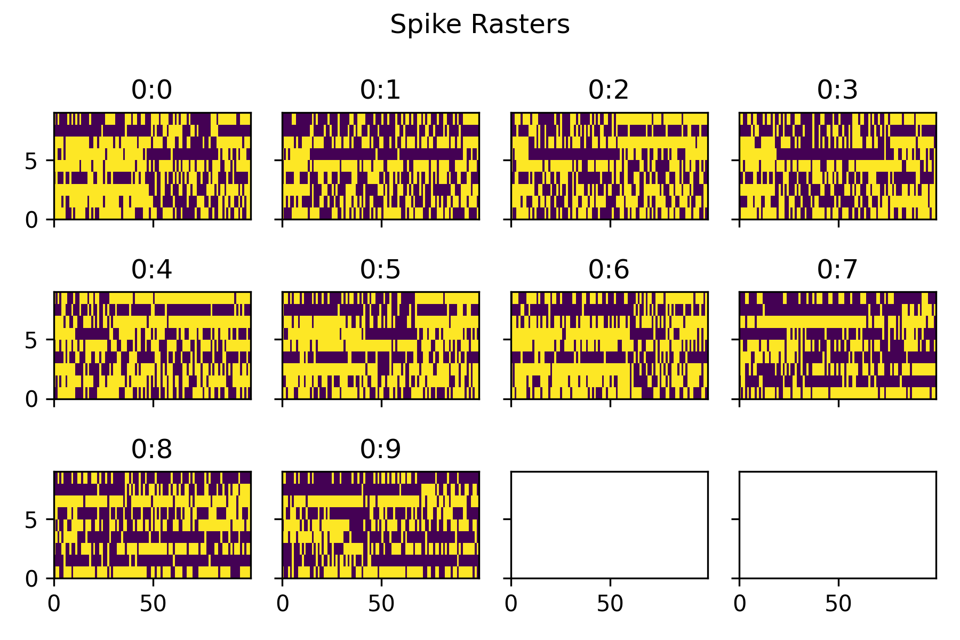
Real-World Use Cases Trial-Switch Changepoint

Slide 33
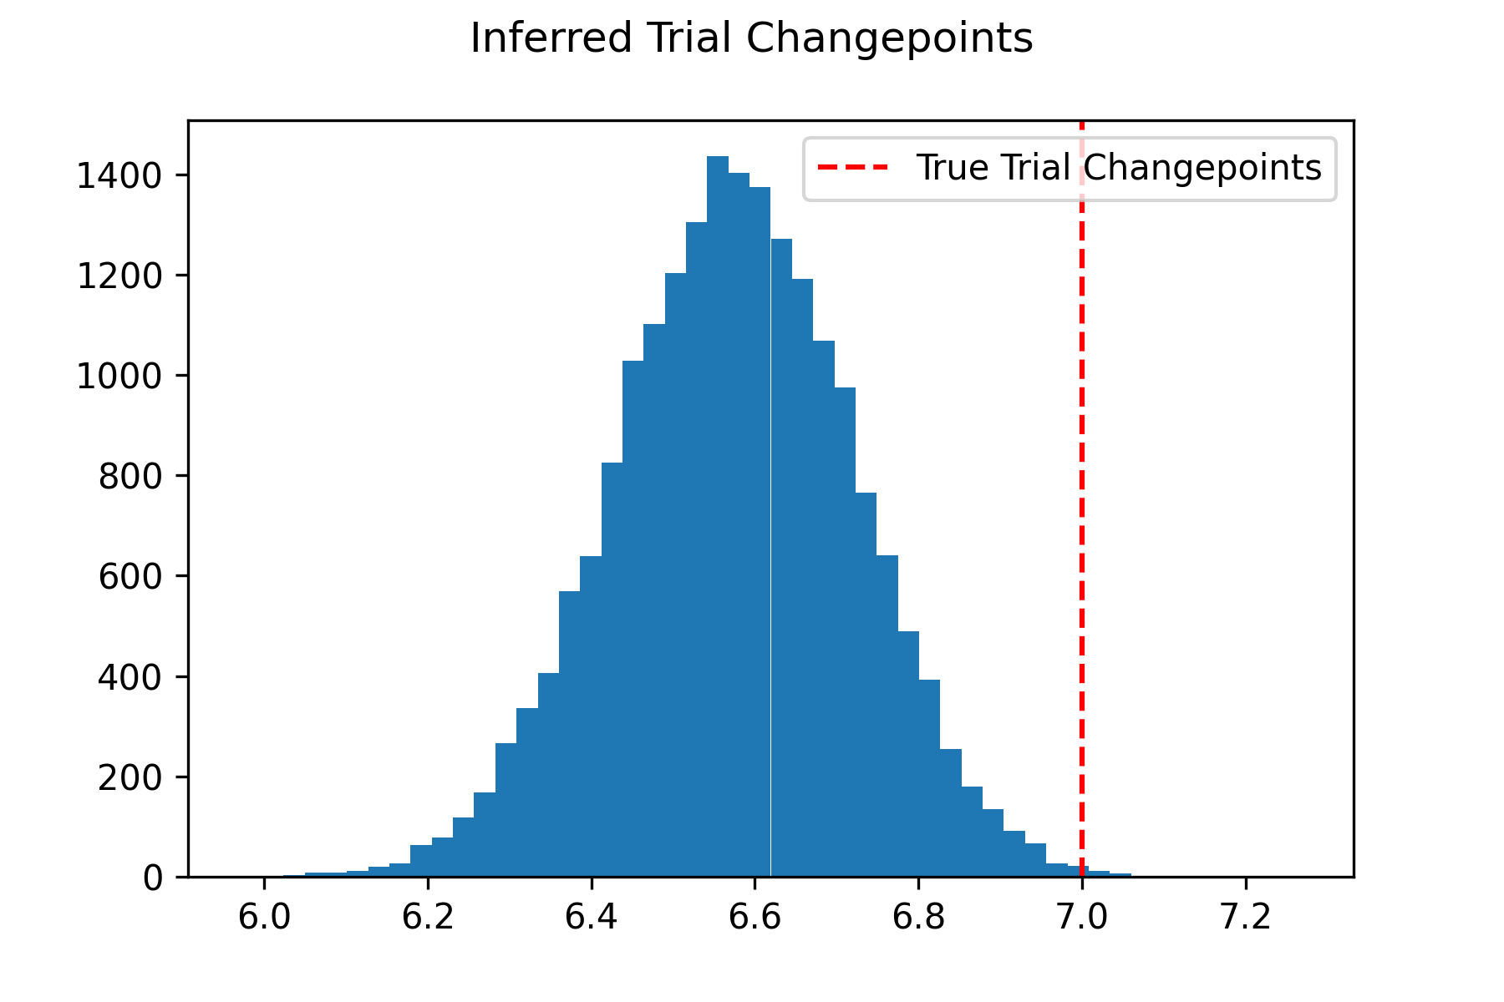
Real-World Use Cases Trial-Switch Changepoint

Slide 34
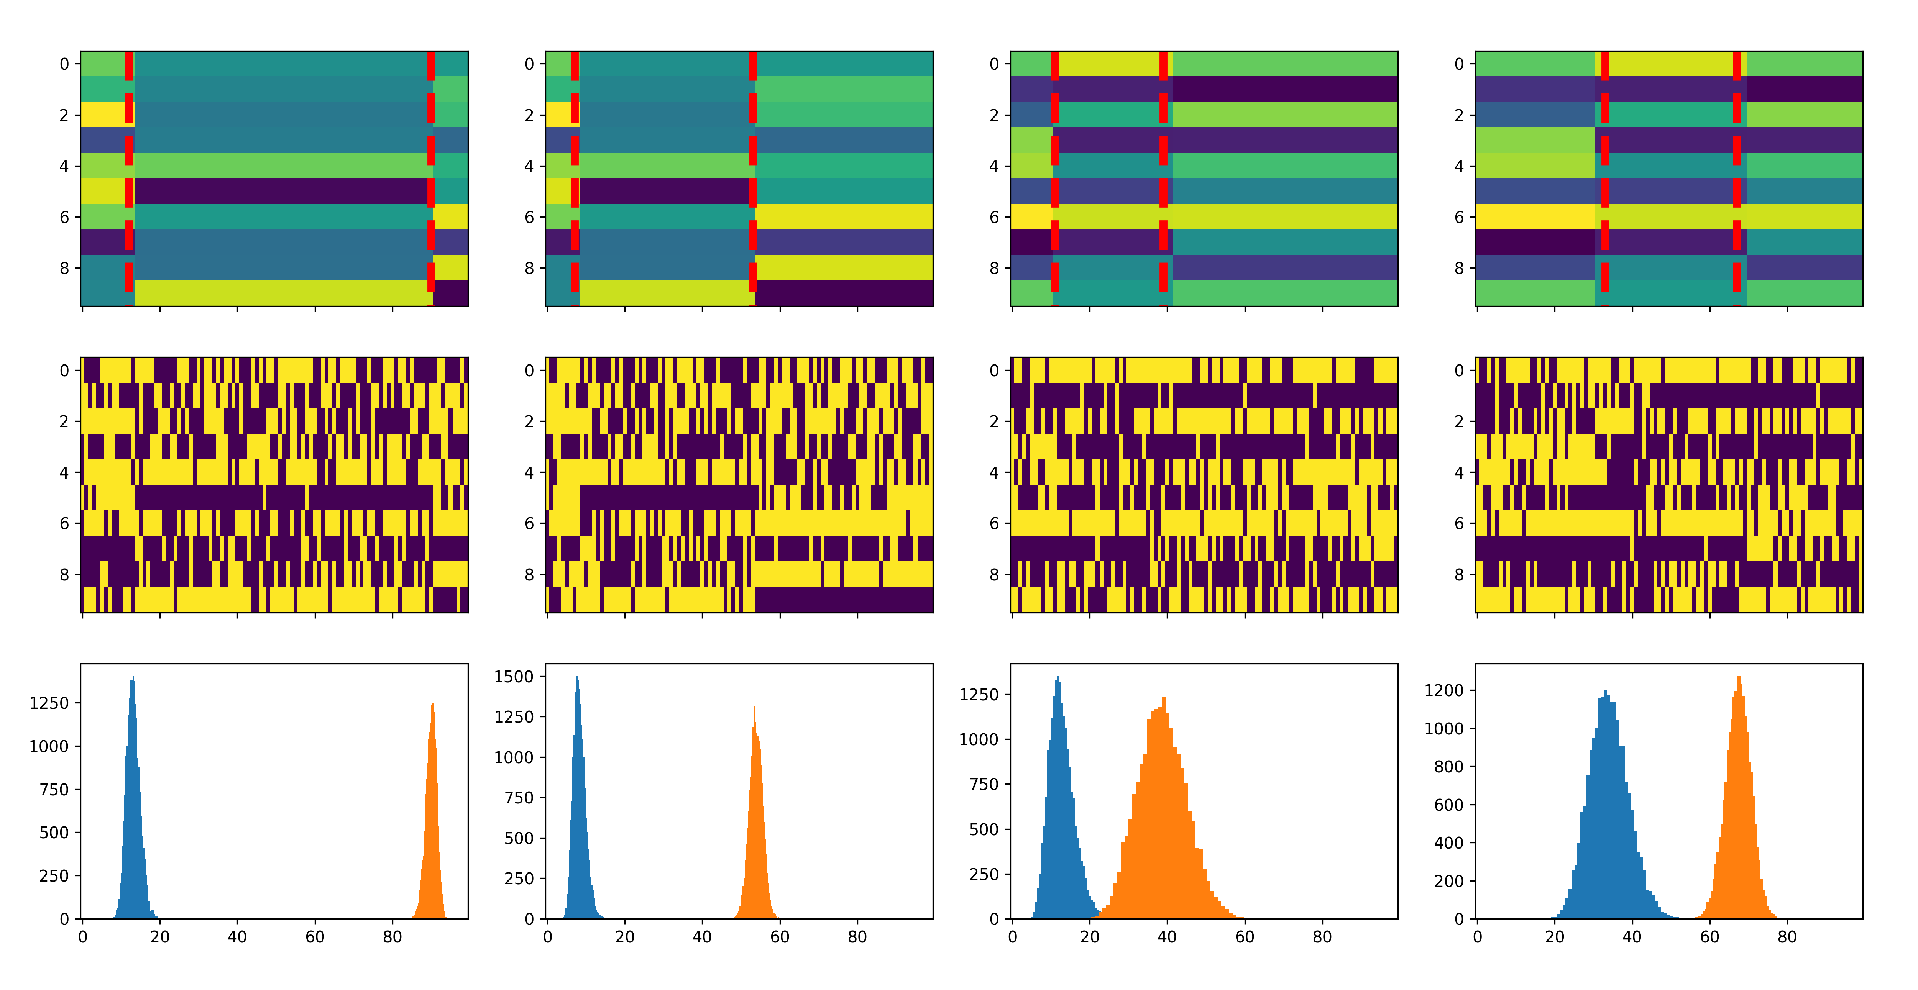
Real-World Use Cases Trial-Switch Changepoint

Slide 35
Real-World Use Cases
More examples at
https://www.pymc.io/projects/examples/en/latest/gallery.html

