Slide 1
SUPA COO (C++) Lecture 2 – 20 Oct 2015
Dr. Adrian Buzatu
University of Glasgow, adrian.buzatu@glasgow.ac.uk
Thanks to to some usage of previous lecturer’s materials
(S. Allwood-Spiers & W. H. Bell)

Slide 2
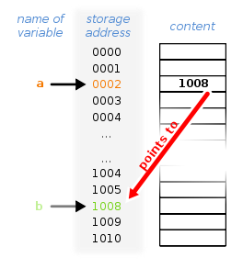

Object and memory address pointer and reference

Slide 3
If we don’t change the input to a function, pass it by constant reference (const std::string& s) if the object is large, either string, or a std::vector, etc. If small, like a bool, can be passed by value.
If we do change the input to a function and use it after the function, pass it by reference (std::string* s) or by pointer (std::string* s)
As if the function returns more than one output

Slide 4
References & pointers passing by reference passing by pointer Sarah’s lecture number 1 and 2
Standard template library
std::string
std::vector
std::map
Looping over containers via iterators
Sarah’s lecture number 3 and 4

