Slide 1
SUPA ROO (ROOT) Lecture 1 – 19 Nov 2015
Dr. Adrian Buzatu
University of Glasgow, adrian.buzatu@glasgow.ac.uk

Slide 2
Big data numerical analysis has particular needs. The solution are libraries in C++ called ROOT.
Fill and fit histograms or graphs
Statistics
Compute new quantities based on the input data (TLorentzVector)
Process
In a TFile write a TTree with just numbers, but also C++ classes
Write
Read
Plot
Overlay histograms, write legend, text, axis labels, text size, colours, style
or Histograms (TH1) or Graphs (TGraph) or functions (TF1)
Perform an event selection
Evaluate quality of fit, how close 2 histograms are
Compressed size (10x relative to text file)

Slide 3
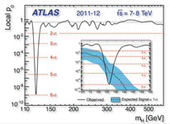
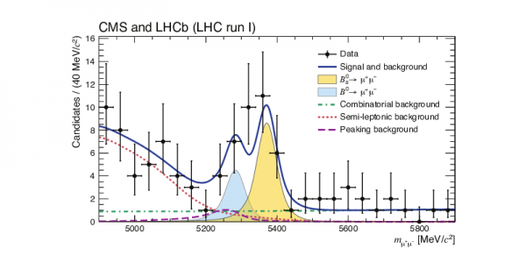
CERN uses ROOT for its data analysis. Particle, astroparticle, nuclear physics too.

Slide 4
ROOT is open source from CERN, root.cern.ch and continuously updated and documented.
Complete C++ compilation executable, with int main () and #include
Executable
A .C file with functions, not compiled
Macro
In terminal, one command at a time
Interactive
PyROOT
Python interface, easier syntax, calls C++ code, not compiled

Slide 5
Learn Python by yourself in the next two weeks! I takes only one day. https://docs.python.org/2/tutorial/ Covered in Lab3. Once I have a flat tree, I just use PyROOT. Flat tree = a tree with just numbers to create a tree that stores complex objects like a class Planet, I use C++.

Slide 6
Download and install ROOT from CERN. Install also PyROOT. Or ssh to your work linux machine. Or ssh to brutha.physics.gla.ac.uk.

Slide 7
CERN has documentation and tutorials.
Official:
http://root.cern.ch
Documenation:
http://root.cern.ch/drupal/content/documentation
User's Guide: many PDFs by categories:
http://root.cern.ch/drupal/content/users-guide
Tutorials:
http://root.cern.ch/root/html/tutorials/
How To:
http://root.cern.ch/drupal/content/howtos

Slide 8
Google a class to know its members, its methods, its history of inheritance, eg: “ROOT TH1” -> ROOT: TH1 Class Reference - Cern Study on your own C++ class inheritance.

Slide 9
There are many tutorials out there - 1
BABAR ROOT tutorialhttp://www.slac.stanford.edu/BFROOT/www/doc/workbook/root1/root1.html
ATLAS ROOT tutorial
wget http://www.ppe.gla.ac.uk/~abuzatu/SUPAROO/RootTutorial_ATLAS.tgz
tar xvzr RootTutorial_ATLAS.tgz
then read the instructions from tutorial.txt using the input file tutorial.root the solutions are presented in the .C file

Slide 10
There are many tutorials out there - 2
Dan Clemens: worked out examples
https://twiki.ppe.gla.ac.uk/pub/ATLAS/WebHome/RootManual.pdf
Fermilab ROOT tutorial
http://www-root.fnal.gov/root/CPlusPlus/
http://www-root.fnal.gov/root/class/exercises.htm
Columbia university
http://www.nevis.columbia.edu/~seligman/root-class/RootClass2011.pdf

Slide 11
Tasks until next lab
Work through the Babar and ATLAS tutorials.
Bring examples of your current research code to the lab.
Try to move it from macros to a compiled C++ mode.
Faster.
Fewer bugs.
Easier to develop upon.

Slide 12
Now: illustration of TreeDraw() for flat tree.

