Slide 1

Intelligent Banking Operations Agent
Empowering Banks with AI-driven Speed, Safety, and Compliance
Presented by [ABHISHEK GUPTA]

Slide 2






The Challenge
A Day in the Life of a Modern Bank
Speed vs. Safety
Fairness & Consistency
Information Overload
Customers demand instant transactions, but sophisticated fraud is a constant threat.
Loan decisions must be unbiased and strictly adhere to complex, ever-changing credit policies.
Human analysts are overwhelmed with data, leading to slow, expensive, and error-prone manual reviews.

Slide 3




Our Innovation
The Intelligent Banking Operations Agent
We've built a team of specialized AI agents that work together to automate and assist in critical banking operations. This is a digital workforce that empowers human experts, not replaces them.
Fraud Triage Agent
Credit Risk Agent
A master detective sniffing out fraud in real-time, analyzing patterns and anomalies.
A seasoned underwriter evaluating credit applications with speed and accuracy, ensuring compliance.
Compliance RAG Agent
Banking Supervisor
A diligent officer with instant recall of every policy and regulation, providing real-time guidance.
The team captain orchestrating the entire workflow, ensuring seamless collaboration and oversight.

Slide 4

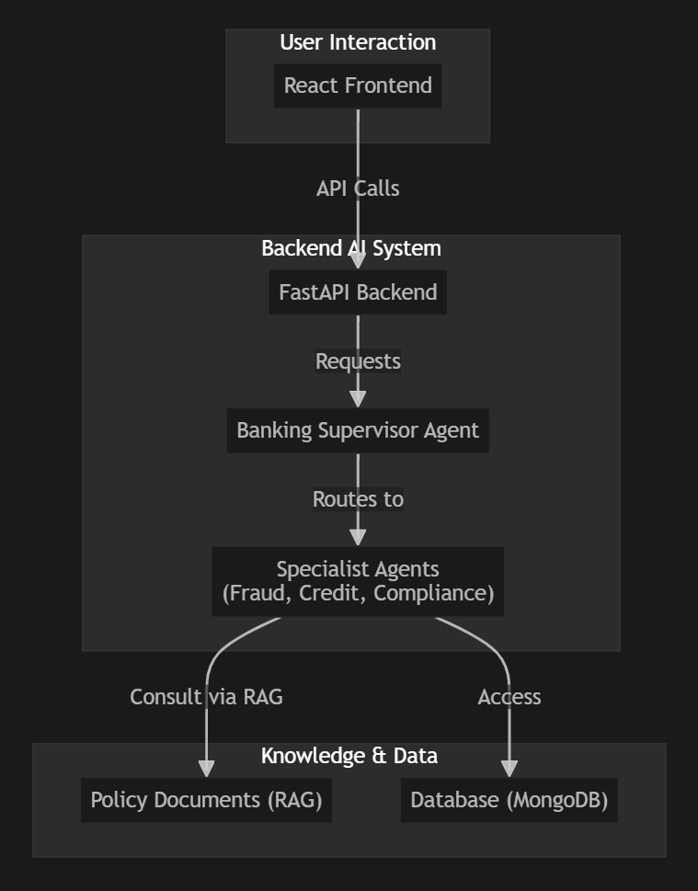
Under the Hood
High-Level Technical Architecture
Our system is built on a modern, decoupled architecture designed for scalability and maintainability. The user interacts with a React frontend, which communicates with a FastAPI backend. The backend then delegates tasks to the appropriate AI agent, which uses Retrieval-Augmented Generation (RAG) to consult policy documents.

Slide 5
Feature Spotlight
AI-Powered Credit Risk Assessment
Old Way: Rigid Rules
Our Way: Intelligent Reasoning
Manual scorecard calculations.
The CreditRiskAgent uses Retrieval-Augmented Generation (RAG).
Hard-coded policy rules.
Slow, rigid, and costly to maintain.
Receives loan application and queries CreditPolicy.txt.
LLM synthesizes data with policies for a nuanced decision.
The Result: A detailed, policy-grounded rationale that cites the exact policy sections used, making every decision transparent and auditable.

Slide 6
Feature Spotlight
Next-Gen Fraud Detection
Old Way: Brittle If-Then
Our Way: Holistic Analysis
Simple rule-based systems.
The FraudTriageAgent uses an LLM for comprehensive analysis.
Easily bypassed by novel fraud patterns.
High false-positive rates.
Builds rich context: transaction velocity, geo-location, device novelty.
RAG pulls relevant AML/KYC policies for context.
The Result: The ability to catch complex fraud patterns and provide clear, human-readable explanations that drastically reduce manual review time.

Slide 7
Next Steps
Our Strategic Roadmap
Q3: Workflow Automation
Next Year: Future-Proofing
Implement LangGraph workflow for complex, multi-agent collaboration (e.g., fraud alert triggering compliance check).
Introduce a Customer Service Agent and provide long-term memory for agents to learn from past decisions.
1
2
3
Q4: Enhanced Compliance
Expand the team with an Anti-Money Laundering (AML) Agent to monitor transaction patterns over time.

Slide 8

Sustainable Growth
Business Model: B2B SaaS for Financial Institutions
1
2
Tiered Pricing
Value Proposition
Starter: Access to one agent (e.g., Fraud Triage) with a monthly API call limit.
Reduce operational costs.
Improve decision accuracy.
Professional: Access to the full suite of agents and higher limits.
Enhance regulatory compliance.
Free up human experts for critical tasks.
Enterprise: Custom agent development, on-premise deployment, and dedicated support.

Slide 9

Thank You
Questions & Discussion
Empowering your bank, one intelligent agent at a time.

Slide 10
Intelligent Banking Operations Agent
Fraud & Credit Triage – Hackathon Pitch

Slide 11
Agenda
The problem we solve
Our solution: Fraud & Credit triage
Impact: faster decisions, fewer losses
Results & next steps

Slide 12
Fraud Triage
Minimize losses with low friction and efficient reviews

Slide 13
Goal
Prioritize suspicious activity to cut fraud losses
Control review costs and customer friction

Slide 14
How it works (simple)
We score each event for risk
High risk → quick hold; medium → review; low → pass
Analysts see why it was flagged and decide fast
The system learns from decisions to improve precision

Slide 15
Why it works
Known checks catch obvious fraud; AI finds new patterns
Clear reasons shown to analysts → trust + speed
Right alerts at the right time → less noise

Slide 16
High-signal features
Velocity: txn count/amount over 1h/24h/7d; rate-of-change vs baseline
Geo: distance from last location, impossible travel, country risk
Device/IP: new vs seen, fingerprint diversity, proxy/ASN risk
Behavioral: z-score vs user history, time-of-day, MCC mix
Merchant: MCC risk, merchant novelty, basket deviation
Graph: shared devices/IPs across accounts, degree features

Slide 17
Model choices
Isolation Forest (unsupervised): cold start, imbalance, ms latency
Autoencoder/LOF: alternate anomaly options
XGBoost/Logistic (supervised) when labels exist; support calibration
Calibration: map scores to risk buckets/empirical fraud rates

Slide 18
Business impact
Fewer false alarms → happier customers
Faster decisions → more throughput
Less fraud loss at the same review effort

Slide 19
What we measure
Accuracy of alerts
Time to decision
Estimated loss avoided

Slide 20
Analyst experience
Clear 'why flagged' explanation
Similar past cases for quick context
One-click actions (hold/release/report)

Slide 21
Handling realities
Imbalance & delayed labels: anomaly/PU; evaluate via PR curves
Drift: weekly PSI; recalibrate thresholds; review spiking rules
Adversaries: multi-signal, random spot-checks, rotating windows
Data quality: robust defaults; schema validation; fallback rules

Slide 22
Operations
Real-time friendly
Scales with demand
Safe fallback if AI is unavailable

Slide 23
Governance & pitfalls
Version rules/models; immutable logs; approvals; PII minimization
Avoid: rule explosion, ROC over PR, ignoring capacity, static thresholds

Slide 24
Fraud triage – 30s story
We combine proven checks with AI to spot fraud early
We route only meaningful alerts to the team
Analysts act fast with clear reasons

Slide 25
Credit Triage
Approve good customers fast; control portfolio risk

Slide 26
Goal
Maximize portfolio profit under risk, capacity, and compliance
Approve good, block risky, refer ambiguous

Slide 27
How it works (simple)
We estimate risk and affordability
Clear decisions: approve, review, or decline
Approved cases get limits/pricing that fit ability to pay

Slide 28
Why it works
Rules keep us compliant; AI improves approvals with low risk
Reason codes explain decisions to customers and regulators

Slide 29
High-signal features
Affordability: DTI/FOIR, income stability, cash flow, EMIs
Credit behavior: bureau score, delinquencies, utilization, inquiries
Stability/identity: employment tenure, address/device consistency
Fraud overlap: synthetic markers, app velocity, shared device/IP
Macro/segment: industry, region proxy, secured vs unsecured

Slide 30
What we deliver
Higher approval rate at the same bad rate
Fair, explainable decisions with audit trail
Right limits and pricing from day one

Slide 31
Thresholds, queues, actions
Approve if PD < t1; decline if PD > t2; else Refer
Maximize Expected Profit ≈ margin*EAD*(1−PD) − LGD*EAD*PD − OpCost
Capacity-aware Refer volume; segment by product/bureau band
On Approve: risk-based pricing and affordability caps

Slide 32
What we measure
Approval rate and default rate
Time to decision
Customer satisfaction and fairness checks

Slide 33
Explainability & adverse action
Reason codes mapping to top contributors
What-if: path from Refer → Approve
Audit trail: inputs, score, policy hits, versions, final decision

Slide 34
Handling realities
Selection bias: parceling/EM; validate via sensitivity/shadow cohorts
Macro shocks: adjust cutoffs/limits; faster vintages; stress tests
Data quality: verify income; robust imputation; conservative fallback
Fair lending: disparity monitoring; reason-code integrity; consistent cutoffs
Adversaries: inflated income/docs → cross-check with bank data

Slide 35
Operations & trust
Fast pre-qualification; quick underwriting
Built-in A/B testing for safe improvements
Compliant, auditable decisions

Slide 36
Credit triage – 30s story
We approve good customers quickly and fairly
Risk and affordability guide limits and pricing
Clear reasons build trust and compliance

Slide 37
Results summary
Fraud: fewer false alerts and faster reviews
Credit: higher approvals at stable risk
Ops: quicker decisions and clear reasons
Governance: fully auditable and compliant

Slide 38
Q&A
Thank you

