Slide 1
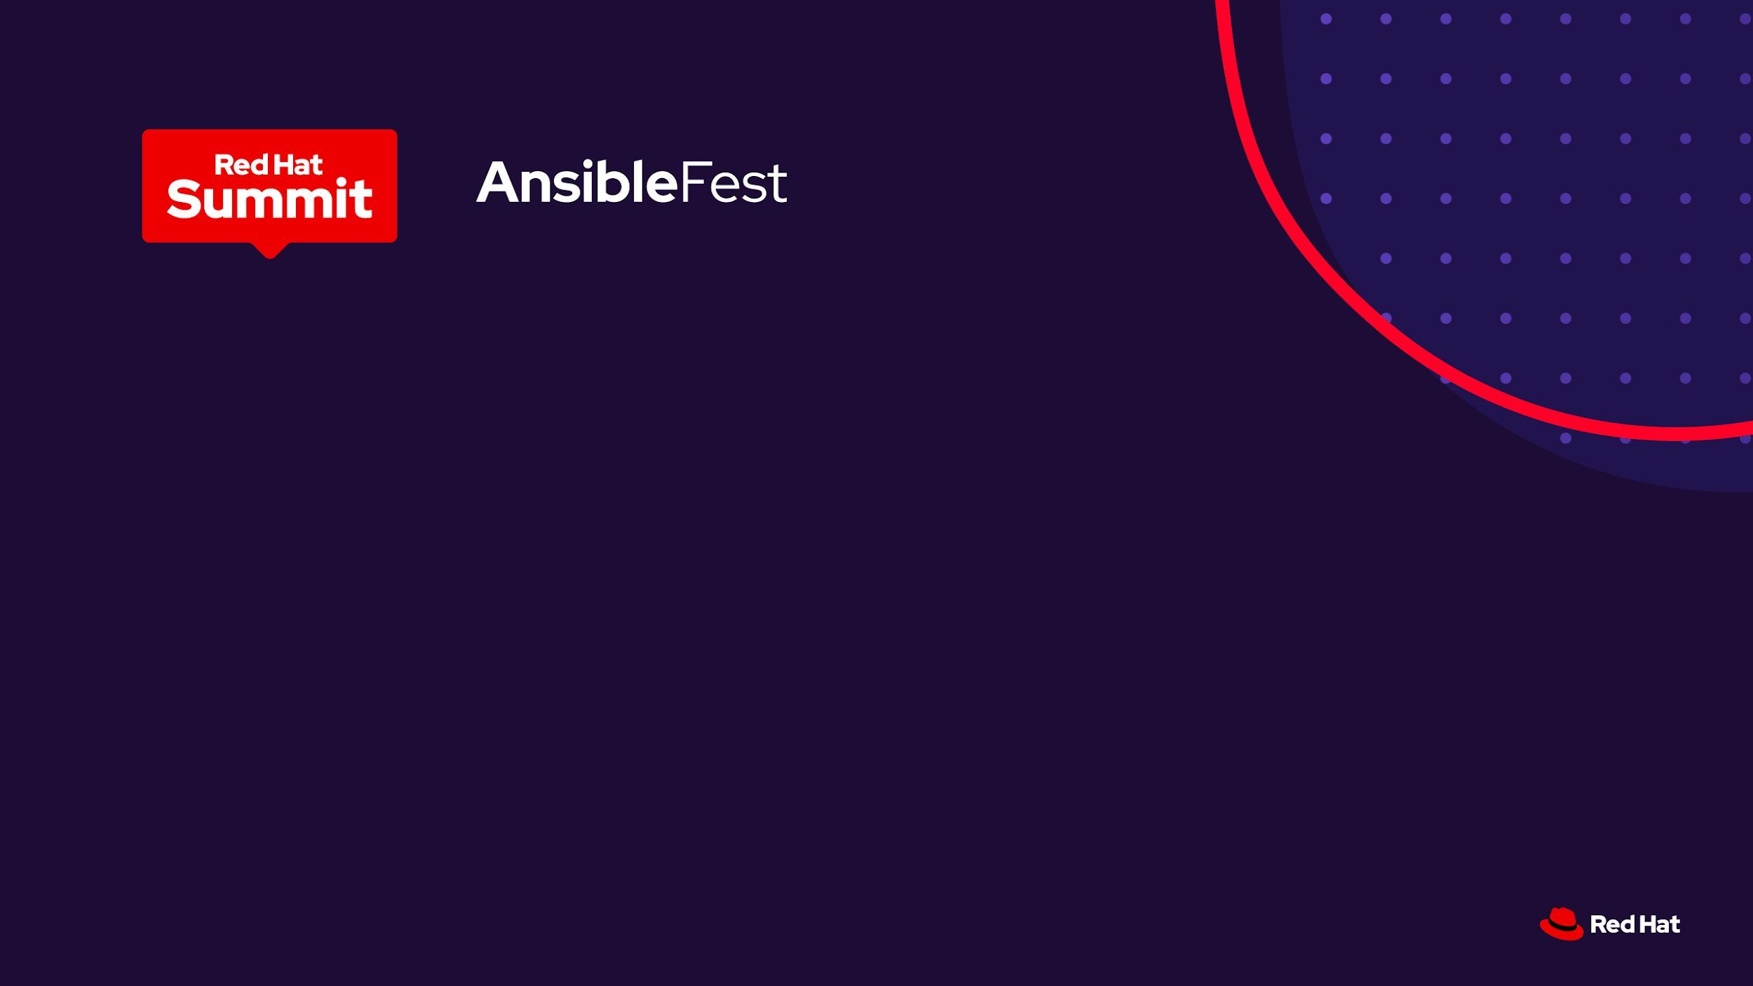
Lab: Proactive dependency
remediation
Start from the fix, not the flaw.
Red Hat Lightwell · IBM Concert · Ansible Automation Platform · Tekton · ArgoCD
~10 minute intro · 55 minutes hands-on
Notes:
Set the frame: this lab is not about finding vulnerabilities. It is about what happens the instant a trusted fix exists.

Slide 2

Patching is reactive, and slow
The bottleneck is not the fix — it is knowing where the fix needs to go
A CVE drops. Now what?
THE MANUAL LOOP
›
Which of our applications actually use the affected package?
1
Scanner flags a CVE
›
Who owns them? What breaks downstream if we patch?
2
Hunt for affected apps
›
Someone opens a spreadsheet. Weeks pass.
3
Chase down owners
4
Open tickets
Industry average to remediate a critical dependency CVE is measured in weeks, not minutes.
5
Manual PR + deploy
6
Hope nothing broke
Elapsed: days to weeks
2
Notes:
Most vulnerability programs are a detection pipeline bolted onto a manual remediation process. We're going to invert that.

Slide 3
Start from the fix, not the flaw
Move the trigger, and everything downstream changes
Reactive (typical)
Proactive (this lab)
Trigger: a scanner finds a CVE
Trigger: Lightwell publishes a remediated package
“We have a problem”
“We have a solution — go apply it”
Hunt for affected apps
Concert already knows
Manual PR, manual deploy
Tekton builds, ArgoCD deploys
Red Hat Lightwell publishes a hardened, remediated build of a package into Artifactory. That publish event is the trigger — the fix arrives before anyone files a ticket.
3
Notes:
This is the key idea of the lab. Everything downstream follows from moving the trigger.

Slide 4
The cast: who does what
Concert answers “who is affected?” — AO owns the decisions
Artifactory
Package store — emits the webhook when a Lightwell package lands
Event-Driven Ansible
Always-on listener — turns the event into a workflow
IBM Concert
Pre-indexed SBOM inventory + Arena View dependency topology
Automation Orchestrator
The brain — routing decisions, approval gates, audit trail
AAP
The hands — playbook execution
Tekton
CI — build, test, image, GitOps manifest bump
ArgoCD
CD — GitOps sync to OpenShift, drift detection, rollback
Note what Concert is not doing: it is not orchestrating.
4
Notes:
Concert is an inventory and topology service here, not the orchestrator. AO owns routing and policy.

Slide 5
Lab architecture
From package publish to validated production deploy
Package publish
Event detection
Orchestration
Impact analysis
Source update
Build & deploy
Validation
1
2
3
4
5
6
7
Ansible
Automation
Platform
TRIGGER
Artifactory
lightwell-remediated
repo emits webhook
One publish event,
both lanes react
Event-Driven
Ansible
Rulebook matches,
fires workflow
Automation
Orchestrator
Owns routing,
policy, audit
Automation
Orchestrator
Could own the query
and the policy gate
AAP playbook
Bump requirements,
branch, commit, push
Tekton + ArgoCD
Test, build image,
GitOps sync
AAP validation
3/3 pods healthy,
/health reports 6.0.2
IBM
Concert
Concert ingest
New Lightwell build
indexed in the SBOM
Risk prioritization
Ranks affected apps
by exposure
SBOM inventory
+ Arena View
12 of 537 apps
on an older build
Concert
Secure Coder
Safe-version fix,
opens a pull request
Concert Workflows
Change request,
approval, tracked
SBOM updated
Portfolio drift
12 to 11
Solid outline — the path this lab walks · Dotted outline — the same step, owned by Concert instead
The trigger is a fix being published — not a flaw being found. Publish to validated production deploy in ~3 minutes.
5
Notes:
Walk it left to right. The thing to notice is step 1: the trigger is a fix being published, not a flaw being found. Concert owns the bottom lane -- it answers 'who is affected' in one API call and then gets written back to at the end so inventory reflects reality. Everything in the top lane is Ansible orchestrating and executing, with Tekton and ArgoCD doing the actual build and deploy. The dotted boxes are the conversation piece: Concert can own most of these steps itself -- Secure Coder opens the fix PR, Concert Workflows drive the change request and approval. We run them through AAP here because that is where the policy and the audit trail live, but the split is a design choice, not a constraint.

Slide 6
The flow, with timings
Package publish to validated production deploy in ~3 minutes
0:00
0:02
0:05
0:11
0:24
1:40
2:30
2:58
1
2
3
4
5
6
7
8
Package
published
Artifactory
Webhook in,
rule matches
Event-Driven
Ansible
Workflow up,
route decided
Automation
Orchestrator
12 of 537
apps affected
IBM Concert
Version bumped,
branch pushed
AAP
Test, build,
push image
Tekton
Auto-sync,
rolling update
ArgoCD
Healthy,
SBOM updated
AAP + Concert
~3 minutes · package publish to validated production deployment · zero manual steps
Compare: the same change through a ticket-driven process is typically 2–6 weeks of elapsed time, most of it spent identifying which applications are affected and who owns them.
6
Notes:
Timings are representative of the lab environment. The point is the shape of the curve, not the exact seconds.

Slide 7
What you'll do
Three modules, 55 minutes hands-on
01
02
03
DETECT
ORCHESTRATE
VALIDATE
~15 min
~25 min
~15 min
Publish the Lightwell package. Watch EDA fire. Read Concert's portfolio impact analysis and Arena View topology, and follow the AO routing decision.
Watch the AO workflow drive the git commit, the Tekton PipelineRun and the ArgoCD sync. See new pods come up on the remediated package.
Walk the full audit trail — Artifactory › EDA › AO › Concert › Tekton › ArgoCD › running pod — and confirm Concert's inventory reflects reality.
7
Notes:
Module 1 is the interesting one conceptually; module 2 is where it gets satisfying to watch.

Slide 8
What to watch for
Four moments that carry the whole argument
The switch node
That is where your policy lives. Change one condition and the whole risk posture changes.
The Concert query latency
One API call replaces a portfolio-wide scan. That is the entire value proposition in a single HTTP request.
The ArgoCD sync
Nobody SSH'd anywhere. Desired state went into Git and the cluster converged. Rollback is one command.
The audit trail
Every hop is independently queryable. This is what an auditor actually asks for.
8
Notes:
Call these out live as they happen rather than reading the slide up front.

Slide 9
Demo questions
Where should this go next? We want your opinions.
1
Wrap it all in a ServiceNow ticket?
2
More OpenShift-native — or more pizzazz?
Auto-create a change record at the switch node, attach the Concert impact analysis and Tekton logs, close it on validation. Governance, or just latency?
Should more of this run as OCP-native primitives? What would make the demo memorable rather than merely correct?
3
Policy gates.
4
Red Hat Dependency Analytics.
Where do OPA / Kyverno / ACS admission policies belong? Block at admission, or gate earlier in the pipeline? Who owns the policy?
Does RHDA overlap with Concert here, or complement it? Shift-left in the IDE vs. portfolio-wide inventory — do both run?
5
Trusted Profile Analyzer.
6
Should prod ever be fully hands-off?
Where does TPA fit for SBOM attestation and VEX? Should Tekton emit a signed SBOM so the trail includes provenance, not just a version bump?
The one we keep arguing about. If an approval gate is always required — approval by whom, and on what evidence?
9
Notes:
Leave real time for this. The ServiceNow and policy-gate questions usually generate the most disagreement.

Slide 10
Let's build it
Module 1: Detect — package publish and Concert impact analysis
Notes:
Hand off to the lab guide and start Module 1.

