Slide 1
Water Heater Project

Slide 2
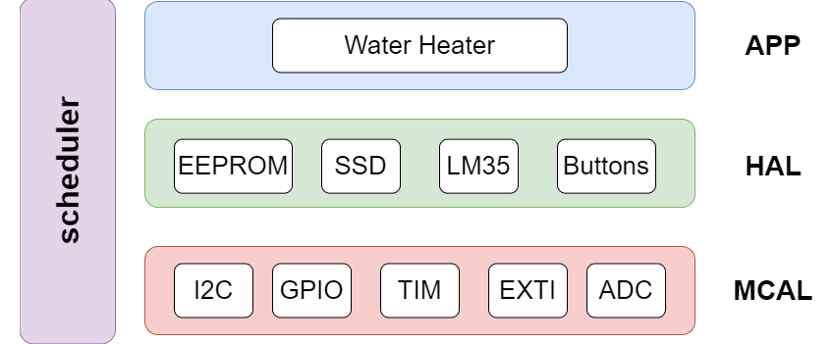
Software Architecture

Slide 3
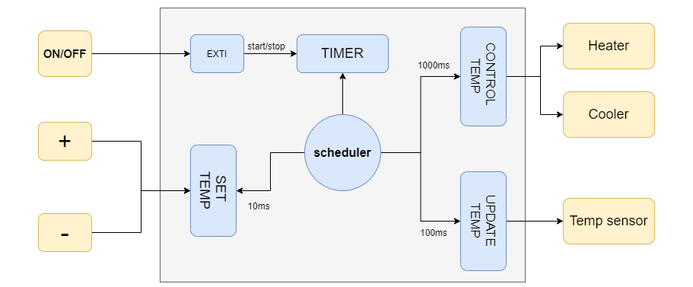
Static Architecture

Slide 4
Timing Analysis
Task Name | Execution Time (ms) | Periodic Time (ms)
SET_TEMP | ~0 | 20
UPDATE_TEMP | ~0 | 100
CONTROL_TEMP | ~0 | 1000
 | Tick Time (ms) | 20
 | Major cycle (ms) | 1000

Slide 5
Detailed Design
Doxygen HTML and PDF documentation are included in the project Zib file

