Slide 1

Data Sampling
Notes:
<Notes>

Slide 2
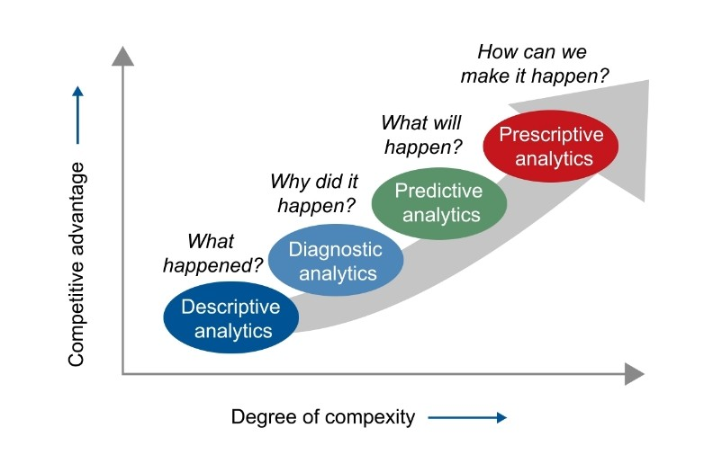
Hierarchy of data Analysis Types
How do we optimize results?
What should we do?
Optimization Analytics
Notes:
Data analytics encompasses various types of analysis techniques that help extract meaningful insights from data. Here are some common types of data analytics, along with simple real-life examples for each:
1. Descriptive Analytics:
Explanation: Descriptive analytics involves summarizing historical data to understand what happened in the past. It provides insights into trends, patterns, and relationships within the data.
Example: You collect information about a mobile customer’s characteristics and behavior including whether they churned.
2. Diagnostic Analytics:
Explanation: Diagnostic analytics focuses on determining why certain events happened by examining historical data and identifying the root causes of problems or trends.
Example: You analyze the descriptive data and determine that the customer churned mostly likely due to a competitive offer.
3. Predictive Analytics:
Explanation: Predictive analytics involves using historical data to make predictions about future outcomes. It leverages statistical algorithms and machine learning techniques to forecast trends, behavior, or events
Example: You use data from previous examples of both retained and churned customers to build a model that predicts which ones will likely churn in the next 30-60 days.
4. Prescriptive Analytics:
Explanation: Prescriptive analytics goes beyond predicting future outcomes by providing recommendations on what actions to take to achieve desired outcomes. It considers various scenarios and suggests the best course of action based on data analysis.
Example: You leverage the predictive model to target market certain high-value customers with retention offers and use the results to update your prescriptive model.
5. Optimization Analytics:
Explanation: Analysis of the impact of many actions taken in order to optimize a global goal like: increased revenue, profit, decreased costs, increased customers, etc.
Example: Use prescriptive models + multi-armed bandits or other optimization approaches to maximize revenue by minimizing the costs of retention and targeting most valuable customers.

Slide 3

Population vs Sample
Ideally, analyze all data for insights.
Examples:
A mobile company wants to assess all potential customers.
A government must consider all citizens’ needs for a new service.
Full data collection is often impractical due to:
High costs of data acquisition
Time constraints
Computational and storage limitations
Increased complexity in processing large datasets
Solution: Select a representative, make inference
Notes:
Statistically speaking, we want a sample that keeps the probability distribution of the population under a reasonable significance level. In other words, if we look at the histogram of the sample, it must be the same as the histogram of the population.

Slide 4
Data Sampling
A Sampling Method is a process to select a subset of observations from the entire population. Ideally, the observations in the sample are representative of the population. Common methods include:
Random Sampling: Each subset of n units is equally likely to be chosen.
Stratified Sampling: The population is divided into meaningful groups (strata), and samples are drawn from each.
Cluster Sampling: The population is divided into clusters (unrelated to key study features), and some clusters are randomly selected.
Systematic Sampling: Every kth observation is selected from a random starting point, where k ≈ (population size) / n.
Convenience Sampling: Easily accessible observations are selected (non-random).
Notes:
Sample size calculator https://www.surveymonkey.com/mp/sample-size-calculator/

Slide 5
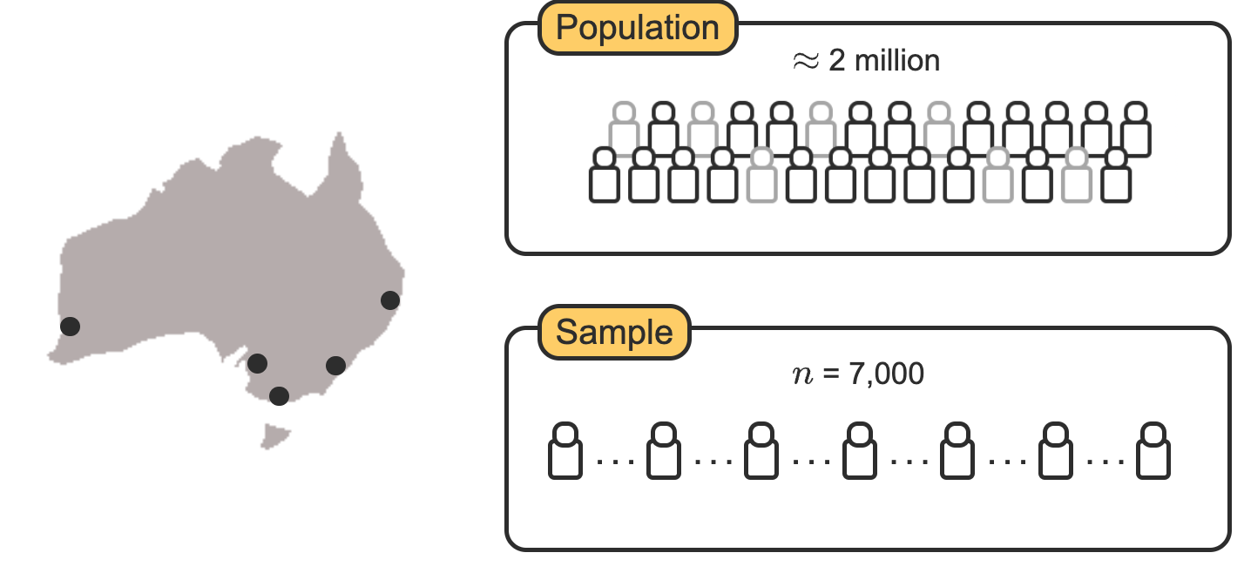
Sampling scenario
A population is the entire set of all individuals, items, or events of interest.
An observational unit (aka observation) is an individual, item, or event of the population where data is recorded.
A sample is a subset of observations from the population used for analysis.
Example: Transportation satisfaction survey across 5 cities.
Notes:
For a community hospital, what is the reasonable definition of population?
How about a cell phone carrier?
Online retailer?

Slide 6
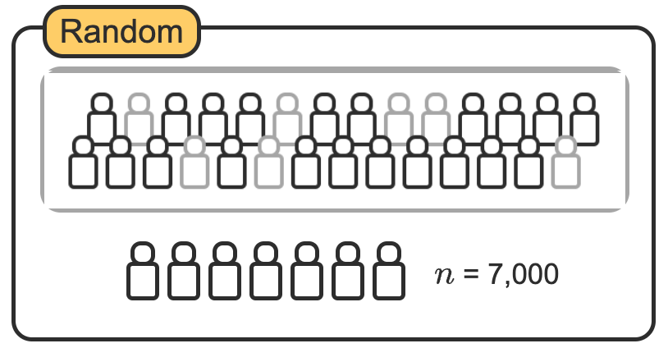
Random Sampling
In random sampling, passengers are selected at random from a list of all passengers in the five cities.
Random sampling reduces the potential for sampling bias.
But this could result in missing important events that occur less frequently.

Slide 7
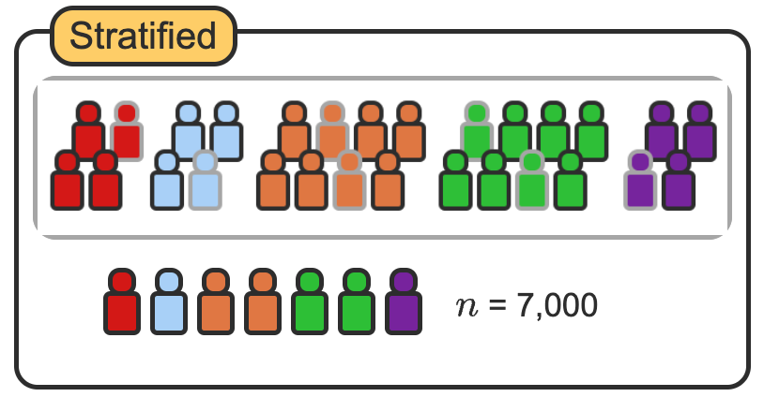
Stratified Sampling
Passengers are first divided into groups based on city.
Then from each group, passengers are selected at random.
Unlike pure random sampling, stratified sampling ensures adequate representation from each city.
This is especially important when working with data that includes events that are relatively rare (e.g., customer churn, network intrusion, cancer cell detection, etc.)

Slide 8
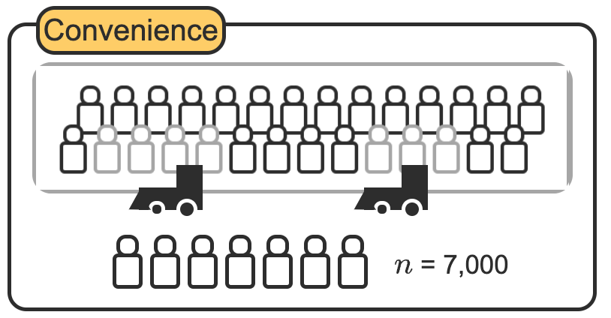
Convenience Sampling
Select passengers waiting in the train stations uses convenience sampling.
This method is easy and quick, but the sample is not likely representative of all train passengers.

Slide 9
Systematic Sampling
Every 286th passenger from a list of all 2 million potential passengers is selected for the sample.
Population / sample size = selection criteria
Depending on ordering of the list, this could be close to random, or highly biased.
Select every 286th person

Slide 10
Sampling distribution – not all samples equal
A sampling distribution is like taking many small samples from a big jar of jellybeans and calculating the proportion of red beans in each sample. If you repeat this process over and over, you’ll get a bunch of different averages.
Now, imagine plotting those averages on a graph—you’ll notice that most of them cluster around the true average of the whole jar. This pattern of sample proportions is the sampling distribution. It helps us understand how much the results can vary and lets us make better guesses about the whole jar without checking every single jellybean!

Slide 11
Sampling activity: Coin Toss
Go to the coin flip simulator here: https://flipsimu.com/
Flip 10 coin, record the number of heads.
Repeat 5 times.
Calculate the average number of heads.
Does this average seem to well represent the expected number of heads, assuming the coin is fair?
Record your average here: Coin Tosses

Slide 12
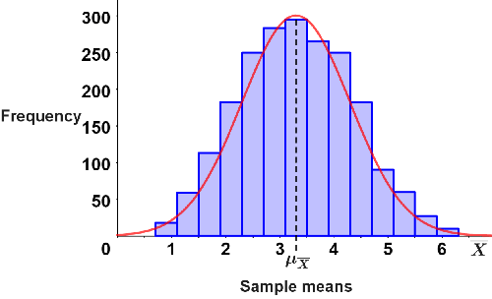
The central limit theorem
The sampling distribution of the sample mean approaches a normal distribution as sample size increases,
regardless of the population's original distribution (assuming random sampling).
Works well for large n (>30).

Slide 13
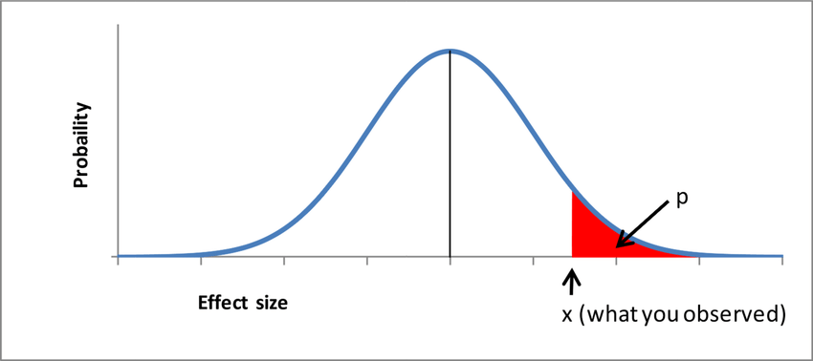
Is our sample significantly different than the population?
Proportion of heads …

Slide 14
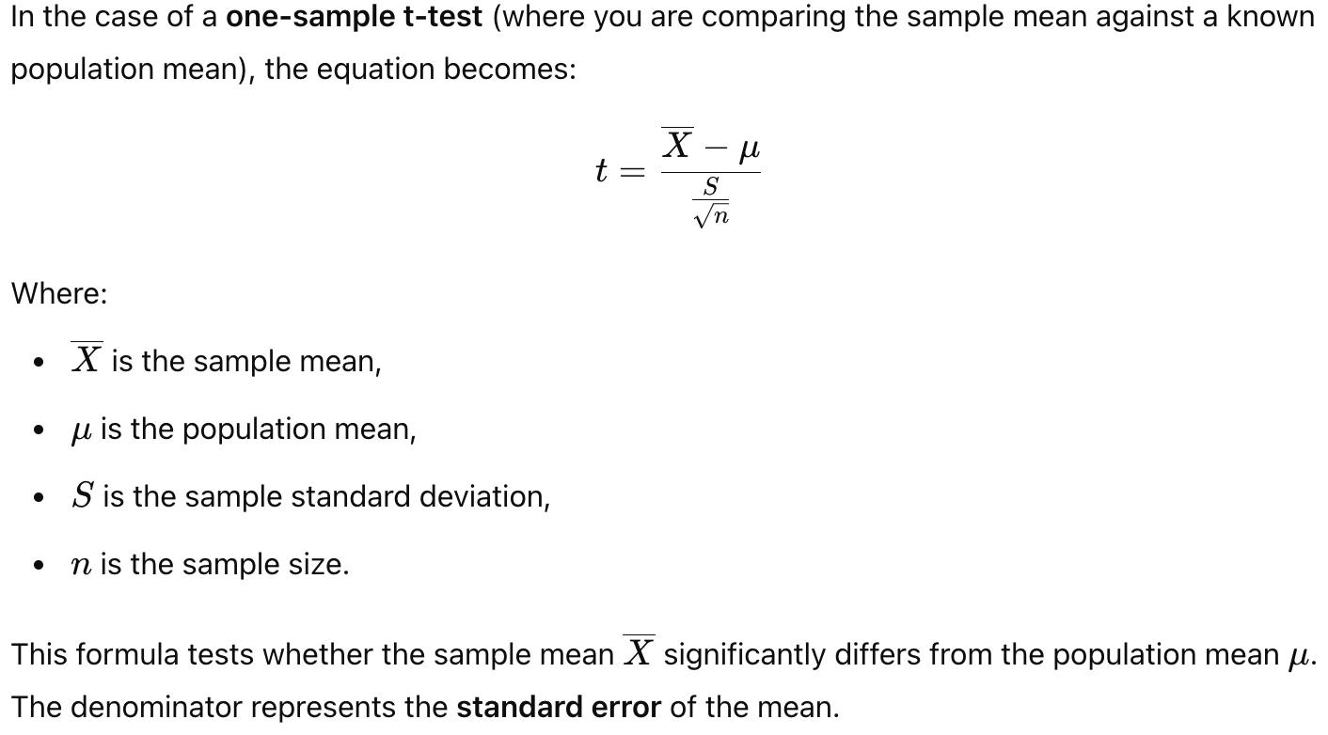
One-sample t-test

