Slide 1
Detect Cancer in Gigapixel
Pathology Images
Fan Yang (fy2232)
Hongyu Li (hl3099)
2018-12-14

Slide 2
Contents
Part Ⅰ Introduction
Part Ⅱ Data Preprocess
Part III Models & Results
Part IV Improvement

Slide 3
01
Introduction
PART ONE

Slide 4
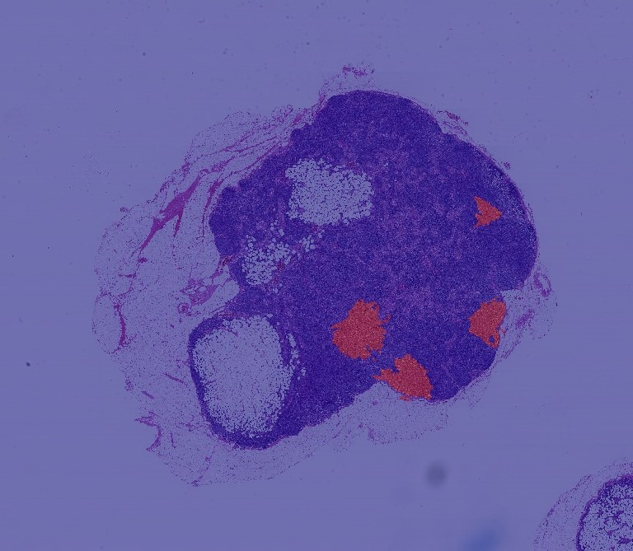
INTRODUCTION
Two Goals:
1. Tumor / Normal ?
2. Localize the tumors for a pathologist's review.

Slide 5
02
Data Preprocess
PART TWO

Slide 6
Localize Information
Imbalanced Data
Small Dataset
Data Issues

Slide 7
Extract Patches
Resampling
Data Augmentation
Techniques

Slide 8
Extract Patches
In order to extract patches and its labels, we slide a window
(e.g. 299*299) to across the slide.
And based on the paper, we predict the label of the center
region(e.g. 128*128) for each patch.

Slide 9
Resampling
In order to solve imbalanced data problem, we resampled our
training data from all patches with replacement.
Data Augmentation
8 Transformations: rotate by 4 multipliers of 90 degree and
left-right flip.

Slide 10
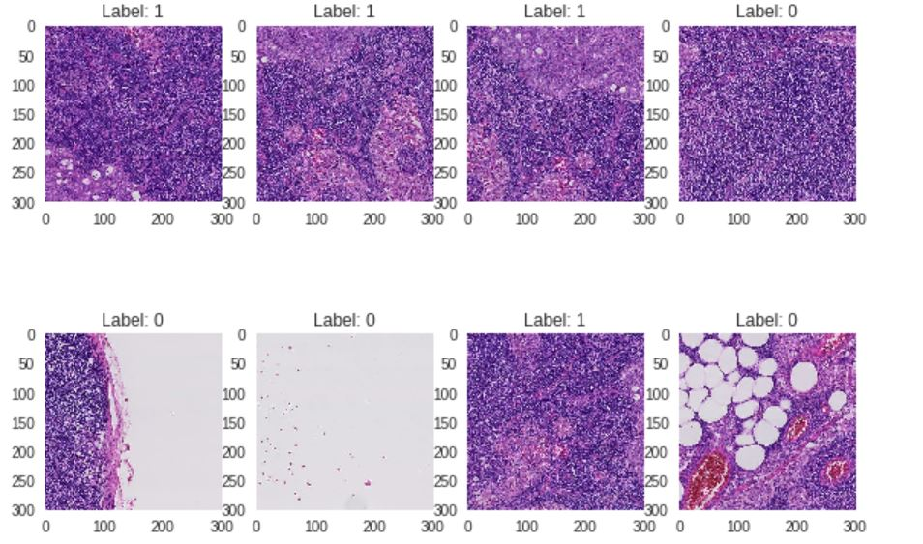
Examples

Slide 11
03
Models & Results
PART THREE

Slide 12
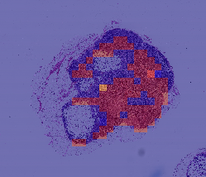
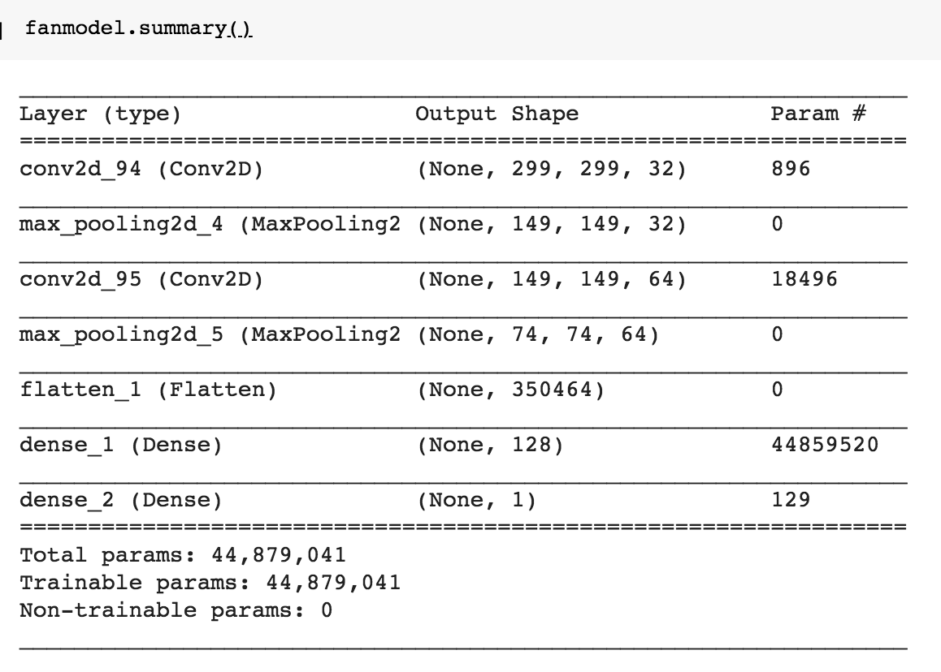
Model 1.1: Simple Baseline
Zoom Level: 4
Window Size: 299*299
Center Size: 128*128
Stride: 128
Patches: 672
Epochs: 5
Batch Size:10
Optimizer: SGD
Left: Ground Truth, Right: Predicted

Slide 13
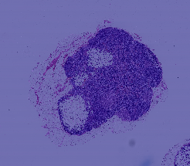
Model 1.2: Pre-trained Baseline — InceptionV3
Zoom Level: 4
Window Size: 299*299
Center Size: 128*128
Stride: 128
Patches: 672
Epochs: 5
Batch Size:10
Optimizer: RMSProp
InceptionV3
+ Flatten Layer
+ Dropout(0.3)
+ Dense(1)
Left: Ground Truth, Right: Predicted

Slide 14
Model 1: Problems We Found
Both of them performed badly!
Custom model is similar to random guess and pre-trained model tends to predict 0 for all patches.
Learned from this baseline: Except resampling, how can we solve unbalanced classes problem？-----> Multi-Classes

Slide 15
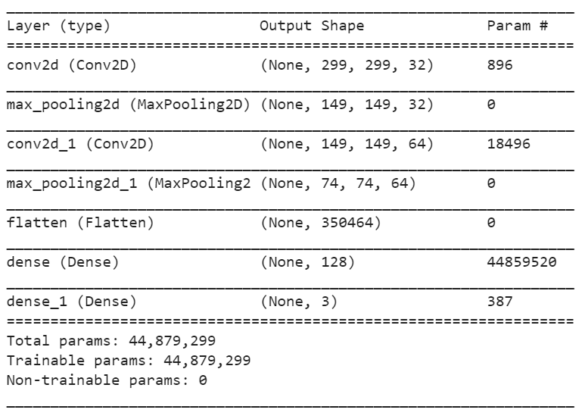
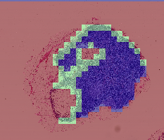
Model 2:Simple Model for Multi-classes
Zoom Level: 4
Window Size: 299*299
Center Size: 128*128
Stride: 128
Patches: 672
Epochs: 5
Batch Size:10
Optimizer: SGD
Left: Ground Truth, Right: Predicted

Slide 16
Model 2: Problems We Found
It seemed that our model always tends to classify tumor patches into normal patches while training.
Solution: How about changing the weights between false positive and false negative rate? → Increased the weights of false positive and defined our own loss function.

Slide 17
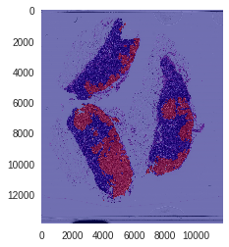
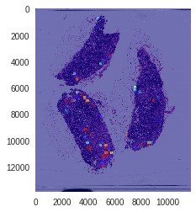
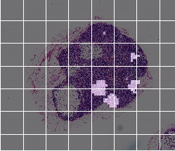
Model 3: Pre-trained Model with Weighted Loss
Zoom Level: 3
Window Size: 300*300
Center Size: 200*200
Stride: 200
Patches: 2000
With data augmentation
Epochs: 11
Batch Size:32
Optimizer: RMSProp
InceptionV3
+ Flatten Layer
+ Dropout(0.3)
+ Dense(1)
Left: Ground Truth, Right: Predicted

Slide 18
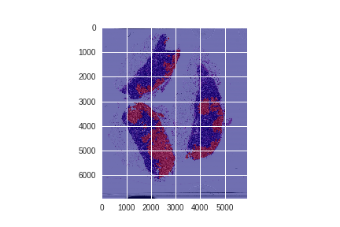
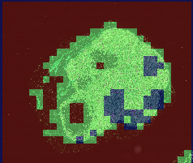
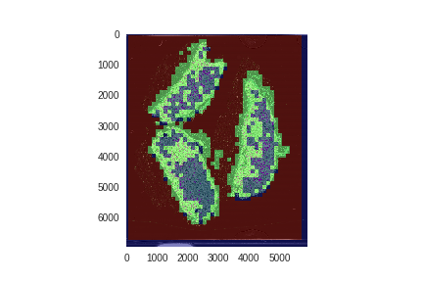
Model 4: Multi-Scale Model For Multi-Classes
Level 4(300*300)
+ CNN(32,3*3)
+ MaxPooling
+ CNN(64,3*3)
+ MaxPooling
Level 5(150*150)
+ CNN(32,3*3)
+ MaxPooling
+CNN(64,3*3)
Zoom Level: 4&5
Window Size: 128*128/64*64
Center Size: 128*128/64*64
Stride: 128/64
With data augmentation
Epochs: 20
Batch Size:10
Optimizer: RMSProp
MaxPooling
Flatten()
Dense
Output
Left: Ground Truth, Right: Predicted

Slide 19
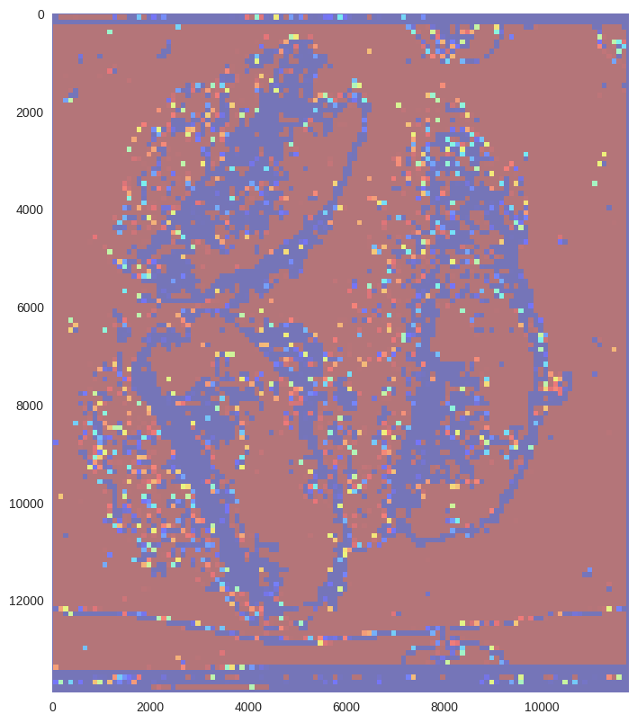
Model 5: Single-Scale Model with Multi-Inputs
InceptionV3
+ Flatten Layer
+ Dropout(0.3)
+ Dense(1)
Inputs: 2000 patches from 4 different images
Zoom Level: 3
Window Size: 100*100
Center Size: 80*80
Stride: 80
Epochs: 5
Batch Size:32
Optimizer: RMSProp

Slide 20
04
SUMMARY
PART FOUR

Slide 21
SUMMARY
In our case, multi-scale model seems to perform best.
Model Setting: Resampling + Data Augmentation + Weighted Loss + Diverse Inputs.

Slide 22
EVALUATION
Model | AUC | Recall | Precision
Multi-Scale | 0.9647 | 0.7164 | 0.980
(Evaluation for test image: tumor 078 )

Slide 23
NEXT
Scale up the model.
Improve diversity of inputs.

