Slide 1
Becoming a Full Stack Data Science Professional
Frank Zheng

Slide 2

What’s a full stack data science professional
Could be data scientist, analyst, or developer.
A full stack data science professional is a person who can influence the product roadmap, move the metrics in the right direction and makes the overall team more data oriented.
A full stack data science professional is the one who has sufficient exposures in database management, data analysis, data visualization, prediction model machine learning and data reporting.

Slide 3
Data warehousing & BI infrastructure
Led data science team and helped summer intern company to build data warehouse (PostgreSQL) for later analytics purpose.
Helped the company to establish evidence-based analytics culture by implementing BI tool (powerBI) for different departments and continuously develop dynamitic dashboards to assist decision making process.

Slide 4
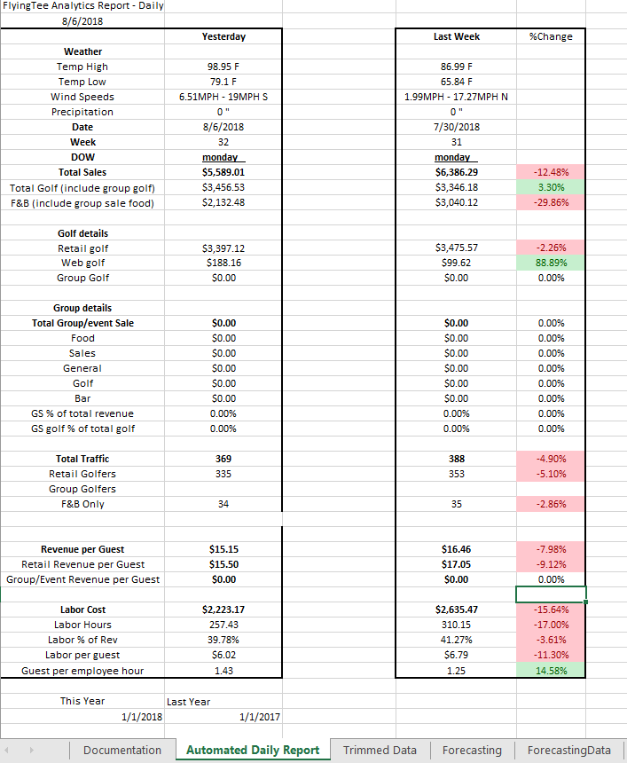
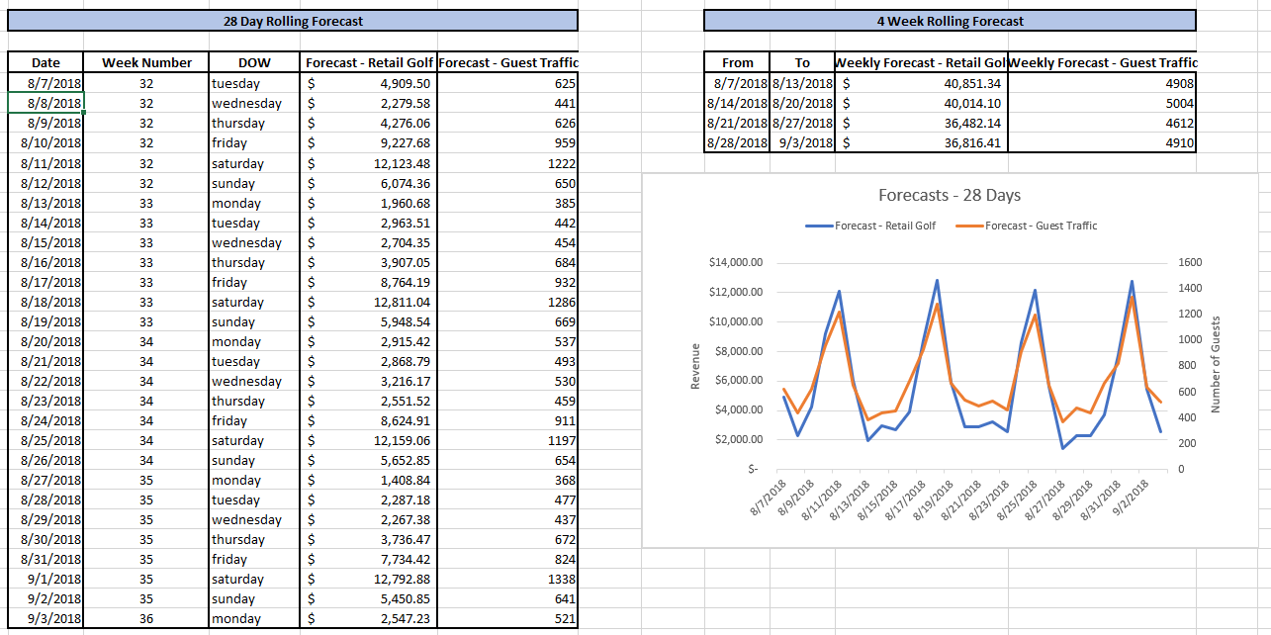
KPIs and dashboard building
Linked daily business report with backend database ensuring data accuracy.
Added prediction function to report and fully automated it.
Email bot sends report with several key takeaway point to management level people.

Slide 5
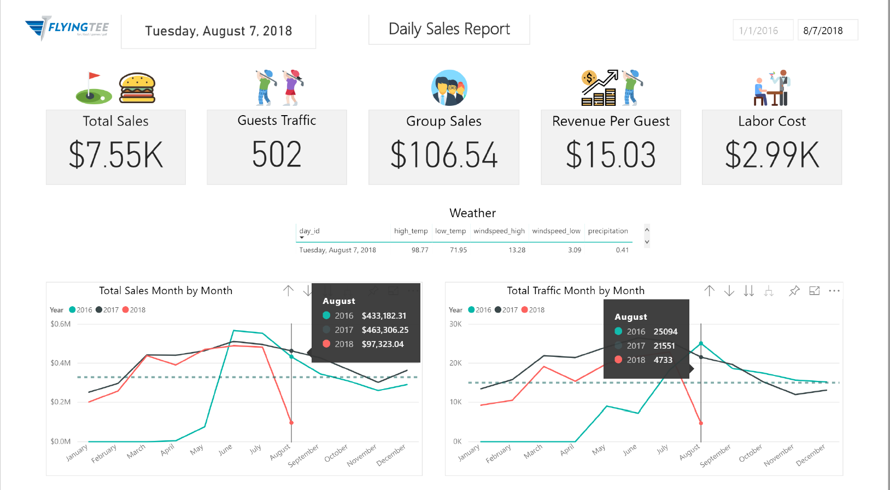
KPIs and dashboard building
Interviewed and discussed with different departments in order to design their desired dashboard. (metrics, update frequency, etc…)
Example showed here is for operations team with their favorite KPIs…

Slide 6
Predictive analytics and model building
Data mining and built prediction model to forecast daily revenue and guest traffic in order to solve company staffing issues. (R and Python)
Helped company to understand what are the key factors to their business.
The company is currently using the model to predict business performance because of its high accuracy (88%).
Better staffing greatly improves customer experience and saves operational and labor costs by 32%.

Slide 7
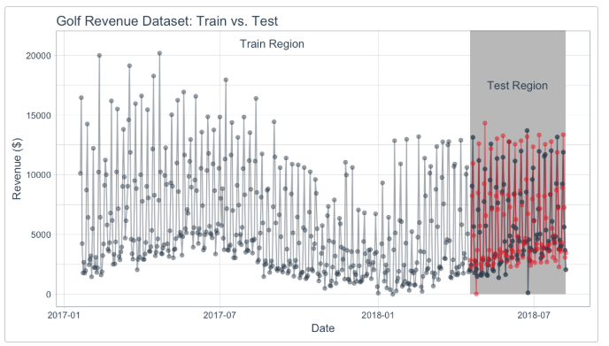
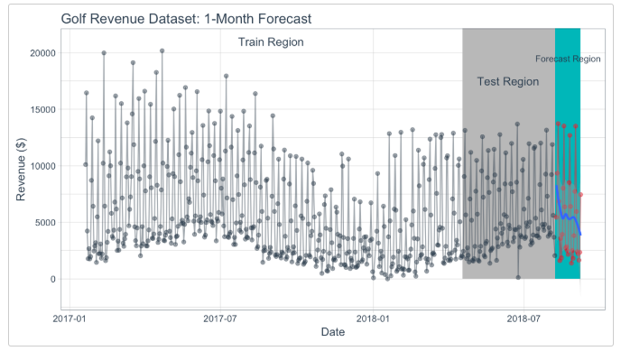
Predictive analytics and model building

Slide 8
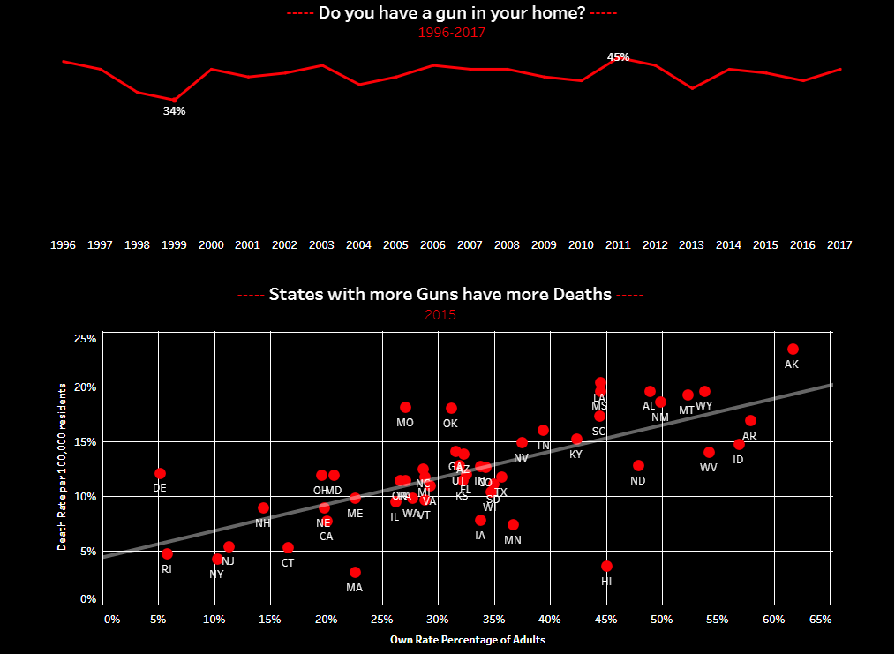
Storytelling skill
A tableau work I finished before, it was the time the tragedy 2017 Las Vegas shooting just happened and I wanted to do this dashboard to alert people.
The first view, I described the all the mass shooting events in the US history.
The second view, I compared the US vs. world. The US owns the most firearm of the world (although the US population proportion is relatively low), which indicates the rate of gun ownership in US is very high. Also, US is the country with the most mass shootings.
The third view, I further analyzed the US mass shooting data. It shows that the how US family gun ownership rate changes over the time. Also, by analyzing gun data in different states, the death rate (number of people who died because of gun shot per 100,000 residents) seems to have the positive relationship with the gun ownership rate from adults.
https://public.tableau.com/profile/frank.zheng6763#!/vizhome/Massshootingproject/Story1

Slide 9
Skill set
• Analytics Tools: Tableau, Power BI, Spotfire, Google Analytics, Looker, Excel, SPSS • Programming: SQL, Python, R Programming, SAS, T-SQL, PL/SQL, VBA, MATLAB, Tensorflow, Torch, scikit-learn • Tools: MS Office, Informatica (ETL), Alteryx, Hadoop, SQL Server, KNIME, PostgreSQL, SSIS, SSAS, SSRS, Data warehousing • Statistical Techniques: T-test, ANOVA, Regression, Correlation, Hypothesis Testing
Soft skills: Communication, attention to detail, teamwork, learning skills

Slide 10
Thank you
Questions?

