Slide 2
Actors
Concurrent, lightweight processes that communicate through asynchronous messages
Isolation of state, no internal concurrency
Location transparency

Slide 3
Actors
An actor, in response to a message received, can do the following:
Send a finite number of messages to other actors
Create a finite number of new actors
Designate the behavior to be used for the next messages it receives

Slide 4
Actors – Demo (1)
Tell, Ask
Location Transparency
Become/Unbecome
Streaming
Actor Creation tips

Slide 5
Actor System
Manage the resources to run the actors hierarchy
Actors can create actors and become their supervisors. When a failure/exception occurs, the supervisor can:
Resume the subordinate
Restart the subordinate
Stop the subordinate
Escalate the failure

Slide 6
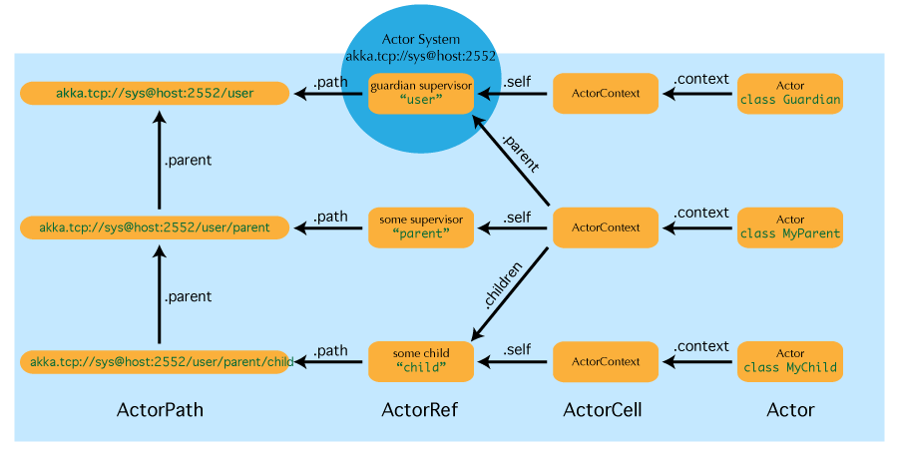
Actor System
Each actor is be located in the network by its unique address
akka.tcp://actorSystem:2552/user/parent/child
akka.tcp://actorSystem:2552/remote/remoteActorSystem:2553/user/parent/child

Slide 7
Actor System
On initialization it creates the top-level actors:
Root guardian “/”
System guardian “/system” guardian actor for all system-created top-level actors, e.g. logging listeners or actors automatically deployed by configuration at the start of the actor system
User guardian "/user" is the guardian actor for all user-created top-level actors; actors created using ActorSystem.actorOf are found below this one
Additional guardians…
Temp guardian “/temp” is the guardian for all short-lived system-created actors, e.g. those which are used in the implementation of ActorRef.ask
DeadLetters guardian “/system/deadLetters” dead letter actor, which is where all messages sent to stopped or non-existing actors are re-routed
Remote guardian “/remote” is an artificial path below which all actors reside whose supervisors are remote actor references

Slide 8
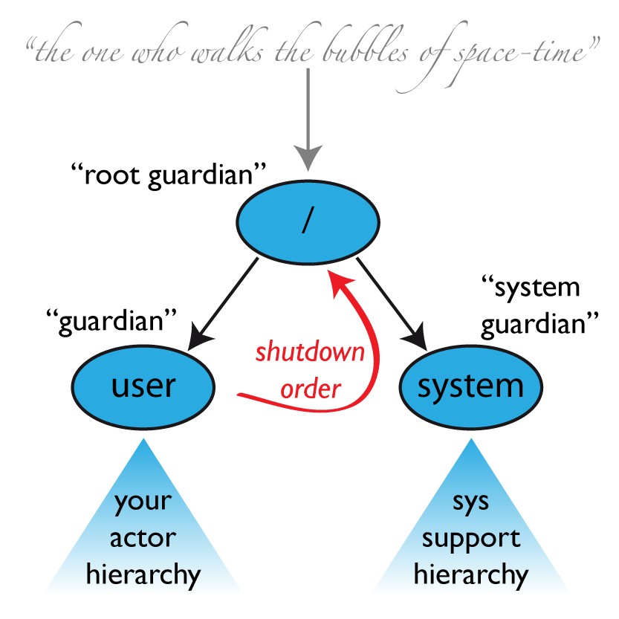
theOneWhoWalksTheBubblesOfSpaceTime
This Actor's only job is to shut down the entire ActorSystem if the root actor fails. Will receive only Supervise/ChildTerminated system messages or Failure message.
…available at
rootPath / "bubble-walker"

Slide 9
Some Recommendations

Slide 10
Single Responsibility Principle
Actors should do only one thing
Do not conflate responsibilities in actors
Become hard to define boundaries of responsibilities
Supervision becomes more difficult (more possibilities to handle)
Debugging gets harder

Slide 11
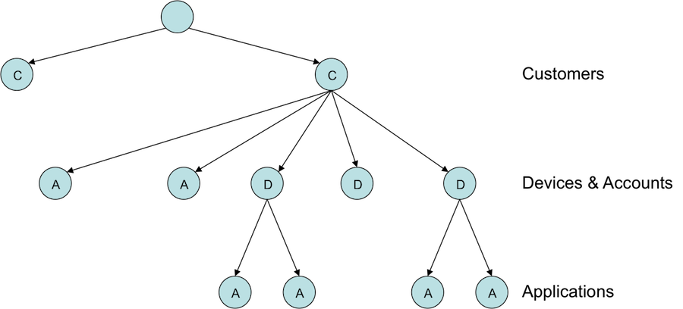
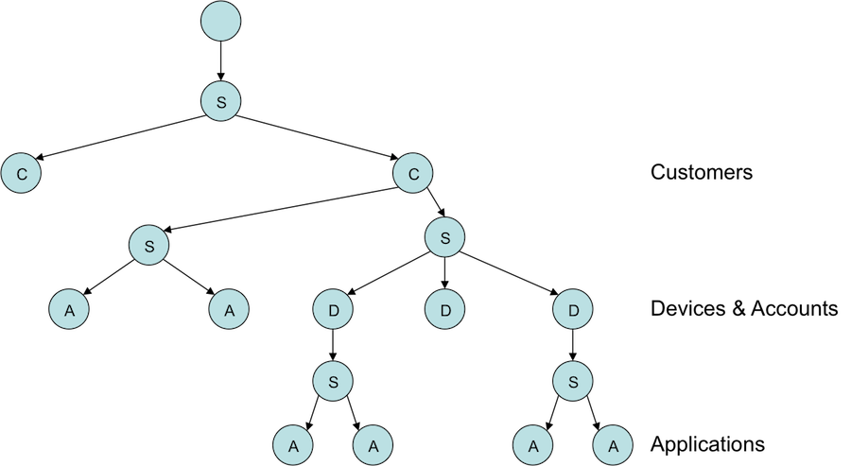
Supervision
Every non-leaf node is technically a supervisor
Create explicit supervisors under each node for each type of child to be managed
Supervisors should do nothing except manage their actors
Conflated supervisors
Explicit supervisors

Slide 12
Error Kernel Pattern
The root of the trees must not fail under any circumstance
If an actor carries important internal state, delegate dangerous tasks to child actors
Keep important state close to the top to the hierarchy and push to the bottom error-prone tasks
Shallow hierarchies with a substantial number of actors should be a “smell test”

Slide 13
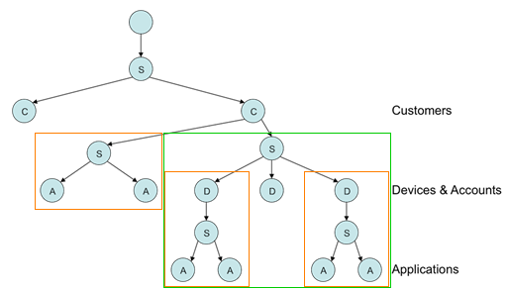

Failure zones
Plan multiple isolated zones with their own resources
Helps preventing starvation of actors
Prevents issues in one branch from affecting another

Slide 14
Avoid Blocking
If you are blocking on IO/locks, then tying up a thread is a massive waste of memory resources
Passively waiting when that thread can be doing other things
Eventually results in actor starvation as thread pool dries up
Bad performance
Waste of system resources
class CustomerUpdate(dbDriver:DatabaseDriver) extends Actor{ def receive ={ case UpdateCustomer(customer) => val originalSender = sender() implicit val ec:ExecutionContext = ExecutionContext.fromExecutor(new ForkJoinPool()) val future = Future { // some JDBC action } future.onComplete { case Failure(x: Throwable) => throw new CustomerUpdateException(x) case Success => originalSender ! TransactionSuccess } } }

Slide 15
When you must block…
Isolate blocking calls to actors that don’t share resources with non-blocking work
Scala’s feature Managed Blocking (careful!)
import scala.concurrent.blocking blocking{ // do some naughty blocking stuff }

Slide 16
Push, don’t Pull
Resist the temptation to ask for everything
Creates system actor in temp guardian
Callbacks can introduce complexity (state can escape in closure)
It forces assumptions about time in your system
Extra pattern/Cameo pattern

Slide 17
Demo (2)
Extra Pattern, Cameo Pattern

Slide 18
Never Publish "this"
Don't hand out closures with ‘this’ outer reference; especially take care with Future callbacks. Copying to local vals helps.
Use ‘self’ instead, which is an ActorRef
Don't send it anywhere
Don't register it anywhere
Particularly with future callbacks
Avoid closing over "sender" in Akka, it will change with the next message

Slide 19
Use Immutable Messages
Mutable data inside actors is fine. If an actor’s mutable state is exposed to the outside, you are back in normal Java concurrency
Immutable message enforces which actor owns the data
Pass copies of mutable data
If state needs to be shared/transactioned Scala STM can help
When you really need composable message flows across many actors updating their internal local state but need them to do that atomically in one big transaction. Might not be often, but when you do need this then you are screwed without it.
When you want to share a datastructure across actors.

Slide 20
Make debugging easier
Consider use external functions to encapsulate business logic as complexity increases
Easier to unit test outside of actor context
Trace-level logs should have output that you can read easily
Unique IDs for Messages
Akka ensures ordering on a per actor basis, also in logging

Slide 21
Monitor
Demo -> Takipi

