Slide 1
Persistent Binary Trie
-Shobhit Raj Gautam(2019201056)
-Abhinav Gupta (2019201064)

Slide 2
Introduction
Trie, also called digital tree is a kind of search tree—an ordered tree data structure used to store a dynamic set or associative array where the keys are usually strings.
No node in the tree stores the key associated with that node, instead, its position in the tree defines the key with which it is associated.
All the descendants of a node have a common prefix of the string associated with that node, and the root is associated with the empty string.

Slide 3
Binary Trie
Binary Tries are like usual tries are used to store strings containing only two characters i.e. 0 and 1.
We have implemented Binary Trie in 2 ways:
1. Variable Bit length Binary Trie.
2. Fixed Bit length Binary Trie.
Both These Trie has own properties and advantages.

Slide 4
Fixed length Binary Trie
This stores number in its bit representation in form of tree.
It is Binary Tree where each node has 2 child, left child representing bit 0 and right child bit 1.
The height of tree is O(K) where k is number of fixed bits for each number.
K = log n where n is largest decimal number that can be represented with k bits.
For each query , path traversed is O(log n) as each query is traversed till leaf node.

Slide 5
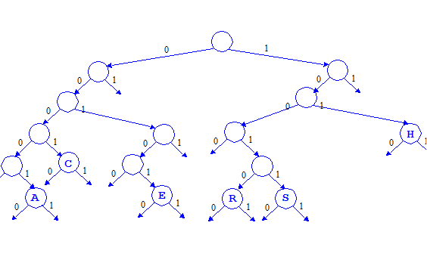
Fixed length path for each number.

Slide 6
Variable length Binary Trie
This also represents Number in form of bits in tree.
But, length of each number is equal to number of bits in binary form, i.e it does not pad bits to give fixed length to all numbers.
For ex:
2 – (10) , Takes 2 nodes in Trie,
7 -(111) , takes 3 nodes in Trie.
It is space optimized as no padded are used.
Search Query runs faster, equal to O(log q), where q is length of bits in searching that number.

Slide 7
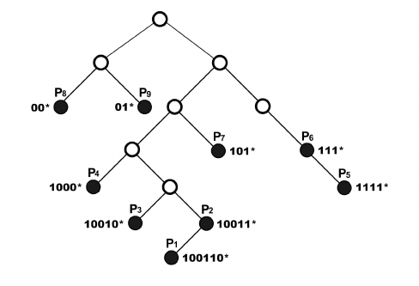
0
0
Variable length Binary Trie

Slide 8
Construction: Fixed Length Trie
Steps
Convert Number to Binary Form.
Pad 0 bit in start for making it to fixed length.
Traverse Tree from root recusively,if bit is 0, go left and if bit is 1 go right, i.e create nodes for that particular number.
Repeat process until whole bit string is traversed.
Construction takes O(log n) time where n is largest number in decimal form which can be represented with given fixed bits.

Slide 9
Construction: Variable Length Trie
Steps same as above except, no padding is done.
Additionally, structure has flag bit, which is 1 for node representing LSB of number, else 0.
Space- O(K)
Time for search is O(K)
Note:
K is no of bits taken by the numbers in its binary form.

Slide 10
Applications:
MAX_XOR using fixed length binary Trie
Steps:
Given number is converted in binary form and padded to fixed length.
Tree is traversed till all bits of number are visited.
If current bit is 0,tree has Right node then go right.
If current bit is 1, tree has left node then go left.
Repeat This procedure till whole bits of given number is traversed.
While traversing back keep on increases count to 2 raised to power position of current bit and adding it to the previously calculated value.

Slide 11
Applications:
Time and Space optimized Search using Variable length Binary Trie
Steps:
Convert number in binary form.
Traverse left of node if bit is 0 and left node exists, Traverse right of node if bit is 1 and right node exists.
If path exists till last bit of number and last node of tree has flag bit 1, then element found else not found.
It takes O(log n) time where n is number to be searched.

Slide 12
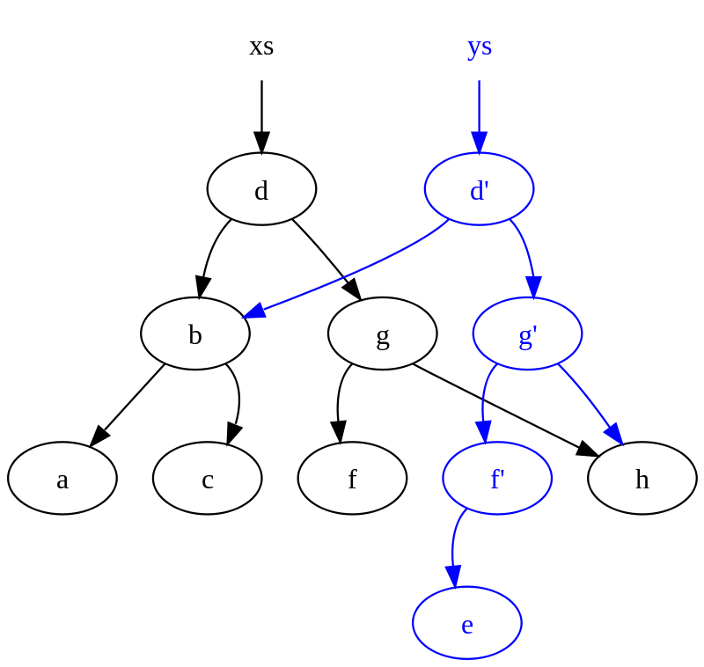
Persistency in Data Structure
A persistent data structure is a data structure that always preserves the previous version of itself when it is modified.
Such data structures are effectively immutable, as their operations do not (visibly) update the structure in-place, but instead always yield a new updated structure.
Black Tree is Old Version.
Blue Tree is New Version.

Slide 13
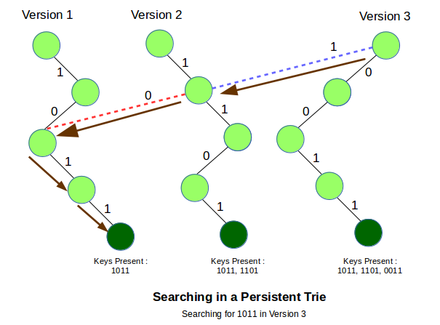
Persistent Binary Trie
For each new insertion Query, a new Tree is created with elements equal to bits in that inserted node.
New Version tree nodes point to nodes of original Tree as shown below:

Slide 14
Implementation:
STEPS
Any new insertion in the trie leads to a change in the data of only O(logn) vertices along the path starting from the root.
So if we store the Trie using pointers (i.e. a vertex stores pointer to the left and the right child vertices)
Then while insertion,we simply need to create new vertices instead of changing the available vertices.
Vertices that are not affected by the Insertion query can still be used by pointing the pointers to the old vertices.
Thus O(logn) new vertices will be created, including a new root vertex of the Trie, and the entire previous version of the tree rooted at the old root vertex will remain unchanged.

