Slide 1
Persistent Segment Tree
-Shobhit Raj Gautam(2019201056)
-Abhinav Gupta (2019201064)

Slide 2
Introduction
Segment tree is a tree data structure used for storing information about segments or intervals.
It is generally used to process range queries efficiently.
For such intervals or segments endpoints are fixed or known a priori.
So Sets of intervals stored with the node can be structured in any manner convenient depending on the problem.

Slide 3
Properties
It can be built in O(n) time.
Segment trees support searching for all the intervals that contain a query point in O(log n).
Leaf node of Tree correspond to the elementary intervals in an ordered way.
The internal nodes of Tree correspond to intervals that are the union of elementary intervals of set I.
Root of Tree is union of all elements in set I.

Slide 4
Structure of Segment Tree
Sum representation in Segment Tree
Sum of the segment a[0…n−1] is stored as root.
We then split the array into two halves a[0…n/2] and a[n/2+1…n−1] and compute the sum of each halve and store them.
Each of these two halves in turn also split in half, their sums are computed and stored.
And this process repeats until all segments reach size 1.
For each such segment we store the sum of the numbers on it

Slide 5
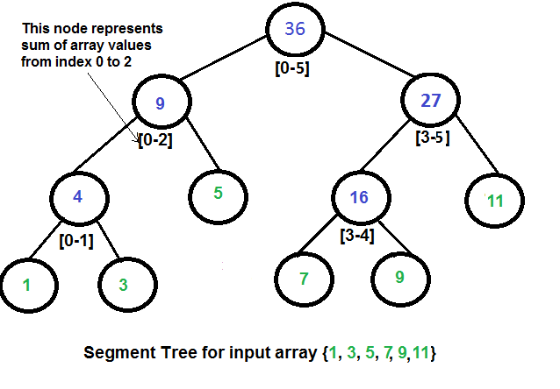

Slide 6
Lemma: Total Nodes < 4n
PROOF
From previous Representation,
The first level of the tree contains a single node (the root),
the second level will contain two vertices, in the third it will contain four vertices, until the number of vertices reaches n.
Thus the number of vertices in the worst case can be estimated by the sum 1+2+4+⋯+2⌈log2n⌉=2⌈log2n⌉+1.
And 2⌈log2n⌉+1< 4n.
Total nodes in Tree < 4N i.e O(4n).

Slide 7
Construction of Tree O(n)
The leaf node represents value of single element, Therefore we can simply copy the values of the elements from array.
We start the construction at the root vertex and the construction procedure, is called on a not-leaf vertex, first recursively constructs the two child vertices, and than sums up the computed sums of these children.
If it is called on a leaf vertex, it simply uses the value of the array.
The time complexity of the construction is O(n).

Slide 8
Lemma: Search Time O(Log n)
PROOF
At the first level, we only visit one vertex, the root vertex, so here we visit less than four vertices.
Since each vertex can only cause at most two recursive calls.
By induction hypothesis:
At any arbitrary level, there are at most 4 nodes that can be visited.
Since the segment tree has a height of log(n) and that at any level there are at most 4 nodes that can be visited.
Therefore we visit at most 4logn vertices in total, and that is equal to a running time of O(logn).

Slide 9
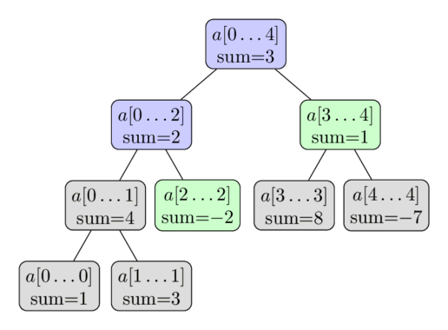
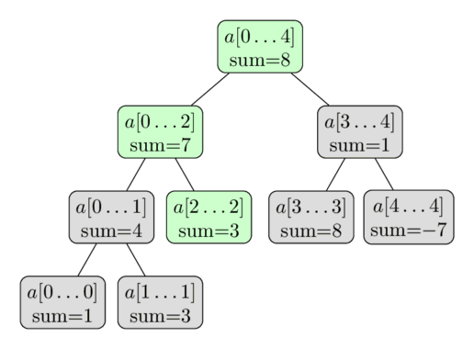
Update in Segment Tree
Original Segment Tree
Update In Segment Tree
Thus only O(log n) needs to be updated for single update Query.

Slide 10
Search In Segment Tree
Obviously start the traversal from the root vertex of the Segment Tree.
Traverse the Segment Tree, Let's assume that we are currently at the vertex that covers the segment a[tl…tr].
There are three possible cases.
The easiest case is when the segment a[l…r] is equal to the corresponding segment of the current vertex (i.e. a[l…r]=a[tl…tr]), then we are finished and can return its value.
Alternatively the segment of the query can falls completely into the domain of either the left or the right child. Go in desired child and repeat process.
There is the last case, the query segment intersects with both children. First we go to the left child, compute a partial answer for this vertex, then go to the right child, compute the partial answer using that vertex, and then combine the answers by adding them and return answer to parent.

Slide 11
Applications:
Max-Min Operation Using Segment Tree
The tree will have exactly the same structure as the tree described above.
We only need to change the way t[v] is computed in the build and update functions. t[v] will now store the maximum of the corresponding segment.
And we also need to change the calculation of the returned value of the sum function, replacing the summation by the maximum.
This problem can be easily changed into computing the minimum instead of the maximum.

Slide 12
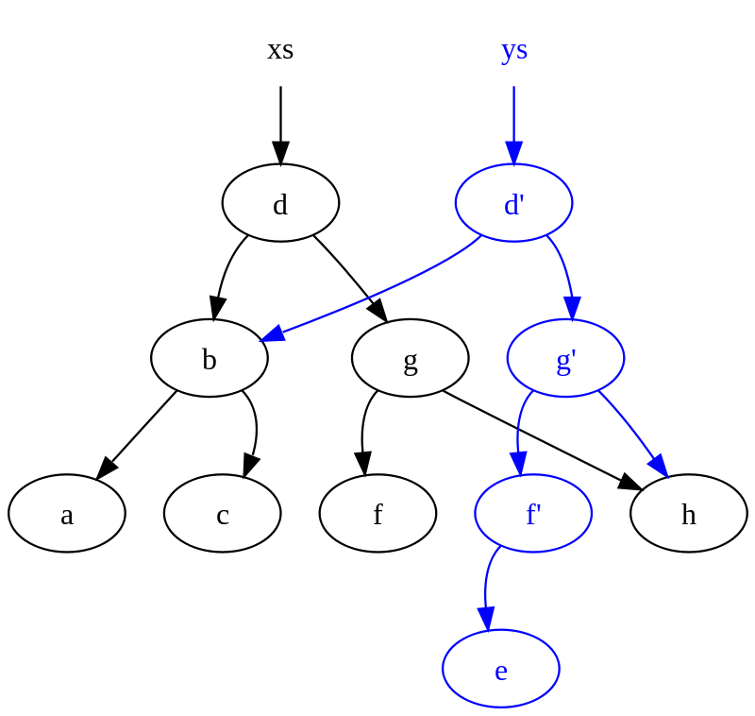
Persistency in Data Structure
A persistent data structure is a data structure that always preserves the previous version of itself when it is modified.
Such data structures are effectively immutable, as their operations do not (visibly) update the structure in-place, but instead always yield a new updated structure.
Black Tree is Old Version.
Blue Tree is New Version.

Slide 13
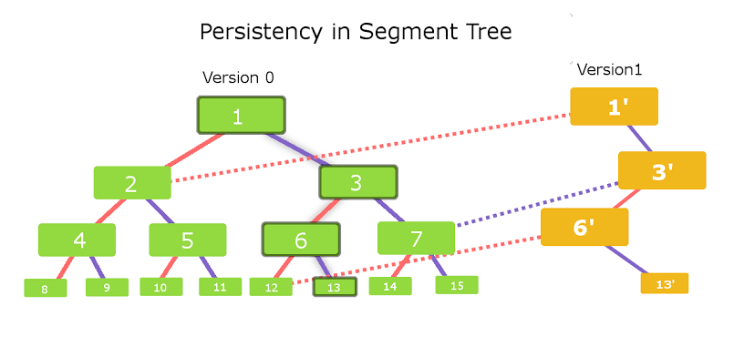
Persistent Segment Tree
For each Update Entry, a new Tree is created with elements equal to
height of Original Tree.
New Version tree nodes point to nodes of original Tree as shown below:

Slide 14
Any change request in the Segment Tree leads to a change in the data of only O(logn) vertices along the path starting from the root.
So if we store the Segment Tree using pointers (i.e. a vertex stores pointers to the left and the right child vertices), then when performing the modification query, we need to create new vertices instead of changing the available vertices.
Vertices that are not affected by the modification query can still be used by pointing the pointers to the old vertices.
Thus for a modification query O(logn) new vertices will be created, including a new root vertex of the Segment Tree.
The entire previous version of the tree rooted at the old root vertex will remain unchanged.

Slide 15
Implementation:
STEPS
Create new Root node
Create one child lying in path of modified element
Point other child of new root to other child of root in original Tree.
Recurse above steps till element is found at leaf node.

Slide 16
Drawbacks
Update in range takes O(k) time where k is number of elements in range.
SOLUTION
It can be done in O(log K) with Lazy Segment Tree.

