Slide 1
WHAT Materials, equipment, infrastructure, references/resources are used in the process?
EOS-Glossary
WHO owns this procedure and who participates in the process?
Owner: | Ciro Martinez
Swim Lanes: | Customer Satisfaction (Quality)
CORP, Segment, or BU: | Connection Systems
INPUTS - Triggers process to start
KIM – Known Issues Matrix QAM – Quality Assurance Matrix BOM – Bill of Materials DFMEA – Design Failure Mode and Effects Analysis Initial SOW – Statement of Work BOP – Bill of Process (if available) CSR – Customer Specific Requirements Product Drawing – Latest approved version Preliminary Process Flow available FTQ (First Time Quality) target defined for MQ1 BIQ (Built in Quality) Leader – assigned to the project RASIC Chart – Q specific activities
OBJECTIVE: Establish a standardized and proactive APQP process that leverages lessons learned and best practices from similar products to prevent quality and performance issues, ensure robust risk mitigation, and drive flawless launches for assigned new programs.
SCOPE
This procedure applies to all new program developments.
OUTPUTS – Process deliverables
MQ1 Release aligned with QAM MQ2 Release aligned with QAM Safe Launch Plan implemented Control Plan completed & approved Full PPAP (Production Part Approval Process) approved Sign-off completed by Manufacturing Engineering and BIQ Engineer
What methods/procedures &/or techniques are used to describe HOW the process is done.
A. Known Issues Matrix (KIM) – EAGP_4-3_CS_11_F01_EN B. Quality Assurance Matrix (QAM) – EAGP_4-3_CS_11_F02_EN C. MQ1 Release Document – EANW_4-3_ME_OM_21-02 C. MQ1 Format – EANP_4-3_ME_OM_21_F05 E. Control Plan – EAGP_4-3_CS_01-F01_EN F. Safe Launch Plan – HOGW_5-3_CS-SPS_02-02_EN G. Statement of Work (SOW) – EANW_4-3_ME_OM_21-01 F01 H. Safe Launch Matrix – EANP_5-3_MG_OM_01-02_F01_ES I. APQP Dashboard – Matrix provided by EMAIL Excel file (PMO-See Page # 7)
What METRICS are used to report the effectiveness/efficiency of the process or to monitor/measure performance?
APQP Dashboard Metrics: % Alignment of QAM vs. SOW Review % Completion of MQ1/MQ2 QAM Audits Safe Launch Coverage (3 months post-launch) Full PPAP Approval Status

Slide 2
3 | BIQ Leader w/ Product Eng & Manufacturing Eng
Review KPCs, QCIs, PSDs, and Fit/Function (FF) characteristics; verify tolerances and confirm measurement capability by assessing whether existing equipment can effectively measure and comply with product specifications.
Product Drawing
1a | BIQ (Built in Quality) Leader / Plant Quality Engineer
Program is assigned to the BIQ leader and BIQ leader creates a Known Issues Matrix (KIM) by gathering data from similar products and programs using QSYS inputs, including Warranty claims, 0km issues, PORs, PCRs, and FFMs from global sources.
A – Inputs from current systems
2 | BIQ Leader with Product Engineer
Identify and document critical characteristics within the Quality Assurance Matrix (QAM) to ensure proper controls and monitoring throughout the product lifecycle.
Product Drawing
1b
Identify Customer Specific Requirements (CSR) to ensure applicable requirements ,specifications, expectations, and compliance obligations are captured and integrated into the project deliverables.
A / Part Drawing / DFMEA
5 | BIQ Leader with Manufacturing Eng
Ensure alignment between the Statement of Work (SOW), Quality Assurance Matrix (QAM), and the Error-Proofing/Poka-Yoke, Measurement Devices or Gauges List to guarantee consistent definition of requirements and effective risk mitigation. Update APQP Dashboard.
Drawing and preliminary SOW
BIQ Engineer
4 | BIQ Leader w/ Product Eng & Manufacturing Eng
Confirm that the equipment will have the capability to prevent quality issues
DFM inputs and QAM review
6 | BIQ Leader with Manufacturing Eng
Conduct MQ1 assessment from the BIQ perspective.
QAM and KIM with SOW
7

Slide 3
7 | BIQ Leader
Is process capable to prevent and detect quality issues including critical characteristics
9 | Manufacturing or Industrial Engineering w/ BIQ leader
Document PFMEA by focusing on critical characteristics, potential failure modes, and associated process controls.
PFMEA Workshop with ME
8a | BIQ Leader
Approve MQ1 from BIQ perspective
MQ1 Event
Yes
8b | BIQ Leader
Document the improvement plan in the KIM, monitor ME and Supplier and update APQP Dashboard until closure, and then proceed to Step # 9
MQ1 Event
No
10 | BIQ Leader / Quality Manager of the Plant
Perform MQ2 revision from BIQ perspective & Approve MQ2 by Plant Quality Mgr
MQ checklist
11 | BIQ Leader
B,D
12b | BIQ Leader / Quality Manager of the Plant
Approve MQ2 form BIQ perspective
MQ checklist
Is process capable to prevent and detect quality issues including critical characteristics
Yes
13
12a | BIQ Leader
Document the improvement plan in the KIM, update APQP Dashboard and follow it until is closed then move to next step
A MQ2 vs QAM format
No

Slide 4
13 | BIQ Leader
Develop Process Control Plan using the information from the PFMEA, MQ exercise, and QAM.
PCP workshop
14 | BIQ Leader
Prepare a safe launch plan in accordance with customer requirements and document it within the control plan.
Containment /Safe Launch
15 | Plant PPAP Responsible person
Submit PPAP package
Email or Customer Portal
16 | BIQ Leader
Customer PSW
Did we get Full PPAP Approval and no safe launch issues in 90 days
17 | Plant Quality Engineering
Manufacturing Plant takes control of the program
Yes
18 | BIQ Leader
Document action item in the KIM until it is closed. Save KIM for similar products of other plants or regions
KIM format
No

Slide 5
Process Step # | Owner | Requirements and/or Additional Details
1a, 1b | BIQ Leader / Plant Quality Engineer | Develop a Known Issues Matrix (KIM Form) using QSYS data (Warranty, 0km, PORs, PCRs, FFMs, BIQ Leaders should review escalations from Quality Directors (via Olivier De Galard) from similar products/programs. Identify customer-specific requirements and expectations. to ensure critical issues are included. KIM must reflect lessons learned across manual, semi-automatic, and fully automated processes to prevent risks of product mishandling specially in safety products.
2 | BIQ Leader / Product Engineer | Document critical characteristics in the Quality Assurance Matrix (QAM), ensuring lessons learned from the Known Issues Matrix (KIM) are integrated for future MQ evaluations.
3 | BIQ Leader / Product Engineer / Mfg Engineering | Review KPCs, QCIs, PSDs, and F/F characteristics, ensuring tolerances are met with available equipment. All KPCs and F/F features require investment, monitoring, and 100% verification. If no investment is planned, customer approval must be obtained.
4 | Manufacturing / Process Engineering | Confirm equipment can prevent quality issues; inform Program Management, and escalate if unresolved by the BIQ Leader. Explain further the risks encountered and potential issues.
5 | BIQ Leader / Manufacturing/ Process Engineer | Ensure Alignment of Statement of Work (SOW) - QAM and Error Proof / Poka-yokes list to ensure that the machine or equipment being installed achieves that desired quality care to prevent issues with customers. Decision to invest less than required will lead to a Red Status in Quality for the program management dashboard reviews.
6 | BIQ Leader | Perform MQ1 from BIQ perspective, ensure that all items in QAM are evaluated versus SOW, ensure that the Dashboard for APQP is updated with your information.
7 | BIQ Leader | If the process can prevent, detect, and monitor quality issues (including critical characteristics), proceed to Step 8; if not, document gaps in the KIM, inform Program Management, and escalate if unresolved by the BIQ Leader.
8a | BIQ Leader | Approve MQ1 from BIQ perspective if QAM is in compliance at the point when the machine is assessed by quality at supplier of machinery site. Follow the MQ1 checklist with required approval from BIQ leader.
8b | Industrial Engineering or Mfg Engineering | Document PFMEA based on critical characteristics, potential failure modes and process controls with support of the BIQ Leader

Slide 6
Process Step # | Owner | Requirements and/or Additional Details
9 | ME/ IE | Document PFMEA with focus on Critical Characteristics with High Severity impact, potential failure modes associated and process controls already identified in QAM format with support of BIQ Leader
10 | BIQ Leader / Quality Manager | Perform MQ2 revision from BIQ perspective & Approve MQ2 by Plant Quality Mgr
11 | BIQ Leader | If the process can prevent and detect quality issues (including critical characteristics), proceed to Step 12; if not, document gaps in the KIM and inform the Plant Quality Manager and Regional Quality Director about the risks of not meeting required controls for specific KPCs or other critical features.
12 | BIQ Leader / Quality Manager | Approve MQ2 form BIQ perspective
13 | BIQ Leader | Create the Control Plan using PFMEA, MQs, and QAM inputs. It may be phased, but must be completed before launch. The BIQ Leader should hold reviews until all key QAM and KIM issues are addressed with defined controls in the plan.
14 | BIQ Leader | Prepare a safe launch plan according to the customer requirement and document it in the control plan
15 | Plant PPAP Engineer or Technician | Submit the PPAP package with support from the multidisciplinary team. Coordination is the Program Manager’s responsibility, not Quality or the BIQ Leader.
16 | BIQ Leader | Did we get Full PPAP Approval and no safe launch issues in 90 days then go to step 17, if we didn’t, document the open items in the KIM
17 | Plant Quality Engineering | Plant takes control of the program
18 | BIQ Leader | Document action item in the KIM until closure with Multi- disciplinary team.

Slide 7
RASIC Chart to clarify R- responsibilities for specific Quality related tasks in PM book
EMEA RASIC Task | APQP RASIC Global Procedure | Task Owner | Program Management | Sales | Customer Satisfaction | Manufacturing Engineering | Product Engineering | Humarn Resources | Supply chain Management | Production Control ( PC&L) | Manufacturing
Lessons Learned / Problem Solving | KIM Format (Step 1a) | CS | I | I | R | C | C | I | C | C | S
Prototype Control Plan | Process Control Plan deployment with QAM/KIM | CS | I | I | R | S | S | I | S | S | S
Training on Customer specific Requirements | Customer Specific Requirements Step 1b | CS | S | S | R | S | S | S | S | S | S
Develop Incoming Control | Step 2 and Step 13 -QAM Format and development of process control plan | CS | I | I | R | S | S | I | S | C | S
Pre-Launch Control Plan | Step 13- Process Control Plan deployment with QAM/KIM | CS | I | I | R | S | S | I | S | S | S
Early Containment plan & CSE coverage | Step 14 - Safe Launch Plan | CS | I | I | R | S | S | I | I | S | S
Production Control Plan / Control Plan | Step 13- Process Control Plan deployment with QAM/KIM | CS | I | I | R | S | S | I | S | S | S
Produce and Release Master Sample for PPAP | Step 13- Process Control Plan deployment with QAM/KIM | CS | I | I | R | S | S | I | S | S | S
Part Submission Warrant (PSW)/ Production Part Approval Process (PPAP) | Part Submission Warrant (PSW)/ Production Part Approval Process (PPAP)- Step 15 of APQP procedure | PM | S | S | A | R | R | R | R | R | R
***Production Readiness Assessment |  | Plant Quality | S | S | R | S | S | S | S | S | S
***Production readiness assessment currently
Part of Plant Quality responsibilities in EMEA only.
Responsible - Those who do the work to achieve the task.
Approval - Those who are ultimately accountable for the correct and thorough completion of the deliverable or task, and the one to whom Responsible is accountable. or Accountable In other words, an Accountable must sign off (Approve) on work that Responsible provides.
Support - Resources allocated to Responsible. Unlike Consulted, who may provide input to the task, Support will assist in completing the task
Inform - Those who are kept up-to-date on progress, often only on completion of the task or deliverable; and with whom there is just one-way communication.
Consult - Those whose opinions are sought; and with whom there is two-way communication.

Slide 8
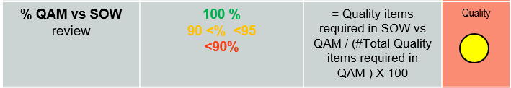
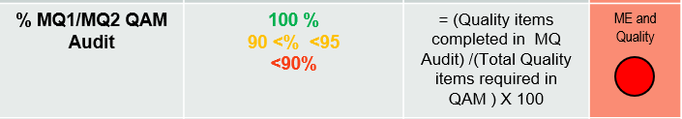
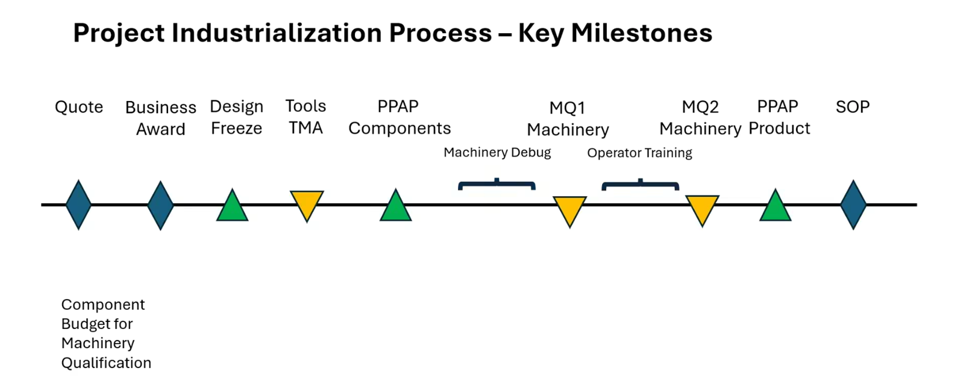
Reference Only -BIQ Procedure – One Page Summary
KIM – Capture Mfg lessons learned from OEM (warranty, escalations)
2. Do a KIM for the program (involve experts)
4. Do QAM per product type (include PE & Q)
5. Quailty team to Review SOW vs. QAM & KIM with ME experts
6. Formalize a SOW per Product Type prior to PO issued for equipment
1. Define Program Priorities
3. Review Qty of Dim for KPC, QCI, FF, PSD (Final products only)
Assess Component Functions (PE)
7. MQ1/MQ2 Audit vs QAM
Ensure alignment of critical Component functions with KPC, QCI, F/F list
APQP Dashboard Metris added per Program
KIM = Known Issues
In Mfg (Warranty,
escalations, complaints
Lessons learned)
BIQ Engineer (APQP)
Product Engineering
Mfg Engineering F4
Quality team to
actively engage
in the F4 process
QAM = Quality Assurance
Matrix (Example: SCCAF)
Equipment P.O. with
SOW improvements
Improved
SOW
QAM
Audit
(MQ1)
QAM
Audit
(MQ2)
Qty of KPC’s and Tolerances
Qty of QCI’s and tolerances
Plan for measurement equipment
F/F – Plan for Testing equipment
Plan for Robust Quality Control
=
QAM
Add extra budget for Newly design
*Added investment related to Customer Critical Functional items
SOW – Statement of Work prior to PO order!
Purpose: Align KPC’s to Error Proof list in SOW
Warranty, Escalations, OEM Issues
Cost claim impacts, Mfg Plant issues.
KIM

Slide 9
BIQ Leader (CS)- Roles and Responsibilities (Reference Only)
1. Update APQP Dashboard metrics as programs assigned are monitored
2. Knowledge & Risk Management
Create and maintain the Known Issues Matrix (KIM) using historical data (Warranty, 0km, PORs, PCRs, FFMs).
Identify and document critical characteristics in the Quality Assurance Matrix (QAM).
Review historical product issues to define customer-specific requirements and expectations.
3. Product Review and Characterization
Review KPCs, QCIs, fit/function characteristics, and assess equipment capability to meet tolerances.
4. Print Requirements Alignment to SOW (Equipment & Pokayokes) and QAM
Ensure alignment of the Statement of Work (SOW) with the QAM and Poka-yoke/Error Proofing measures.
Confirm the availability and capability of equipment to prevent quality issues.
5. Machine Qualification (MQ) Assessments with Quality Assurance Matrix
Perform MQ1 and MQ2 assessments from a BIQ perspective.
Approve MQ1 and MQ2 readiness and escalate open issues when necessary.
Determine process capability to detect and prevent quality issues.
Document any open gaps or issues in the KIM.
6. Support Process Failure Mode and Effects Analysis (PFMEA) development
Support the documentation of PFMEA:
Focus on critical characteristics with high severity.
Link failure modes and controls to QAM and MQ learnings.
7. Process Control Plan & Launch Readiness
Support creation of the Control Plan based on PFMEA, MQs, and QAM.
Prepare and document a Safe Launch Plan per customer requirements.
Confirm full PPAP Approval and monitor for issues during the safe launch phase.
8. Program Handoff & Continuous Monitoring
Ensure all issues are documented in KIM until full closure.
Collaborate with multi-disciplinary teams to close actions.
Ensure a clean handover to the plant upon successful PPAP and safe launch.

Slide 10
PROCEDURE REVISION RECORD
Release Date | DCR Number | Revision | Requester / Document Owner
2025-11-21 | DCR 4093 | Initial Release of the Procedure | Ciro Martinez

