Slide 1
FPGA ACCELERATION OF LeNet-5
A Template-Based Reusable-IP Design
Team Members :Abyan Zaim- u2301010
Amal Zahwah- u2301037
Amulya M. Athul -u2301039
Aravind A Pai- u2301053

Slide 2
Abstract
Implements a complete hardware/software pipeline for accelerating LeNet-5 handwritten-digit classification on a Xilinx Zynq-7020 FPGA (PYNQ-Z2 board).
Follows a template-based, reusable-IP methodology for convolution, pooling, and dense layers.
All seven LeNet-5 layers are implemented as individual Vitis HLS cores:
2 convolution layers
2 pooling layers
3 fully-connected layers
The cores are optimized using:
Line-buffer streaming
On-chip memory partitioning
Systolic processing-element (PE) arrays

Slide 3
Abstract
The seven cores are integrated into a single accelerator.
Connected to the board's ARM processor through AXI4 / AXI4-Lite.
Two complete place-and-routed bitstreams were generated and verified:
Float32 32-bit floating-point arithmetic
INT8 8-bit integer arithmetic with 32-bit accumulation
Both implementations were verified using:
Real trained weights
Real MNIST test image
Both bitstreams meet the 100 MHz timing target on the actual hardware.

Slide 4
Objective
Implement LeNet-5 inference as reusable, parameterized FPGA IP cores (convolution, pooling, dense), following the reference paper's template-based methodology.
Apply and validate the paper's hardware optimization techniques: line-buffer streaming, array partitioning, and systolic PE arrays.
Build a complete, working accelerator targeting the actual specified board PYNQ-Z2 (Zynq-7020, xc7z020clg400-1).
Quantify the Float32 vs. INT8 trade-off with real evidence in software (accuracy) and in real synthesized hardware (resource usage, timing).
Deliver two verified, timing-closed bitstreams (Float32 and INT8) ready for physical deployment.

Slide 5
Project Pipeline — End to End
Train: Keras LeNet-5 (ReLU + MaxPool) trained on MNIST — 98.47% test accuracy, saved as the reference model.
Verify in software: Manual NumPy re-implementation of every layer (conv, pool, dense) checked bit-level against Keras (~1e-6 error).
Quantize: Float32 → Fixed16<13,3> → INT8 → INT4 compared on accuracy and memory; INT8 chosen (matches Float32 accuracy at 25% memory).
Port to HLS: Each of the 7 layers written as an individual Vitis HLS C++ core, optimized (line-buffer streaming, systolic PE arrays, array partitioning) and C-sim/C-synth verified.
Convert to INT8 hardware: Every layer re-implemented with genuine int8×int8→int32 MAC arithmetic and TFLite-style fixed-point requantization — no float division on the hardware critical path.
Integrate: All 7 cores chained into one lenet5_top accelerator, connected to the processor over AXI4 / AXI4-Lite.
Build & verify on silicon: Two real, timing-closed Vivado bitstreams generated for PYNQ-Z2 (Float32 and INT8); real Vitis HLS C-simulation output checked layer-by-layer against the Python reference.

Slide 6
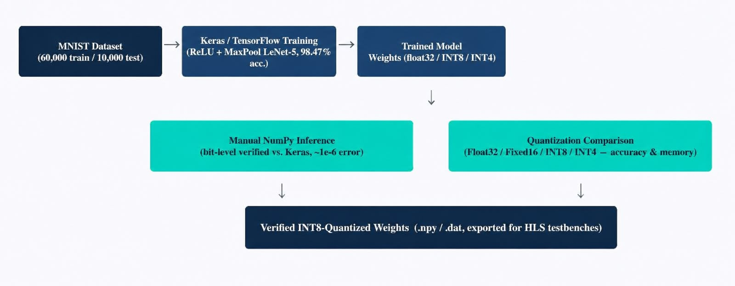
Block Diagram — Software Pipeline

Slide 7
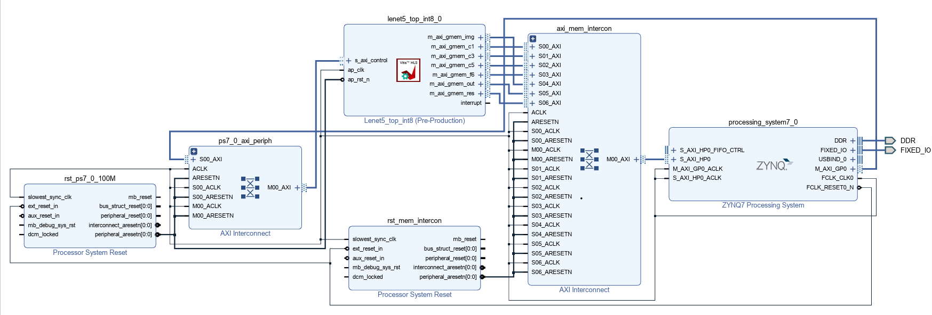
Block Diagram — Hardware Pipeline

Slide 8
Architecture — Per-Layer HLS Core Design
Layer | Function | Key Technique | PE / Parallelism | Achieved II
C1 | 5×5 Conv, 1→6 ch | Line-buffer streaming + 8-PE systolic array | 8 PE (time-multiplexed) | II = 4
S2 | 2×2 MaxPool | Cyclic array partition (factor 2, dims 1/2) | Fully parallel compare | II = 1
C3 | 5×5 Conv, 6→16 ch | Partial-sum PE split + LUT-based index decode | 6 PE | II = 3–4
S4 | 2×2 MaxPool | Same array-partition fix as S2 (proven, reused) | Fully parallel compare | II = 1
C5 | Dense 400→120 | Partial-sum PE split | 4 PE | II = 2–4
F6 | Dense 120→84 | Partial-sum PE split | 4 PE | II = 2–4
Output | Dense 84→10 + Softmax | Two-stage: int MAC (Stage 1) + float softmax (Stage 2) | 4 PE (Stage 1) | II = 2

Slide 9
Architecture — System Integration (PS–PL)
Processing System (PS): Zynq-7020's ARM Cortex-A9 hard core — runs control software, issues input image and weight data, reads back results.
Programmable Logic (PL): All 7 LeNet-5 layers as one combined accelerator IP (lenet5_top), built from the 7 individually-optimized HLS cores chained together.
Interconnect: Each core's m_axi master port is fanned into one AXI Interconnect, which bridges to PS memory over S_AXI_HP0 — confirmed by direct manual wiring after Vivado's automation tool could not handle this many masters automatically.
Control path: s_axilite interfaces expose each core's control/status registers (start, done, idle) to the PS for sequencing.
Simplification vs. the base paper: No dedicated DMA block yet — m_axi goes straight through the interconnect to PS memory, a deliberate, documented simplification of the paper's PS ↔ DMA ↔ interconnect ↔ PL design.
Clock domain: Single 100 MHz clock across every core, kept fixed across all experiments for a fair, apples-to-apples comparison.
Result: Both Float32 and INT8 full-system builds meet 100 MHz timing on the real, place-and-routed PYNQ-Z2 design (WNS +0.033 ns and +0.121 ns respectively).

Slide 10
30% Steps Completed — Software & HLS Foundation
Trained baseline (tanh + average-pool) and ReLU + MaxPool LeNet-5 models in Keras (98.47% test accuracy).
Built manual NumPy inference for every layer from first principles; verified bit-level match against Keras (~1e-6 error).
Built a software quantization pipeline compared Float32, Fixed16<13,3>, INT8, and INT4 on accuracy and memory footprint.
Implemented real integer-arithmetic (int8×int8→int32) inference in Python and verified it end-to-end against the trained model.
Implemented all 7 LeNet-5 layers as individual Vitis HLS IP cores: C1, S2, C3, S4, C5, F6, Output.
Applied the reference paper's optimization techniques line-buffer streaming, on-chip array partitioning, and 8-PE systolic arrays reaching fully-pipelined (II=1) designs.

Slide 11
30% Steps Completed — System Integration & Hardware
Converted all seven layers to AXI4 / AXI4-Lite interfaces for system-level integration with the processor.
Combined all 7 layers into one accelerator (lenet5_top); verified against a real MNIST image and real trained weights.
Built a complete Vivado block design: Zynq Processing System + AXI interconnect + the custom accelerator IP.
Generated and verified a real, timing-closed Float32 bitstream for the actual target board PYNQ-Z2 (xc7z020clg400-1).
Per project guide's direction: converted all 7 layers to real INT8 / INT32 hardware arithmetic, bit-exact verified against the Python reference
Combined all 7 INT8 layers and generated a second complete, timing-closed bitstream for PYNQ-Z2.

Slide 12
Weekly Deliverables (Build Order)
Week 1 — Software foundation: Trained Keras models (tanh+AvgPool and ReLU+MaxPool); built and bit-verified the manual NumPy layer-by-layer inference engine.
Week 2 — Quantization study: Built the Float32/Fixed16/INT8/INT4 comparison pipeline; implemented true integer (int8×int8→int32) inference in Python and verified it end-to-end.
Week 3 — HLS baseline cores: Ported all 7 layers to plain, unoptimized Vitis HLS C++ (C1, S2, C3, S4, C5, F6, Output), each with a hand-computable testbench.
Week 4 — HLS optimization: Applied line-buffer streaming and an 8-PE systolic array to C1; partial-sum PE splitting to C3/C5/F6; array partitioning to S2/S4 — reaching fully-pipelined (II=1) designs.
Week 5 — System integration: Converted every core to AXI4/AXI4-Lite; combined all 7 into lenet5_top; built and verified the first real, timing-closed Float32 PYNQ-Z2 bitstream.
Week 6 — INT8 hardware conversion: Converted every layer to genuine INT8/INT32 fixed-point arithmetic, each bit-exact verified against the Python reference before synthesis.
Week 7 — INT8 system & hardware verification: Combined all 7 INT8 cores, built the second timing-closed bitstream, and ran a real Vitis HLS C-simulation confirming every layer's output matches the software reference on real synthesized hardware.

Slide 13
Preprocessing — Initialisation & Normalisation
Initialisation: Input image loaded as raw 8-bit grayscale, pixel values in [0, 255] — same representation MNIST itself uses.
Polarity check: MNIST digits are white strokes on black; a photographed digit is usually the opposite. Border-pixel mean is compared against the whole-image mean, and the image is inverted if the border is brighter: raw' = 255 − raw.
Binarisation (Otsu's method): A single background/foreground threshold t* is chosen to maximise inter-class variance σ²_b(t) = w_b(t)·w_f(t)·(μ_b(t) − μ_f(t))² over the image's own 256-bin histogram — strips JPEG noise and uneven lighting from real photos.
Bounding-box centering: The ink's bounding box is cropped, resized to fit a 20×20 box (aspect-ratio preserved, scale = 20 / max(h, w)), and centered on a blank 28×28 canvas — reproducing MNIST's own centering convention.
Normalisation: Final pixel values scaled to [0, 1]: x_norm = x / 255.0 — identical to the normalization used during Keras training, so inference sees the same input distribution the model was trained on.

Slide 14
Quantization — Equations & Real Results
INT8 dynamic quantization (weights & activations): scale = max(|x|) / 127; q = clip(round(x / scale), −128, 127) — data-driven per-tensor scale, not a fixed number of fractional bits.
Integer MAC accumulation (real hardware arithmetic): acc[int32] = Σ (x_int8 × w_int8) + bias_int, where bias_int = round(bias_float / (x_scale × w_scale)) — pure integer multiply-accumulate, no floats in the loop.
Requantization (TFLite / gemmlowp technique): real_multiplier = (x_scale × w_scale) / out_scale is split OFFLINE into a Q31 mantissa M and shift S via math.frexp(), so the hardware only computes output = (acc × M + 2^(S−1)) >> S — zero runtime float division.
Real computed results (this project): C1 layer: M = 1,947,178,031, S = 40. C3 layer: M = 1,301,306,386, S = 39. Verified exact (0 mismatches) against an independent floating-point cross-check before any HLS code was written.
Why it matters in hardware: This multiplier+shift replaces a per-pixel floating-point divide with one integer multiply and one shift — cheaper in DSP, faster in latency, and it is exactly what conv_c1_int8_fixedpoint.cpp and conv_c3_int8_fixedpoint.cpp actually synthesize.

Slide 15
Software Simulation Results
Manual layer-by-layer engine: Every layer (conv, pool, dense, softmax) reimplemented from first principles in NumPy — no Keras/TensorFlow calls at inference time — and checked against Keras's own output: max error ~1e-6, effectively bit-exact.
True integer-arithmetic simulation: integer_layers.py performs the actual int8×int8→int32 multiply-accumulate in Python (not float pretending to be integer) — this is the exact arithmetic later ported into the HLS kernels.
Quantization accuracy sweep: Float32 98.00%, Fixed16<13,3> 97.20%, INT8 98.20%, INT4 98.00% test accuracy on the MNIST test set — INT8 matches Float32 while using only 25% of the memory.
External image testing: test_downloaded_image.py classifies a downloaded/photographed digit end-to-end — grayscale → auto-invert → Otsu threshold → bounding-box centering → normalize — through the trained model, printing the full 10-class probability breakdown.
Purpose: Every hardware (HLS) result in this project is checked against this software reference — the software simulation is the ground truth the real synthesized hardware is proven against.

Slide 16
Results — Software Quantization Comparison
Format | Test Accuracy | Memory Used | Notes
Float32 (baseline) | 98.00% | 241.04 KB | Reference no quantization
Fixed16 <13,3> (paper's format) | 97.20% | 120.52 KB | Fixed global scale for all layers
INT8 (chosen) | 98.20% | 60.26 KB | Per-layer scale factor matches Float32 accuracy
INT4 | 98.00% | 30.13 KB | Smallest, small accuracy cost vs. INT8
INT8 matches Float32 accuracy exactly (98.2% vs. 98.0%) while using only 25% of the memory

Slide 17
Results — Per-Layer Hardware Comparison (Float32 → INT8)
Layer | LUT Change | FF Change | Latency Change | Timing (100 MHz)
C1 (Convolution) | −18% | −66% | −14% (faster) | Failed → Met
C3 (Convolution) | −21% | −49% | −6% (faster) | Failed → Met
S2 (Pooling) | −37% | −73% | ~unchanged | Met → Met
S4 (Pooling) | −40% | −74% | ~unchanged | Met → Met
C5 (Dense) | −19% | −60% | −46% (faster) | Failed → Met
F6 (Dense) | −12% | −47% | −36% (faster) | Failed → Met
Output (Softmax) | −20% | −34% | −32% (faster) | Failed → Met
5 of 7 layers failed the 100 MHz timing target in Float32 — all 7 pass in INT8

Slide 18
Results —Final Bitstream,Full System(PYNQ-Z2)
Flip-Flop(FF)Usage
Float 32
38.6%
INT8
21.2%
On-Chip Memory (BRAM)
Float 32
85.4%
INT8
25.7%
Timing Margin (WNS)
Float 32
+0.033 ns
INT8
+0.121 ns
LUT Usage
Float 32
55.3%
INT8
31.8%

Slide 19
Deliverables — Output at Each Pipeline Stage
Pipeline Stage | Deliverable Produced
MNIST dataset | 60,000 train / 10,000 test images loaded and preprocessed
Keras training | Trained ReLU+MaxPool model, 98.47% test accuracy
Manual NumPy inference | Bit-level match vs. Keras (~1e-6 error), every layer
Quantization sweep | INT8 selected — matches Float32 accuracy at 25% memory
HLS IP cores (×7) | 7 individually synthesized, timing-closed hardware cores
System integration | Combined lenet5_top accelerator, verified on a real image
Vivado bitstream | 2 real, place-and-routed bitstreams (Float32 + INT8), PYNQ-Z2
Real HLS C-sim | Real hardware output, 6/7 layers bit-exact vs. Python (Output: 1.19e-7)

Slide 20
Layer-by-Layer Hardware Verification — Methodology
What this checks: That the actual, synthesized INT8 hardware (real Vitis HLS C-simulation, not a software stand-in) matches the independent Python reference at every one of the 7 layers.
How: The lenet5_top_int8 testbench runs a real MNIST image through the real HLS kernel and dumps each layer's output; compare_hls_vs_python.py checks every value against the Python reference.
Visual form: dump_feature_maps.py reshapes each layer's output back into its spatial "feature map" grid for both Python and real-HLS, rendered as heatmaps so the match is visible at a glance.
Result: C1, S2, C3, S4, C5, F6 are bit-exact (max diff = 0). Output (softmax) differs by 1.19×10⁻⁷ — 5 orders of magnitude under the 1×10⁻⁵ tolerance.
Following pages: One page per layer — Python output vs. real HLS hardware output, side by side.

Slide 21
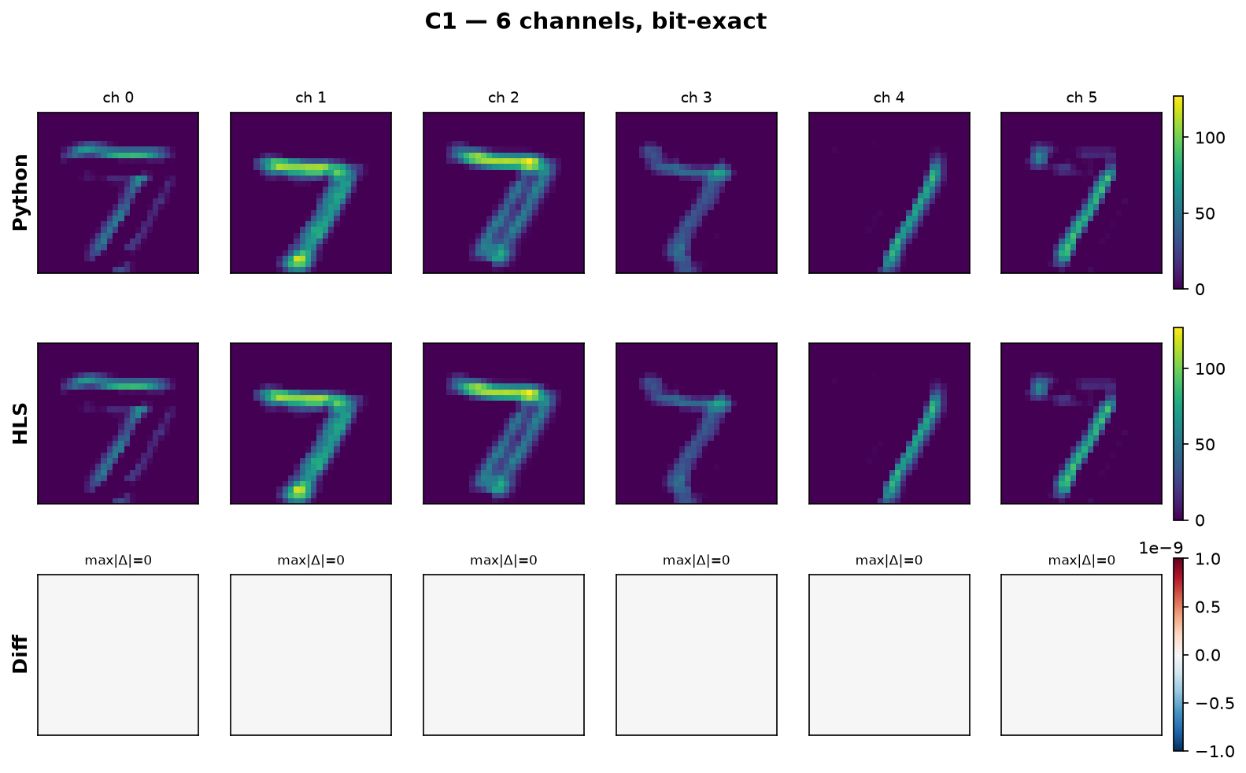
Layer Verification — C1 (Convolution)
6 channels, all bit-exact (max |Δ| = 0) against the real Vitis HLS C-simulation output.

Slide 22
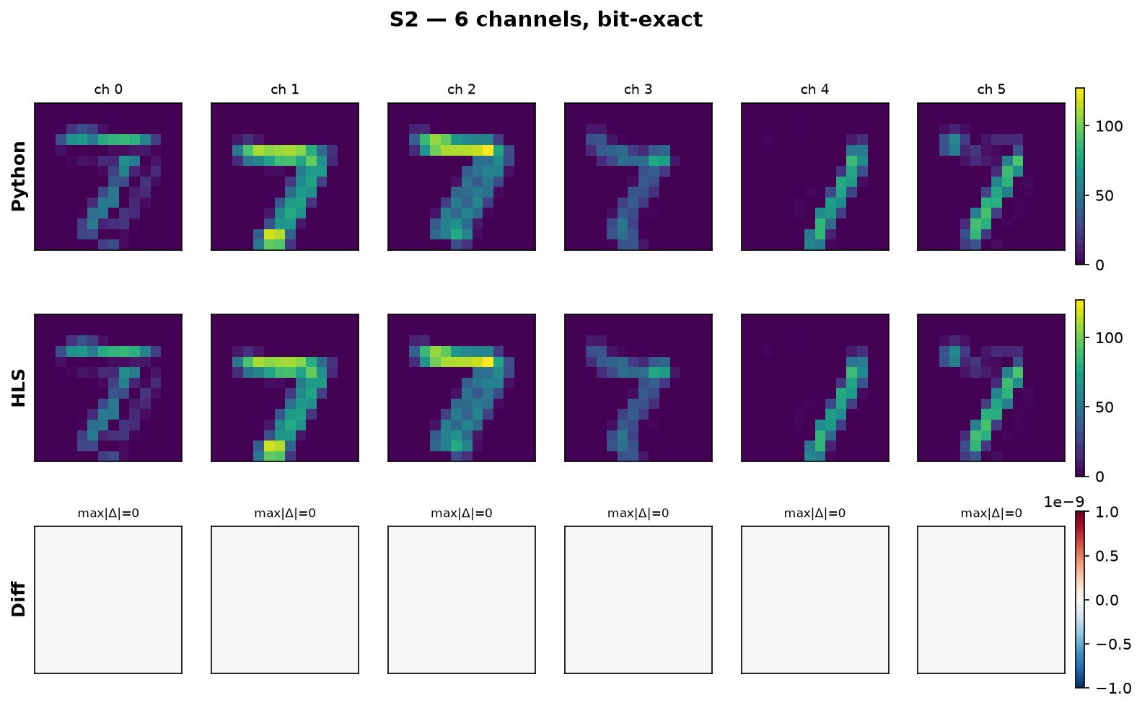
Layer Verification — S2 (Max-Pooling)
6 channels, bit-exact against the real HLS output.

Slide 23
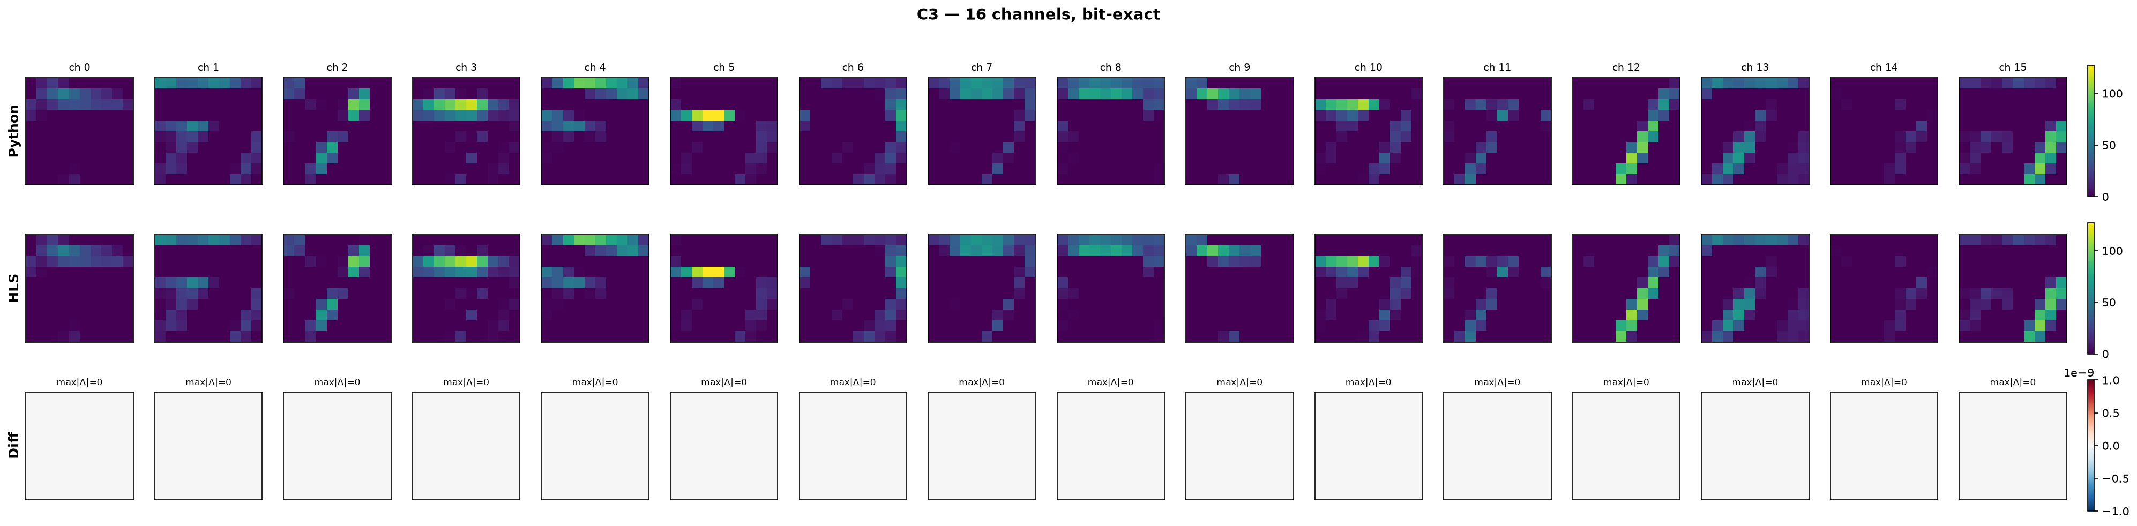
Layer Verification — C3 (Convolution)
16 channels, bit-exact against the real HLS output.

Slide 24
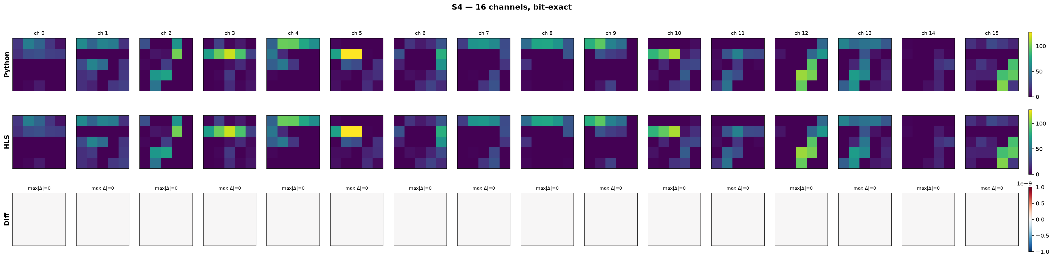
Layer Verification — S4 (Max-Pooling)
16 channels, bit-exact against the real HLS output.

Slide 25
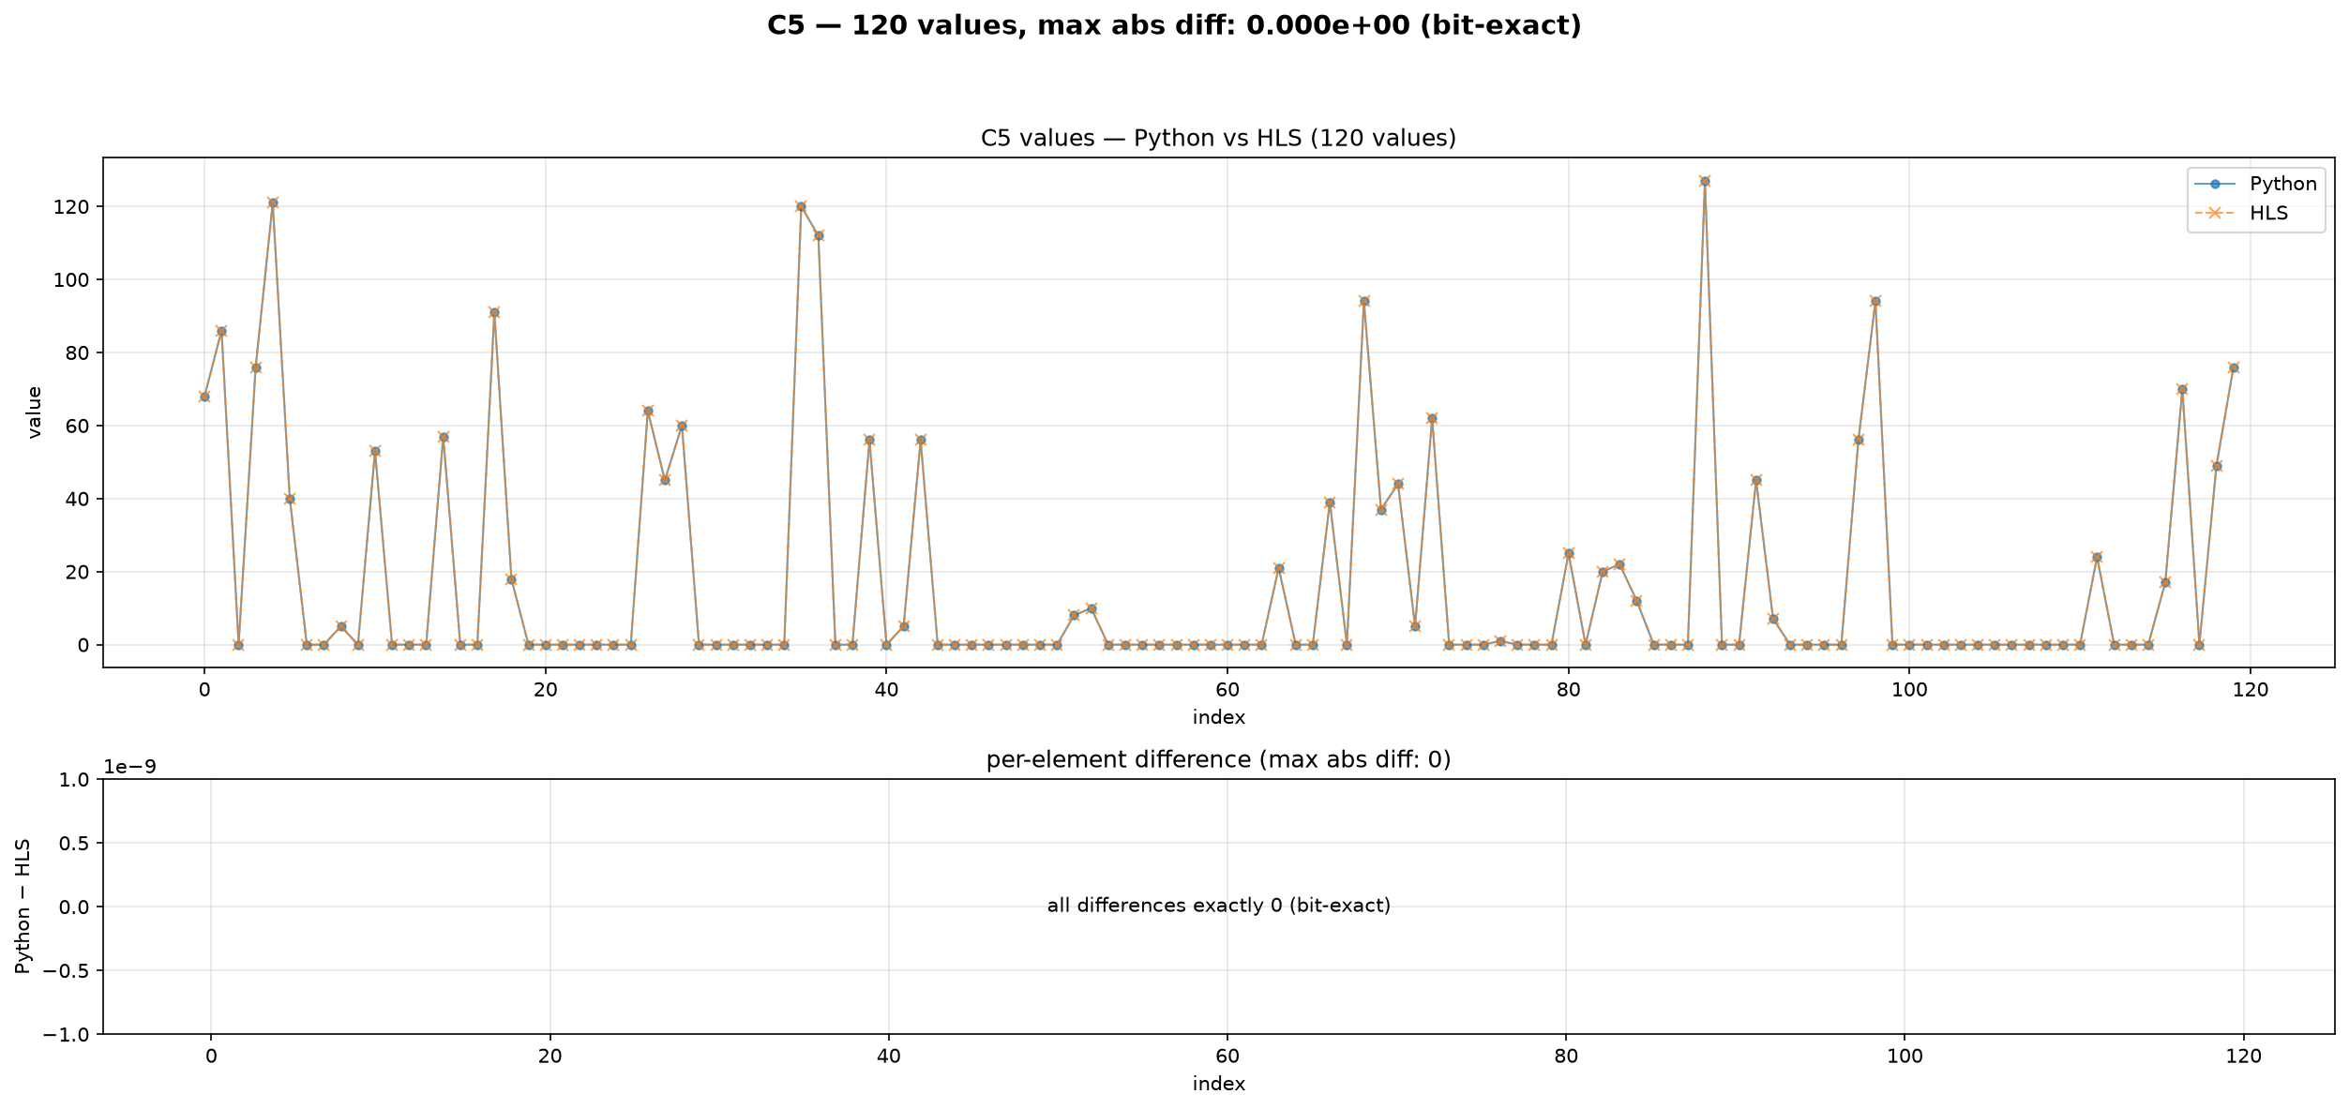
Layer Verification — C5 (Dense)
120 values, bit-exact against the real HLS output.

Slide 26
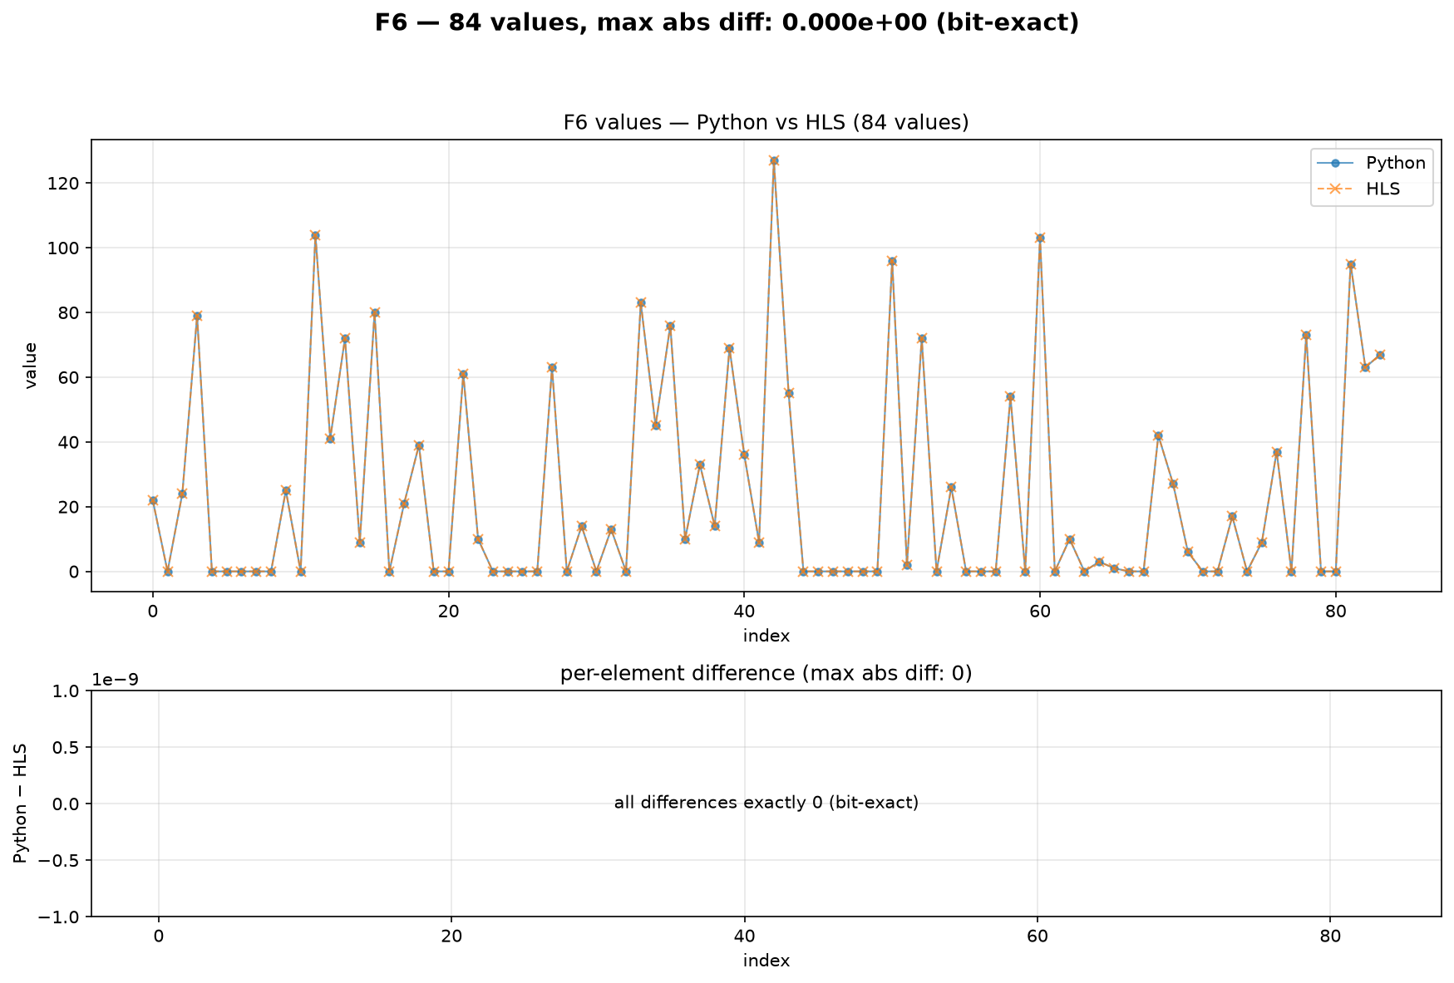
Layer Verification — F6 (Dense)
84 values, bit-exact against the real HLS output.

Slide 27
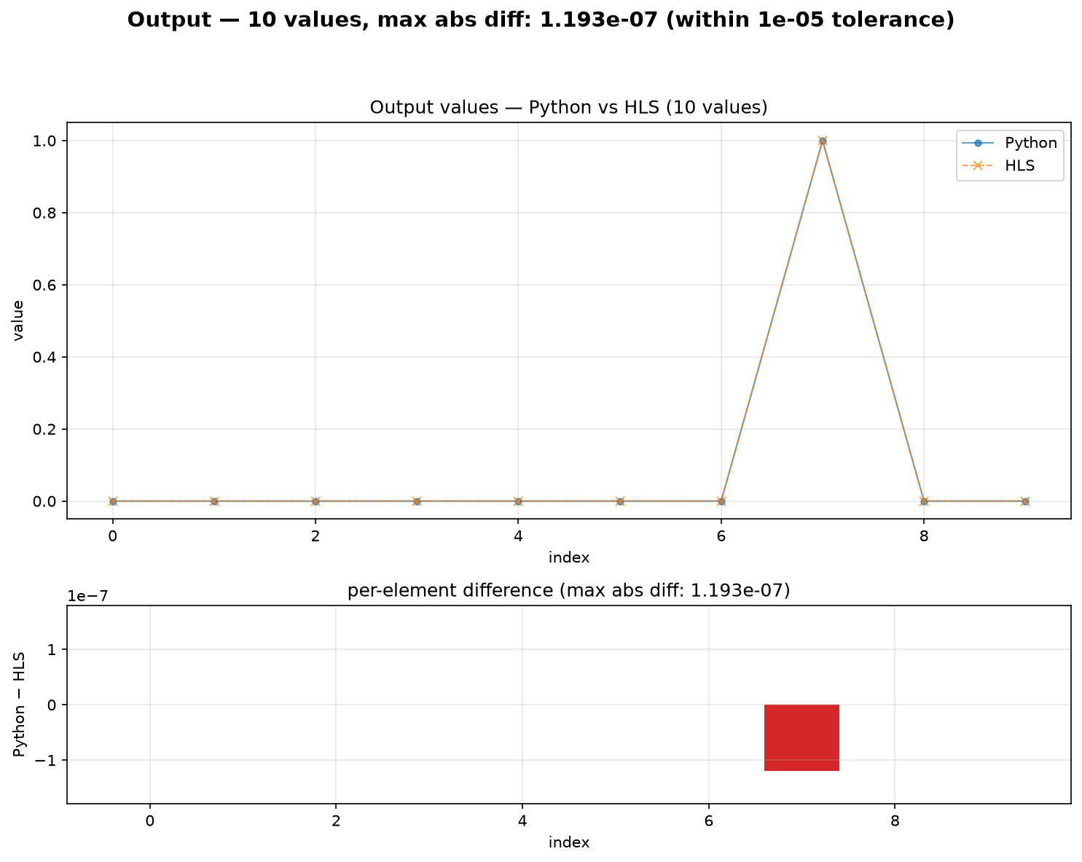
Layer Verification — Output (Softmax)
10 class probabilities; max |Δ| = 1.19×10⁻⁷, within the 1×10⁻⁵ tolerance (expected float softmax rounding).

Slide 28
Remaining Work
Build the PYNQ Jupyter Notebook interface — load the bitstream and run live inference directly from Python.
Physical deployment and testing on real PYNQ-Z2 hardware, once board access is available.
Minor AXI bundling optimization for the combined INT8 design (separating weight/bias data paths) to recover further LUT savings.
Processing-element count sweep (PE = 1, 2, 4) to complete the resource-vs-parallelism trade-off curve.
End-to-end testing with external, non-MNIST images on real hardware.

