Slide 1
第2章传输控制协议

Slide 2
2.1 TRANSMISSION CONTROL PROTOCOL(TCP)
TCP provides connections between clients and servers. A TCP client establishes a connection with a given server, exchanges data with that server across the connection, and then terminates the connection.
When TCP sends data to other end, it requires an acknowledgment in return. If an acknowledgment is not received, TCP automatically transmits the data and waits a longer amount of time. After some number of retransmissions, TCP will give up.
TCP contains algorithms to estimate the Round-Trip Time (RTT) between a client and server dynamically so that it knows how long to wait for an acknowledgment.
A TCP connection is full-duplex.

Slide 3
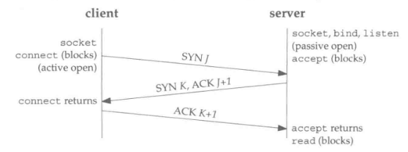
2.2 TCP Connection establishment and termination
The following scenario occurs when a TCP connection is established：
The server must be prepared to accept an incoming connection. This is normally done by calling socket, bind, and listen and is called a passive open.
The client issues an active open by calling connect. This causes the client TCP to send a SYN segment
The server must acknowledge(ACK) the client’s SYN and the server must also send its own SYN to the client.
The client must acknowledge the server’s SYN.

Slide 4
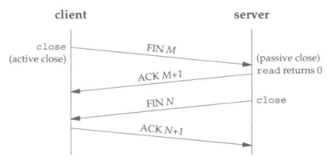
2.2 TCP Connection establishment and termination
The following scenario occurs when a TCP connection is terminated：
One application calls close first, and we say that this end performs the active close.
The other end that receives the FIN performs the passive close. The received FIN is acknowledged by TCP.
The application that received the end-of-file will close its socket. This causes its TCP to send a FIN.
The TCP on the system that receives this final FIN acknowledges the FIN.

Slide 5
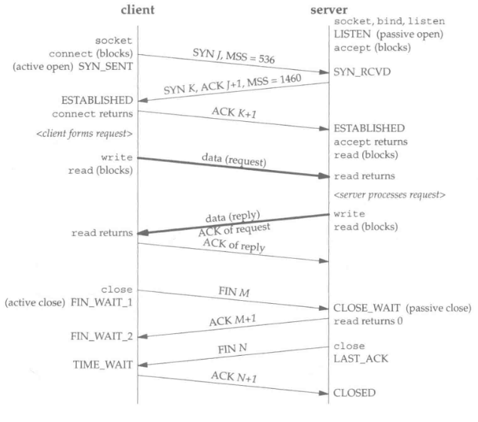
2.3 STATE TRANSITION DIAGRAM
The figure shows the actual packet exchange that takes place for a complete TCP connection: the connection establishment, data transfer, and connection termination.
Once a connection is established, the client forms a request and sends it to the server. The server processes the request and sends a reply. Notice that the acknowledgement of client’s request is sent with the server’s reply.

Slide 6
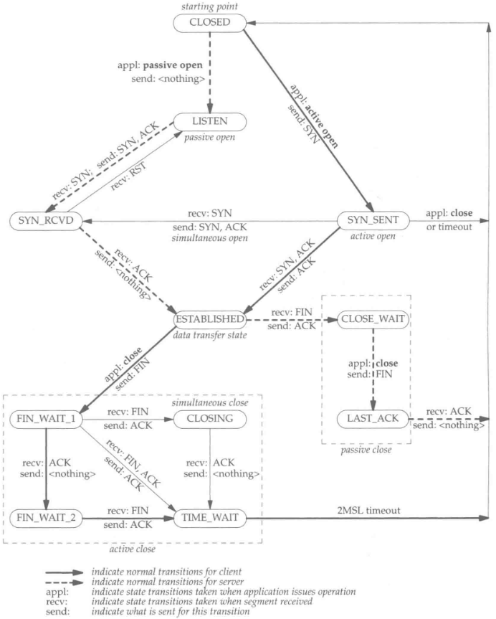
2.3 STATE TRANSITION DIAGRAM
The operation of TCP with regard to connection establishment and connection termination can be specified with a state transition diagram.
There are 11 different states defined for a connection and the rules of TCP dictate the transitions from one state to another, based on the current state and the segment received in that state.

