Slide 1
第3章基本套接字

Slide 2
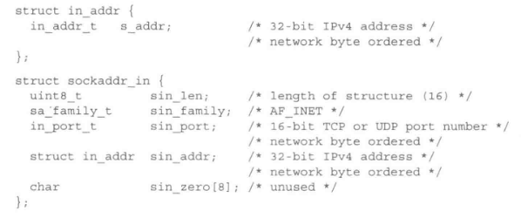
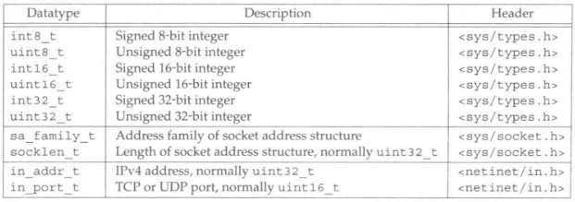
3.1 socket address structures
Most socket functions require a pointer to a socket address structure as an argument.
An IPv4 socket address structure, commonly called an “Internet socket address structure”, is named sockaddr_in and is defined by including the <netinet/in.h> header.

Slide 3
Port number
At any given time, multiple processes can be using any given transport: UDP, SCTP or TCP. All three transport layers use 16-bit integer port numbers to differentiate between these processes.
The Internet Assigned Numbers Authority (IANA) maintains a list of port number assignment. The port numbers are divided into three ranges:
The well-known ports: 0 through 1023. The port numbers are controlled and assigned by the IANA.
The registered ports: 1024 through 49151. These are not controlled by the IANA, but the IANA registers and lists the uses of these ports as a convenience to the community.
The dynamic or private ports: 49152 through 65535.

Slide 4
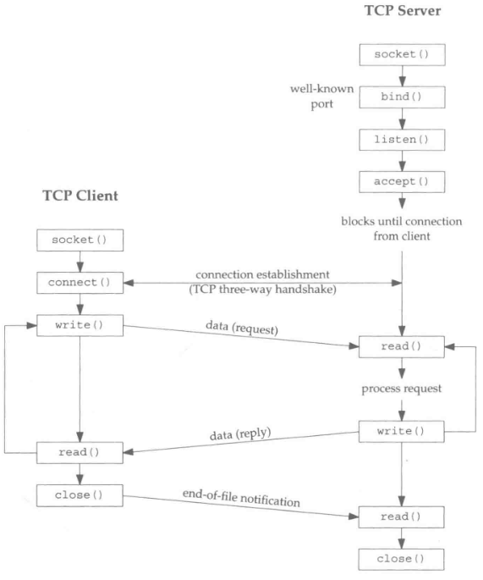
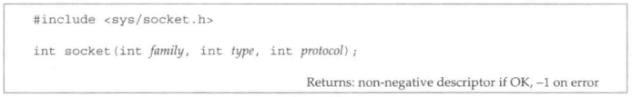
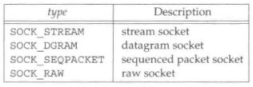
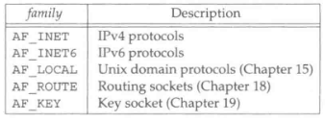

3.2 Elementary Tcp sockets
To perform network I/O, the first thing a process must do is call the socket function.

Slide 5
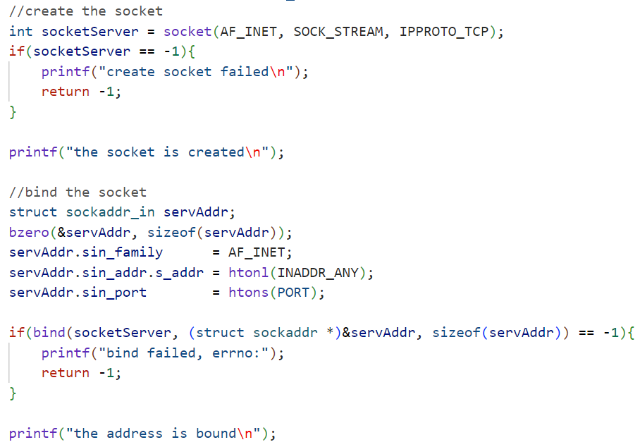
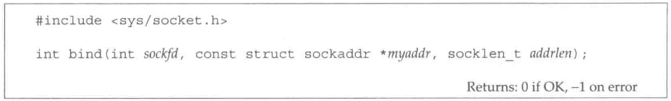
The bind function assigns a local address to a socket. With the Internet protocols, the protocol address is the combination of either a 32-bit IPv4 address or a 128-bit IPv6 address, along with a 16-bit TCP or UDP port number.
A process can bind a specific IP address to its socket. If we specify a IP address of INADDR_ANY, whose value is normally 0. This tells the kernel to choose the IP address.
Normally, a TCP client does not bind an IP address to its socket.

Slide 6
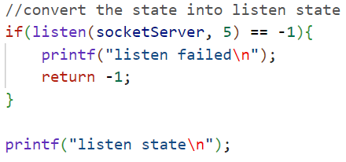
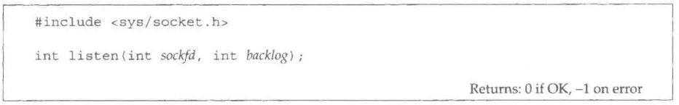
The listen function is called only by a TCP server and it performs two actions:
In terms of the TCP state transition diagram, the call to listen moves the socket from the CLOSED state tot LISTEN state.
The second argument to this function specifies the maximum number of connections the kernel should queue for this socket.
This function is normally called after both the socket and bind functions and must be called before calling the accept function.

Slide 7
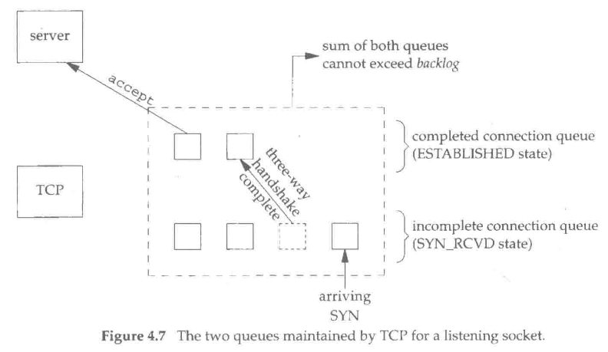
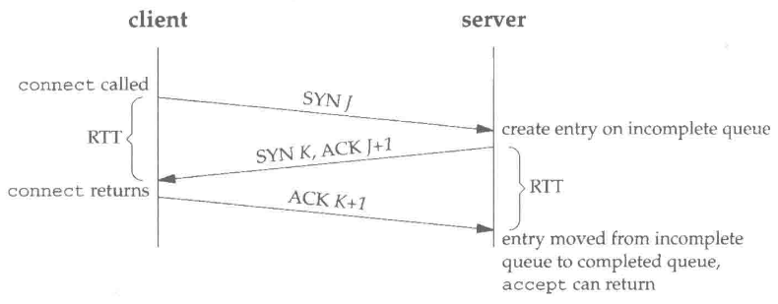
To understand the backlog argument, we must realize that for a given listening socket, the kernel maintains two queues:
An incomplete connection queue, which contains an entry for each SYN that has arrived from a client for which the server is awaiting completion of the TCP three-way handshake.
A completed connection queue, which contains an entry for each client with whom the TCP three-way handshake has completed.
The backlog argument to listen function has historically specified the maximum value for the sum of both queues.

Slide 8
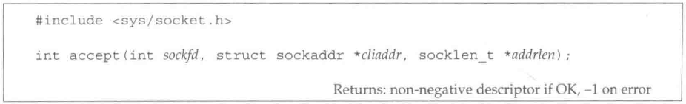
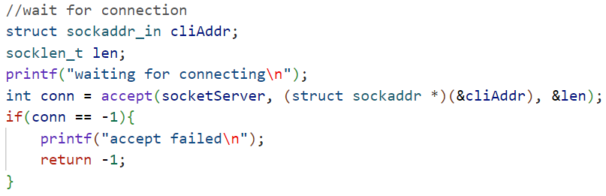
Accept is called by a TCP server to return the next completed connection from the front of the completed connection queue.
The cliaddr and addrlen arguments are used to return the protocol address of client. Addrlen is a value-result argument.

Slide 9

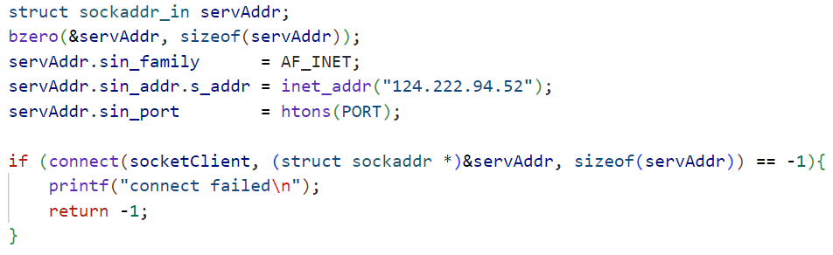
The connect function is used by a TCP client to establish a connection with a TCP server. The client does not have to call bind before calling connect: the kernel will choose both an port and the source IP address if necessary.

Slide 10
Steam sockets (e.g., TCP sockets) exhibit a behavior with the read and write functions that differs from normal file I/O.
A read or write on a stream socket might input or output fewer bytes than requested, but this is not an error condition. The reason is that buffer limits might be reached for the socket in the kernel. All that is required to input or output the remaining bytes is for the socket in the kernel.
ssize_t read(int fd, void * buf, size_t nbytes);
ssize_t write(int fd, void * buf, size_t nbytes);
Client
read
write
Server
write
read

Slide 11
