Slide 1
第四章 并行服务

Slide 2
4.1 Concurrent server
Above example is an iterative server. For something as simple as a daytime server, this is fine. But when a client request can take longer to service, we do not want to tie up a single server with one client; we want to handle multiple clients at the same time.
The simplest way to write a concurrent server under Unix is to fork a child process to handle each client.

Slide 3
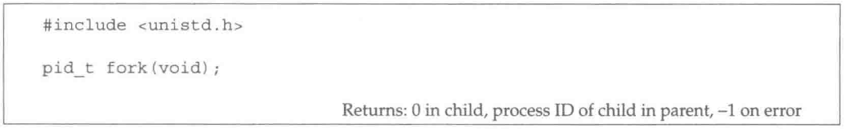
Before describing how to write a concurrent server, we must describe the Unix fork function. This function is the only way in Unix to create a new process.
fork is called once, but it returns twice. It returns once in the calling process with a return value that is the process ID of the newly created process (the child). It also returns once in the child, with a return value of 0. Hence, the return value tells the process whether it is the parent or the child.

Slide 4
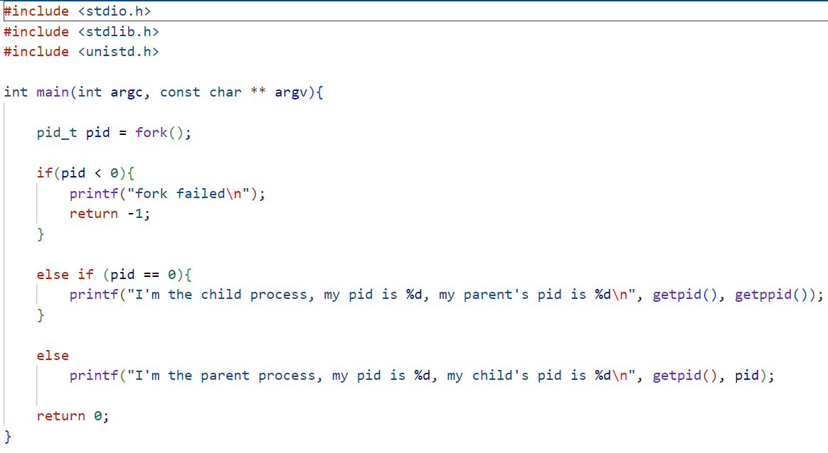

Slide 5
There are two typical uses of fork:
A process makes a copy of itself so that one copy can handle on operation while the other copy does another task. This is typical for network servers.
A process wants to execute another program. Since the only way to create a new process is by calling fork, the process first calls fork to make a copy of itself, and then one of the copies (typically the child process) calls exec to replace itself with the new program.
The only way in which an executable program file on disk can be executed by Unix is an existing process to call one of the six exec functions. Exec replaces the current process image with the new program file, and this new program normally starts at the main function. The process ID does not change.

Slide 6
The differences in the six exec functions are:
Whether the program file to execute is specified by a filename or a pathname;
Whether the arguments to the new program are listed one by one or referenced through an array of pointers;
Whether the environment of the calling process is passed to the new program or whether a new environment is specified.
These functions return to the caller only if an error occurs. Otherwise, control passes to the start of the new program, normally the main function.
Normally, only execve is a system call within the kernel and the other five are library functions that call execve.

Slide 7
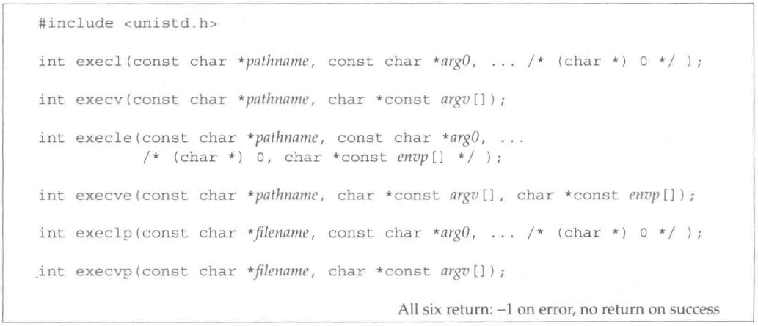
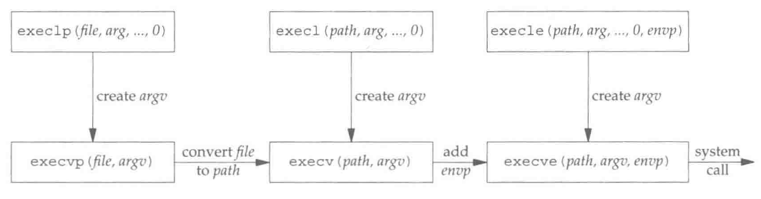

Slide 8
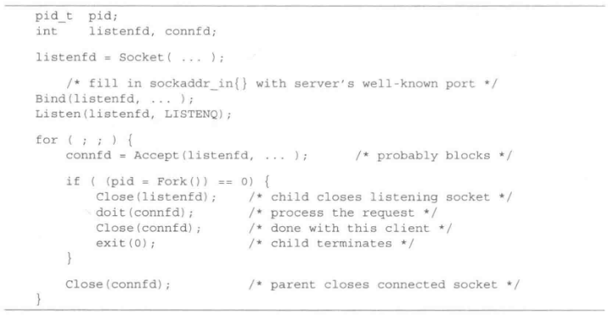
The simplest way to write a concurrent server under Unix is to fork a child process to handle each client. The following Fig. shows the outline for a typical concurrent server.
When a connection is established, accept returns, the server calls fork, and the child process services the client(on connfd, the connected socket) and the parent process waits for another connection(on listenfd, the listening socket). The parent closes the connected socket since the child handles the new client.

Slide 9
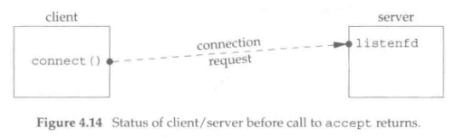
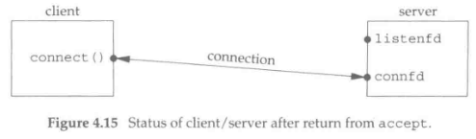
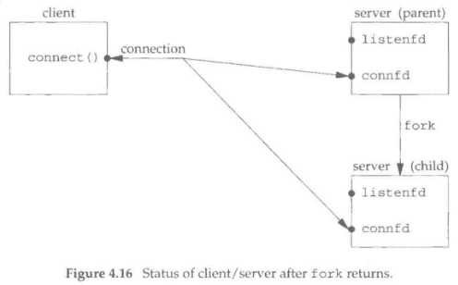
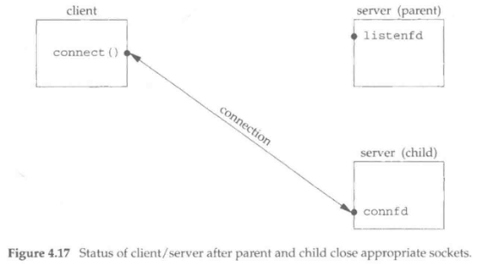

Slide 10
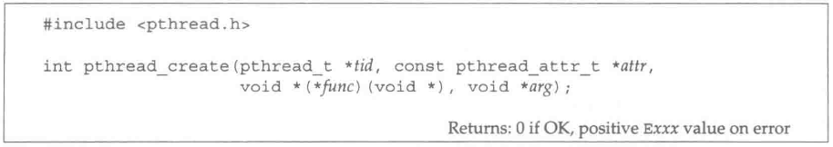
When a program is started, a single thread is created, called the initial thread or main thread. Additional threads are created by pthread_create.
Each thread within a process is identified by a thread ID, whose datatype is pthread_t (often an unsigned int). On successful creation of a new thread, its ID is returned through the pointer tid.
Each thread has numerous attributes: its priority, initial stack size, etc. When a thread is created, we can specify these attributes by initializing a pthread_attr_t variable that overrides the default. We normally take the default, in which case, we specify the attr argument as a null pointer.

Slide 11
Finally, when we create a thread, we specify a function for it to execute. The thread starts by calling this function and then terminates either explicitly (by calling pthread_exit) or implicitly (by letting the function return). The address of the function is specified as the func argument, and this function is called with a single pointer argement, arg. If we need multiple argument to the function, we must package them into a structure and then pass the address to this structure as the single argument tot the start function.
Notice the declaration of func and arg. The function takes one argument, a generic pointer (void *), and returns a generic pointer (void *).

