Slide 1
第五章 进程间通信

Slide 2
5.1 Interprocess Communication
Identifiers and Keys
Each IPC structure (message queue, semaphore, or shared memory segment) in the kernel is referred to by a non-negative integer identifier. To send a message to or fetch a message from a message queue, for example, all we need know is the identifier for the queue.
The identifier is an internal name for an IPC object. Cooperating processes need an external naming scheme to be able to rendezvous using the same IPC object. For this purpose, an IPC object is associated with a key that acts as an external name.
Whenever an IPC structure is being created, a key must be specified. The data type of this key is the primitive system data type Key_t, which is often defined as a long integer in the header <sys/types.h>. The key is converted into an identifier by the kernel.

Slide 3
5.2 message queue
A message queue is a linked list of message stored within the kernel and identified by a message queue identifier.
A new queue is created or an existing queue opened by msgget. New messages are added to the end of a queue by msgsnd. Every message has a positive long integer type field, a non-negative length, and the actual data types, all of which are specified to msgsnd when the message is added to a queue. Messages are fetched from a queue by msgrcv. We don’t have to fetch the messages in a first-in, first-out order. Instead, we can fetch messages based on their type fields.

Slide 4
Each queue has the following msqid_ds structure associated with it:
struct msqid_ds{
struct ipc_perm msg_perm;
struct msgqnum_t msg_qnum; //number of messages on queue
msg_len_t msg_qbytes; //max number of bytes on queue
pid_t msg_lspid; //pid of last msgsnd()
pid_t msg_lrpid; //pid of last msgrcv()
time_t msg_stime; //last msgsnd() time
time_t msg_rtime; //last msgrcv() time
time_t msg_ctime; //last change time
…
};

Slide 5
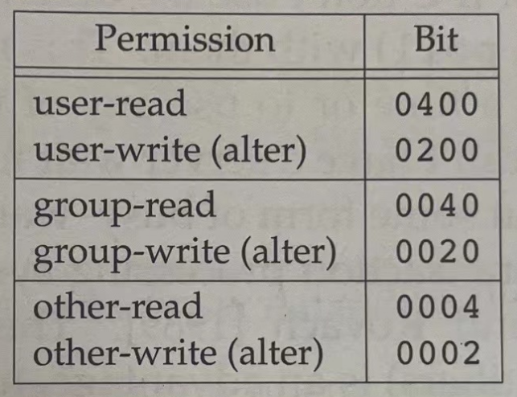
The first function normally called is msgget to either open existing queue or create a new queue. It returns message queue ID if OK, -1 on error.
#include <sys/msg.h>
int msgget (key_t key, int flag);
The setup of flag is listed in the following table.
IPC_CREATE: returns the identifier of the queue if the queue already in the kernel, otherwise, creates a new queue.
Example:
msgget((ket_t)9527, 0666 | IPC_CREATE)

Slide 6
Data is placed onto a message queue by calling msgsnd, which returns 0 if OK, -1on error.
int msgsnd(int msqid, const void * ptr, size_t nbytes, int flag);
The ptr argument points to a long integer that contains the positive integer message type, and it is immediately followed by the message data. If the largest message we send is 512 bytes, we can define the following structure:
struct mymesg{
long msgtype; //positive message type
char mtext[512]; //message data, of length nbytes
};
The ptr argument is then a pointer to a mymesg structure. The message type can be used by the receiver to fetch messages in an order other than first in, first out.

Slide 7
Messages are retrieved from a queue by msgrcv, which returns the size of data portion of message if OK, -1 on error.
ssize_t msgrcv(int msqid, void * ptr, size_t nbytes, long type, int flag);
The type argument lets us specify which message we want.
type == 0: The first message on the queue is returned.
type > 0: The first message on the queue whose message type equals type is returned.
type < 0: The first message on the queue whose message type is lowest value less than or equal to the absolute value of type is returned.

Slide 8
The msgctl function performs various operations on a queue. It returuns 0 if OK, -1 on error.
int msgctl(int msqid, int cmd, struct msqid_ds * buf);
The cmd argument specifies the command to be performed on the queue specified by msqid.
IPC_STAT: Fetch the msqid_ds structure for this queue, storing it in the structure pointed to by buf.
IPC_RMID: Remove the message queue from the system and any data still on the queue.

Slide 9
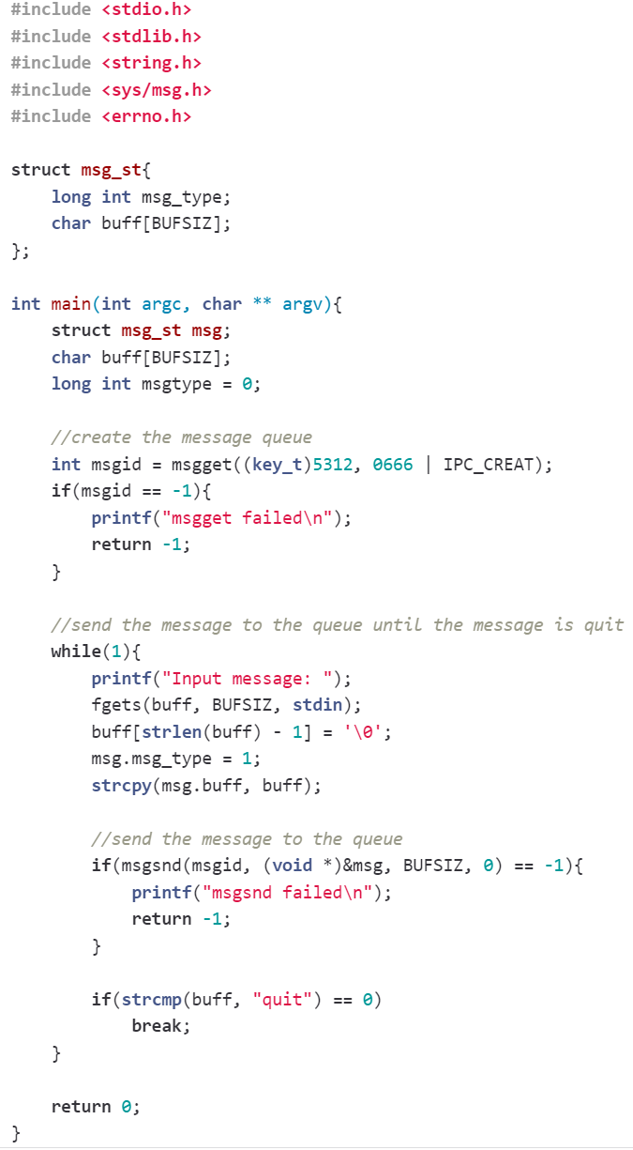
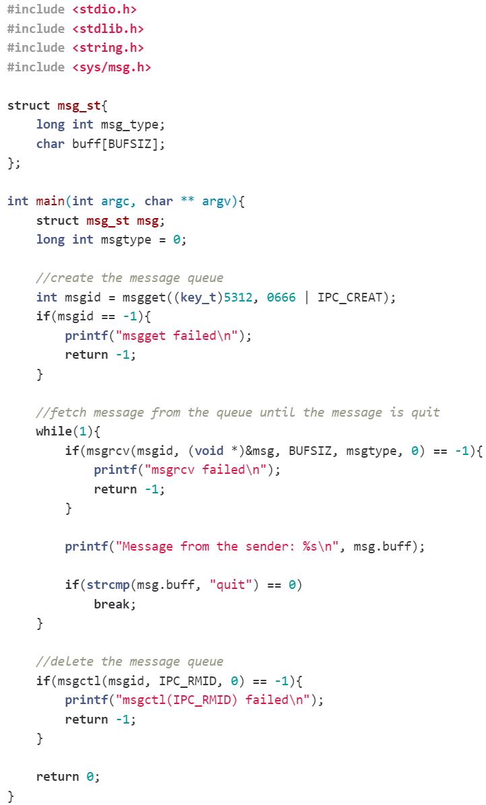
Demonstration of IPC using message queue

Slide 10
5.3 Shared memory
Shared memory allows two or more processes to share a given region of memory. This is the fastest form of IPC, because the data does not need to be copied between the client and the server. The only trick in using shared memory is synchronizing access to a given region among multiple processes. If the server is placing data into a shared memory region, the client shouldn’t try to access the data until the server is done.
The kernel maintain a structure with at least the following members for each shared memory segment:

Slide 11
struct shmid_ds{
struct ipc_perm shm_perm;
size_t shm_segsz; //size of segment in bytes
pid_t shm_lpid; //pid of last shmop()
pid_t shm_cpid; //pid of creator
shmatt_t shm_nattch; //number of current attaches
time_t shm_atime; //last-attach time
time_t shm_dtime; //last-detach time
time_t shm_ctime; //last-change time
};

Slide 12
The first function called is usually shmget, to obtain a shared memory identifier.
#inclue <sys/shm.h>
int shmget(key_t key, size_t size, int flag);
Returns: shared memory ID if OK, -1 on error
The size parameter is the size of the shared memory segment in bytes. If a new segment is being created, we must specify its size. If we are referencing an existing segment, we can specify size as 0. When a new segment is created , the contents of the segment are initialized with zeros.

Slide 13
Once a shared memory segment has been created, a process attaches it to its address space by calling shmat.
void * shmat(int shmid, const void * addr, int flag);
Returns: pointer to shared memory segment if OK, -1 on error
The address in the calling process at which the segment is attached depends on the addr argument. If addr is 0, the segment is attached at the first available address selected by the kernel.
If the SHM_RDONLY bit is specified in flag, the segment is attached as read-only. Otherwise, the segment is attached as read-write.

Slide 14
When we are done with a shared memory segment, we call shmdt to detach it. Note that this does not remove the identifier and its associated data structure from the system. The identifier remains in existence until some process specifically removes it by calling shmctl with a command of IPC_RMID.
int shmdt(int void * addr);
Returns: 0 if OK, -1 on error
The addr argument is the value that was returned by a previous call to shmat. If successful, shmdt will decrement the shm_nattch counter in the associated shmid_ds structure.

Slide 15
The shmctl function is the catchall for various shared memory operations.
int shmctl(int shmid, int cmd, struct shmid_ds * buf);
Returns: 0 if OK, -1 on error
The cmd argument specifies one of the following commands to be performed, on the segment specified by shmid.
IPC_STAT: Fetch the shmid_ds structure for this segment, storing it in the structure pointed by buf.
IPC_RMID: Remove the shared memory segment set from the system. Since an attachment count is maintained for shared memory segments, the segment is not removed until the last process using the segment terminates or detaches it. Regardless of whether the segment is still in use, the segment’s identifier is immediately removed so that shmat can no longer attach the segment.

