Slide 1
第六章 同步

Slide 2
6.1 Mutexs
Synchronization is normally needed to allow the sharing of data between threads processes. Mutexes and condition variables are the building blocks of synchronization.
6.1.1 Mutexes: Locking and Unlocking
A mutex, which stands for mutual exclusion, is the most basic of synchronization. A mutex is used to protect a critical region, to make certain that only one thread at a time executes the code within the region or that only one process at a time executes the code within the region. The normal outline of code to protect critical region looks like:

Slide 3
lock_the_mutex(…);
critical region;
unlock_the_mutex(…);
Since only one thread at a time can lock a given mutex, this guarantees that only one thread at a time can be executing the instructions within the critical region.
Posix mutexes are declared as a variables with a datatype of pthread_mutex_t. If the mutex variable is statically allocated, we can initialize it to the constant PTHREAD_MUTEX_INITIALIZER as in
static pthread_mutex_t lock = PTHREAD_MUTEX_INITIALIZER;

Slide 4
The following functions initialize, destroy, lock, and unlock a mutex:
#include <pthread.h>
int pthread_mutex_init(pthread_mutex_t * mptr, const_mutexattr_t * attr);
int pthread_mutex_destroy(pthread_mutex_t * mptr);
int pthread_mutex_lock(pthread_mutex_t * mptr);
int pthread_mutex_unlock(pthread_mutex_t * mptr);
If we try to lock a mutex that is already locked by some other thread, pthread_mutex_lock blocks until the mutex is unlocked. pthread_mutex_trylock is a nonblocking function that returns EBUSY if the mutex is already locked.

Slide 5
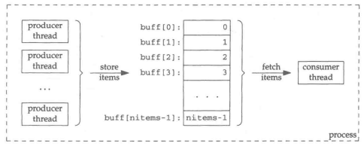
6.1.2 Producer-Consumer Problem
One or more producers (threads or processes) are creating data items that are then processed by one or more consumers.
We have multiple producer threads and a single consumer thread, in a single process. The integer array buff contains the items being produced and consumed (i.e, the shared data).

Slide 6
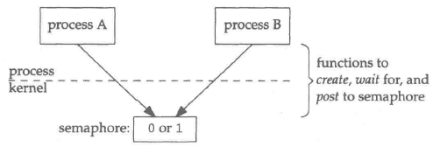
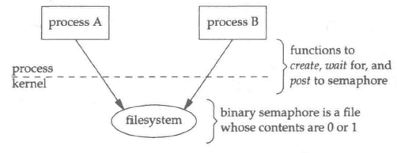
6.2 Semaphores
A semaphore is a primitive used to provide synchronization between various processes or between the various threads in a given process.
In the following figure, we note three operations that a process can perform on a semaphore.
Create a semaphore. This is also requires the caller to specify the initial value.
Wait for a semaphore. This tests the value of the semaphore, waits(blocks).
Post to a semaphore. This increments the value of the semaphore.

Slide 7
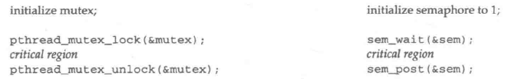
A binary semaphore can be used for mutual exclusion, just like a mutex as follows:
We initialize the semaphore to 1. The call to sem_wait waits for the value to be greater than 0 and then decrements the value. The call to sem_post increments the value and wakes up any threads blocked in a call to sem_wait for this semaphore.
#include <semaphore.h>
int sem_init(sem_t * sem, int shared, unsigned int value);
int sem_destroy(sem_t * sem);

Slide 8
A memory-based semaphore is initialized by sem_init. The sem argument points to the sem_t variable that the application must allocate. If shared is 0, then the semaphore is shared between the thread of a process, else the semaphore is shared between processes. When shared is nonzero, then the semaphore must be stored in some type of shared memory that is accessible to all the processes that will be using the semaphore. As with sem_open, the value argument is the initial value of the semaphore.
When we are done with a memory-based semaphore, sem_destroy destroys it.
If a memory-based semaphore is being shared between the threads of a single process, then the semaphore has process persistence and disappears when the process terminates.
If a memory-based semaphore is being shared between different processes, then the semaphore must be stored in shared memory and the semaphore remains in existence as long as the shared memory remains in existence.

Slide 9
The sem_wait function tests the value of the specified semaphore, and if the value is greater than 0, the value is decremented and the function returns immediately. If the value is 0 when the function is called, the calling thread is put to sleep until the semaphore value is greater than 0, at which time it will be decremented, and the function then returns.
int sem_wait(sem_t *sem);
int sem_trywait(sem_t *sem);
The difference between sem_wait and sem_trywait is that the latter does not put the calling thread to sleep if the current value of the semaphore is already 0.

Slide 10
When a thread is finished with a semaphore, it calls sem_post, which increments the value of the semaphore by 1 and wakes up any thread that are waiting for the semaphore value to become positive.
int sem_post(sem_t * sem);
int sem_getvalue(sem_t *sem, int * valp);
sem_getvalue returns the current value of the semaphore in the integer pointed to by valp. If the semaphore is currently locked, then the value returned is either 0 or a negative number whose absolute value is the number of threads waiting for the semaphore to be unlocked.

Slide 11
6.3 Read-write locks
A mutex lock blocks all other threads from entering what we call a critical region. This critical region usually involves accessing or updating one or more pieces of data that are shared between the threads. But sometimes, we can distinguish between reading a piece of data and modifying a piece of data.
We now describe a real-write lock and distinguish between obtaining the read-write lock for reading and obtaining the read-write lock for writing:
Any number of threads can hold a given read-write lock for reading as long as no thread holds the read-write lock for writing.
A read-write lock can be allocated for writing only if no thread holds the read-write lock for reading or writing.

Slide 12
Stated another way, any number of threads can have read access to a given piece data as long as no thread is modifying that piece of data. A piece of data can be modified only if no other thread is reading or modifying the data.
In some applications, the data is read more often than the data is modified, and these applications can benefit from using read-write locks instead of mutex locks. Allowing multiple reads at any given time can provide more concurrency, while still protecting the data while it is modified from any other readers or writers.
A read-write lock has a datatype of pthread_rwlock_t. If a variable of this type is statically allocated, it can be initialized by assigning to it the constat PTHREAD_RWLOCK_INITIALIZER.

Slide 13
Pthread_rwlock_init initializes a read-write lock. Pthread_rwlock_rdlock obtains a read-lock, blocking the calling thread if the read-write lock is currently held by a writer. Pthread_rwlock_wrlock obtains a write-lock, blocking the calling thread if the read-write lock is currently held by either another writer or by one or more threads. Pthread_rwlock_unlock releases either a read lock or a write lock.
#include <pthread.h>
int pthread_rwlock_init(pthread_rwlock_t * rwptr, const pthread_rwlockattr_t *attr);
int pthread_rwlock_rdlock(pthread_rwlock_t *rwptr);
int pthread_rwlock_wrlock(pthread_rwlock_t *rwptr);
int pthread_rwlock_unlock(pthread_rwlock_t * rwptr);
All return: 0 if OK, positive Exxx value on error

Slide 14
The following two functions try to obtain either a read lock or a write lock, but if the lock cannot be granted, an error of EBUSY is returned instead of putting the calling thread to sleep.
int pthread_rwlock_tryrdlock(pthread_rwlock_t * rwptr);
int pthread_rwlock_trywrlock(pthread_rwlock_t * rwptr);
Both return: 0 if OK, positive Exxx value on error
When a thread no longer needs a read-write lock, it can call the function pthread_rwlock_destroy.
int pthread_rwlock_destroy(pthread_rwlock_t * rwptr);
Return: 0 if OK, positive Exxx value on error

