Slide 1
PlaybackGPT
A tool to generate code in the UI automation space
Aby George

Slide 2
How does it work?
What does PlaybackGPT do?
It uses the manual action of testing various scenarios in a UI along with natural language inputs to generate PAF (or any framework) code required for UI automation testing.
A browser extension or GUI will be used to start/stop or enter inputs, etc.
The application will capture the UI data like locators (xpaths, CSS selectors), inputs, text, etc., in the sequential order that the corresponding actions are performed (like click on elements, etc.).
It will combine those simple actions with the complex NLP instructions to generate and store the code required to replicate the test scenario using GPT with RAG.

Slide 3
Proposed methodology
Existing methodology
A reviewer conducts the test to be performed manually.
They then document the steps to be replicated and pass it on to the PAF developers.
The PAF developers create the respective PAF script that correspond to the steps written by the reviewers
While the reviewer conducts the manual tests and documents their steps – PlaybackGPT will capture these inputs and convert them into code directly.

Slide 4



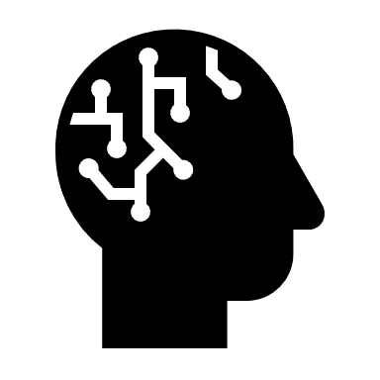



A simple flow chart
Vector Database
Extract and generate locators
Recorded actions
Capture complex steps
Generated raw data of the actions, UI elements, complex steps
Converted code in the required framework
Code inserted into the release cycle
Natural language inputs
GPT-4

Slide 5
GPT Requirements
1. Model – gpt-4-32k (0613)
This model has been chosen because :
* It has the largest context to provide large segments of code for larger testcases.
* It has function calling enabled which will helps in generating custom frameworks like PAF.
2. Text embedding – text-embedding-ada-002 (Version 2)
Recommended model by openai.

Slide 6
How can it help?
It would save a massive amount time by expediting the process of test automation code development.
The cost incurred to develop test automation code would be brought down by a sizeable margin by automating large chunks of the development.
Speed up the release timelines for the associated products by circumventing bottlenecks due to the lack of availability of testcases for new functionality.

Slide 7
Some stats
On average a ‘testcase’ takes about 1.5 days – 13 hours
The average time it takes to perform a testcase manually would be around 10-20 minutes. Combined with the task of writing the natural language instructions, it would be fair to approximate a maximum of 1 hour for any testcase generation using the prescribed method.
This would theoretically increase the efficiency of automation test script generation by 13x.
Another cost to factor in would be the token generation cost by GPT.

Slide 8
What would a scaled (Future) version look like?
A testcase scenario would be performed on the UI manually with the steps documented.
The above step would generate the PAF code required to run the testcase countless number of times which generates reports, etc.
The generated code would be pushed directly into the release pipeline and executed when required or in the case of a new release.
Any update to the UI could be handled by replaying the original recording or editing the particular step by the manual tester/reviewer.

Slide 9
Assumptions
Most UI automation testing process will follow the same structure of the test being conducted manually at least once and having some form of documentation written along with the execution.

Slide 10
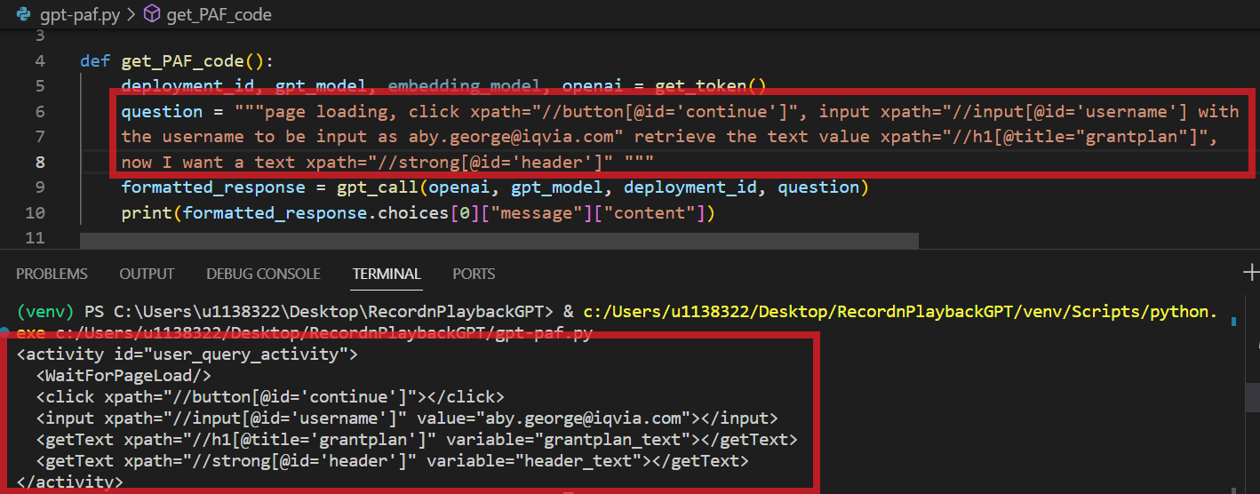
Here, GPT generates PAF code in the correct format referring to the user manual. It automatically generates unique and appropriate id’s, names, labels, etc., based on the context.
Here the input is a combination of UI locators and natural language input.
In the next slide, we can look at how we can automatically acquire the UI locators some of the natural language input.
Some crude input consisting of UI locators and natural language.
GPT generated output – (PAF Code) in the correct format with unique and appropriate names and labels.

Slide 11
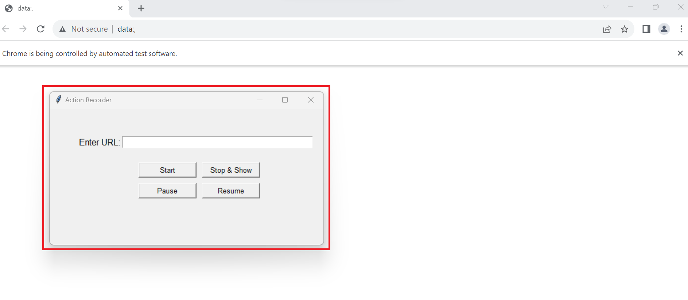
As a test is performed manually (just a single time is required) – the action recorder captures all the UI locators required in the correct order along with the action that is being performed and stores it.
This in turn can be fed as input to the GPT code generator to produce the required code.
Some complex actions though, cannot be simply captured – like validation, pass messages, checking calculations, comparing texts, etc.
This is where the natural language processing capabilities of GPT come into play
This action recorder records the UI actions performed and captures the required UI locators sequentially as the tests are being manually performed (this is a one-time process).

Slide 12
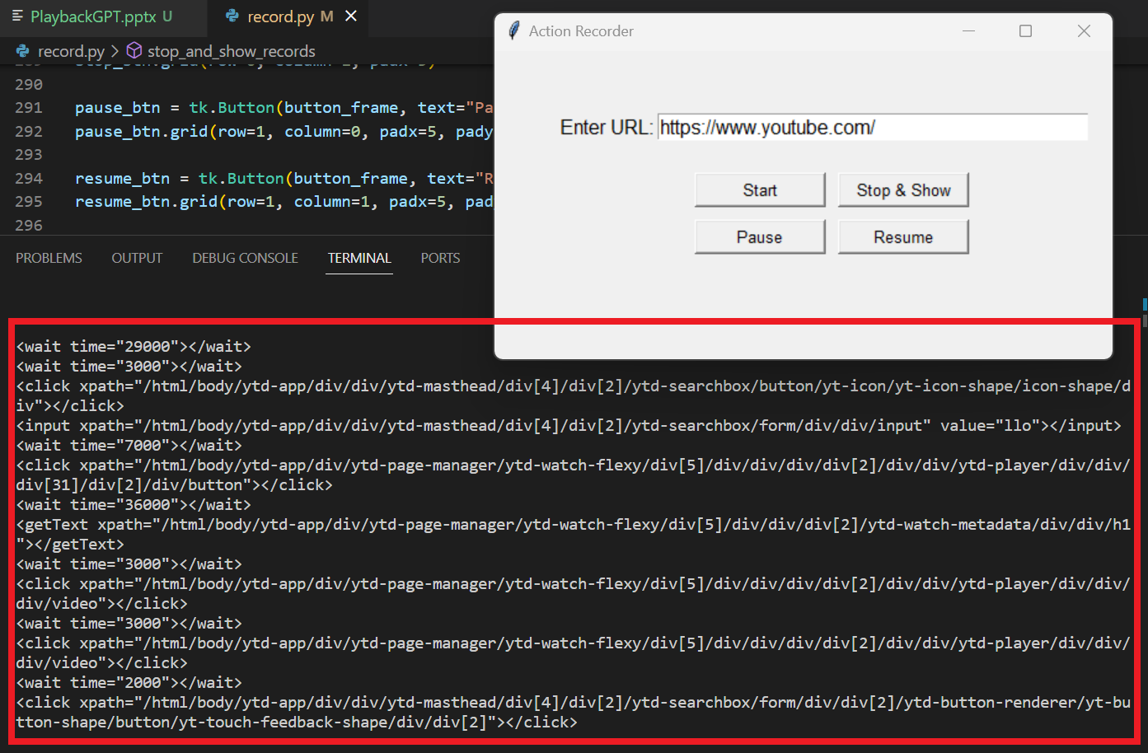
Here is a sample of some code generated by the action recorder alone – it generates the xpaths (UI locator), wait times, input values, in the correct order – this is crude PAF code.

Slide 13
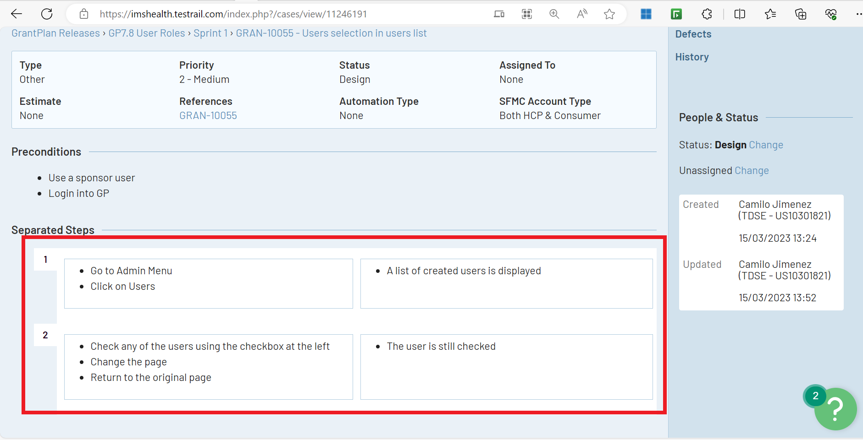
These are the test steps performed manually and written down by reviewers which are passed down to the PAF code developers .
This process can be cut short by simply taking the actions the reviewer performs to conduct the test manually in conjunction with the test steps written by them to directly generate PAF script (or possibly, other custom framework code as well).

