Slide 1
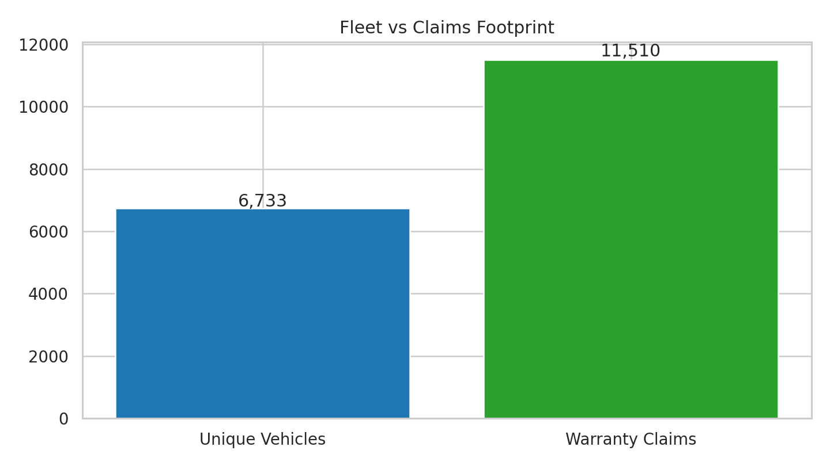
Warranty Prediction System - Montra Electric
Montra Electric
Logo Placeholder
Key takeaway: Focus on proactive claim prevention and budget visibility
• Two goals: 3-month claim risk + 12-month cost forecast
• Dataset: 11,510 claims, 6,733 vehicles, 40 features
• Value: proactive risk mitigation, cost control, resource planning

Slide 2
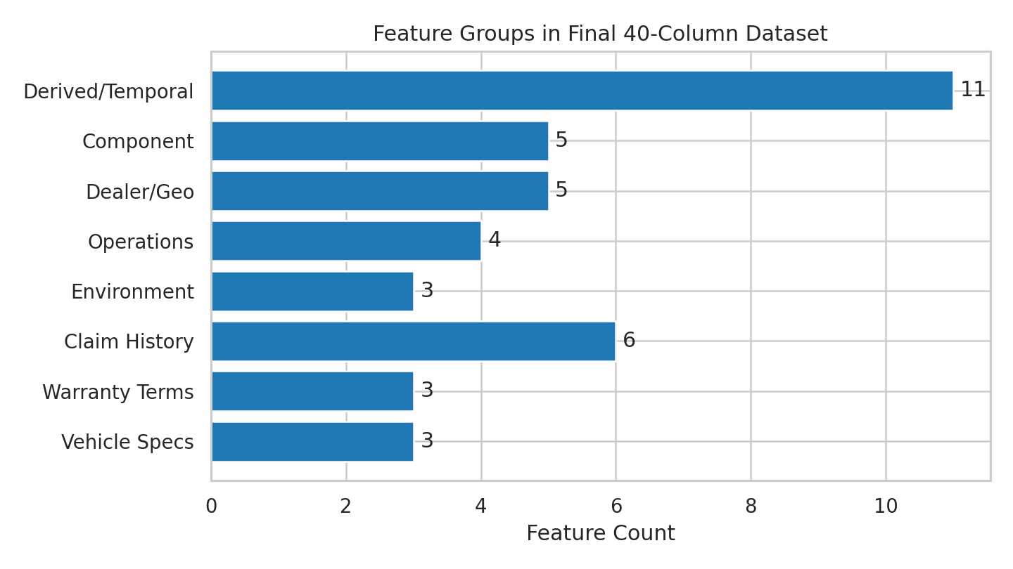
Understanding the Data: From Raw to Analysis-Ready
Montra Electric
Logo Placeholder
Key takeaway: Reliable integrated dataset for analytics and modeling
• Integrated claims, vehicles, components, dealer, and environment data
• Cleaning: null handling, duplicate checks, and date-rule validation
• Feature engineering: temporal, usage intensity, repeat-claim signals
• Final set: 11,510 rows × 40 features

Slide 3
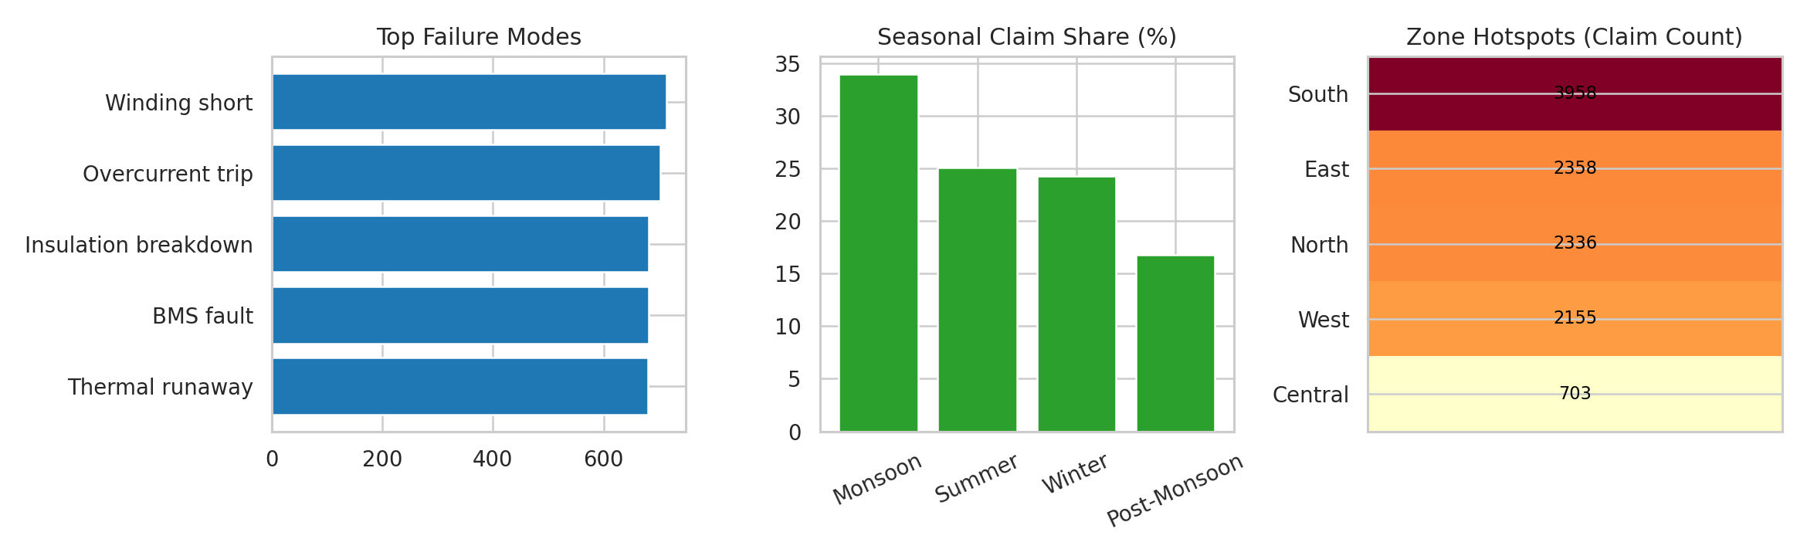
Data Exploration Reveals Critical Patterns
Montra Electric
Logo Placeholder
Key takeaway: Warranty risk is concentrated by variant, season, and zone
• Highest claim-intensity variants: TrioX-Cargo, TrioX-Lite
• Subsystem concentration: Powertrain (4,774 claims)
• Seasonality peak: Monsoon (34.0% of claims)
• Zone hotspot: South (3,958 claims)

Slide 4
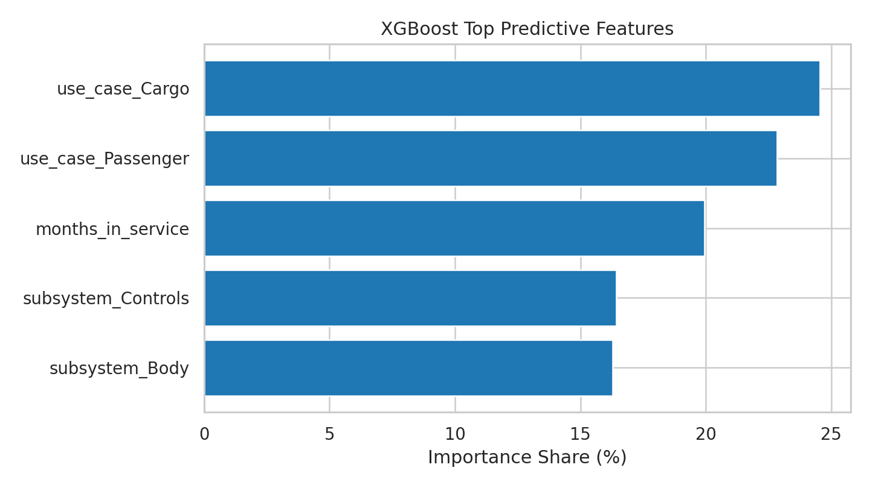
Technical Solution Design
Montra Electric
Logo Placeholder
Key takeaway: Two-pronged modeling balances explainability and forecasting power
• Problem 1: XGBoost classifier for 3-month claim likelihood
• Problem 2: Prophet + ARIMA ensemble for monthly cost forecast
• Inputs: vehicle profile, usage, history, environment, subsystem signals
• Metrics: Precision, Recall, F1, ROC-AUC, RMSE, MAE, MAPE

Slide 5
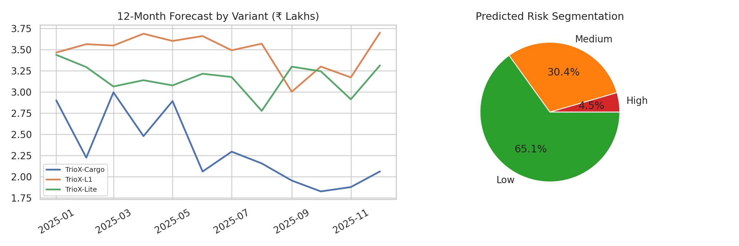
Actionable Solutions & Key Results
Montra Electric
Logo Placeholder
Key takeaway: Baseline outputs are actionable and ready for iterative improvement
• XGBoost baseline: test accuracy 77.8%, ROC-AUC 0.58
• Risk split: High 4.5% | Medium 30.4% | Low 65.1%
• Prophet+ARIMA: RMSE ₹189,454, MAE ₹175,817, MAPE 88.9%
• 12-month projected cost (top variants): ₹107.4 lakhs

Slide 6
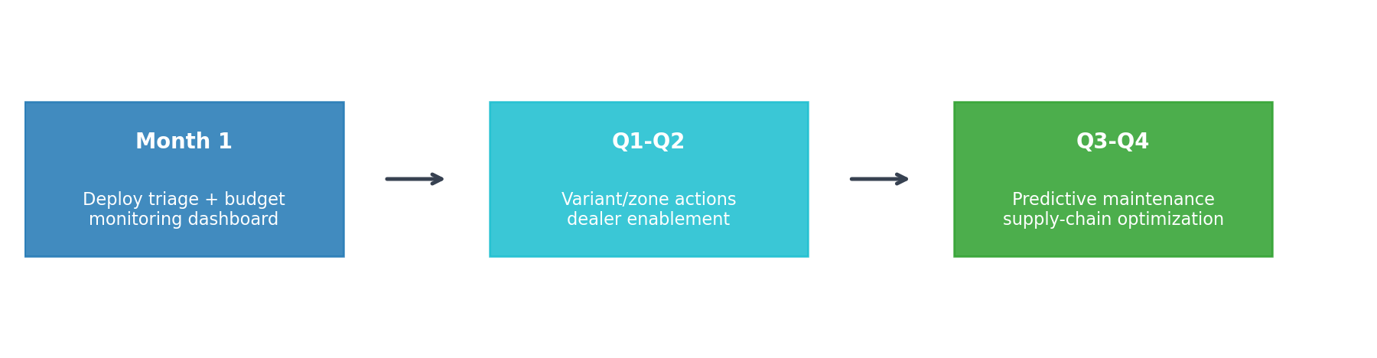
Strategic Recommendations & Implementation Roadmap
Montra Electric
Logo Placeholder
Key takeaway: Phased execution converts analytics into measurable business impact
• Month 1: deploy high-risk triage and forecast dashboard
• Q1-Q2: variant root-cause actions and zone-wise service optimization
• Q3-Q4: predictive maintenance and spare-part pre-positioning
• KPIs: prediction lift, MAPE reduction, cost reduction, service score uplift

