Slide 1
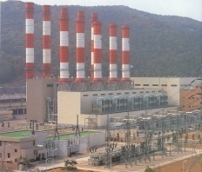



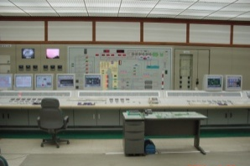
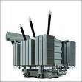
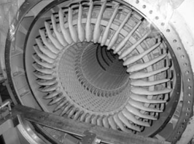

Personal Experience Presentation
06-05-2015
Liang Xu
Notes:
Wisdom, knowledge, and commitment, inspired and motivated.
All the guidance and encouragement to support me to finish my master period of study.
I also want to thank Dr. A for his valuable time to attend this presentation.

Slide 2
Content
Personal Statement ( Education and Experience)
Model-Based Failure Prognosis( Condition Monitoring)
Laplace Approximation
Prognosis Application and Case Study
Closing Remarks

Slide 3





Name: Liang XU
Age: 28
Education:
Wichita State University (2013)
Master of Science in Mechanical Engineering
Research assistant in Reliability Engineering Automation Laboratory (REAL)
Thesis: A Generic Bayesian Approach for Model Based Failure Prognosis
Work:
SpectraQuest, Inc (2013 to 2015)
Rotational Machinery Diagnostic Software Developer
Expert in Vibration Analysis, Signal Processing
Matlab/Labview Programming
Hand on experience with Testing, Data Acquisition.

Slide 4

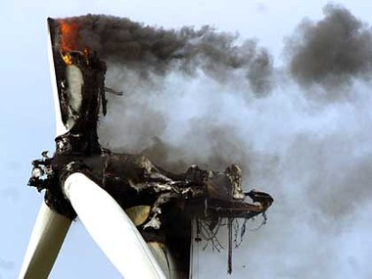
Introduction: Motivation
Safe and reliable operation of complex engineered systems requires health monitoring and prognosis using real time sensory signals.
Effective failure prognosis provides tremendous benefits such as improved safety, reliability, and reduced costs.
Challenges: accurately assess the current health state of system degradation and precisely evaluate the remaining useful life.

Slide 5
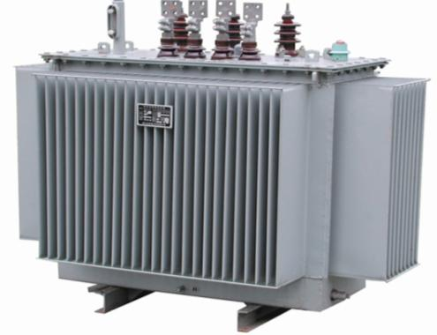
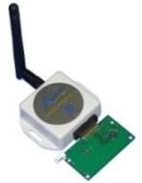
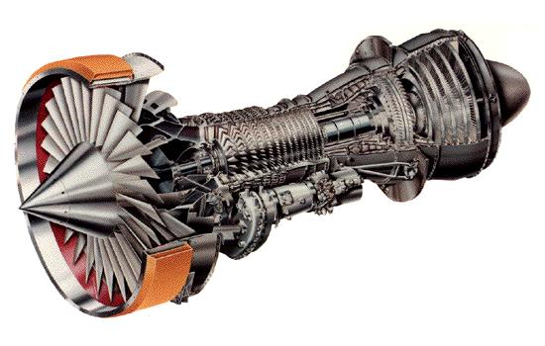
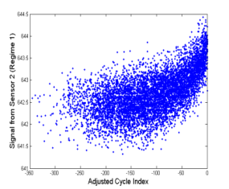
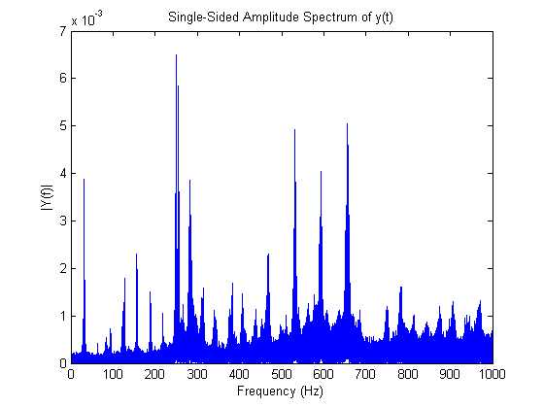
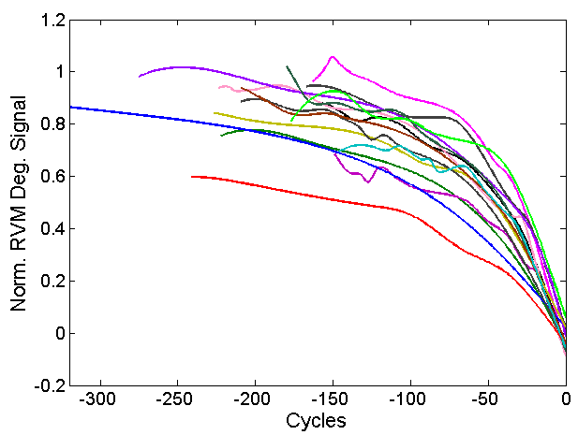
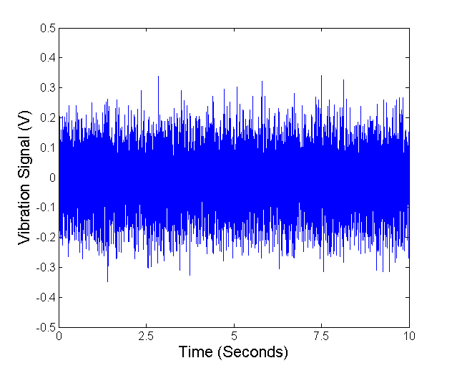
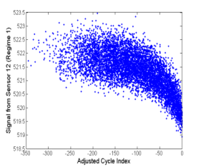
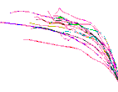
Failure Prognosis
Essential Tasks
Self-Powered
Wireless Sensor
NASA Aircraft Engine
Power Transformer
Health sensing function
To ensure high damage detectability by designing an optimal sensor network (Λ)
Health reasoning function
To extract system health relevant information in real-time and to diagnose system health condition (κ)
Health prognosis function
To predict remaining useful lives (RULs) of engineered systems in real-time (κ)
Health management function
To enable optimal decision making on maintenance of engineered systems (κ)
Health Sensing
Receiver
Energy Harvester
Sensory Signals
Health Reasoning
Health Grade
Health Index
Life Prediction
RUL Distribution
RUL Distribution
Failure
Threshold
Predicted
Life
Health Prognostics
Health Index
Health Management
Probability of Failure
Degradation Signal
Probability Density
Probability Density
Prediction
Reliability
Time
T: current time
T_{d}: designed life
Design Life
RUL
RUL
Notes:
This slide reviews the current status of PHM research.
In the PHM practice, the sensing function is used to collect sensory data. If necessary, the signal processing is then employed to extract the system health-relevant information. Finally, health prognostics predict remaining useful life based on the health-relevant information. Our lab has developed techniques for the sensing function and signal processing. The interest here is the last part, which is to make accurate RUL prediction.
Prognostic techniques in single time-scale can be classified into two categories: model-based and data-driven prognostics. The challenges are the lack of prediction robustness, which means the prognostic algorithm may not give accurate RUL prediction when the testing data set are different from the training data set and the incapability to deal with the lack of failure data, which means the prognostic accuracy can be very low when we do not have enough run-to-failure data.
For prognostics in multiple time-scales, joint/dual extended Kalman filter and particle filter can be used. However, these methods do not take into account the time-scale separation and cannot give accurate and stable health condition estimation. And there is little understanding on a multiscale framework for prognostics in multiple time-scales.

Slide 6
A Generic Bayesian Prognosis
Step 1 : selecting an appropriate degradation model, and prior.
Step 2 : building a likelihood function, with the new data.
Step 3 : updating the joint probability distributions of the model parameters.
Step 4 : updating the lifetime distribution based on the updated degradation model parameters.

Slide 7
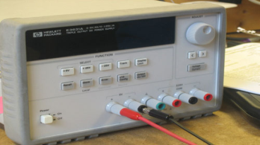
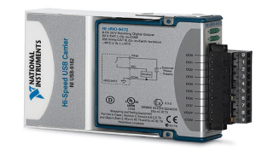

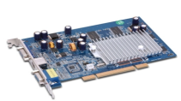
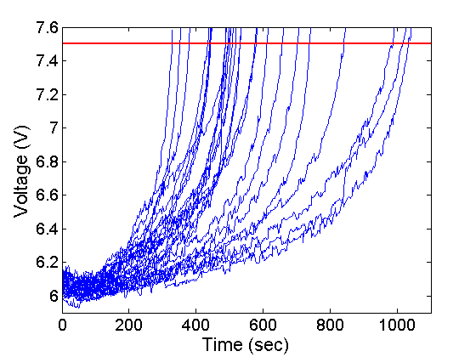
Prognosis Case Study
Connector
Data Acquisition
PC
Regulated Power Supply
DAQ System

Slide 8
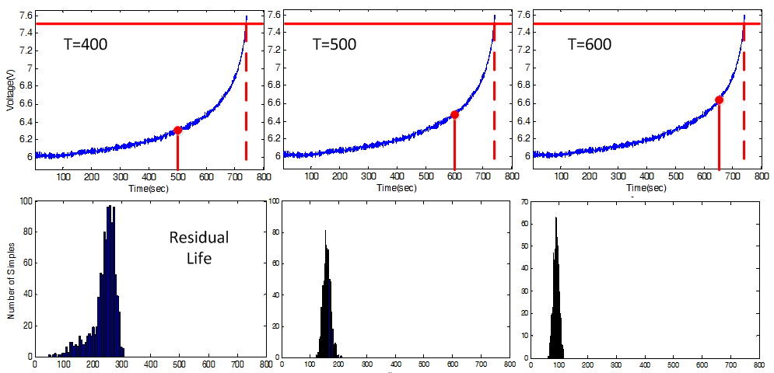
Prognosis Case Study
T= 500
T= 600
T= 650

