Slide 1
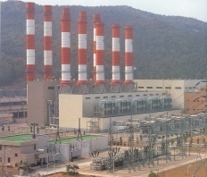



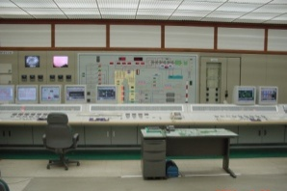
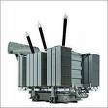
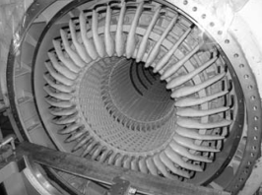

AEROSOL Package User Manual (1)
01-21-2016
Liang Xu
Notes:
Wisdom, knowledge, and commitment, inspired and motivated.
All the guidance and encouragement to support me to finish my master period of study.
I also want to thank Dr. A for his valuable time to attend this presentation.

Slide 2
Content
Personal Statement ( Introduce my self)
AEROSOL Package Overview
How to Use the Package
Example Experiments
Future Work
2

Slide 3





Personal Statement
Name: Liang XU
Education:
Wichita State University (Graduate 2013)
Master of Science in Mechanical Engineering
Research assistant in Reliability Engineering Automation Laboratory (REAL)
Thesis: A Generic Bayesian Approach for Model Based Failure Prognosis
Work:
SpectraQuest, Inc (2013 to 2015)
Rotational Machinery Diagnostic Software Developer
Expert in Vibration Analysis, Signal Processing
Matlab/Labview Programming
Hand on experience with Testing, Data Acquisition.
3

Slide 4

AEROSOL Package Overview
AEROSOL Package
AEROSOL Modeling
Sandia O.D.E Package
General Package Solve Ordinary Different Equation
Discrete Regime
Continuous Regime
Particles size < = k-mer
Particles size < = k+1-mer

Slide 5
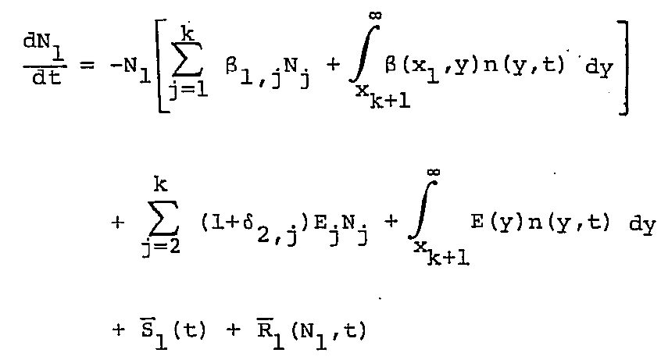
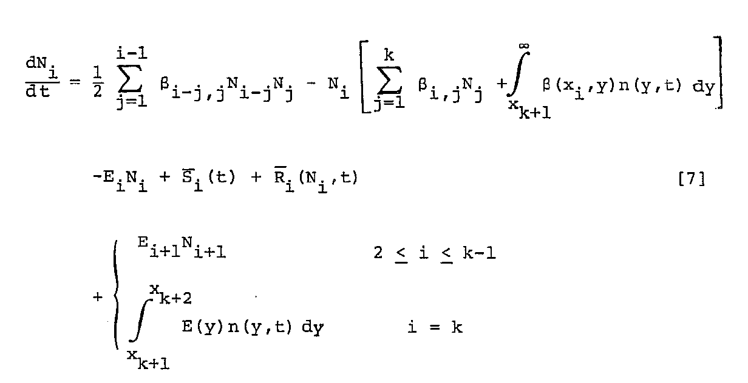
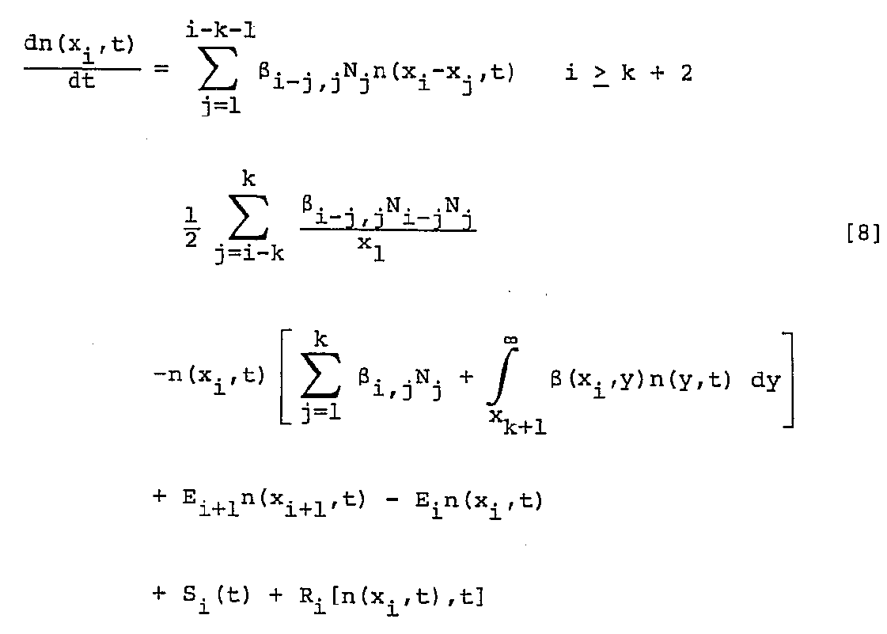
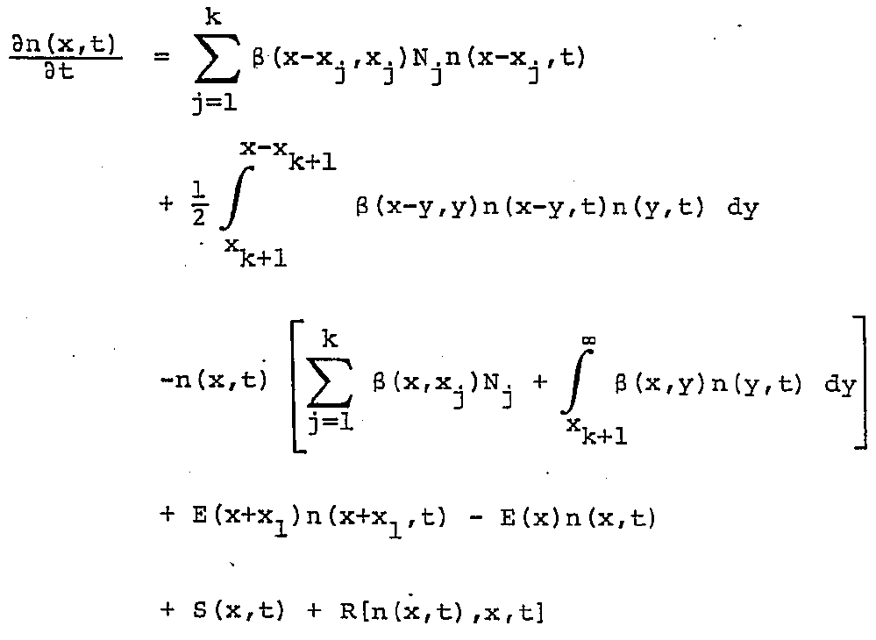
AEROSOL Package Overview
Aerosol Modeling ( 4 Equations )
i = 1
2 <= i <=k
x_{K+1} <= x <=x_{2k}
x > x_{2k}

Slide 6
AEROSOL Package Overview
Numerical Techniques
Discrete Regime
In the continuous regime, n( x , t ) is assumed to be a continuous function of x.
Therefore, by determining the temporal variations of n( x , t ) at a finite number of grid points in x, the value of n( x, t ) at intermediate points can be determined by interpolation.
Linear
Logarithmic Spline
Cubic
Continuous Regime
In the discrete regime N_{i}, (i = 1, …..,k) is governed by solving a set of k ordinary differential equations. The user need only specify the number of discrete sizes and based on the size of the monomer, the code will determine all the cluster sizes and the smallest particle point locations in the continuous regime in the rage x_{k+1} <= x <= x_{2k}

Slide 7
AEROSOL Package Overview
Subroutines
Excluding the O.D.E. Package, AEROSOL package consists of 20 routines which can be divided into four categories.
1, Coefficients Specification Routines
Specify the kinetic coefficients and initial conditions
2, Interpolation, Integration and output Routines
Determine the interpolation and integration method, and the form of the output.

Slide 8
AEROSOL Package Overview
3, Convenience Routines
Diagnose input error.
Check interpolation method
Computer the first moment of the distribution
Compute the steady state approximation solution for the discrete regime
4, Central Routines
Control the code by reading the input data, calculating coefficients, storing values and provide the derivatives needed for O.D.E. package

Slide 9
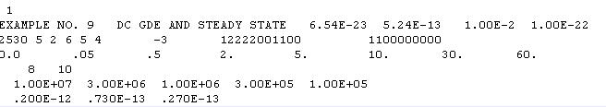
How to Use the Package
Input Data
Particle Size Domain
Error Tolerances
Number of Grid Points
Number of Discrete Multiplets
Number of Outputs
Steady State Approximation
Grid Point Selection
Number of Interpolating points
Interpolation Method

Slide 10
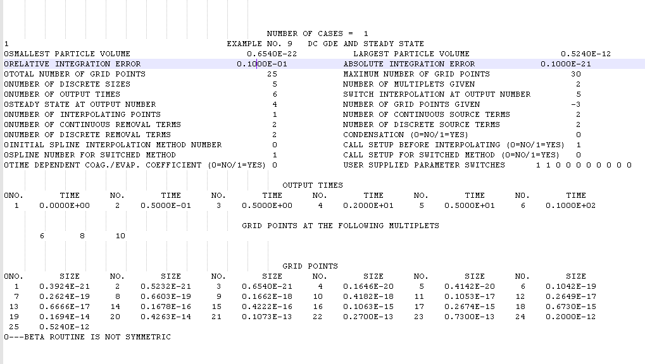
How to Use the Package
Output Data

Slide 11
Example Experiments
In the manual, the author give us 9 experiments
Input Errors
Simple Coagulation
Coagulation and Sources
Add Grid Points
Add Descending Grid Points
Input Error to DC CGE
DC GDE with Source
DC GDE and Steady States

Slide 12
Future Work
Try some other example
Learn some basic knowledge about Aerosol
Learn to use the O.D.E. package separately

