Slide 1
CUSP-GX-5004: APPLIED DATA SCIENCE

Slide 2
Time Series Analysis
Continued

Slide 3
Follow-up on Interest Rates

Slide 4
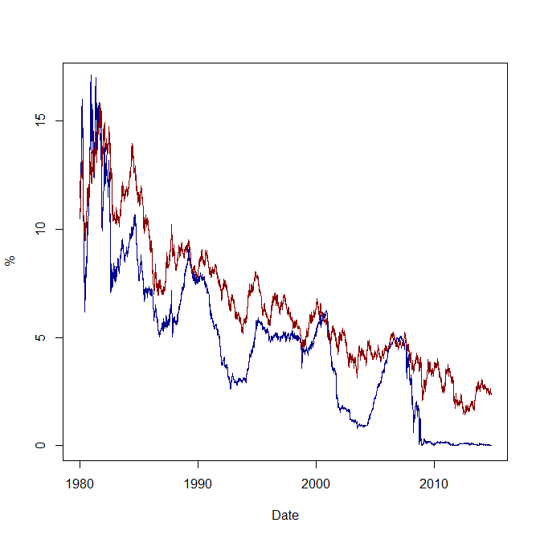
Short- and Long-Term Rates

Slide 5
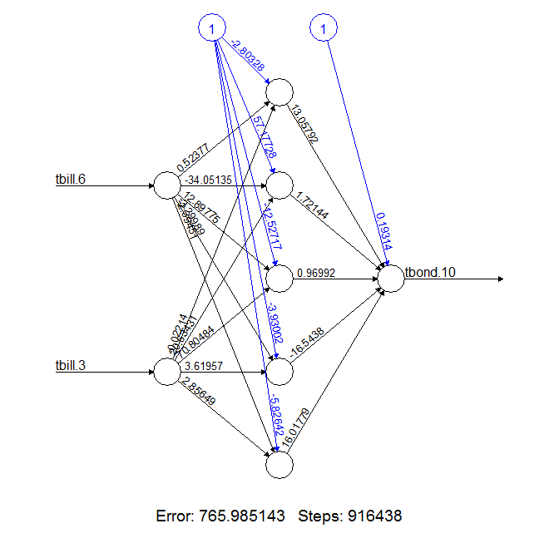
Visualization of Optimized ANN

Slide 6
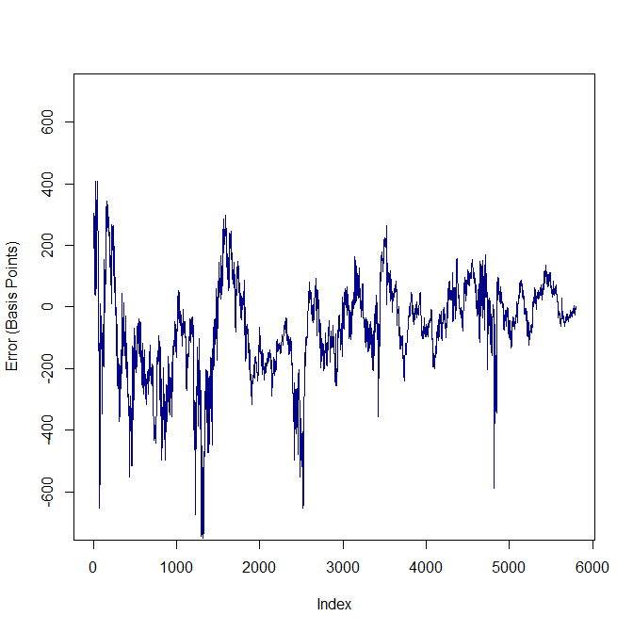
Prediction Error

Slide 7
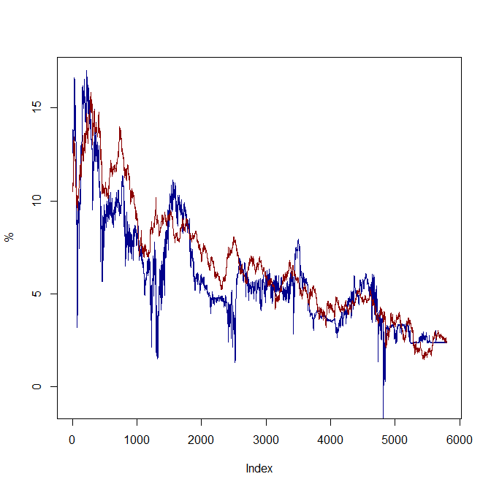
What the ANN Forecasts

Slide 8
Follow-up on Markov Processes

Slide 9
In the Limit
Room | A | B | C
A | 0.250 | 0.500 | 0.250
B | 0.250 | 0.500 | 0.250
C | 0.250 | 0.500 | 0.250

Slide 10
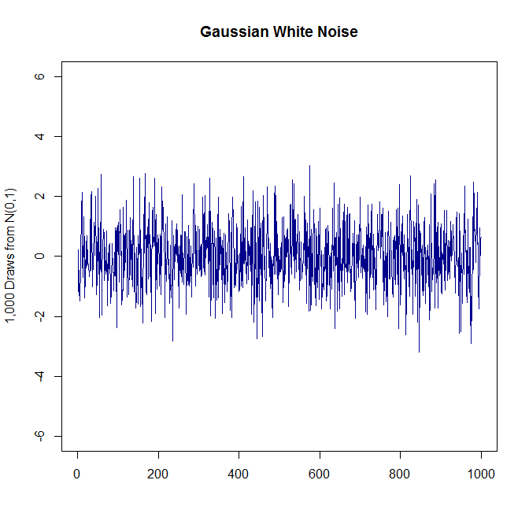
Simplest Time Series

Slide 11
What Are Its Characteristics?
Independent draws from normal distribution with zero mean and finite variance.
By design, resulting time series process:
Has no trend.
Has no serial dependence.
Is stationary.
Ideal building block: so let’s build an AR(1) process.

Slide 12
The AR(1) Model

Slide 13
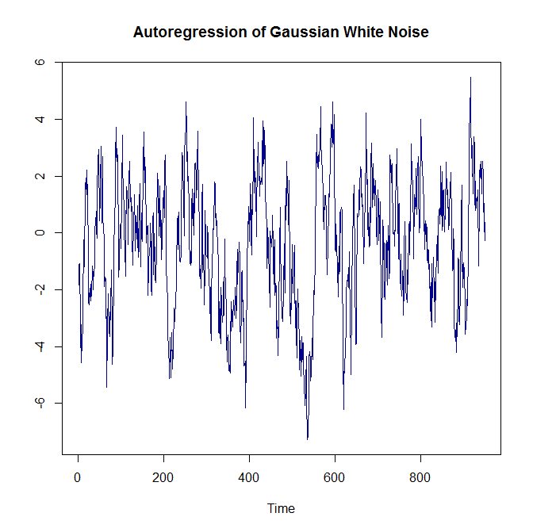
Today Is Mostly Yesterday Plus Noise

Slide 14
Using Monte Carlo Simulation to Examine Limiting Behavior

Slide 15
Using Math to Examine Limiting Behavior

Slide 16
AR(1) Model
Through MC simulation and math we find that the series is stationary and un-trended.
Gained an important component: correlation across observations through time.
This is called “autocorrelation”.
Let’s examine this autocorrelation.
In R, acf()
In Python, use statsmodels.tsa

Slide 17
AR(1)
Builds directly from white noise processes.
Can capture fairly rich set of time series characteristics.
You can build this into a linear model with other attributes as well if you want to capture time dependence.

Slide 18
Some Actual Data
Air pressure at sea level in pounds per square inch measured monthly at Darwin, Australia, 1882 to the present.
Stationary times series (won’t explode).
Un-trended over time.
But strongly cyclical.

Slide 19
More Data
Monthly sunspots from the Solar Influences Data Analysis Center (SIDC) since 1749.
http://sidc.oma.be/silso/
Waves of long duration.
Is AR(1) appropriate?
Other time series methods to estimate?

Slide 20
Are Stock Returns Correlated?
Recall that we’ve looked at stock prices using the bivariate regression model and CAPM.
Log daily returns are log(today’s price) – log(yesterday’s price)
Are returns correlated from one day to the next?
Examine the performance of a company that’s been around for a long time.

Slide 21
Volatility Regimes
Define volatility to be the square of log returns.
Always positive.
Large swings in prices (large values for log returns) imply higher volatility.

Slide 22
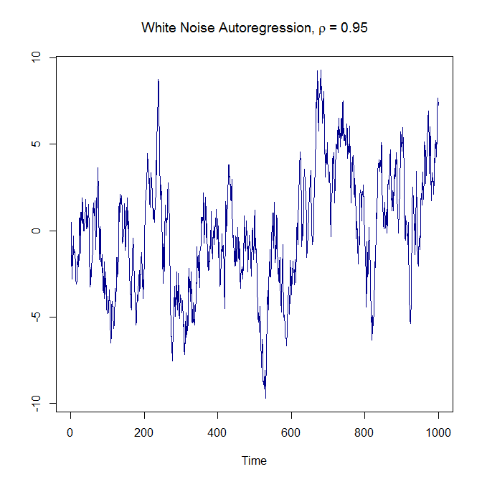
What Happens as ρ→1?

Slide 23
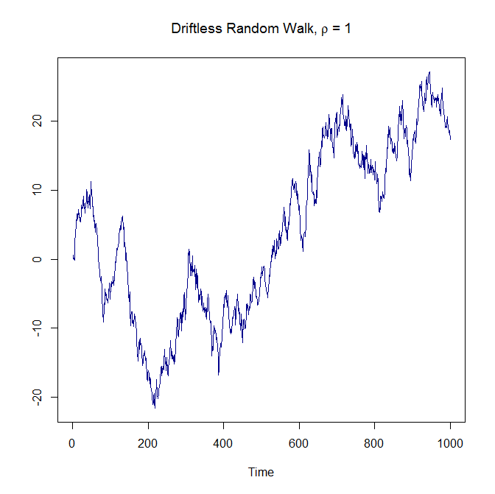
Today Is Yesterday Plus Noise

Slide 24
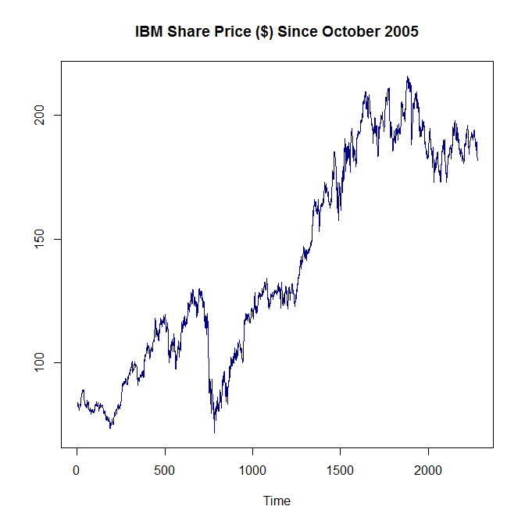
Can You Tell the Difference?

Slide 25
Linking Random Walks and Markov Processes
Drunken Sailor on a Mountain Top

Slide 26
Moving Averages (Smoothing)

Slide 27
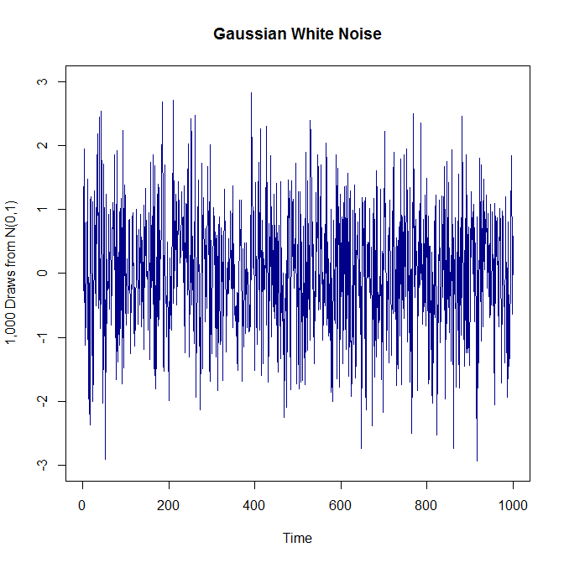
Simplest Time Series

Slide 28
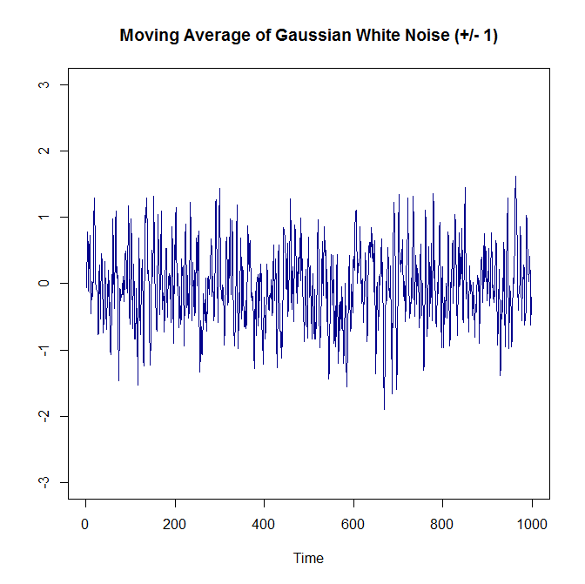
Smoothing White Noise

Slide 29
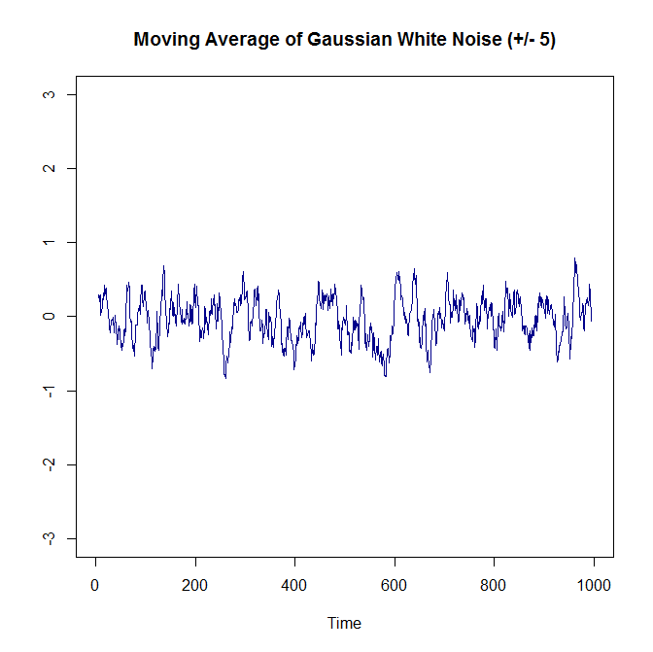
And Yet More Smoothing

Slide 30
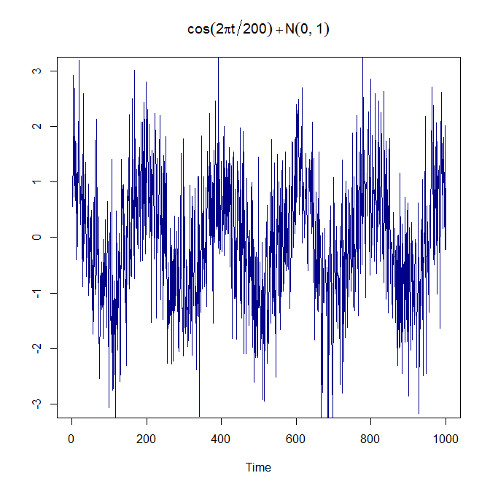
The Signal and the Noise

Slide 31
Correlation and Causality

Slide 32
Experimentation
In the physical sciences, experiments can be designed explicitly to explore ideas about the physical world.
Experimental discovery of the Higgs field at the LHC.
In systems that involve human interaction, correlation and causation may not (indeed are not) same thing.
Experimentation involving humans raises ethical and other issues.

Slide 33
Development of Techniques
Urban systems are perfect examples of this interaction.
Yet still want to be able to address questions of causation with observational data that may not be experimental.
Angrist and Pischke, “Mostly Harmless Econometrics: An Empiricist’s Companion”

Slide 34
An Ideal
Double blind studies based on randomized clinical trials.
Control group
Treatment group
Administrator does not know which individuals are in either group until the study is complete.
Compare average outcomes across two groups.

Slide 35
Angrist and Pischke’s FAQs
The relationship of interest
The ideal experiment
The identification strategy
The method of inference

Slide 36
What is the Causal Relationship of Interest?
An analysis could be a purely descriptive process without an explanation of an underlying causal mechanism.
Causal relationship is useful for making predictions about the consequences of changing policies.
It tells us what would happen in an alternative or counter-factual universe.

Slide 37
We Already Explored This Issue
The causal effect of schooling on wages: incremental increase in wages earned if an individual received more schooling.
Range of empirical studies suggest that the causal effect of a college degree is about 40% higher wages on average.
Causal inferences have been drawn in other empirical work.

Slide 38
Other Research Areas
Acemoglu and others have examined the impact that democratic political institutions have on economic growth in the developing world.
Results are indeterminate.
Duflo and others have used extensive randomized trials to examine the effects of various interventions on poverty.
Discussed in TED talk.

Slide 39
Intervention as Experiment
With regard to schooling and wages, one could consider the experiment of offering financial incentives to secondary-school students with the potential of dropping out.
Could observe the students after the intervention to evaluate effects.

Slide 40
What Is Your Identification Strategy?
Identification strategy: the manner in which a researcher uses observational data to approximate a real experiment.
Mroz and others explore whether married individuals earn higher wages on average.
Savage and others approximate the work lifecycle using a variety of statistical techniques to explore adverse implications of shocks to employment.

Slide 41
This Is Experimental Design
The rise of the “natural experiment” as experimental design.
Researcher does not create the experiment (as in the physical sciences).
Instead, researcher exploits some feature of observational outcomes and treats them “as if” they are the result of randomization and experimentation.

Slide 42
Natural Experiments
Useful Wikipedia definition: “A natural experiment is an empirical study in which individuals (or clusters of individuals) exposed to the experimental and control conditions are determined by nature or by other factors outside the control of the investigators, yet the process governing the exposures arguably resembles random assignment.”

Slide 43
Examples of Natural Experiments
Lotteries that truly randomize a group of individuals.
Galiani et al. (2011) study effects of randomized eligibility for mandatory military service in Argentina. Both draft eligibility and actual conscription increase the likelihood of having a criminal record later in adulthood.
Possible inference: Delayed entry to the labor market has adverse implications.
Quotas also function in this manner.

Slide 44
Other Types of Natural Experiments
Jurisdictional boundaries over which policies are different.
Different minimum wages (New Jersey and Pennsylvania).
Policy changes that are exogenous to individuals.
The number of polling places was consolidated for California’s 2003 special gubernatorial recall election. Voters whose distance to the polling place increased constitute a treatment group.

Slide 45
What Is Your Method of Inference?
The population to be studied.
The sample to be used.
Assumptions to be made when comparing the treatment group and control group.
Always there so should be upfront about them.

Slide 46
What Is the Purpose of This?
In most circumstances, we seek to draw inferences about the effects of some type of policy.
Would decreasing the opportunity costs of education result in higher incomes (and taxes)?
Do democratic reforms lead to higher growth?
Does microfinance result in higher levels of education and health?
Would raising taxi fares result in fewer inefficient journeys?

Slide 47
Which Takes Us Back to the Beginning of the Course
Regression with true randomization.
Linear regression with natural experiments.
Both include probability models.

