Slide 1

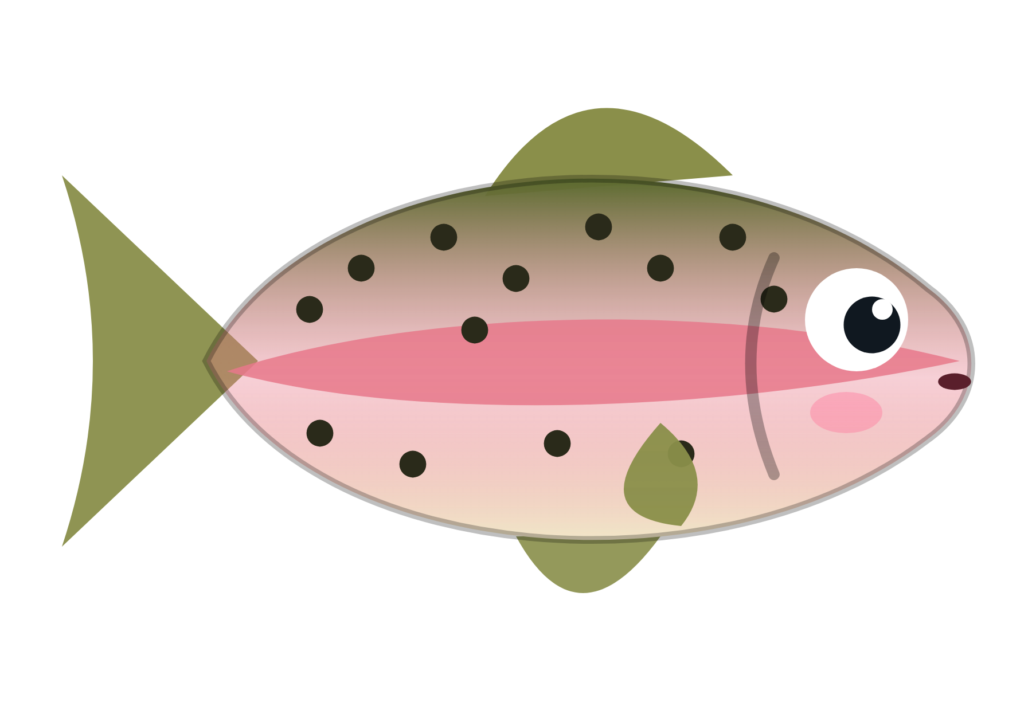
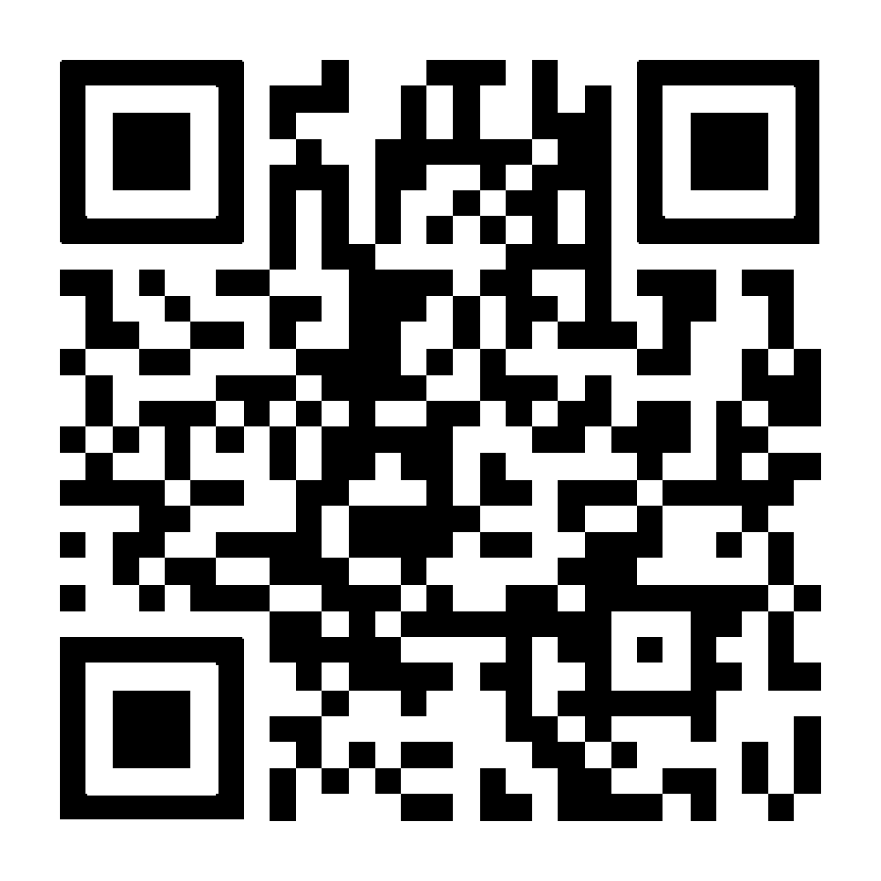
Weather for Fish
Scan to try it
Target audience: fish. Smartphone adoption among target audience: 0%.
on your phone or laptop, right now
abyyworld.github.io/weather-for-fish
Notes:
Deadpan. Let the tagline land. Then: "We built a weather app. For fish." Invite the room to scan the QR code and follow along on their own phones.

Slide 2

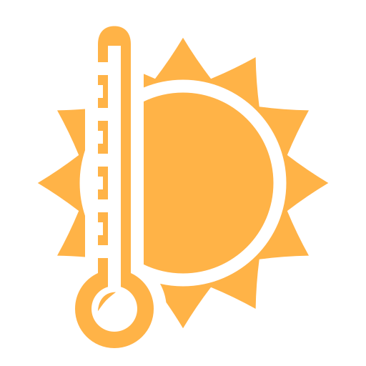

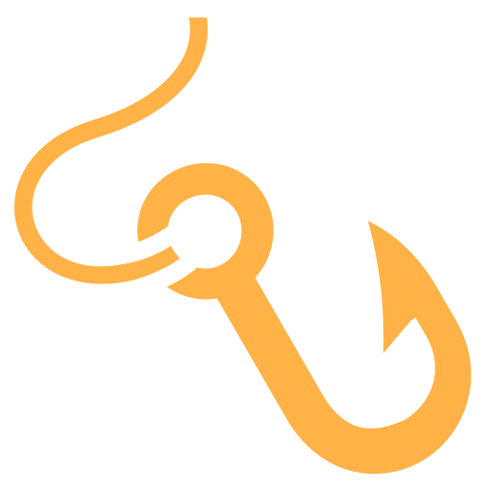
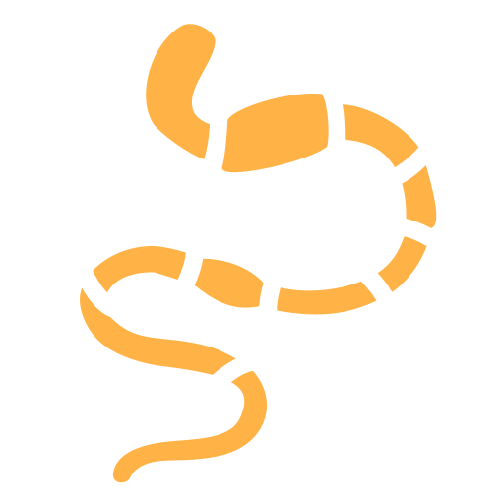
THE PROBLEM
Every weather app has the same bug
It assumes you have lungs.
Can I breathe?
Is it too hot?
What’s hunting me?
Are the humans coming?
Is there food?
“Will it rain?” Mate. I’m already wet.
Notes:
Humans ask one question: will it rain. Fish do not care. They are already wet. A fish has five questions, and no app answers any of them.

Slide 3
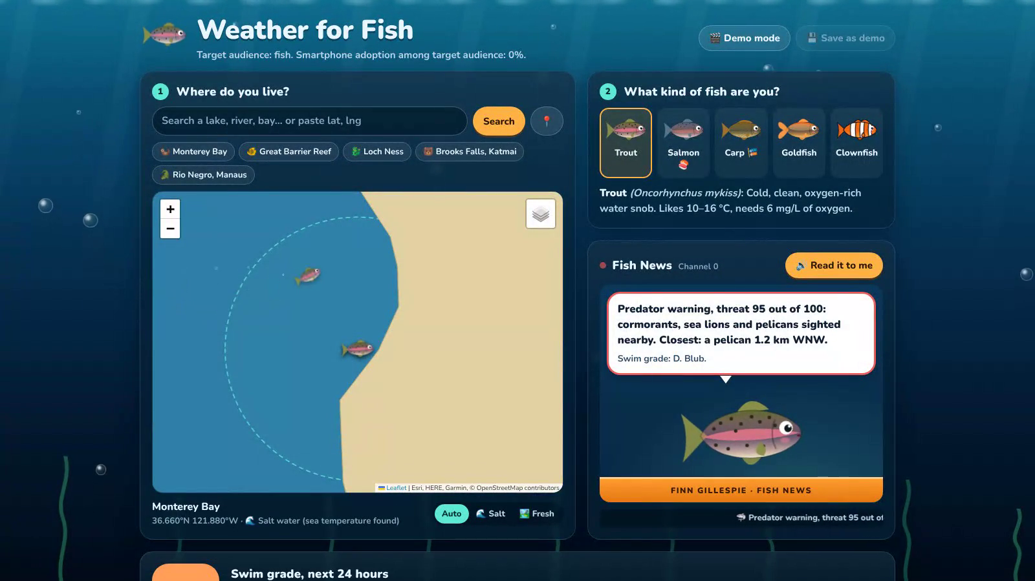
Live from the reef (well, Monterey Bay)
Live: abyyworld.github.io/weather-for-fish Code: github.com/abyyworld/weather-for-fish
Notes:
Play the clip (click it), or switch to the live site. Beats: the anchor reads the news, the radar sweeps, a heron explains itself, trout becomes clownfish, solunar tables, the Shipping Forecast.

Slide 4
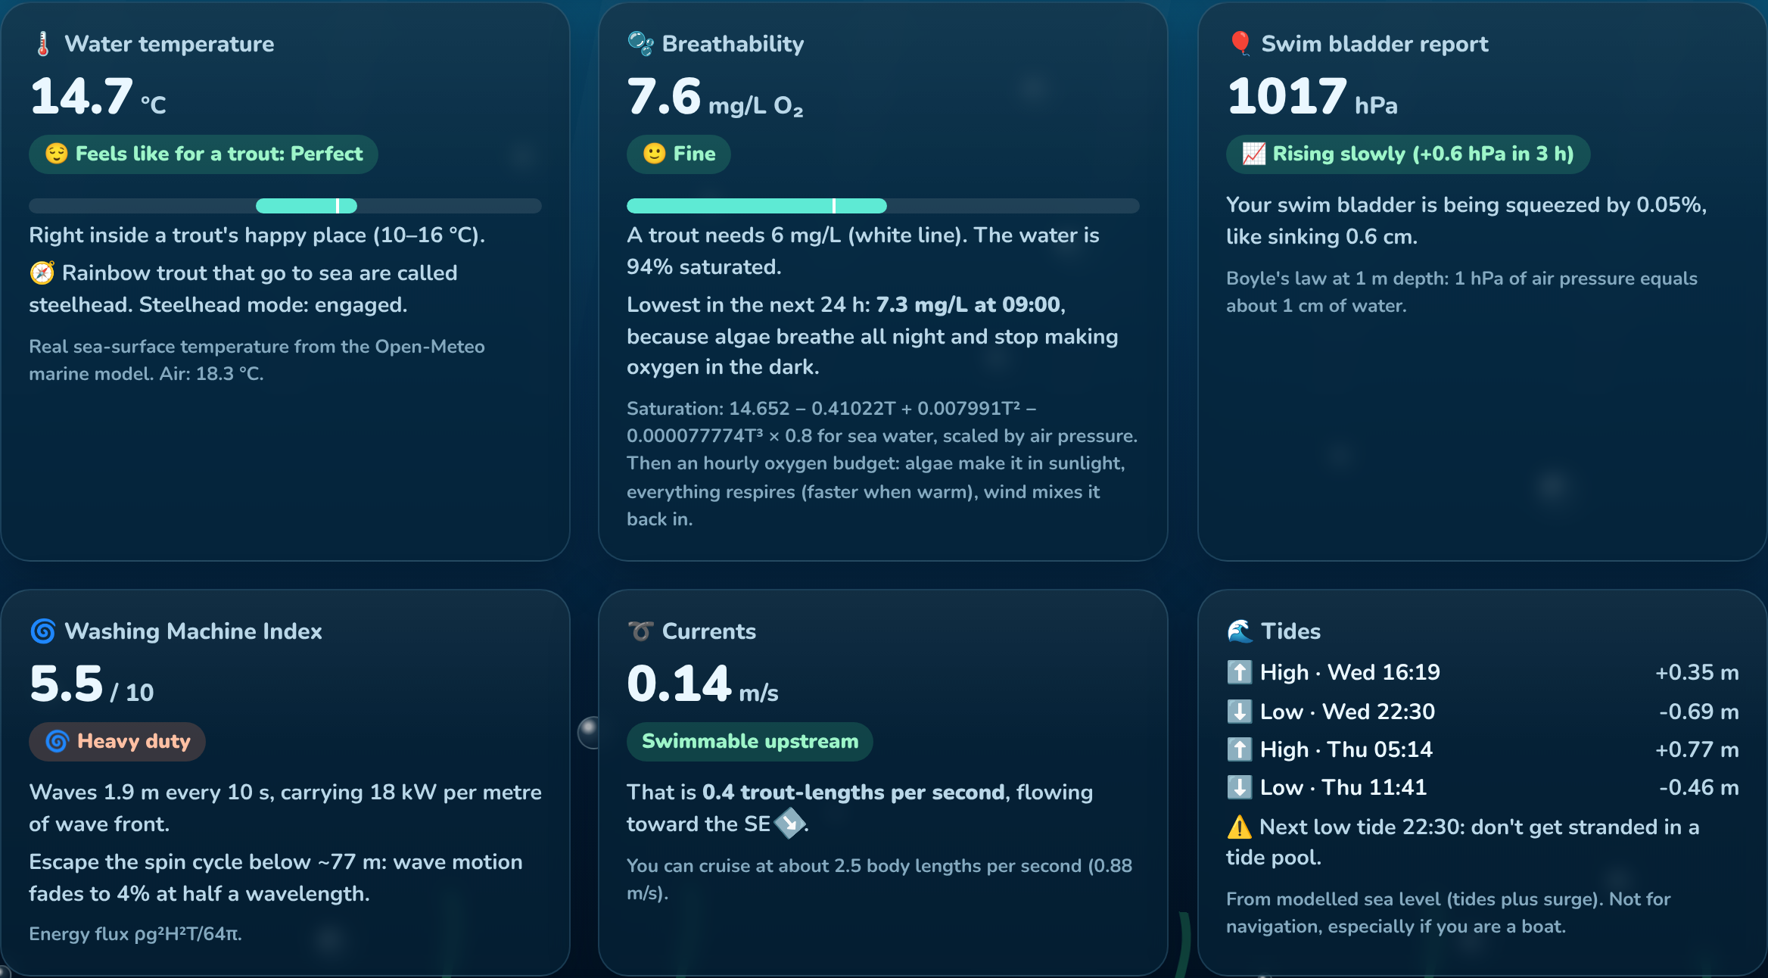
CAN I BREATHE?
The worst time to be a fish is 5 a.m.
Algae make oxygen all day and breathe it all night. We model it hour by hour, so you know when to gasp.
O₂ = 14.652 − 0.41022T + 0.007991T² − 0.000077774T³
Odum (1956) · Cole & Caraco (1998) · θ = 1.047
Notes:
Real chemistry: the textbook saturation formula, then an hourly oxygen budget. Algae make oxygen in sunlight, everything respires faster when warm, wind stirs it back in. The pre-dawn crash falls out of the maths.

Slide 5
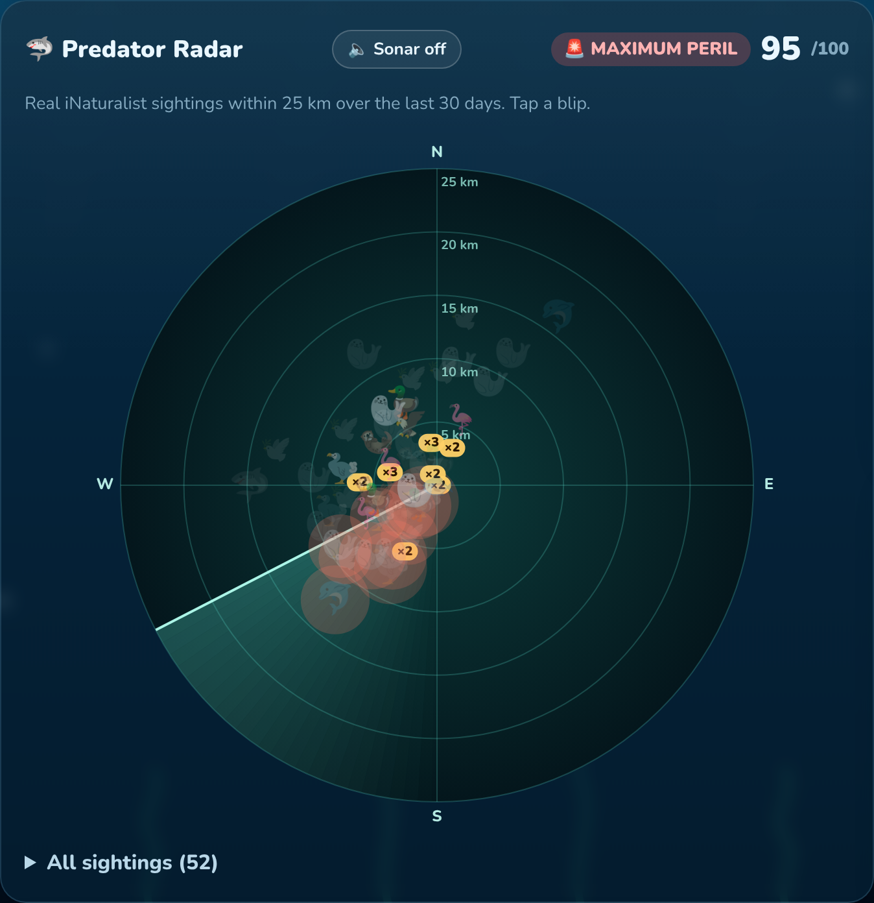
WHAT’S HUNTING ME?
Real predators, real distance, real bearing
Live iNaturalist sightings within 25 km. Tap a blip and it explains itself:
Heron: stands perfectly still for 20 minutes. Do not trust the statue.
Pelican: the pouch holds 11 litres. You fit. Your family fits.
Shark: older than trees. Act natural.
Notes:
Predators are looked up on iNaturalist by scientific name, then one query for everything seen near you this month. Threat = danger × proximity × recency. Fifty photos of one gull colony is fifty tourists, so repeats count for less.

Slide 6
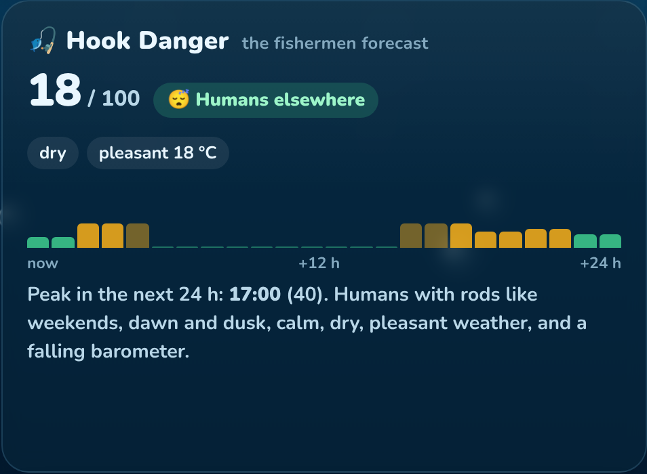
ARE THE HUMANS COMING?
Anglers believe fish bite when the barometer falls
So that’s when the anglers turn up. We forecast the forecasters.
Hook Danger = Saturday × dawn × calm × dry × pleasant × falling pressure. Carp mode remembers that carp anglers camp overnight with bite alarms.
Snack Index: rain washes worms in, mayflies hatch at dusk, the moon does the rest.
Notes:
The only weather app that forecasts other people’s beliefs about the weather. When it says Hook o’clock, stay under your rock.

Slide 7
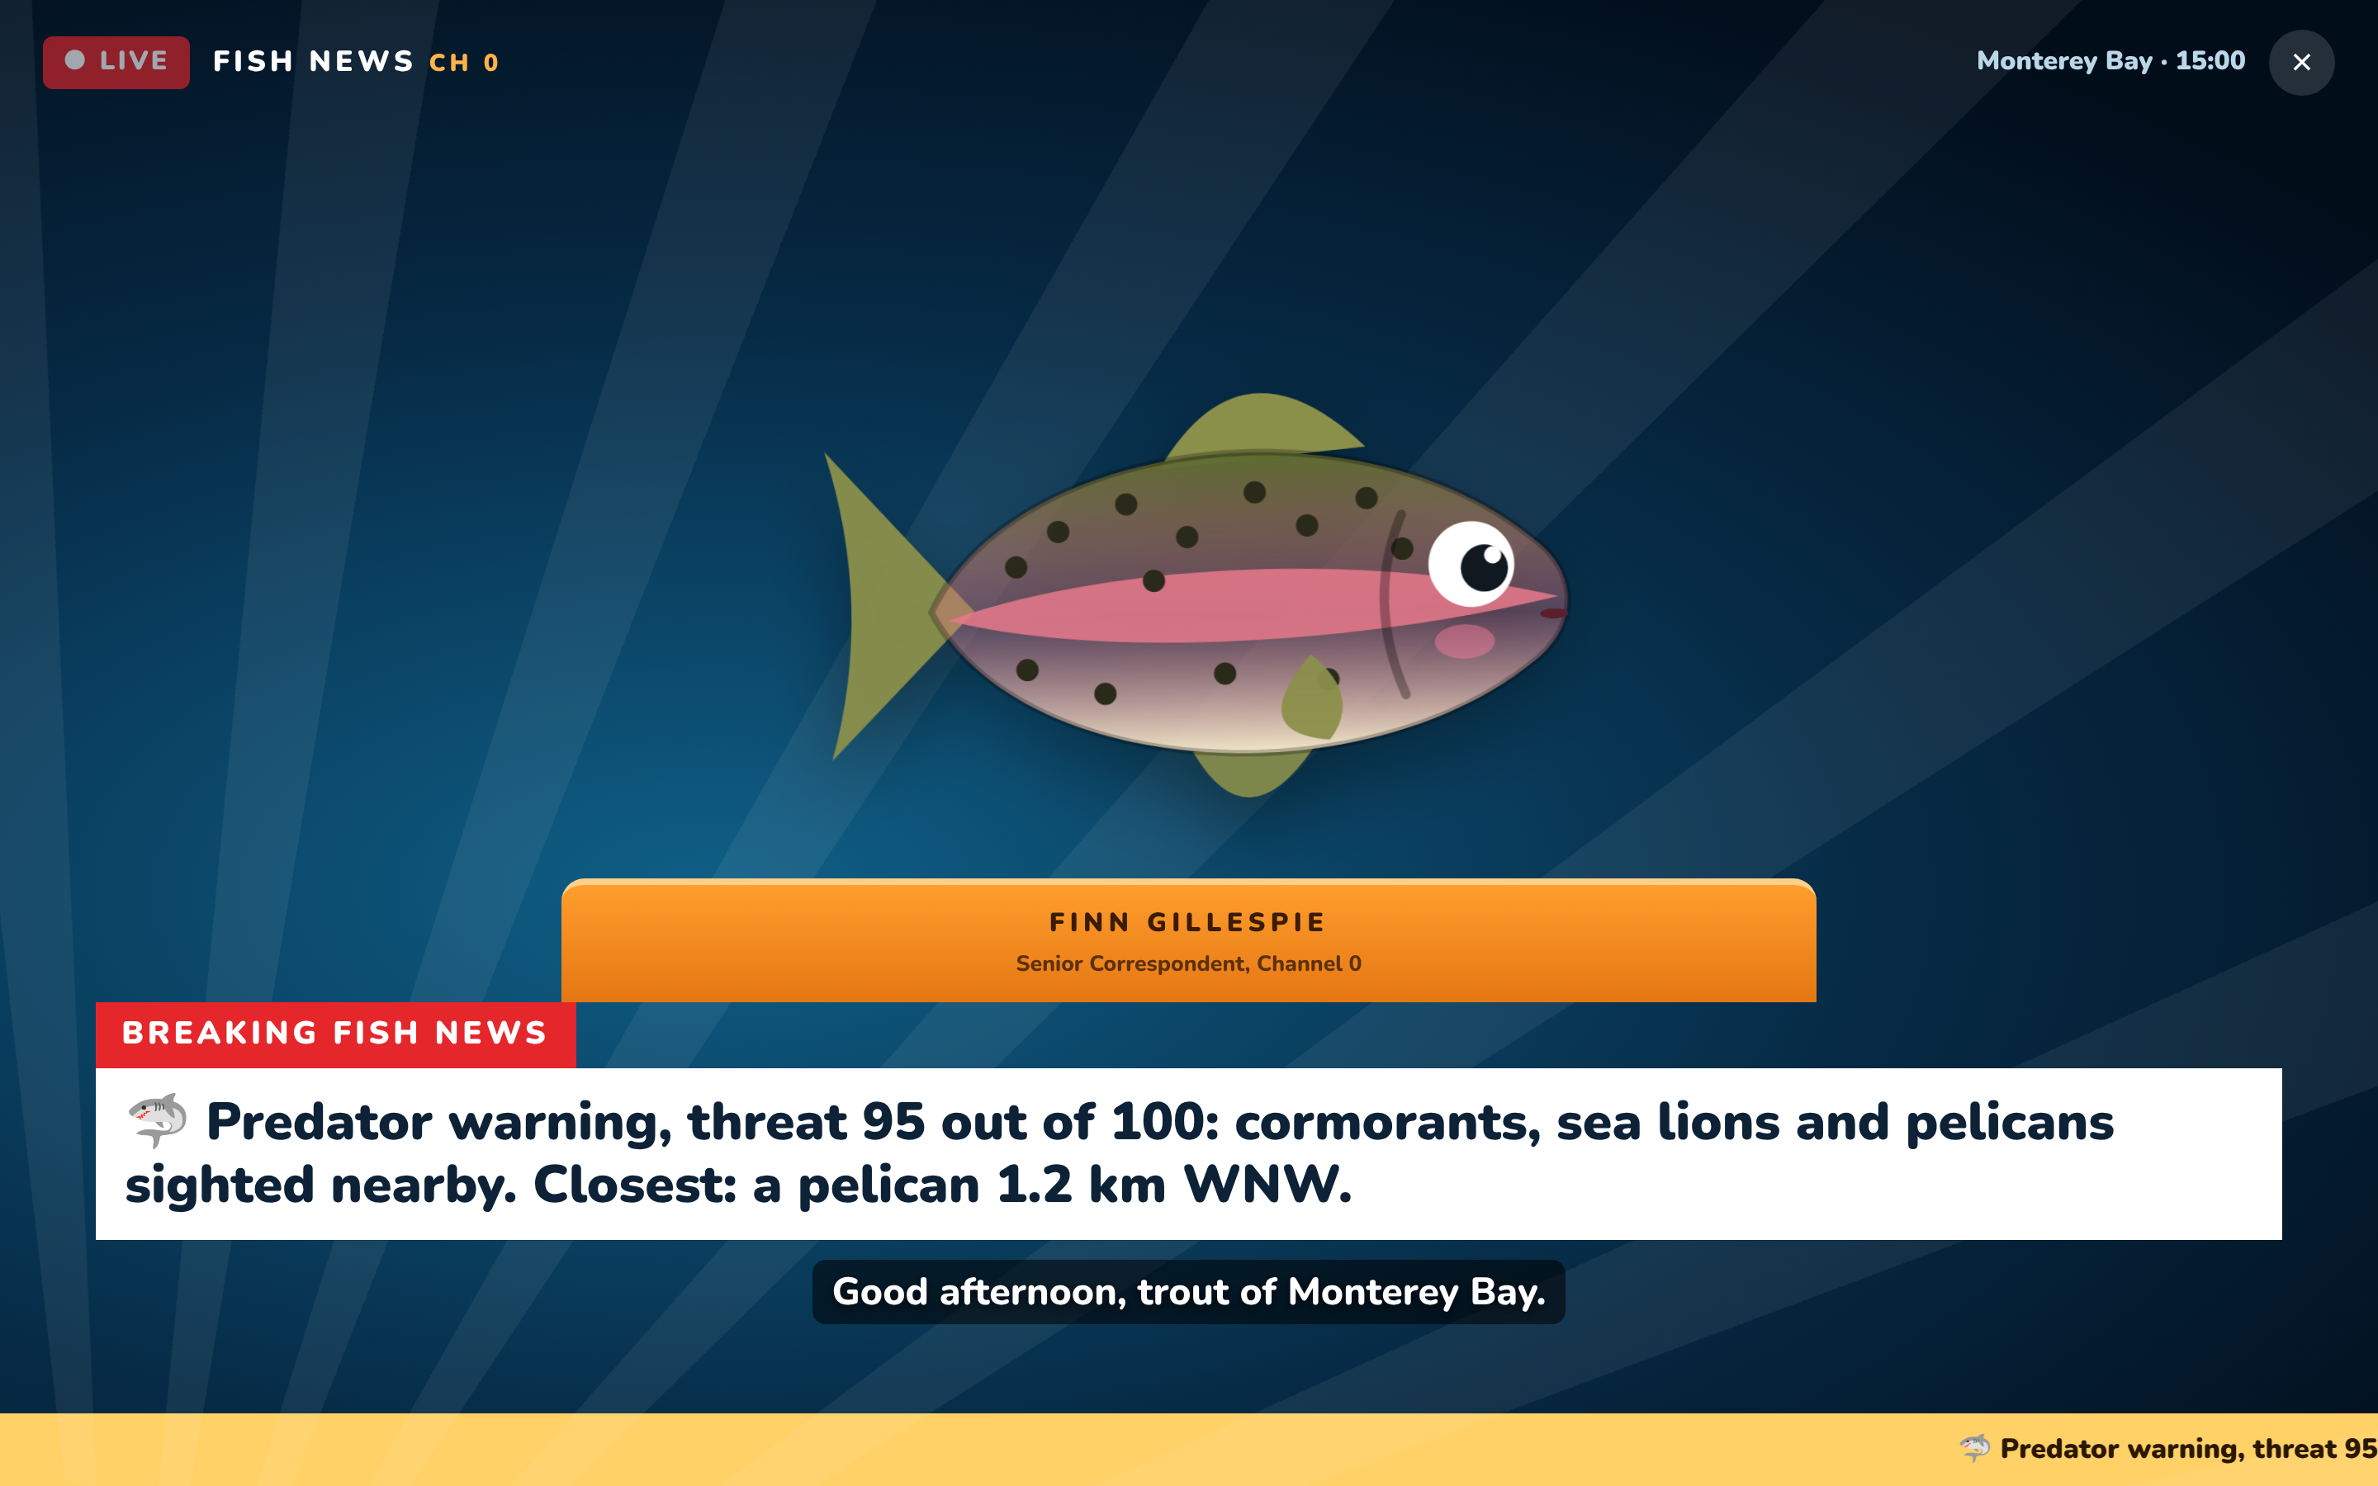
FISH NEWS, CHANNEL 0
Finn Gillespie reads you the news
Most important first: salt water, oxygen, predators, fishermen, heat. Otherwise: “Conditions are great, go be a fish.”
Every broadcast ends with “Blub.”
Notes:
Read it to me: full-screen broadcast, mouth moves with each word, subtitles follow the voice. The most important journalism of our time.

Slide 8
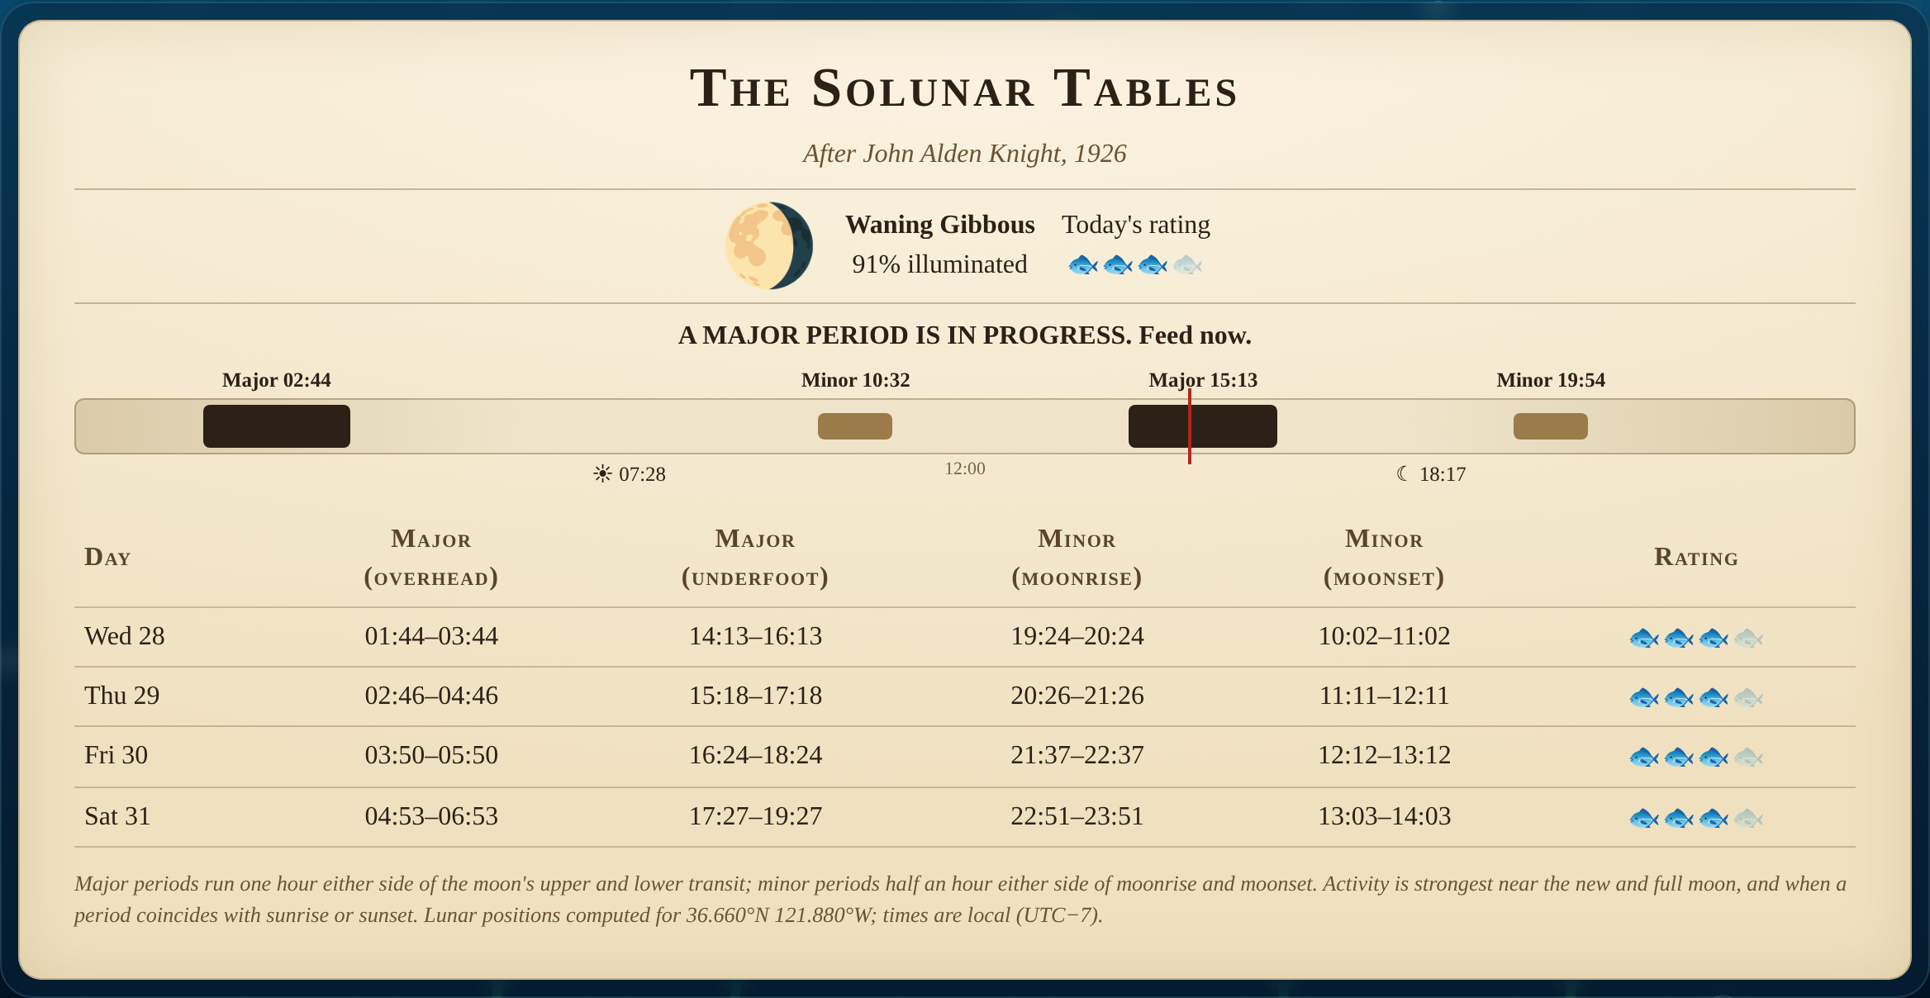
THE ESOTERIC PART
The Solunar Tables
After John Alden Knight, 1926
Fish feed when the moon is directly overhead or underfoot, and again at moonrise and moonset. We compute every period from the moon’s true position, to the minute.
Presented with total seriousness. Peer review pending since 1926.
Notes:
Deadpan. A real 1926 angling theory, still printed in fishing magazines. Moon altitude sampled every ten minutes, refined by golden-section search, checked against SunCalc in the tests.

Slide 9
FISH RADIO 4 · LONG WAVE 198 kHz
“And now the Shipping Forecast, issued by the Fish Office on behalf of the Maritime and Codguard Agency…”
Ichthyomancy
The moon’s real zodiac sign. Moon in Capricorn: “a sea-goat, literally half fish. A big day for your people.”
MONTEREY BAY.
Northwest 3 or 4. Moderate. Fair. Good.
Predators: cormorant, occasionally sea lion.
Humans: scattered, mainly elsewhere.
Angler’s folklore
“When the wind is in the west, then the fishes bite the best.” Checked against today’s real wind.
Real Beaufort force, WMO sea state and official visibility terms. Preceded by the six Greenwich pips.
Notes:
Read in your calmest BBC voice. The app plays the six Greenwich pips first. Format is exact: wind, sea state, weather, visibility. Then predators and humans.

Slide 10
UNDER THE FINS
Real science. Unreal audience.
0
0
31
1
API keys
build steps: double-click and swim
unit tests on pure forecast maths
heron standing on the antenna
Plain HTML and JavaScript. Live data from Open-Meteo and iNaturalist. Works offline. If an API dies, the rest keeps swimming: “Radar offline: a heron is standing on the antenna.”
Odum 1956 · Cole & Caraco 1998 · Wanninkhof 1992 · Haurwitz 1945 · Boyle’s law · Knight 1926
Notes:
For the CS judges: the science is pure functions in one file, tested with node:test, including the timezone parser under four TZ settings. A Playwright test drives the whole app from file:// and knocks out each API in turn.

Slide 11
Every number on screen is real.
Blub.
Try it live: abyyworld.github.io/weather-for-fish
Source code: github.com/abyyworld/weather-for-fish
Not intended for use by fish.
Notes:
Let the line land. Click, say "Blub." and walk off.

