Slide 1
Lindsay,ali,Ben
CAS 101

Slide 2
Experience at pcc
Lindsay
Ben
Ali
First Class
Web Certificate 1 year
First Term
2 year program
Second Term
Web Certificate 1 year

Slide 3
What are your goals?
Lindsay
Ben
Ali
Complete the certificate and eventually continue to obtain an AAS.
Complete the AAS and get a job.
Desire to become a full stack developer and get a career going!

Slide 4
Current job
Lindsay
Ben
Ali
Currently a barista and have been learning development on her own.
Full time student and Cook
Working at Acceptto Co.
As intern.

Slide 5
Any Experience?
Lindsay
Ben
Ali
I have been learning web development (html, css, JS, ruby) on my own for a year and held an internship in computer science last summer.
I have taken several online courses using Codecademy.
I have been learning on my own for six months (ie CSS, Python, JS) and last year I built my own web pages.

Slide 6
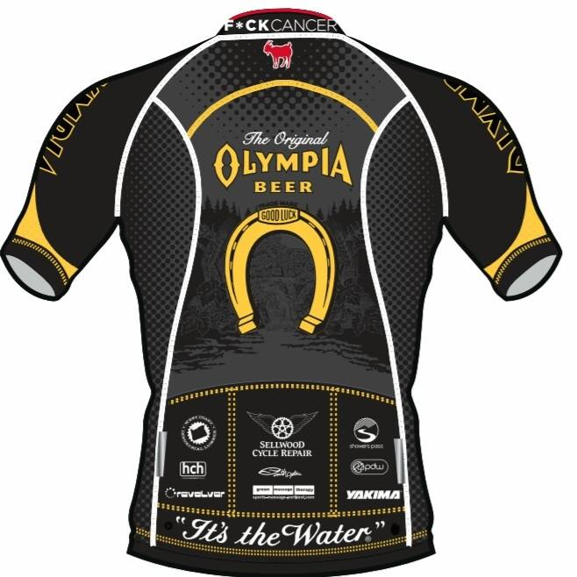
Lindsay races bicycles
ROAD
TRACK
CYCLOCROSS

Slide 7

Ben Snowboards
Also plays guitar
And enjoys cooking

Slide 8
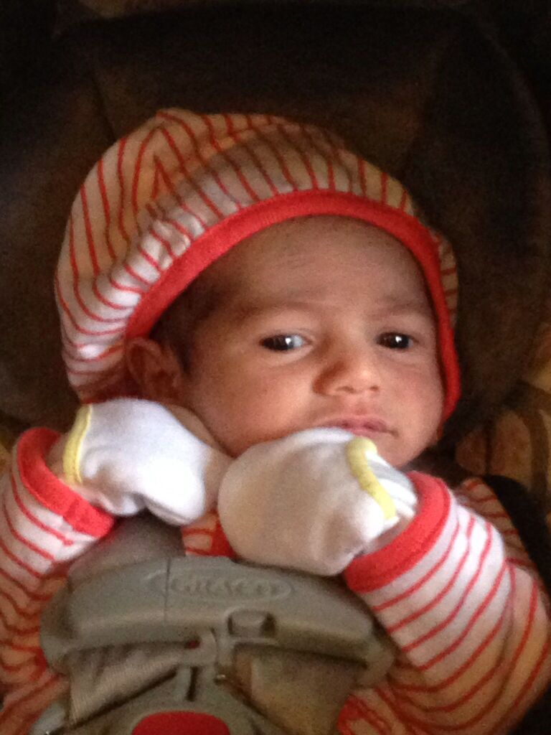
Alireza Barzin Zanganeh
Learning, having time with my family, reading and cooking

