Slide 1
MATRIX CALCULATOR
made by
Bekzhol Zholdubai uulu

Slide 2
Matrix is the important part of the Algebra mathematics. And if you are seeking to find out results of these matrix problems then you can choose matrix algebra calculator this calculator consists of all types of methods operations and functions you need to know about in matrix and want to solve questions of matrix of any type. Yup just need to choose the required function and then order of matrix and elements of the matrix and the required resultant will be appeared on the screen.

Slide 3
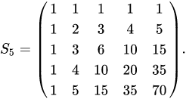


If you have a matrix problem
And you solve
Find det(S5).
But you are not sure

Slide 4


or you don’t know

Slide 5
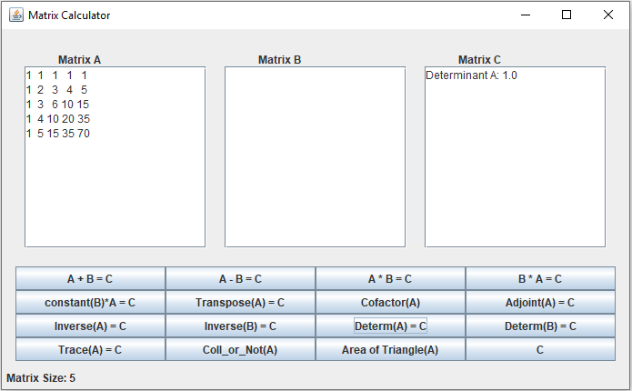
Then you use the matrix calculator to check yourself
or get the answer.

Slide 6
My suggestion is use only for checking yourself.

Slide 7


