Slide 1

Unity MCP Workshop
Ahmad Ayman Saad
Notes:
[Before 2:00, up on screen while people sit down]
If people are early: "grab the project from the QR / GitHub link while you wait."

Slide 2
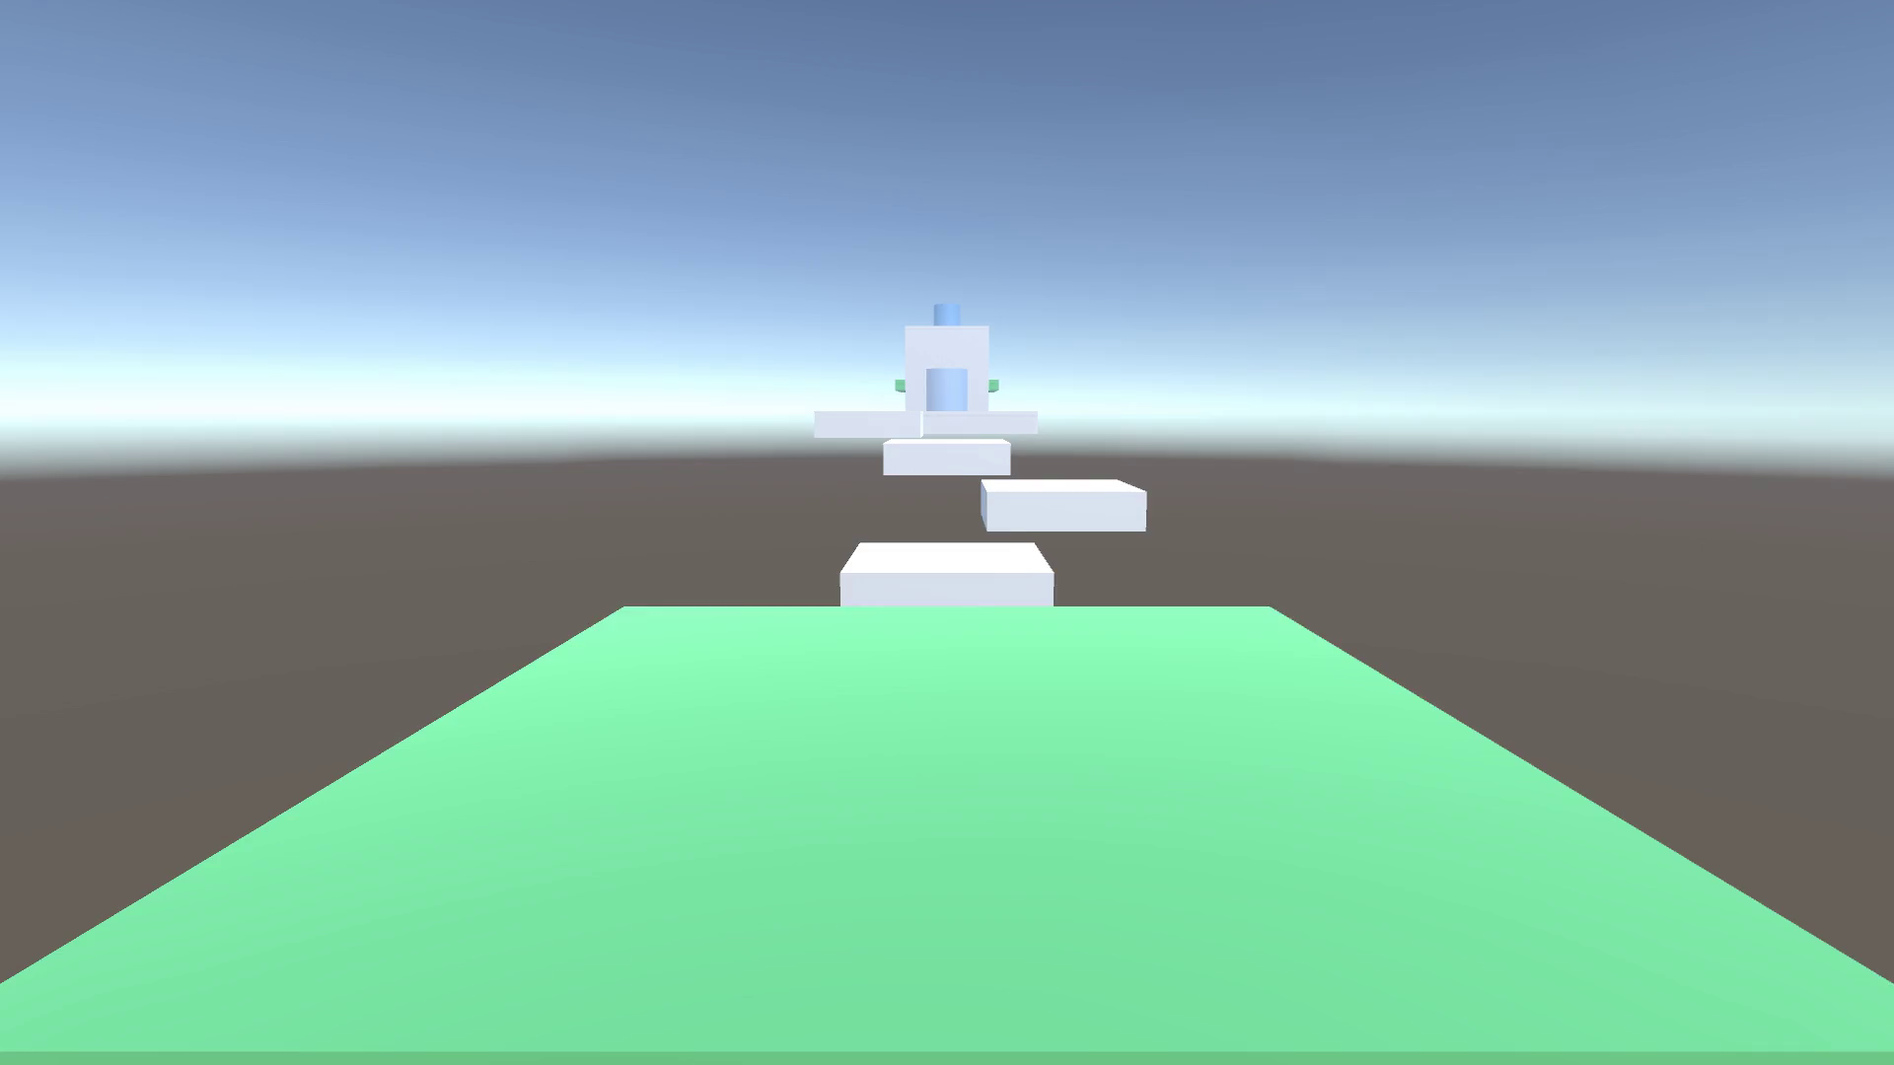
This is the game.
Notes:
[2:00] COLD OPEN, part 1: the BEFORE. Grey boxes, a green floor. A tiny parkour game.
"This is the game you're getting today. Pretty plain, right?"

Slide 3
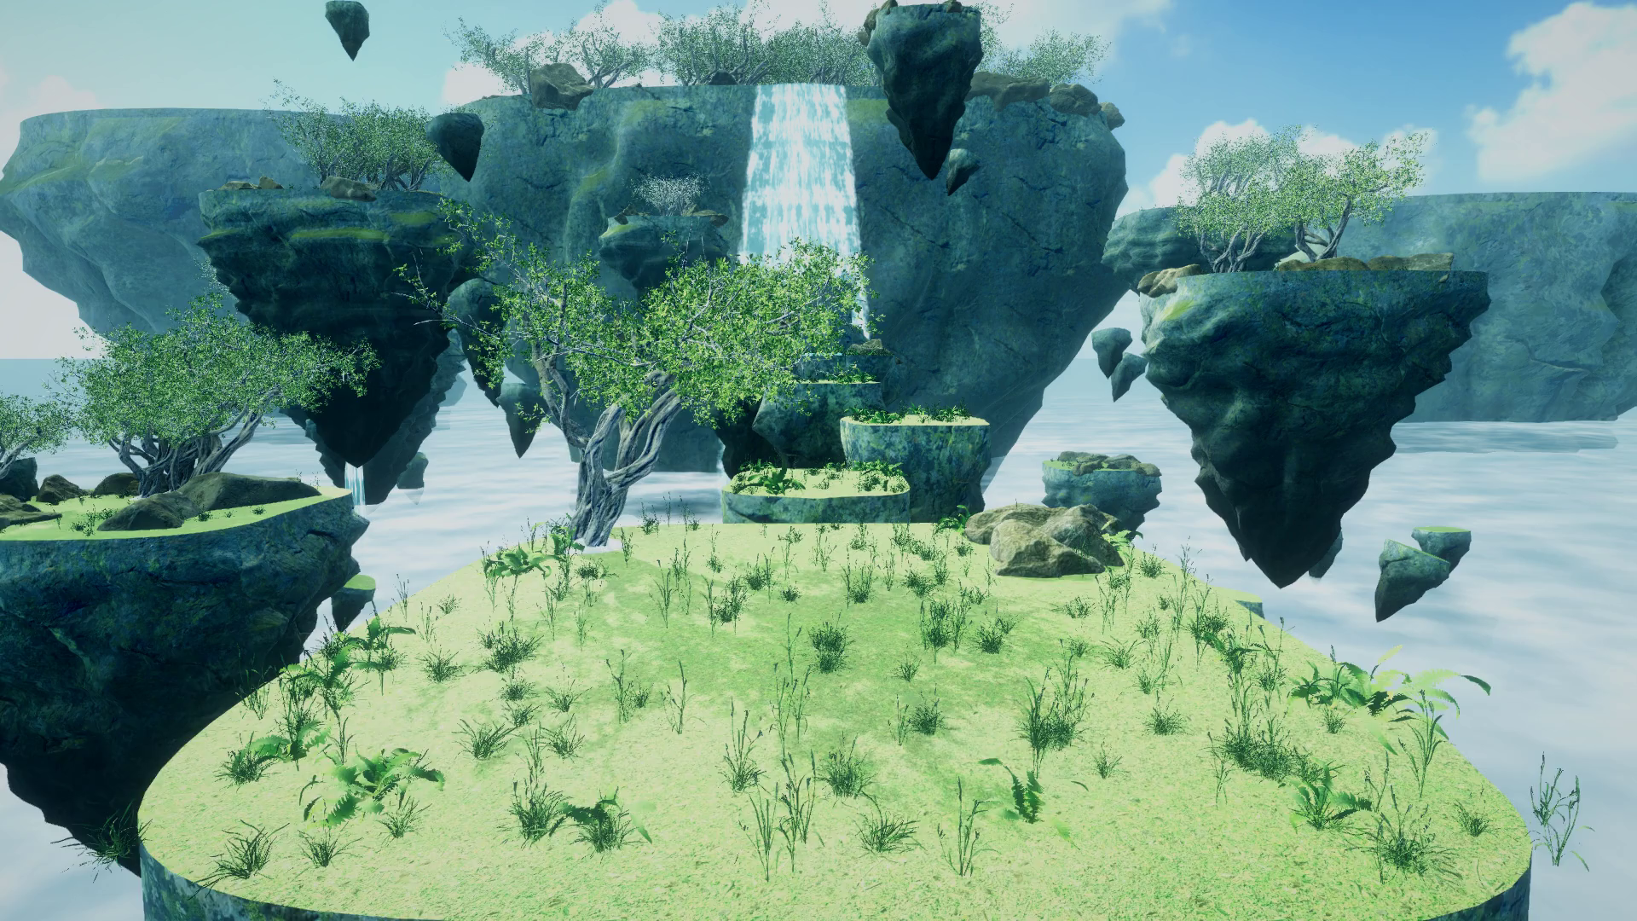
Today, we make this.
Notes:
COLD OPEN, part 2: the AFTER. Don't explain it yet. Let it play.
"By 4 pm, every one of you will have made something like this, without doing the boring parts yourself."
What it is (if asked): the same parkour course, same colliders. Only the art changed: sky islands, a waterfall, a cloud sea. All free CC0 assets from Poly Haven, placed by an agent through MCP.

Slide 4

Task: Place rocks one by one
Notes:
My rock story. I spent ~20 minutes placing rocks on a grass plane, one by one.
It felt productive. It did nothing for the actual game.

Slide 5
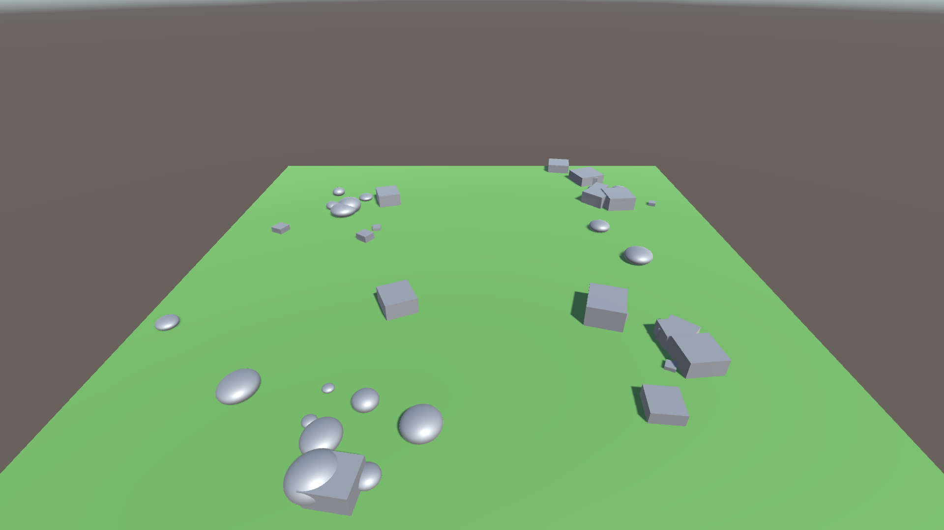
20 minutes.
Task: Place rocks one by one
Notes:
My rock story. I spent ~20 minutes placing rocks on a grass plane, one by one.
It felt productive. It did nothing for the actual game.

Slide 6

Productive? Probably Not
Notes:
Most game-dev time goes to chores that aren't the actual goal.
Placing rocks, wiring up UI, fixing the same console error again.
A rough draft would have been fine. I could have adjusted it later.

Slide 7





Today
2:00
What MCP is
2:30
Plug it into Unity
2:55
Break
3:00
Tools + the loop
3:30
You build
3:52
Show us
Notes:
Quick map of the two hours. Keep it fast.
Part I: what MCP is, then we plug it into Unity together.
Part II: why tools matter (the loop), a live demo, then you build.

Slide 8


Who’s who
You
Agent
MCP
Tools
Loop
set the goal
does the work
plugs it in
what it uses
checks it
Notes:
Meet the cast. Every time you see one of these symbols today, it's the same character.
You (coral) give the goal. The agent (violet) does the work. MCP (teal) plugs it into Unity.
Tools (amber) are what it uses. The loop (green) is how it checks its own work.

Slide 9
Part I
Getting started with MCP
Notes:
[2:10] Part I: Getting started with MCP-compatible AI clients.
Technical bits fast and fun, then straight into Unity.

Slide 10
MCP
Notes:
"Who's heard of it? Who's actually used one?"
Meet the cast for today. Every time you see these symbols, it's the same character:
violet sparkles = the AI model/agent, teal MCP logo = MCP, coral = you, amber wrench = tools, green arrows = the feedback loop.

Slide 11

Model
Context
Protocol
Notes:
Model Context Protocol. Three words.
Model = the AI. Context = what it knows right now. Protocol = the standard way to plug things in.

Slide 12


Model ← context
your scene
Model
the console
your files
Notes:
The model GETS context: your scene, your console errors, your files.
It knows a lot by heart, but not YOUR project. For that it needs tools.

Slide 13



Model → context
adds the rocks
Model
moves them
“done: 40 rocks”
Notes:
...and it GIVES context back. It acts, then tells you what happened.
That last line matters: the report is what lets it check its own work.

Slide 14






Protocol = standard
Claude Code
Unity
Cursor
Blender
T3 Code
Notion
Unity AI Assistant
Google Calendar
Build a tool once. Every client can use it.
Notes:
Protocol = a standard. One plug, many sockets.
Anthropic made it while building Claude Code. Now it's everywhere.
Build a tool once, and any MCP client can use it.

Slide 15

Client ↔ Server
You
Claude Code
MCP for Unity
Unity
you talk
the client
the server
where it happens
Notes:
YOU talk to a client (Claude Code, T3 Code, Cursor, Unity's own Assistant). That's where the agent lives.
The SERVER exposes the tools. Unity ships its own; there's also MCP for Unity (community) and Blender MCP.
The app is the thing that actually changes.

Slide 16
MCP vs CLI
CLI
MCP
commands in a terminal
great for code + git
every tool its own way
one standard plug
easy setup, huge support
reaches a running editor
Notes:
Some harnesses go all-in on CLIs (terminal commands), and that's valid.
MCP wins on support and easy setup, and it can reach things a CLI can't easily touch, like a RUNNING editor.
Not a war. Use both.

Slide 17




It's everywhere.
Unity
Browser
Blender
Databases
GitHub
Calendar
Notion
Google Docs
Notes:
MCPs exist for almost everything: calendar, Google Docs, Notion, databases, the browser, GitHub...
You can even have one bot manage multiple coding sessions.
People share these online, so you can just pick them up and play.

Slide 18

In Unity, it can…
read your scene
check the console
add, move and scale objects
change materials and lights
write a script and test it
Notes:
Unity has SO many things you can expose as tools.
Example: you have a grass plane and want rocks on it. A tool places them. Then you say "more scattered, random scale and rotation" and it adjusts.
It can basically drive the whole editor with you.

Slide 19

“It’s just hype.”
“It’ll wreck my project.”
“It burns tokens.”
Notes:
Say the objections out loud before they do.

Slide 20
True. For bad setups.
Notes:
All partly true, for BAD setups: bloated tools, no feedback, vague prompts.
That's what the rest of today fixes.

Slide 21
Let's plug in the MCP!
Notes:
[2:30] LIVE SETUP. Everyone follows along. Same steps are in the repo README for Windows, Mac and Linux.
Walk the room while scripts run.

Slide 22
Install
Unity 6
Blender (design track)
the rest: setup script
Notes:
Only two things to install by hand: Unity 6 (via Unity Hub) and Blender (only if you want the design track).
Everything else (uv, Claude Code, the MCP servers) the setup script handles.

Slide 23
Download the project
github.com/ac0rdj/unity-mcp-workshop
Code → Download ZIP
Notes:
Code button -> Download ZIP -> unzip somewhere simple (Desktop is fine).
Both MCP packages are already inside the project.

Slide 24
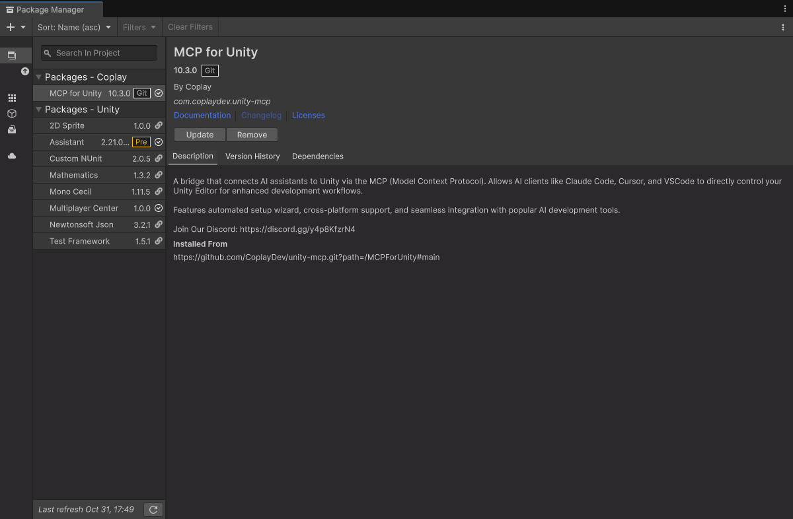
Open it in Unity
Unity Hub → Add → pick the folder
Notes:
Unity Hub -> Add -> pick the unzipped folder. Open with Unity 6.
First open takes a few minutes (imports). The MCP for Unity server starts by itself.

Slide 25



Run the setup script
Windows
double-click setup\setup-windows.cmd
Mac / Linux
bash setup/setup-mac-linux.sh
Notes:
Windows: double-click setup\setup-windows.cmd
Mac / Linux: bash setup/setup-mac-linux.sh
It installs uv and Claude Code if missing, then connects all four MCP servers (Unity x2, Blender, Context7).

Slide 26
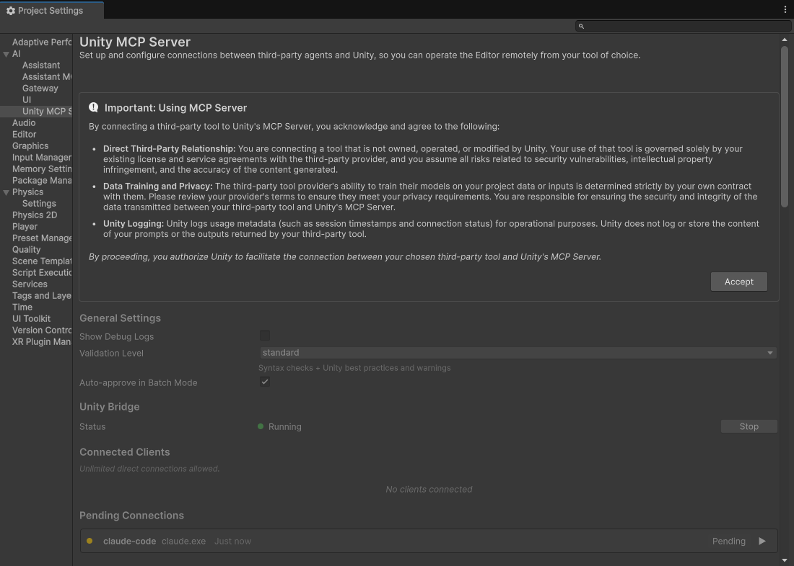
Unity's own MCP
Accept → approve the connection
Notes:
Unity's official MCP (AI Assistant package): Project Settings -> AI -> Unity MCP Server.
When Claude connects the first time, Unity asks. Accept -> approve the connection. Only once.

Slide 27
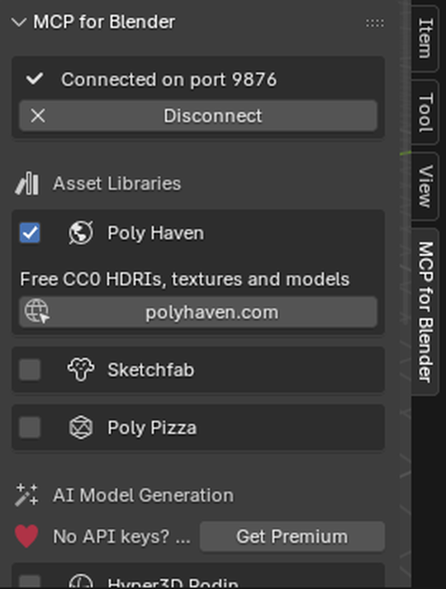
Blender
tick Poly Haven → Start
Notes:
Design track only. In Blender: N panel -> MCP for Blender tab.
Tick Poly Haven (free CC0 models, textures, HDRIs, no account), then Start. It listens on port 9876.

Slide 28
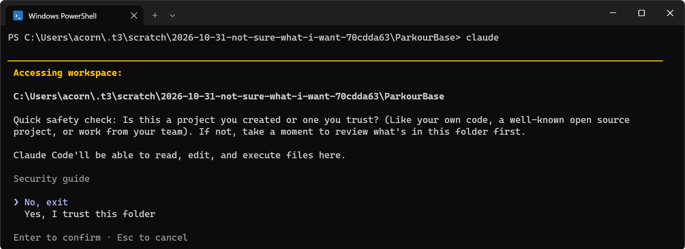
Trust the folder
pick “Yes”
Notes:
Open a terminal IN the project folder, type: claude
It asks if you trust the folder. Pick "Yes".

Slide 29
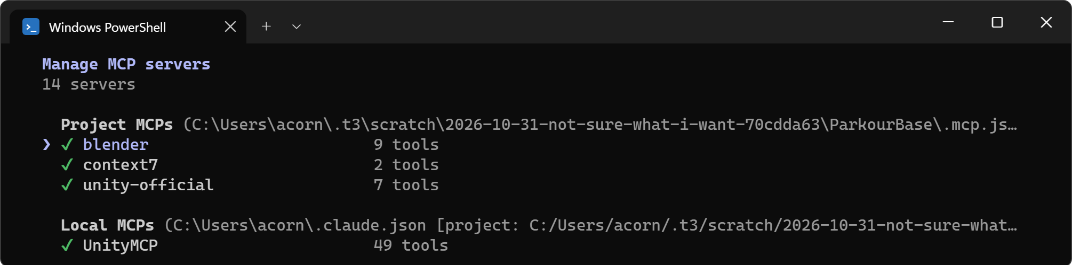
/mcp
Notes:
Type /mcp. You should see UnityMCP, unity-official, blender, context7, all connected.
If one is red: the "Stuck?" slide has fixes. Don't wait for everyone; helpers walk the room.

Slide 30

Just say it
“what’s in my scene?”
Notes:
Say it, don't type it. I'm using Wispr Flow (backup: Win + H on Windows).
It shows the point: you're directing, not typing code.

Slide 31
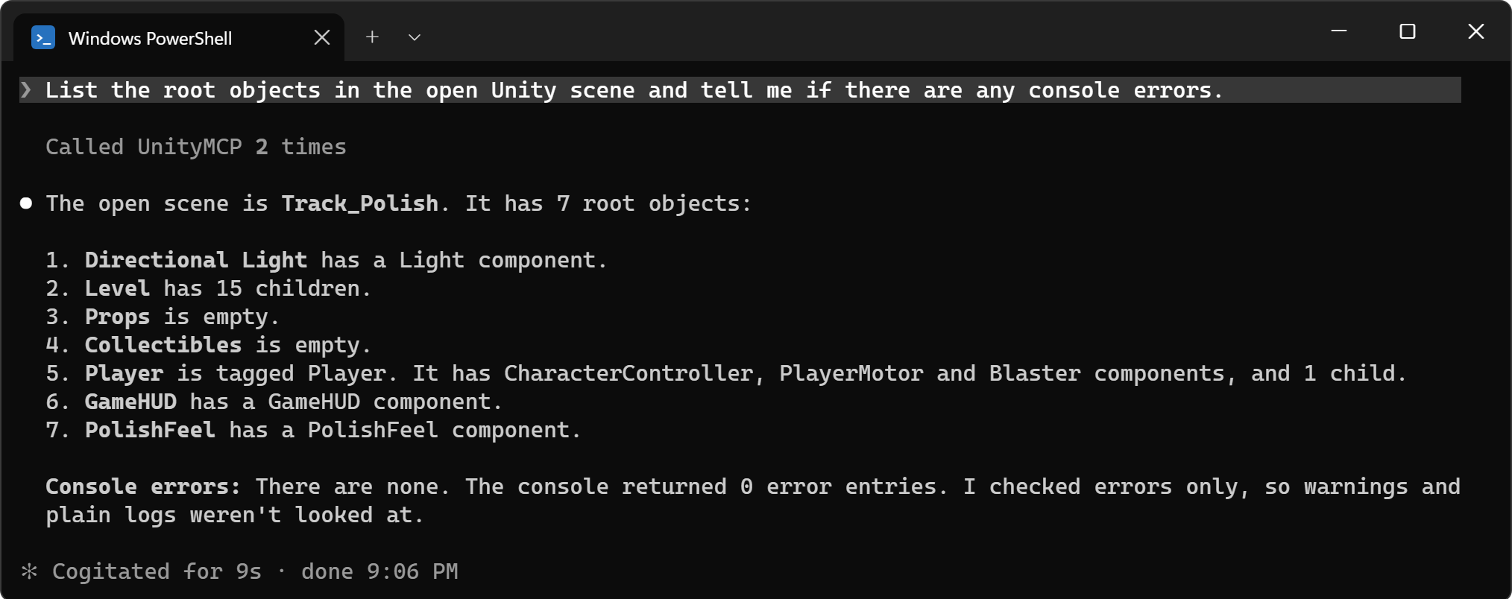
Claude reads your scene
Notes:
The first time the agent reads your scene back to you is the "oh" moment. Pause on it.
It listed every object AND checked the console. Nobody told it how.

Slide 32
Stuck?
restart claude → /mcp
keep Unity open → Start Server
Blender says port 9876?
Notes:
Fixes for the usual problems:
- Server missing in /mcp: quit claude and start it again in the project folder.
- UnityMCP red: Unity must be open. Window -> MCP for Unity -> Start Server.
- Blender: the addon panel must say "Connected on port 9876". Start it again.
[2:50–2:55] buffer + Q&A.

Slide 33
Break
back at 3:00 · next: how agents fix their own mistakes
Notes:
[2:55] 5 minute break. Anyone still not connected: come find me now.

Slide 34
Part II
MCP tools
Notes:
[3:00] Part II: MCP tools. Why some tools make agents great and some make them waste tokens.

Slide 35

Goal
Notes:
[3:00] First principles. This is how agents actually work.
An agent has a goal.

Slide 36
Goal
Action
Notes:
To reach it, it takes an action.

Slide 37

Goal
Action
Outcome
Notes:
The action has an outcome. Good or bad.

Slide 38
Goal
Action
Outcome
Feedback
Notes:
...and it takes that outcome as feedback for the next action.
Goal -> action -> outcome -> feedback. That's the loop.

Slide 39
×1000
“that failed” → console → “3 errors” → fix → run again → “works”
Notes:
An agent is hundreds or thousands of these loops chained together:
"That's not working... let me check the console... oh, 3 errors... fixed... run again."

Slide 40

MCP = Action
Goal
Action
Outcome
Feedback
Notes:
The action part can be code. But a big part is MCP: things that can't easily be done via code or a CLI.
Spawn an object. Move it. Change a material.

Slide 41


MCP = Feedback
Goal
Action
Outcome
Feedback
Notes:
It's not just the action. The outcome often comes FROM the tool:
"build failed", "object not found", "3 errors in console". That's the feedback.

Slide 42
Design the loop.
Notes:
This is the real skill. When you engineer with agents, focus here:
give the agent great feedback and it fixes itself.
Thankfully a lot of tools are already built and shared, ready to use.

Slide 43
Bad tools are worse than no tools.
?
every tool costs context, before any work happens
Notes:
Bloated tool lists and huge outputs waste tokens and confuse the agent.
The agent has to read every tool description before it does anything.

Slide 44
Light. Focused. Obvious.
Notes:
Good tools aren't bloated or heavy. Easy for an agent to pick up and use correctly.

Slide 45

You don't need all of them.
scene
console
materials
profiler
packages
tests
lightmaps
store
Notes:
Great MCPs just help with the process. You don't need to turn them all on.
Agents skip tools that aren't relevant. Turn off the noisy ones.

Slide 46
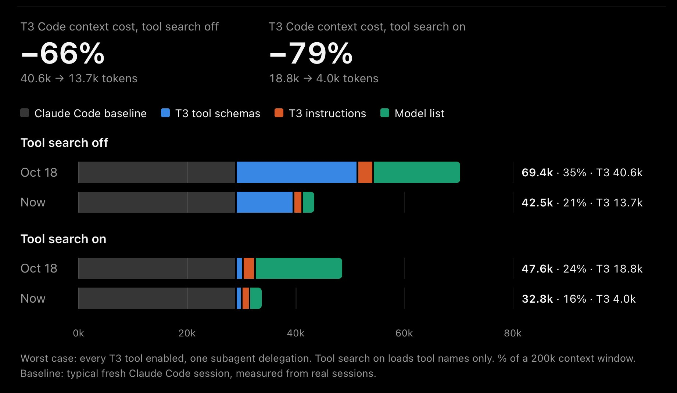
79% less context. 4x better tool use.
Theo, T3 Code · Day 23 · x.com/theo
Notes:
Real example. Theo (T3 Code) last week: "Your agents will now use the tools in T3 Code 4x better while using 79% less context."
He found the tool descriptions had grown way too big, built an eval from real agent usage and failures, then cut them down.
Lighter tools = the agent reads less and gets it right more. Source: x.com/theo/status/2114955692193054930

Slide 47
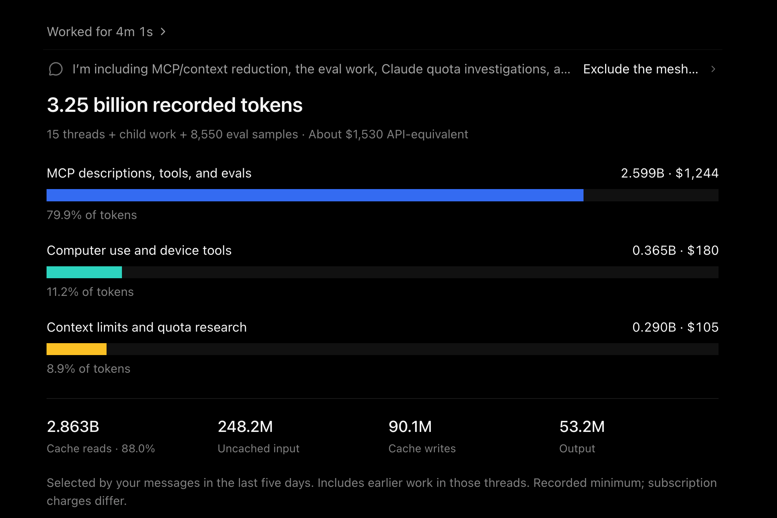
Good tools take real work.
“btw this cost $1500 in tokens to do lol” · Theo
Notes:
Follow-up from Theo: getting there cost ~3.25 billion tokens (~$1,530), most of it on MCP descriptions, tools and evals.
The point: good tools are real engineering work. Measure them like anything else.
Source: x.com/theo/status/2114962514933141516

Slide 48
Scatter some rocks.
Notes:
[3:22] LIVE in the RockDemo scene: an empty grass plane with a "Rocks" parent.
1. Say: "Scatter 40 rocks across the Grass plane under the Rocks object."
2. React honestly: "Too uniform."
3. Say: "More random: vary scale 0.5 to 2.5, random Y rotation, and cluster some."
4. Narrate the loop as it happens: goal, action, outcome, feedback.
Prompts are in ParkourBase/DEMO-PROMPTS.md.

Slide 49
Before
20 minutes by hand
Notes:
The empty plane again. Same scene as my 20-minute story.

Slide 50
After
~1 minute, by talking
Notes:
About a minute with the agent, by talking.
And I'm still the one deciding what "good" looks like.

Slide 51
+
Partner, not replacement.
Notes:
Example: you're not a modeler. Your modeler friend is still working on the real assets.
You don't want the demo to look ugly, so the agent fills in placeholders (Poly Haven via MCP) until theirs are ready.
It's a partner that uses tools with you and for you. You're still the director.

Slide 52
Your goal.
Pick a goal. Make the agent get there.
Notes:
[3:32] Your turn. Delegate a task to an agent through MCP and let it reach the goal you set.
If you already have your own game, use that. Plain code agents count too; a lot of the world is code.

Slide 53

The base game
click to blast yourself where you look
Notes:
A small parkour course. Click to blast yourself in the direction you're looking.
Simple on purpose, so there's lots to add.

Slide 54

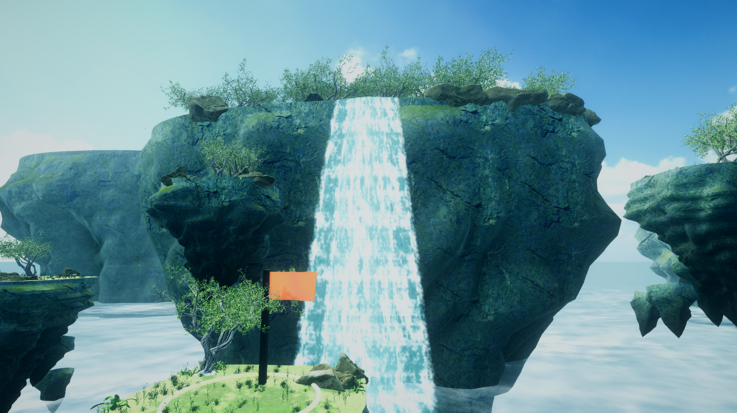
Design track
Notes:
Into art? Same course, re-skinned as floating sky islands: Poly Haven trees, grass, moss rock, sky, a waterfall, cloud sea, post-processing.
Honest framing: this is the CEILING. It came from a script plus Blender, not one prompt. Aim for a slice of it.

Slide 55
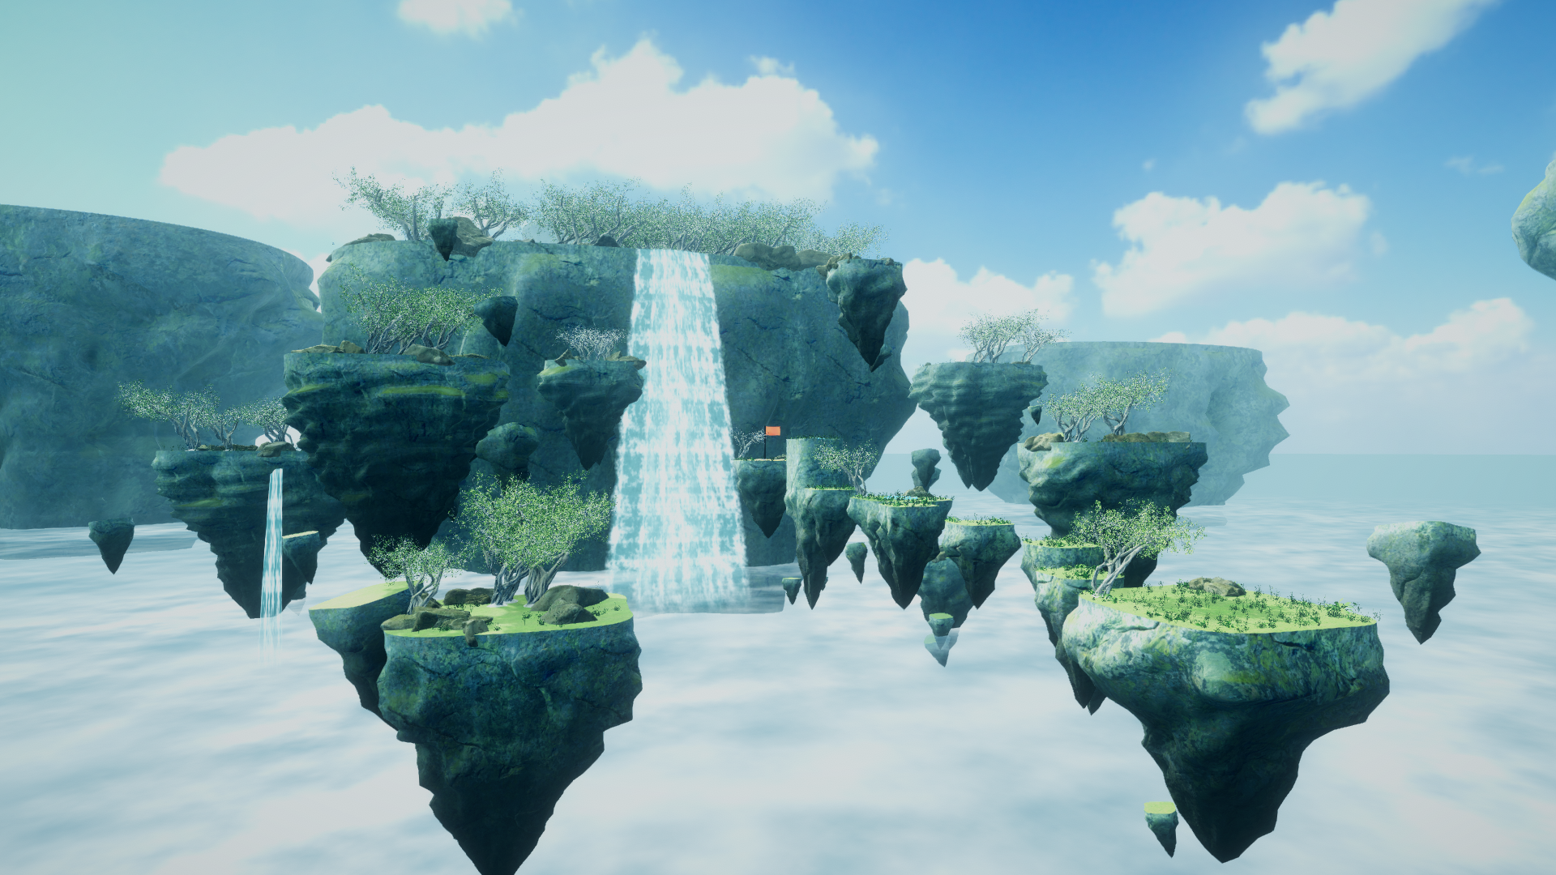
Notes:
Let this one breathe. Same colliders as the base game. Only the art changed.

Slide 56
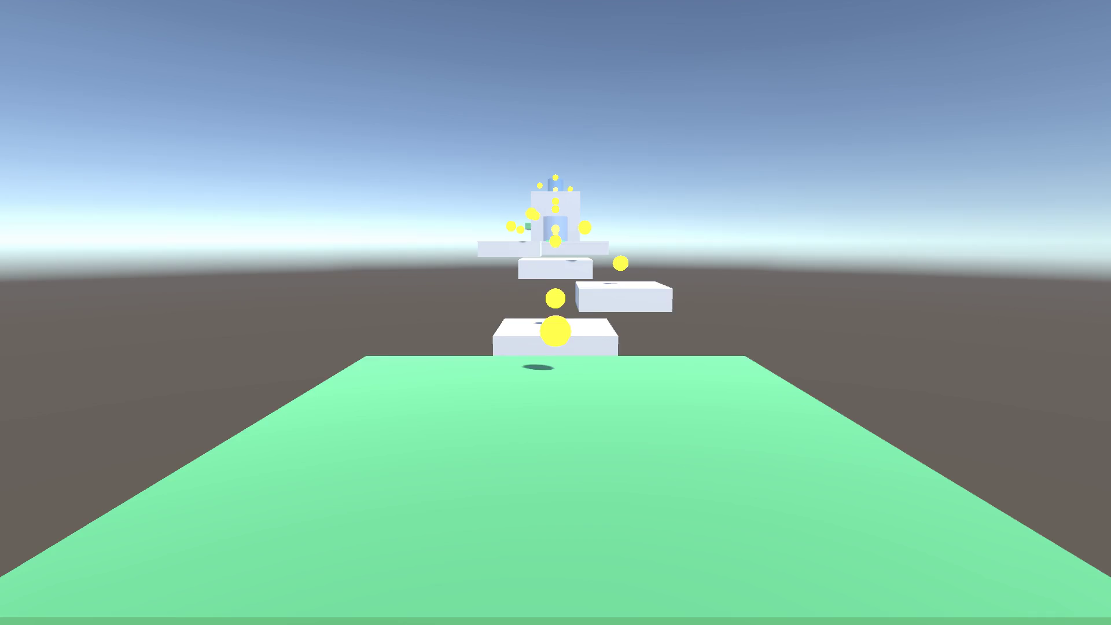
Mechanics track
Notes:
Game feels too boring? Add mechanics: coins on risky blaster arcs, a coin counter, double blast, a moving platform, a jump pad.
Took an agent a few minutes. The starting prompt is in DEMO-PROMPTS.md.

Slide 57
Polish track
ANYTHING
Notes:
Make it feel good: blast sparks, FOV kick, screen shake, sounds generated in code, best time.
(The effects show while playing. A live play-through beats this clip if there's time.)

Slide 58
Pick a track.
Design
Mechanics
Polish
placeholder props
lighting + mood
make it pretty
coins + a score
double blast
a new section
jump / blast feel
add sounds
do anything!
Notes:
Pick ONE. Starter ideas for each are in the README.

Slide 59

Be specific. Give feedback.
Notes:
Be as specific as possible.
"I don't like that, can you fix it?" is a valid prompt.
Plan with the agent before it builds: "let's plan this a bit more first."

Slide 60
20 minutes. Go.
start with one idea · back at 3:52
Notes:
[3:32–3:52] Build time. Walk the room. Ask people what prompt worked best so far; you'll want volunteers in 20 minutes.

Slide 61
Show us.
Notes:
[3:52] 2–3 volunteers: what did you make, and what prompt worked best?

Slide 62
What do you repeat?
Notes:
Take this home: look at what you do over and over that isn't your real goal.
That's where an agent + the right tools pays off.

Slide 63
What do you repeat?
Try to automate that!
Notes:
Take this home: look at what you do over and over that isn't your real goal.
That's where an agent + the right tools pays off.

Slide 64
Build the loop.
github.com/ac0rdj/unity-mcp-workshop
Notes:
[4:00] Final slide. Goal, action, outcome, feedback. Design that loop and the agent does the rest.
Thanks for coming. The project stays on GitHub; keep building.

