Slide 1

DataNova 2026 · Problem statement DN-BU-01
Lighthouse
Churn prediction and causal retention planning
See who is about to leave, what each customer is worth, and the offer that will actually keep them.
Team Tiramisu Tensor
Live app: lighthouse-retention.vercel.app
Videos: lighthouse-retention.vercel.app/watch
Code: github.com/ac265640/LightHouse
Notes:
We are Team Tiramisu Tensor and this is Lighthouse, our answer to DN-BU-01, customer churn prediction and retention strategy. A lighthouse doesn't stop ships from sailing; it shows which ones are heading for the rocks early enough to change course. That is what this system does: it finds the customers about to leave, works out which of them are worth saving and can be saved, and tells the team exactly what to do. Everything we show is live at lighthouse-retention.vercel.app.

Slide 2

The problem: customers leave, and teams can't tell who to save
What churn cost this company in one quarter
Our problem statement
26.5%
1,869
DN-BU-01: Customer Churn Prediction and Retention Strategy
of all customers left in a single quarter
customers lost, out of 7,043
What the brief asks for:
A churn prediction model
Insights about customer segments
A retention playbook the business can act on
$139k
$389k
Our data: IBM Telco Customer Churn 11.1.3, 7,043 customers of a California telecom, 52 columns covering services, billing, offers and exit reasons.
of monthly revenue walked out the door
of lifetime value still at risk among those who stayed
Notes:
We chose DN-BU-01. The brief asks for three things: a churn model, segment insights and a retention playbook. We used the extended IBM Telco dataset: 7,043 California customers with services, billing, the retention offers they received and why churners left. In one quarter, 26.5 percent of customers left: 1,869 people and 139 thousand dollars of monthly revenue. The customers who stayed still carry 389 thousand dollars of lifetime value at risk.

Slide 3



Why most churn projects never pay off
A high accuracy score is where the hard questions start. Three traps sit between a good model and a retention program that makes money.
Models that cheat
Risky is not the same as persuadable
No sense of time or value
Some columns are only recorded after a customer leaves. Keep them and the model looks perfect in testing, then fails in real use.
The riskiest customers often leave whatever you offer, and many others would have stayed anyway. Ranking by risk wastes the budget.
A yes-or-no score can't say how many months a customer has left, so it can't price a save or say who to call first.
0.998
−$11.5k
1 quarter
accuracy (AUC) of a model that cheats
result of the usual approach on a $15k budget
of data: time has to be modelled, not assumed
Notes:
Why do retention programs keep failing? First, leakage: this dataset ships with columns written after the customer leaves; a model that uses them scores 0.998 and is useless on day one. Second, risk is not persuadability: when we replay the usual approach, sending the standard offer to the riskiest customers, it loses 11.5 thousand dollars on a 15 thousand dollar budget. Third, a yes-or-no score has no sense of time or value, so it can't tell you who to call first.

Slide 4




Our solution: Lighthouse answers three questions
The output: a ranked call list
Who is leaving, and why?
When, and what are they worth?
What will actually keep them?
Who to contact, with which offer, and the expected return for each.
Five model families compete, then a calibrated ensemble scores every customer. SHAP shows the top five reasons for each one.
A survival model estimates the months each customer has left, and turns that into lifetime value and value at risk.
Causal inference measures how much each offer really changes churn, for each customer. A budget optimiser then picks who to contact.
Delivered as a live product, not a notebook
A web workspace for retention analysts, an API that scores new customers, and a Gemini AI copilot that answers questions from the real numbers.
Notes:
Lighthouse answers three questions. Who is leaving and why: a calibrated ensemble with SHAP reasons for every customer. When will they leave and what are they worth: a survival model that gives months left and lifetime value. And what will actually keep them: causal inference on the offers, then a budget optimiser. The output is a ranked call list: who to contact, with which offer, and the expected return. It is delivered as a live web app, an API and an AI copilot.

Slide 5
Step 1: we refused to let the model cheat
We tested every column alone. These six are only written after a customer leaves, so we removed all of them.
0.998
0.923
with the leaks: looks perfect, fails in use
honest score on unseen customers
Gender is kept out of the model and used only to audit fairness. It added just 0.001 AUC.
10 new signals were engineered, such as bill drift, refunds and services held.
Notes:
Before training anything, we tested every column on its own. Churn reason, category and status predict churn perfectly because they are churn. The satisfaction score and the vendor's churn score were recorded after the fact. With them in, a model scores 0.998, which looks perfect and fails on day one. We removed all six; our honest model scores 0.923 on customers it never saw. We also kept gender out of the model and used it only to check fairness.

Slide 6
Step 2: five models compete, the best is calibrated
0.923
1.4%
accuracy (AUC) on 1,409 unseen customers
calibration error: a 30% score means 30 in 100 leave
3.4×
93%
more churners in the top 10% than average
of customers get a reliable confidence label
The stacked ensemble combines all five, then we calibrate it so its probabilities are honest.
Notes:
We didn't rely on one model. Logistic regression, random forest, XGBoost, LightGBM and CatBoost competed under five-fold cross-validation, then a stacked ensemble combined them. Statistical tests show it beats logistic regression and random forest and matches the best boosters. On a locked holdout of 1,409 customers it scores 0.923, with a calibration error of 1.4 percent: when it says 30 percent, about 30 in 100 really leave. Conformal prediction flags the customers the model is unsure about instead of faking confidence.

Slide 7
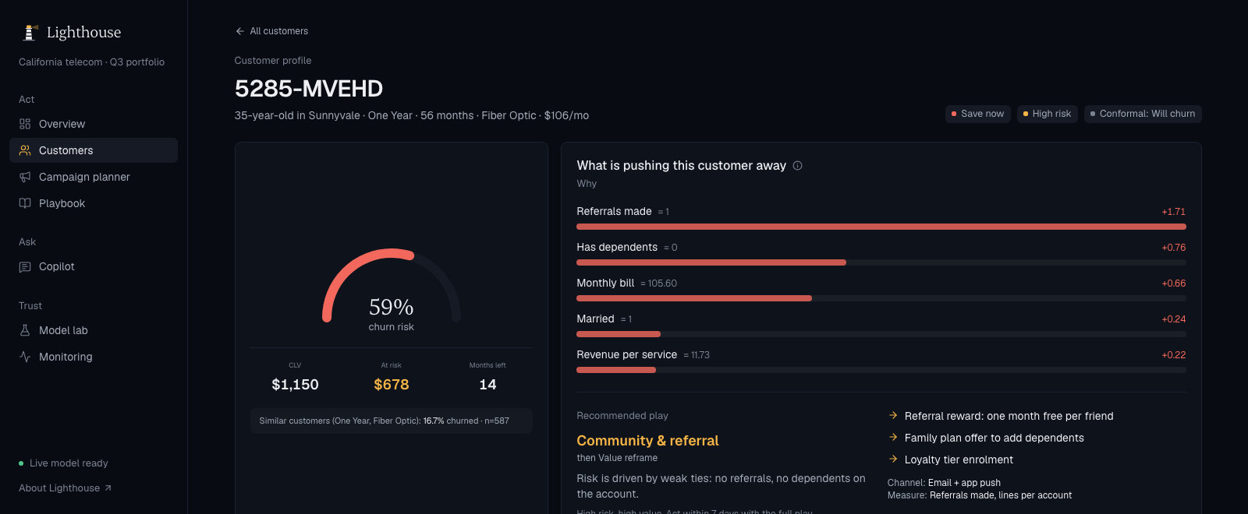
Step 3: how long each customer has, and what they're worth
Our data is a one-quarter snapshot, so everyone in it has already survived to today. We corrected for that with a survival model (Cox, left-truncated), so every customer gets a timeline and a dollar value.
Before the fix
After the fix
87% risk this quarter, yet 52 months left. A contradiction.
Two separate models now agree on who is at risk (correlation 0.95).
Example: customer 5285-MVEHD
0.83
0.90
59%
14
$1,150
$678
churn risk
months left
worth if kept
value at risk
survival model accuracy (c-index)
accuracy predicting this quarter's churn
Notes:
Knowing who will leave isn't enough; we need to know when, so we can put a price on a save. Because the data is a single quarter, everyone in it has already survived to their current tenure. Without correcting for that, our first model said a customer had 87 percent risk and 52 months left. We fixed it with left truncation and a custom baseline. Now the survival model, built separately, predicts this quarter's churn with 0.90 accuracy and agrees with the classifier. For example, customer 5285-MVEHD has 59 percent risk, about 14 months left and is worth 1,150 dollars if kept.

Slide 8
Step 4: the offer that looked best did nothing
The twist
A plain comparison says Offer A cuts churn by 20 points. But Offer A only goes to customers who have stayed 66+ months, and they rarely leave anyway.
What we found
Compared fairly (doubly-robust, inside each tenure tier), Offer A's effect is +1.6 points.
No offer works on average. The value is in choosing who receives it.
Every campaign comes with an A/B test size to confirm it.
Notes:
This is our most important finding. The data records which offer each customer got. A plain comparison says Offer A cuts churn by 20 points. But offers are handed out by tenure: Offer A only goes to customers past 66 months, who almost never leave. When we compare like with like, inside each tenure window, with a doubly-robust estimator, the 20-point effect disappears; it is actually plus 1.6 points. No offer works on average. So the value comes from choosing who receives each offer, and Lighthouse sizes an A/B test so every campaign can be proven.

Slide 9

Step 5: spend the budget where it changes the outcome
3.7×
return on the campaign budget, where the usual approach loses money
How the optimiser decides
For each customer and offer: churn prevented × lifetime value − offer cost
Rank everyone, then spend the budget from the top
Result: 400 customers contacted, about 65 saved
Notes:
Here is what that is worth in money. Give each strategy the same 15 thousand dollar budget. Random outreach loses 15.4 thousand. Business as usual, the standard offer to the riskiest customers, loses 11.5 thousand: it spends money on people who leave anyway or would have stayed. Lighthouse ranks every customer by the churn their offer is expected to prevent, times their lifetime value, minus the cost. It contacts 400 customers, expects to keep about 65, and returns 55.5 thousand dollars: 3.7 times the spend.

Slide 10




Segments and the retention playbook
Every at-risk customer gets a play, chosen from their own churn drivers
Contract lock-in
1,227
Discounted 12 or 24-month contract, priced from their value
customers
Community & referral
444
One month free per friend referred, family plan to add lines
customers
Early-life onboarding
55
Welcome call and setup help in the first 90 days
customers
Save now 699
Low-cost save 1,085
Value reframe
38
Plan right-sizing and bundles when the bill is the problem
customers
Grow 2,434
Maintain 956
Seven plays in total, each with actions, a channel and a KPI to track.
Notes:
Every active customer gets one of four priorities. Save now: high risk and high value, 699 customers who deserve a call this week. Low-cost save: at risk but lower value, so an automated digital touch. Grow: safe and valuable, so upsell. Maintain: leave them alone. Then each at-risk customer gets a play chosen from their own SHAP drivers rather than a generic segment. Most need contract lock-in; a large second group have never referred anyone, so they get a community and referral play. Each play comes with actions, a channel and a KPI.

Slide 11
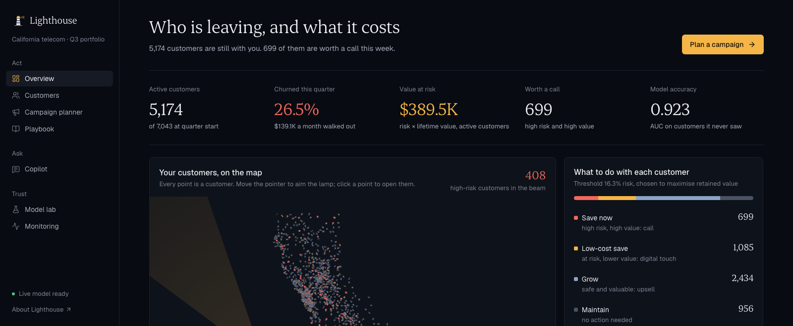



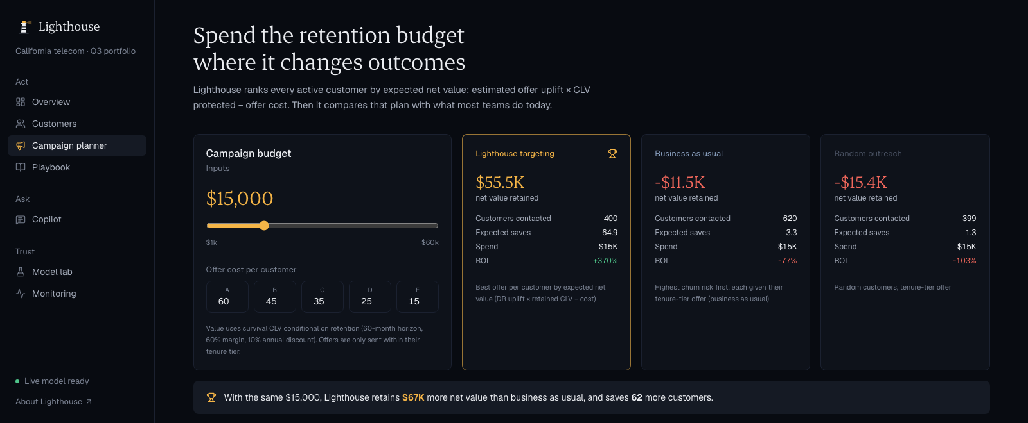



The product: a live workspace for retention teams
Live customer map
Every customer at their real location, lit by risk
Customer profile + what-if
Change a contract and watch the risk move: 59% → 29%
AI retention email
Gemini writes a personal email from each customer's drivers
Campaign planner
Budget split, three strategies, A/B test size, CRM export
AI copilot
Answers from Lighthouse's own data and shows its sources
Model lab + monitoring
Evidence, fairness audit and drift checks on new data
Try it: lighthouse-retention.vercel.app
Notes:
All of this is a working product. An analyst opens the overview and sees value at risk, the priority mix and a live map of every customer. Each customer profile has risk, months left, lifetime value, the drivers and a what-if simulator: move a customer to a two-year contract and the live model drops their risk from 59 to 29 percent. One click drafts a personal retention email with Gemini. The campaign planner runs the optimiser live. The copilot answers questions by calling Lighthouse's own API and shows which tools it used. It is all live at lighthouse-retention.vercel.app.

Slide 12
How Lighthouse is different
 | A typical churn project | Lighthouse
Testing | Random split, leaky columns left in | Leakage audit and a locked holdout of unseen customers
Probabilities | Scores that only rank customers | Calibrated: 30% means 30 in 100, plus confidence labels
Time and value | Will they leave: yes or no | Months left and lifetime value for every customer
Offers | Assume the offer works | Causal estimate of what each offer really changes
Decision | A list of the riskiest customers | A budget plan with expected return and an A/B test size
AI | A chatbot that can guess numbers | A copilot that only uses numbers from the model's tools
Delivery | A notebook | A live web app and API, 30 automated tests, $0 hosting
Notes:
What makes Lighthouse different? Most churn projects split data randomly, leave leaky columns in, and stop at a ranking. We audit leakage and test on a locked holdout. Our probabilities are calibrated. We add time and value with survival analysis. Instead of assuming offers work, we measure what each one really changes. The output is a budget plan with an expected return, not just a list. The AI copilot can only use numbers from the model's own tools. And it is delivered as a live, tested product.

Slide 13



Built to run in a real company
CRM data
Lighthouse API
Analyst workspace
Action
nightly customer export (CSV)
scores, drift check, plays
web app for the retention team
calls, emails, offers, A/B tests
Rollout plan
Weeks 1–2
Months 1–2
Quarter 2
Score the nightly export
Prove the offers
Close the loop
Connect the CRM file, check drift first, send call lists to the team
Run the A/B tests the planner sizes, retrain the offer model on the results
Trigger plays automatically when a customer's risk crosses the threshold
Works for any subscription business telecom, streaming, SaaS, insurance, banking: anything with tenure, billing and offers. Runs today on free hosting.
Notes:
How would a company adopt this? The CRM's nightly export goes to the Lighthouse API, which checks for drift before scoring, and the retention team works from the web app. Phase one, in the first two weeks: score the nightly export and send call lists. Phase two: run the A/B tests the planner sizes so offer effects move from observational to proven. Phase three: trigger plays automatically from the CRM when a customer's risk crosses the threshold. Nothing is tied to telecom; any subscription business can plug in. And it already runs live on free hosting.

Slide 14




Built to be trusted, honest about its limits
Fairness audit
What we are honest about
Recall is checked by gender, age and seniority. Gaps are shown in the app, not hidden, and gender is never a model input.
One quarter from one company: retrain on a client's own history before use.
Offer effects are observational and none is significant alone, so every campaign is A/B tested.
Exit reasons can't be predicted from the profile (44% vs a 45% baseline), so plays use churn drivers instead.
Recall differs by group; the fairness audit makes it visible.
Drift monitoring
Every feature is compared with training data. New customer files get a stable, watch or drift verdict before anyone acts.
Tested and reproducible
30 automated tests, one command to retrain every model, and an AI copilot with read-only access and usage limits.
Notes:
A company will only use this if it can trust it. We audit fairness by gender, age and seniority and show the gaps in the product. We monitor every feature for drift and check every new file before it is scored. The project has 30 automated tests, one command rebuilds every model, and the AI copilot is read-only with usage limits. We are also honest about the limits: one quarter of data, observational offer effects, and exit reasons that can't be predicted from the profile.

Slide 15
Lighthouse turns a churn score into a plan
Who to save, what they're worth, and the offer that will actually keep them.
0.923
1.4%
0.83
3.7×
honest accuracy (AUC)
calibration error
survival accuracy
campaign return
Live app lighthouse-retention.vercel.app
Videos lighthouse-retention.vercel.app/watch
Code github.com/ac265640/LightHouse
Thank you
Team Tiramisu Tensor
DataNova 2026 Global Data-thon · DN-BU-01
Notes:
To close: most churn projects stop at a high accuracy score. We went further. We removed the leaks that make models look perfect, calibrated the scores so they mean what they say, gave every customer a timeline and a dollar value, and tested whether the offers actually work. They don't on average, and targeting turns a money-losing campaign into a 3.7 times return. Lighthouse turns a churn score into a plan. Thank you; everything is live at lighthouse-retention.vercel.app.

